Slide 1
PROGRAMME REVIEWS 2020
WORKSHOP FOR SER WRITERS
Prof Nilanthi de Silva
Director, Quality Assurance Council
26 November 2019

Slide 2
Time | Activity | Resource Person
9.30 – 9.40 am | Welcome address | Prof. P S M Gunaratne, Vice-Chairman, UGC
9.40 – 10.30 am | Introduction: workshop objectives, purpose, scope, requirements to undergo Programme Review | Prof. Nilanthi de Silva Director, QAC
10.30 – 10.45 am | Tea
10.45 – 11.30 pm | Quality Assessment: criteria, best practices and standards in PR; writing up and submission of the SER | Prof. Nilanthi de Silva
11.30 – 12.00 pm | The reviewer’s perspective: What do reviewers look for in the SER and during the site visit? | Prof R Mudiyanse, Faculty of Medicine, Peradeniya
12.00 – 12.30 pm | Clustered reviews: criteria for clustering, preparation of SER | Dr Upali Mampitiya, Faculty of Natural Sciences, OUSL
12.30 – 1.30 pm | Lunch
1.30 – 2.30 pm | Preparation for the site visit | Dr Anura from USJP Faculty of Management Studies?
2.00 – 3.00 pm | General Q&A session

Slide 3
SESSION 1. INTRODUCTION

Slide 4
Objectives of workshop
To provide participants with information regarding:
  the purpose and scope of programme reviews conducted by the QAC and requirements to be met for programme review
  Criteria, best practices and standards for programme review
  QAC guidelines for writing and submission of SERs for PR in 2020
To enable participants to understand reviewers’ expectations and prepare for the site visit

Slide 5
Background: National Framework for Quality Assurance
Sri Lanka Qualifications Framework
Subject Benchmark Statements
Codes of Practice
Internal Quality Assurance
External Quality Assurance

Slide 6
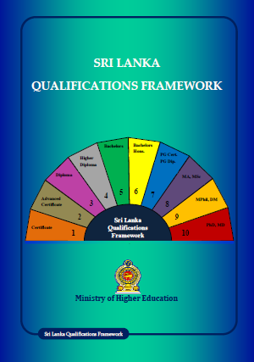
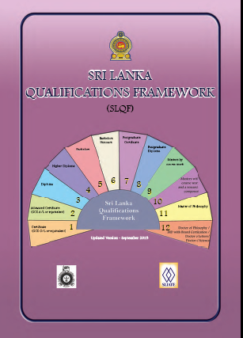
Sri Lanka Qualifications Framework
First Edition published in June 2012
Updated version released by UGC in September 2015

Slide 7
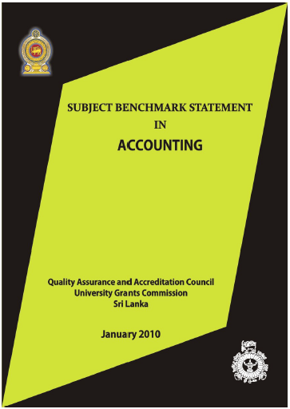
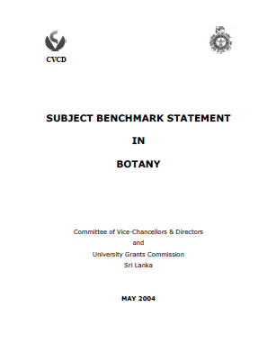
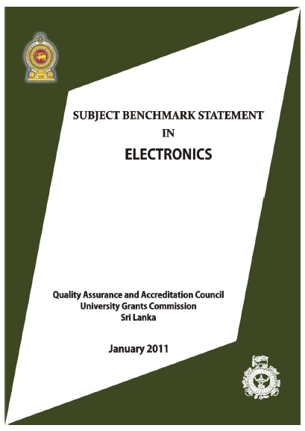
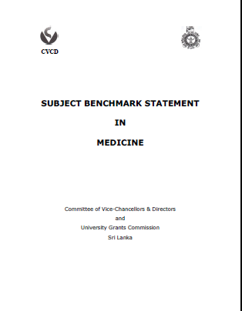
Subject Benchmark Statements

Slide 8
Codes of Practice provide reference points on key elements of good practice
Assessment of Students
Career Guidance
External Assessors
Postgraduate Research Programmes
Programme Approval, Monitoring and Review
Student Support and Guidance
Staff Development
Student Feedback
Peer Observation
External Degrees
Academic Accountability

Slide 9
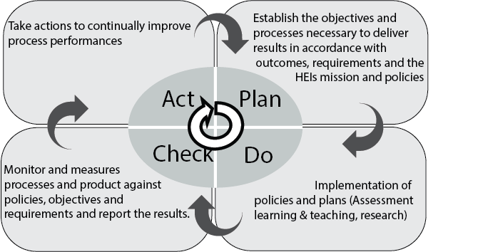
Internal quality assurance
Cumaraswamy, 2019, Manual for review of distance education institutions

Slide 10
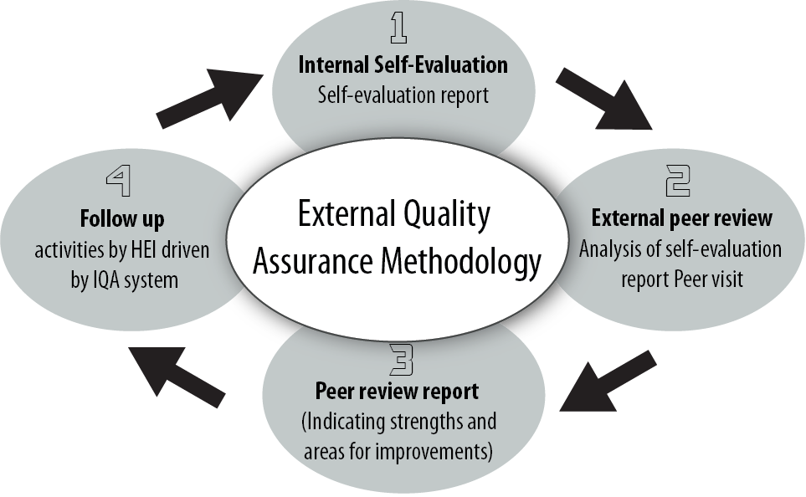
External Quality Assurance
Cumaraswamy, 2019, Manual for review of distance education institutions

Slide 11
Types of external reviews
Institutional review - analyses the effectiveness of an institution’s processes for managing and assuring the quality of academic activities undertaken by the institution
Programme review - evaluates the effectiveness of Faculty’s or Institute’s processes for managing and assuring quality of study programmes, student learning experience and standards of awards within a programme of study
Subject Review - evaluates the management and assurance of quality at subject/departmental level, rather than the programme of study

Slide 12
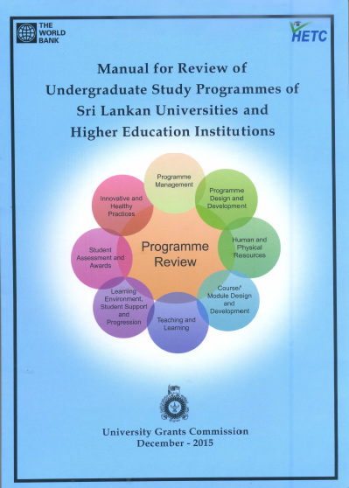
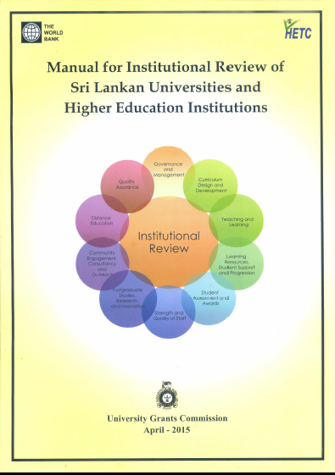
External Reviews in current cycle
Two levels of assessment
  Institution (university)
  Program of study
Nationally agreed criteria and standards
Reviewers trained and selected at national level, from all universities, and across all disciplines

Slide 13
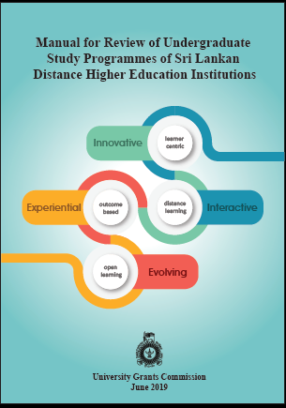
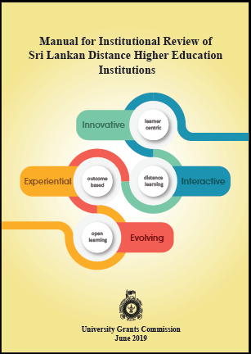
Distance education institutions and programmes

Slide 14
Purpose of Programme Reviews
Promote continuous improvement of study programmes
Promote a quality culture with regular self-evaluation and periodic peer review
Instill confidence among all stakeholders regarding quality of study programmes
Achieve accountability for use of public funds
Promote and showcase innovations and good practices in study programmes

Slide 15
Scope of programme reviews
Criteria selected on the basis of feedback received from academics after completion of the first cycle of external reviews in 2004 – 2013
Eight criteria for conventional programmes
Six criteria for distance education programmes
Viewed from perspective of students’ learning experience

Slide 16

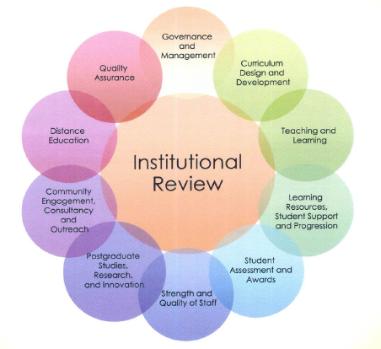
Criteria for external review: conventional

Slide 17
Criteria for distance education programmes
Programme Management
Programme Design and Development
Course Design and Development
Learning Infrastructure, Resources, and Learner Support
Learner Assessment and Evaluation
Innovative and Healthy Practices

Slide 18
Criteria for distance education institutions
Vision, Mission and Planning
Governance and Management
The Learners
Human Resource Development
Programme Design and Development
Course Design and Development
Learning Infrastructure, Resources and Learner Support
Learner Assessment and Evaluation
Postgraduate Studies, Research, Innovation and Commercialization
Community Engagement, Consultancy and Outreach

Slide 19
Requirements to undergo PR
Any undergraduate degree programme which has graduated at least one batch of students
Programmes must be aligned to Level 5, 6 or 7 of the Sri Lanka Qualification Framework (SLQF)
Programme staff must be willing to engage in critical self-evaluation of their programme under the given criteria and gather evidence of achieving the required standards
The University’s Centre for Quality Assurance (Internal Quality Assurance Unit) and the Faculty Quality Assurance Cell must support and facilitate the process

Slide 20
2nd cycle of external reviews
Going into 4th year of UG Programme Reviews in current cycle (2nd)
2017 – Arts, Humanities, Social Sciences
2018 – Fine Arts, Education, Law, Management Studies and Commerce
2019 – Medicine, Dentistry, Health Sciences, Indigenous Medicine, Agriculture, Veterinary Science
2020 – Science, Applied Sciences, Engineering, Technology, Architecture, Geomatics
Total of approx. 55 degree programs offered by 17 Faculties to be reviewed in 2020

Slide 21
Questions?

Slide 22
SESSION 2. QUALITY ASSESSMENT

Slide 23
Criteria, best practices and standards
The 8 ‘criteria’ encompass key aspects of a programme
‘Best practices’ relate to institutional approaches, policies, strategies, operations, procedures etc, that result in value addition to any aspect of the programme
‘Standards’ correspond to best practices, and enable evaluation of the degree of internalization of each practice and the level of attainment.
Standards serve as sign posts in quality assessment

Slide 24
Variable number of standards under each criterion
Criterion
1
2
3
4
5
6
7
8
Number of Standards
27
12
24
19
19
24
17
14
=
=
156
Standards

Slide 25
Criterion 1. Programme Management
Organizational structure, governance and management procedures; Corporate plan
By-laws relating to examinations, disciplinary procedures, student unions;
Duty lists and Codes of Conduct for staff
Curriculum development and revision; adherence to national guidelines / reference points;
Teaching and learning and assessment procedures; adherence to OBE-SCL approach in education provision;
Academic counseling, student counseling, welfare mechanisms and procedures;
Provisions for students with special needs; gender equity and equality, deter any sexual and gender-based harassment; zero-tolerance to ragging.

Slide 26
Criterion 2. Programme Design & Development
Staff cadre and adequacy, human resources profile, competency profile of academic staff;
staff capacity building programmes, staff appraisal and reward mechanisms;
adequacy of teaching and learning facilities;
training and learning resource centers for learning English as a second language;
ICT resources for academic pursuits, library resources, and career guidance services;
and institutional mechanism and facilities for promotion of social harmony and ethnic cohesion.

Slide 27
Criterion 3. Programme Design & Development
Relevance to university’s mission, goal and objectives
Based on needs analysis and national reference points
Outcome driven curriculum with mapping of course unit outcomes to programme outcomes
Constructive alignment of course outcomes, content, teaching and learning strategies, and assessment strategies
Develops intellectual, practical and transferable skills
Process for regular monitoring and review of design, development and approval of programme

Slide 28
Criterion 4. Course / module design and development
Consistency between programme objectives and course objectives
Course designed according to university policies and procedures
Course curriculum encompasses aims and objectives, learning outcomes, content, teaching methods, methods of assessment
Addresses needs of differently abled students
Course specifications accessible to students
Course credits conform to SLQF guidelines
Regular monitoring and review processes to enhance learning outcomes and student achievements

Slide 29
Criterion 5. Teaching and learning
Learning experience enables students to achieve intended learning outcomes
Student-centred process and outcome-based education
Appropriate teaching methods and multiple learning opportunities encourage active learning
Teaching learning strategies aligned with learning outcomes and assessment strategies
Teaching informed by feedback loops

Slide 30
Criterion 6. Learning environment, student support and progression
Learner support services that address identified needs of students
Policies and strategies for co-curricular experience
Assessment and improvement of student support services
Technological innovations enrich students learning experience
Tutoring, mentoring, counselling and peer support structures to support students
Adequate support for SCL and OBE

Slide 31
Criterion 7. Student Assessment and Awards
Policies and procedures relating to standards of performance
Assessment strategies linked to ILOs
Assessment practices are fair, valid, reliable and feasible, with provision for regular and prompt feedback on student progress
Information about assessment published in print and online, and communicated to all students
Regulations, rules and by-laws are explicit and consistent; and ensure confidentiality and integrity
Faculty ensures academic provision to monitor and review assessments

Slide 32
Criterion 8. Innovative and healthy practices
Practices that enhance the learning experience and students outlook
ICT platform and use of Open Educational Resources
Faculty engagement in research, innovation and postgraduate research
Performance appraisal system and reward mechanisms for staff
International collaboration and staff and student exchange
Student participation in co-curricular and extra-curricular activities
Faculty-industry linkages and internships for students
Credit-transfer mechanisms

Slide 33
Criteria, best practices and standards: example 1
Criterion 2. Human & Physical Resources
Best practice 1. The Faculty adopts a participatory approach inclusive of academic staff, non-academic / technical staff, students, alumni and external stakeholders (e.g. industry and professional bodies) at key stages of the design and approval of programme and courses.
Relevant Standard: Programme is developed collaboratively in a participatory manner through a curriculum development committee or equivalent body of the Faculty.
Examples of sources of evidence: minutes of curriculum planning committee; workshop reports

Slide 34
Criteria, best practices and standards: example 2
Criterion 8. Innovative & Healthy Practices
Best Practice 1. The Faculty/Institute has policy and an established ICT-based platform (i.e. VLE/LMS) to facilitate multi-mode teaching and student-centered learning; uses the ICT-enabled tools and techniques sensibly for delivery of learning material, learner support services and conducting/administering students’ assignments and assessments
Relevant Standard: The Faculty/Institute has established and operates an ICT- based platform (i.e. VLE/ LMS) to facilitate multi- mode teaching delivery and learning.
Examples of source of evidence: physical evidence of presence of VLE / LMS; number of courses / documents uploaded into LMS

Slide 35
Assigning Scores for Standards

Slide 36
What will reviewers look for?
Degree of internalization of best practices and level of achievement of Standards, as stated in SER
Degree to which the claims are supported by documented evidence, as indicated in SER
Accuracy of the data and statements made in the SER, as observed during site visit

Slide 37
Claim of internalization of best practice
Meets standard
Evidence sufficient to support claim
Evidence not sufficient to support claim
Below standard
Evidence sufficient to support claim
1 or 2 marks
Evidence not sufficient to support claim
No claim of achievement
3 marks
1 or 2 marks
1 mark
0 marks

Slide 38
Calculation of final score
Criterion No. | Assessment Criteria | Weight
1 | Programme Management | 150
2 | Human and Physical Resources | 100
3 | Programme Design and Development | 150
4 | Course/ Module Design and Development | 150
5 | Teaching and Learning | 150
6 | Learning Environment, Student Support and Progression | 100
7 | Student Assessment and Awards | 150
8 | Innovative and Healthy Practices | 50
 | Total Score | 1000

Slide 39
Award of final grade
Criterion-wise actual score | Total actual score (%) | Grade
Equal to or more than the minimum weighted score for all eight criteria | 80 - 100 | A
 | 70 - 79 | B
 | 60 - 69 | C
 | <60 | D
Equal to or more than the minimum weighted score for seven of the eight criteria | 70 - 100 | B
 | 60 - 69 | C
 | <60 | D
Equal to or more than the minimum weighted score for six of the eight criteria | 60 - 100 | C
 | <60 | D
Irrespective of minimum weighted criterion scores | <60 | D

Slide 40
Questions?

Slide 41
SESSION 3. WRITING UP AND SUBMISSION OF SER

Slide 42
Purpose of SER
The SER should provide review team with
an account of the degree of internalization of best practices and level of achievement of each standard
Demonstrate the degree to which claims are supported by documented evidence
Data presented and statements made in the SER must be accurate

Slide 43
Organization of SER
Section 1. Introduction to the study programme or cluster of programmes
Section 2. Process of preparing the SER
Section 3. Compliance with standards under each criterion
Section 4. Summary

Slide 44
1. Introduction to study programme(s)
Graduate profile and ILOs
Departments contributing to programme(s)
Number(s) of enrolled students and choice of subject combinations
Numbers and profiles of academic, academic support and non-academic staff
Learning resources: library, ELTU, labs, computer facilities, etc
Student support system and management
SWOT analysis of the degree programme
Major changes since last review

Slide 45
2. Process of preparing the SER
Appointment of SER writing team and ToRs
Composition and responsibilities of working teams
Familiarization with manual and methodology of review process
Activity schedules of the working teams, methods of collecting information
Collation of data and evidence, synthesis of draft report
Compilation into draft SER by Chair of writing team
Discussion and finalization of report

Slide 46
3. Compliance with criteria and standards
Should have 8 subsections (one for each criterion) in same order as in manual
Use template set out in Manual Appendix
  Column 1: serial number of standard
  Column 2: claim of compliance
  Column 3: supporting evidence
  Column 4: codes of documents provided as supporting evidence
Each subsection should have a summary statement on how the programme has internalized the best practices under the relevant criterion

Slide 47
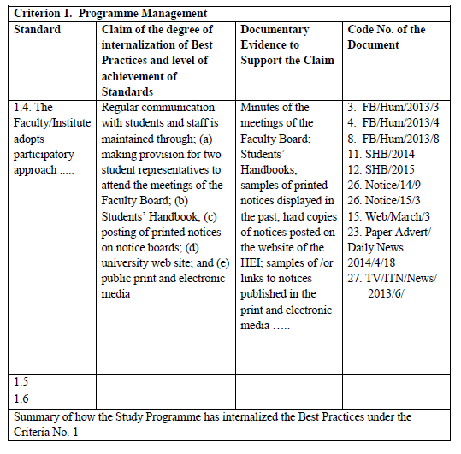
Example:

Slide 48
4. Summary
Summarize the effectiveness with which the Faculty discharges its responsibilities for maintenance of academic standards prescribed in the Manual, and quality of its awards
Should reflect the degree to which the Faculty has internalized best practices, and the internal monitoring mechanism used for continuous quality enhancement
Indicate deficiencies / gaps and actions taken or planned to address such deficiencies and gaps

Slide 49
SER length and format
Word limits:
  3-year degree programme – 8,000 words
  4-year degree programme - 12,000 words
  cluster of 3 – 4 programmes – 16,000 words
Format of report
  Use Times New Roman, 12 point font size
  1.5 line spacing
  A4 size pages

Slide 50
Submission of SER
Hard copies of SER
  4 copies required for a single programme
  5 copies required for a cluster of programmes
Soft copy on CD in pdf format
Cover letter signed by Dean
Deadline for submission: 31 March 2020
Send to: Director, Quality Assurance Council, 94/10 Ananda Rajakaruna Mawatha, Colombo 8

Slide 51
Process after submission of SER
Desk Evaluation of SER by reviewers
SITE VISIT TO VALIDATE CLAIMS IN SER
Preliminary report
Draft report
Comments from Faculty on draft report
FINAL REPORT
Faculty Action Plan for implementation of recommendations
FR edited and published by QAC

Slide 52
Resource materials
Presentations and other publications available on QAC website:
https://www.eugc.ac.lk/qac/
Highlights > Events > Workshops
Workshop for SER writers for Programme Reviews in 2020, held on 26 Nov 2019

Slide 53
Questions?

