Slide 1
INSTITUTIONAL REVIEWS 2020
WORKSHOP FOR SER WRITERS
Prof Nilanthi de Silva
Director, Quality Assurance Council
5 December 2019

Slide 2
Time | Activity | Resource Person
9.30 – 9.40 am | Welcome address | Prof. P S M Gunaratna, Vice-Chairman, UGC
9.40 – 10.30 am | Introduction: workshop objectives, purpose, scope, requirements to undergo Institutional Review | Prof. Nilanthi de Silva Director, QAC
10.30 – 10.45 am | Tea
10.45 – 11.30 pm | Quality Assessment: criteria, best practices and standards in IR; writing up and submission of the SER | Prof. Nilanthi de Silva
11.30 – 12.30 pm | The reviewer’s perspective: What do reviewers look for in the SER and during the site visit? | Prof Chitra Ranjanie, University of Kelaniya
12.30 – 1.00 pm | Question and Answer session | Prof Nilanthi de Silva
1.00 – 2.00 pm | Lunch and close of workshop

Slide 3
SESSION 1. INTRODUCTION

Slide 4
Objectives of workshop
To provide participants with information regarding:
  the purpose and scope of programme reviews conducted by the QAC and requirements to be met for institutional review
  Criteria, best practices and standards for institutional review
  QAC guidelines for writing and submission of SERs for IR in 2020
To enable participants to understand reviewers’ expectations and prepare for the site visit

Slide 5
Background: National Framework for Quality Assurance
Sri Lanka Qualifications Framework
Subject Benchmark Statements
Codes of Practice
Internal Quality Assurance
External Quality Assurance

Slide 6
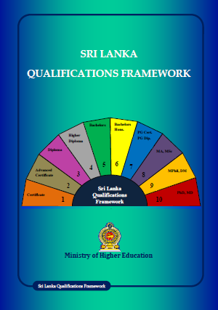
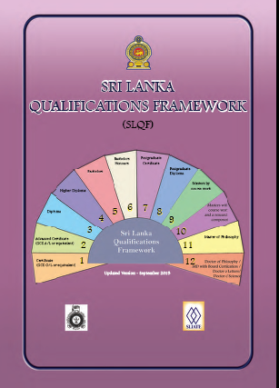
Sri Lanka Qualifications Framework
First Edition published in June 2012
Updated version released by UGC in September 2015

Slide 7
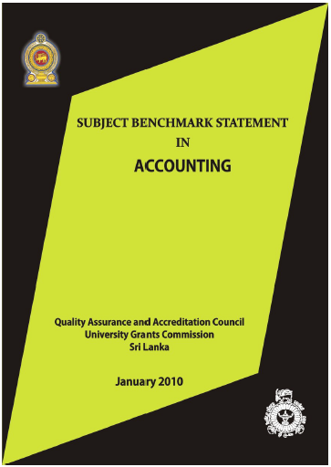
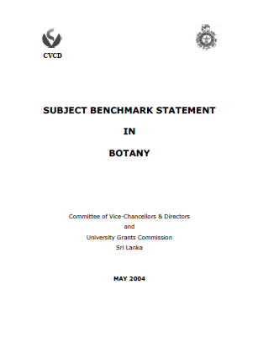
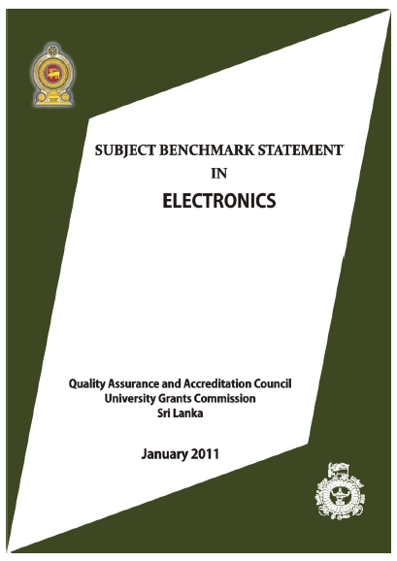
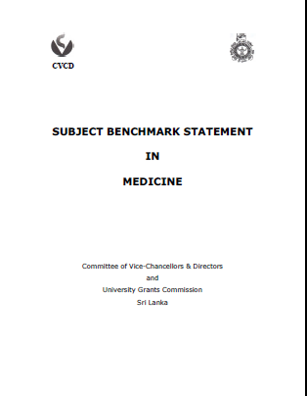
Subject Benchmark Statements

Slide 8
Codes of Practice provide reference points on key elements of good practice
Assessment of Students
Career Guidance
External Assessors
Postgraduate Research Programmes
Programme Approval, Monitoring and Review
Student Support and Guidance
Staff Development
Student Feedback
Peer Observation
External Degrees
Academic Accountability

Slide 9
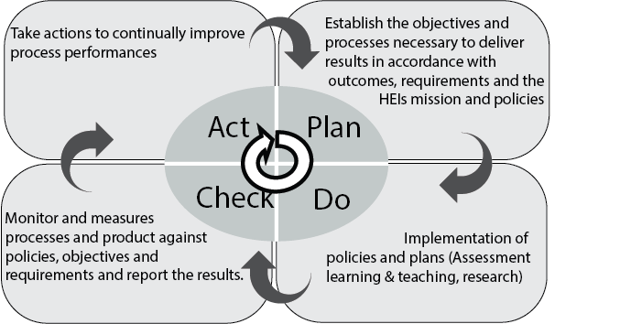
Internal quality assurance
Cumaraswamy, 2019, Manual for review of distance education institutions

Slide 10
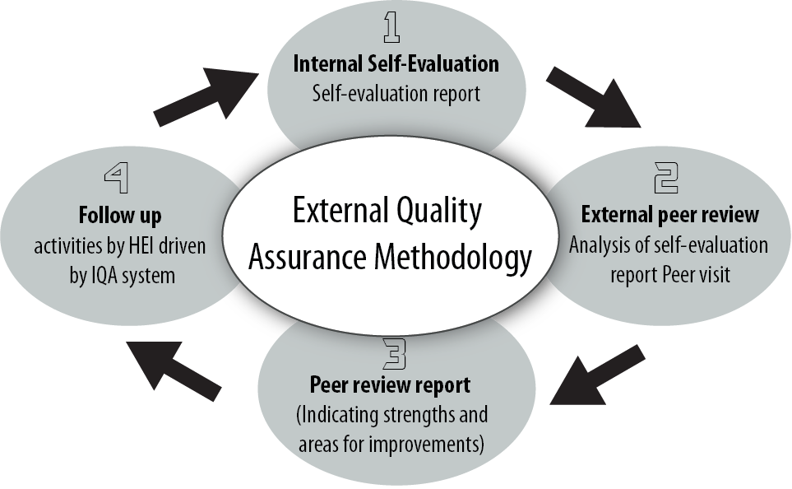
External Quality Assurance
Cumaraswamy, 2019, Manual for review of distance education institutions

Slide 11
Types of external reviews
Institutional review - analyses the effectiveness of an institution’s processes for managing and assuring the quality of academic activities undertaken by the institution
Programme review - evaluates the effectiveness of Faculty’s or Institute’s processes for managing and assuring quality of study programmes, student learning experience and standards of awards within a programme of study
Subject Review - evaluates the management and assurance of quality at subject/departmental level, rather than the programme of study

Slide 12
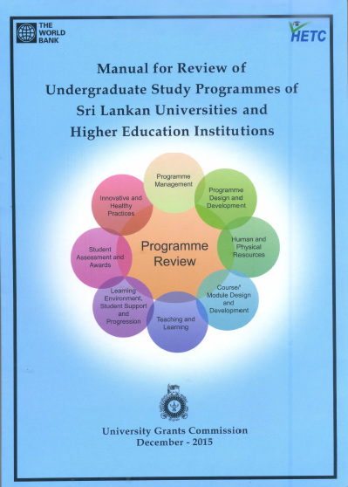
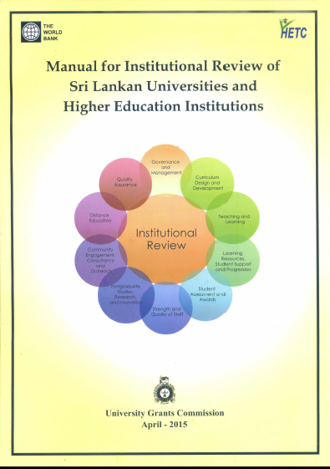
External Reviews in current cycle
Two levels of assessment
  Institution (university)
  Programme of study
Nationally agreed criteria and standards
Reviewers trained and selected at national level, from all universities, and across all disciplines

Slide 13
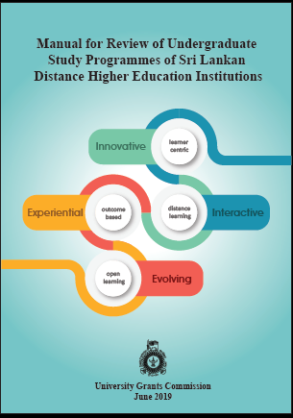
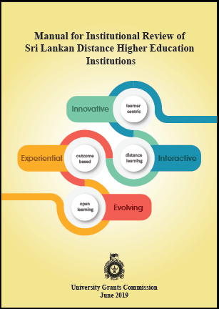
Distance education institutions and programmes

Slide 14
Purpose of Institutional Review
Instill confidence in institution’s capacity to safeguard standards
To achieve accountability through external review and public report
Provide systematic, clear and accessible information on standards and quality claimed by an institution
To promote improvement in the functioning of the university
To showcase innovative approaches to teaching, research, community outreach, etc

Slide 15
Scope of Institutional Reviews
Criteria selected on the basis of feedback received from academics after completion of the first cycle of external reviews in 2004 – 2013
Ten criteria for both types of universities: conventional and distance education
Reviews are constrained by systemic issues: centralized admissions, archaic financial and administrative regulations, rigid organizational structure etc

Slide 16
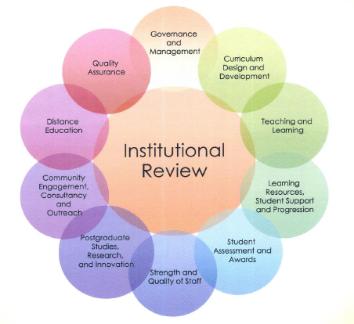

Criteria for external review: conventional

Slide 17
Criteria for distance education programmes
Programme Management
Programme Design and Development
Course Design and Development
Learning Infrastructure, Resources, and Learner Support
Learner Assessment and Evaluation
Innovative and Healthy Practices

Slide 18
Criteria for distance education institutions
Vision, Mission and Planning
Governance and Management
The Learners
Human Resource Development
Programme Design and Development
Course Design and Development
Learning Infrastructure, Resources and Learner Support
Learner Assessment and Evaluation
Postgraduate Studies, Research, Innovation and Commercialization
Community Engagement, Consultancy and Outreach

Slide 19
Requirements to undergo IR
Capacity to develop a corporate / strategic plan for the university
Capacity to develop strategies and policies in accordance with published codes of practice
Compliance with SLQF and SBS
Willingness to engage in constructive self-critical appraisal

Slide 20
2nd cycle of external reviews
Going into 5th year of Institutional Reviews using current manual
2016 – Pilots in CMB, EUSL and PDN
2017 – USJP, RUSL, UVPA, UWUSL
2018 – JFN, WUSL
2019 – MRT, OUSL, SUSL, SEUSL
2020 – KLN, RUH

Slide 21
2nd cycle of external reviews
4th year of UG Programme Reviews
2017 – Arts, Humanities, Social Sciences
2018 – Fine Arts, Education, Law, Management Studies and Commerce
2019 – Medicine, Dentistry, Health Sciences, Indigenous Medicine, Agriculture, Veterinary Science
2020 – Science, Applied Sciences, Engineering, Technology, Architecture, Geomatics
Total of 55-60 degree programs offered by 17 Faculties are to be reviewed in 2020

Slide 22
Questions?

Slide 23
SESSION 2. QUALITY ASSESSMENT

Slide 24
Criteria, best practices and standards
The 10 criteria encompass key aspects of university operations
Best practices relate to institutional approaches, policies, strategies, operations, procedures etc, that result in value addition to any aspect of university functions
Standards correspond to best practices, and enable evaluation of the degree of internalization of each practice and the level of attainment.
Standards serve as sign posts in quality assessment

Slide 25
Criterion
1
2
3
4
5
6
7
8
9
10
Number of Standards
29
15
10
14
15
11
25
6
13
7
Programme Review Quality Framework
=
=
=
145
Standards

Slide 26
Criterion 1. Governance & Management
Legal Acts, establishment codes, rules, regulations, national policy framework and strategies
Mission and objectives, values and standards, in relation to academic commitments, national needs and international context
Communication channels.
Administrative policies, procedures, appropriately qualified personnel, efficient management and administrative capacity,
Physical facilities, financial stability, and resources for effective operations and evidence-based strategic decision making.
Use of technology in managing university activities and as a teaching/learning resource.

Slide 27
Criterion 2. Curriculum & Programme Development
Academic Programmes in relation to University/HEI’s mission, goals and objectives
Approach to design and development of programmes of study
Compliance with the SLQF and SBSs
Outcome-based curricula incorporating the knowledge, skills and attitudes
Course units designed according to the stated programme objectives
Adequate emphasis on development of self-directed learning and lifelong learning
Course specifications with learning outcomes, content, teaching and learning strategies, assessment strategies, and student support approaches
Process for monitoring and review of programmes/courses

Slide 28
Criterion 3. Teaching & Learning
The teaching and learning process is student-centred in keeping with outcome-based education
Use of multiple teaching and learning methods to engage students actively in the learning process
Assessment strategy aligned with ILOs

Slide 29
Criterion 4. Learning resources, student support & progression
Infrastructure and maintenance of facilities in relation to mode and type of teaching and learning and for the number of students
Strategic, operational, and financial plans recognize and support use of facilities
Use of technological innovations in educational transaction
A range of opportunities for tutoring, mentoring, counselling, and stimulation of peer support structures
Support for student-centred learning and outcome-based education

Slide 30
Criterion 5. Student Assessment & Awards
Assessment systems (in-course and end of course) that reflect academic standards and measure the accomplishment of the learning outcomes for individual programmes/courses through the use of diagnostic, formative and summative types of assessments
Principles, procedures, and processes of all assessments are explicit, fair, transparent, valid and consistent while ensuring confidentiality and integrity

Slide 31
Criterion 6. Strength & Quality of Staff
Qualified and competent faculty and staff for effective high quality programmes and student services.
Professional development of human resources that assist in management of the design, development and delivery of programmes and courses and student-centred learning.
Opportunities for faculty and staff to be innovative and creative
Recognition for excellence in teaching and learning, research and community engagement.

Slide 32
Criterion 7. Postgraduate Studies, Research, Innovation and Commercialization
Infrastructure and administrative and financial mechanisms for research and post graduate degrees
Generation of new knowledge through research
Publication of research in indexed peer reviewed journals
Patents obtained where relevant
Research at both undergraduate and post graduate levels
Monitoring and assessment mechanisms for PG studies
Awards are consistent with SLQF levels
Ethical aspects of research
Linkages with industry, business, community and public organizations

Slide 33
Criterion 8. Community Engagement, Consultancy & Outreach
Responsiveness to the needs of the community
Supports community outreach through consultancy and extension services.
Institutional image and social acceptance

Slide 34
Criterion 9. Distance Education
Adherence to UGC guidance on EDPs and Extension Courses.
Programmes delivered through open and distance learning (ODL) methods.
Emphasis on the consistency, continuity and integrity of the learning environment.
Teachers: regular faculty and/or approved adjunct faculty or approved external training University/HEIs
Same standards and requirements as for face to face courses.

Slide 35
Criterion 10. Quality Assurance
QA as an integral part of the overall functioning of the University
University is committed to comply with national policies, regulations and guidelines prescribed by the regulatory agencies
Internal regulatory methods to ensure quality of higher education
External and internal QA are well balanced
Academic networks in the development of QA
Regular reporting to the highest body of the University

Slide 36
Criteria, best practices and standards: example 1
Criterion 2. Curriculum and programme development
Best practice 1. Programmes are developed based on the needs analysis exercise of including market research, liaison with industry, review of national priorities, and views of professional bodies and reflecting the latest development and practices in the field of study.
Relevant Standard: The University/HEI systematically and consistently maintains conformity of academic programmes with its mission and goals; approval of course design and development by the academic authority; regular monitoring and review of programmes.
Examples of sources of evidence: Organizational arrangements for curriculum development and approval; TOR and guidelines for Senate and Faculty level curriculum development committees; Curriculum development documents with programme evaluation policies and procedures

Slide 37
Criteria, best practices and standards: example 2
Criterion 7. Postgraduate Studies, Research, Innovation & Commercialization
Best Practice 1. Research, innovation and commercialization, publication and community engagement are encouraged as core duties of academic staff in addition to teaching.
Relevant Standard: The University/HEI recognizes post graduate training, research innovation, scholarship, and commercialization as core functions as reflected in the Strategic Plan and organizational structure.
Examples of sources of evidence: Strategic Plan; evidence of facilities available for postgraduate training, comparable with national and international benchmarks; Handbook; Prospectus; website.

Slide 38
Assigning Scores for Standards

Slide 39
What will reviewers look for?
Degree of internalization of best practices and level of achievement of Standards, as stated in SER
Degree to which the claims are supported by documented evidence, as indicated in SER
Accuracy of the data and statements made in the SER, as observed during site visit

Slide 40
Claim of internalization of best practice
Meets standard
Evidence sufficient to support claim
Evidence not sufficient to support claim
Below standard
Evidence sufficient to support claim
1 or 2 marks
Evidence not sufficient to support claim
No claim of achievement
3 marks
1 or 2 marks
1 mark
0 marks

Slide 41
Calculation of final score

Slide 42
Award of final grade
Criterion-wise actual score | Total actual score (%) | Grade
Equal to or more than the minimum weighted score for all ten criteria | 80 - 100 | A
 | 70 - 79 | B
 | 60 - 69 | C
 | <60 | D
Equal to or more than the minimum weighted score for nine of the ten criteria | 70 - 100 | B
 | 60 - 69 | C
 | <60 | D
Equal to or more than the minimum weighted score for eight of the ten criteria | 60 - 100 | C
 | <60 | D
Irrespective of minimum weighted criterion scores | <60 | D

Slide 43
Questions?

Slide 44
SESSION 3. WRITING UP AND SUBMISSION OF SER

Slide 45
Purpose of SER
The SER should provide review team with an account of how the University knows that it meets the expectations of stakeholders and wider society in terms of the Standards and Best Practices set out in the Manual, and those of statutory professional bodies where relevant
Data presented and statements made in the SER must be accurate

Slide 46
Organization of SER
Section 1. Introduction to the institution
Section 2. Compliance with standards under each criterion, with list of evidence
Section 3. Conclusions / current actions

Slide 47
Section 1. Introduction
Vision and mission statement
Brief history of the university, with major milestones in development
Size in terms of faculties, academic departments, units, and centres; number of students and teachers; number of administrative and supporting staff etc.
Organizational structure and line of responsibilities among its administrative units and committees.
SWOT analysis to help the review team to contextualize the institution and plan the review process.
Major changes since the last review, and the implications of the changes and challenges for safeguarding academic standards and quality of students’ learning opportunities.
A brief outline of the process followed to prepare the SER

Slide 48
Section 2. Compliance with criteria and standards
Should have 10 subsections (one for each criterion) in same order as in manual
Use template set out in Manual Appendix
  Column 1: serial number of standard
  Column 2: claim of compliance
  Column 3: supporting evidence
  Column 4: codes of documents provided as supporting evidence

Slide 49
Example:

Slide 50
Section 3. Conclusions / Current Actions
Reflect on university’s policies and practices pertaining to all of its educational activities in accordance with its vision and the mission, and the effectiveness of such policies and practices in maintaining the quality of its educational programmes and awards.
Identify a list of actions that are being undertaken at present or to be taken in the future to redress any weaknesses or failures.
Mention any specific issues that need to be discussed with the review team.

Slide 51
SER length and format
Word limit: 20,000 words
Format of report
  Use Times New Roman, 12 point font size
  1.5 line spacing
  A4 size pages

Slide 52
Submission of SER
7 hard copies
Soft copy on CD in pdf format
Cover letter signed by Vice-Chancellor
Deadline for submission: 31 March 2020
Send to: Director, Quality Assurance Council, 94/10 Ananda Rajakaruna Mawatha, Colombo 8

Slide 53
Process after submission of SER
Desk Evaluation of SER by reviewers
SITE VISIT TO VALIDATE CLAIMS IN SER
Preliminary report
Draft report
Comments from University on draft report
FINAL REPORT
University Action Plan for implementation of recommendations
IRR edited and published by QAC

Slide 54
Resource materials
Presentations and other publications available on QAC website:
https://www.eugc.ac.lk/qac/
Highlights > Events > Workshops
Workshop for SER writers for Institutional Reviews in 2020, held on 5 December 2019

Slide 55
Questions?

