Slide 1
Training Workshop for Reviewers Undergraduate Study Programs Sri Lankan Universities & HEIs
Prof. Deepthi C. Bandara
University of Peradeniya

Slide 2
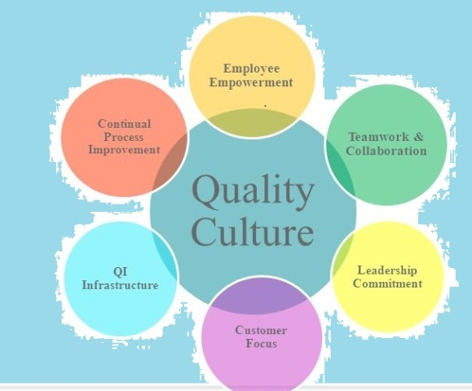
External Quality Assurance
This is to be achieved by inculcating a quality culture within the institutions and promoting continuous quality improvement in all spheres of higher education, facilitated through periodic review and feedback

Slide 3
Distinction between Institutional Review, Program Review and Subject Review
Institutional review - analyses the effectiveness of an institution’s processes for managing and assuring the quality of academic activities undertaken by the institution
Program review- evaluates the effectiveness of Faculty’s or Institute’s processes for managing and assuring quality of study programs, student learning experience and standards of awards within a program of study
Subject Review - evaluates the management and assurance of quality at subject/ departmental level, rather than program of study as a whole

Slide 4
Program Review
Purpose
to achieve accountability for quality and standards
using a peer review process to promote adopting and internalizing good practices
inculcating quality culture and facilitating continuous improvement of the study program
It is also meant to instill confidence, achieve accountability, provide information, promote improvement and showcase innovation in respect of the program of study

Slide 5
Scope
The criteria prescribed for scrutiny of programs of study in the manual have been selected by giving due consideration to the feedback received from the academia based on their experience from the first cycle of external review

Slide 6
Eight criteria…
Program Management
Program Design and Development
Human and Physical Resources
Course/Module Design and Development
Teaching and Learning
Learning Environment, Student Support and Progression
Student Assessment and Awards
Innovative and Healthy Practices

Slide 7
Requirements
Program review is offered to all undergraduate (Bachelors/Bachelors Honours)degree programs which have completed at least one cycle or graduated at least one batch of students.
programs need to be aligned to Level 5 or 6 of the Sri Lanka Qualification Framework (SLQF)
there has to be willingness by program staff to critically self-evaluate their program under the given criteria and gather evidence of achieving the required standards
Internal Quality Assurance Units (IQAU) and the Facultyl Quality Assurance Cell (FQAC) have a major role to play in facilitating the process

Slide 8
Preparation for Program Review
Preparation by the Faculty/Institute
Three to six months before the intended Program Review, the Faculty/Institute responsible for delivering the program of study should begin to compile the Self-Evaluation Report (SER) in liaison with the FQAC of the Faculty/ Institute

Slide 9
Preparation by the QAC, IQAU and the Review Team
The Faculty/ Institute which offers the study program/s has to intimate to the QAC through the IQAU regarding their intention and readiness for programme Review.
This request should preferably accompany the Self-Evaluation Report (SER).
The QAC will select the review team from the pool of accredited reviewers and identify one of them as the Review Chair
Upon receipt of the SER, individual members of the review panel have to peruse the document to make a preliminary assessment/ observation and make notes on any further information that may be required prior to/during the review visit
A pre-review meeting among the review panel, FQAC Chair, and the QAC representative

Slide 10
The Review Visit
The FQAC in liaison with the IQAU and the QAC should make necessary arrangements to receive the review team and facilitate the review process
The Review Team upon completion of the preliminaries during the visit, will
examine and verify (as far as possible) the claims in the program's SER with the Faculty/ Institute of any specific concerns arising from previously conducted program/subject reviews and/or reviews conducted by professional bodies.
gather any further evidence necessary to enable them to form a view on the quality of educational provision, experience of the students, and the degree of achievement of the intended learning outcomes; and
assess to what extent the recommendations and criticisms made by the previous subject and program reviews have been addressed.

Slide 11
All reviews will draw upon the following principal sources of evidence
The SER prepared for the review
Evidence referenced in the SER
Degree of internalization of best practices as prescribed in the Program Review Manual which had been developed by incorporating relevant rules, regulations, codes of practices and other national benchmarks and guidelines in higher education
Information gathered by the review team during the review visit

Slide 12
The Review Report and Process Prior to Publication
the outcome of program review is a published report
the report will give an overall judgment on the reviewers’ assessment of the quality of educational provision and student experience within the program and the standard of the award supported by a commentary on its strengths and weaknesses
there will be a statement on the level performance of the programme under the Grading of A, B, C or D, based on the Study Program Score expressed as a percentage
the draft report will be submitted to the QAC by the review team
the QAC will send a copy of the draft report to the Faculty/ Institute for their perusal
this will provide an opportunity to Faculty/ Institute to peruse the draft report and if there are concerns to make it known to the QAC
QAC will facilitate a meeting between the review team and the Faculty/ Institute to resolve the concerns by discussion before finalizing the report

Slide 13
Outcome of Program Review
After the Faculty/ Institute accepts the program review report, it will enter the public domain through the QAC website so that all stakeholders have access to it
Upon receipt of the Program Review Report (PRR), it should be discussed in depth at the Faculty Board and relevant standing committees including FQAC and the Curriculum Development & Evaluation committee
The PRR should also be sent to the Senate and Council for perusal along with the outcome of these discussions
Internal quality enhancement activities should take place on a continuous basis until the next cycle of EQA

