Slide 1
Trust in quality management: from compliance to enhancement
Hilla Vuori, Senior Advisor, FINEEC
Rediet Abebe, Doctoral Student, Tampere University
INQAAHE Conference, Sri Lanka, 27 March 2019

Slide 2
Presentation outline
1
2
3
4
5
6
Conceptualisation of trust
Trust in quality assurance
Methodology
Case Ethiopia
Case Finland
Best practices for trust-building

Slide 3
The concept of trust
1

Slide 4
What is trust?
Multidimensional and context-specific construct
Common elements:
Relational element between two or more parties
Uncertainty over intentions and behaviour
Willingness to assume perceived risk
Some dimensions of trustworthiness:
Intention
Competence
Reliability
Openness
Risk, uncertainty, and vulnerability
Link between trust and accountability
Distinction from similar notions

Slide 5
Trust in quality assurance
2

Slide 6
Growing importance of trust
Changing landscape between governments and HEIs
Growing accountability requirements in higher education
Perceived decline of public trust in HEIs
Competing explanations of trust ‘crisis’
Trust as a key aspect of functioning QA
“implementation of a quality system carries with it implied criticism of the quality of academics’ work and a lack of trust” (Harvey, 1995, p. 29)

Slide 7
Perspectives on building trust in QA
Rationalist/instrumentalist
Enforcing compliance to regulations, procedures and standards
Control and incentives
Emphasis on external instruments of validation
Presupposes relatively weak internal foundations for establishing trust
Normative/cognitive
Common systems of values, norms and procedures, and institutional reputation
Assumes relatively more enabling conditions for establishing trust
Stensaker and Maassen (2015), Stensaker and Gornitzka (2009)

Slide 8
Perspectives on building trust in QA
Rationalist/instrumentalist
Enforcing compliance to regulations, procedures and standards
Control and incentives
Emphasis on external instruments of validation
Presupposes relatively weak internal foundations for establishing trust
Normative/cognitive
Common systems of values, norms and procedures, and institutional reputation
Assumes relatively more enabling conditions for establishing trust
Accountability and compliance
Enhancement

Slide 9
Quality management models
Accountability/compliance-oriented
Goals and expectations of external stakeholders
Societal responsibility
Top-down orientation
Bureaucratic regulation
Weaker trust relations
Enhancement-led
Institution’s own strategic objectives
Continuous quality enhancement
Overall institutional transformation
Institutional commitment
Stronger trust relations

Slide 10
Methodology
3

Slide 11
Our methodological approach
Case study
Comparative approach
Data sources:
a) Interviews (28)
b) Focus group discussions (2)
c) Stakeholder survey (over 40)
d) Document review
- Institutional and national documents
- Feedback from HEIs on institutional audits (56)
Thematic analysis

Slide 12
Case Ethiopia
4

Slide 13
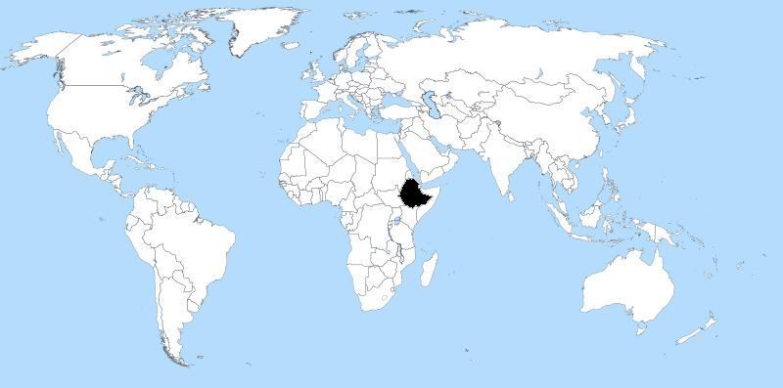
Landscape of Ethiopian HE
About 100 million
70% is under 30 years of age
Rapidly massifying HE
800,000 students (2018)
50 public & 167 private HEIs
Funding
Student and teaching staff
Enrolment size
Prestige
Notes:
Statistics for Female: - 34.7% of total enrolment
- 28.5 % of graduates

Slide 14
Weak trust relations
Acute quality concerns
External and internal QA mechanisms
Double standard: private vs. public
Weak trust foundations
Stated intentions
Capacity
Openness & communication
Risk/uncertainty
Playing ’quality game’
Allegations of corruption
Questionable autonomy, credibility and impartiality

Slide 15
Influence on QA model
Dominance of compliance oriented QA
Focus on input and process
QA units as ’fault finders’
Enhancement activities at early stage
Politicisation and political pressure
Consistent with rationale/instrumentalist perspective
Rigid regulatory system
National and institutional legislations
Active role of agency and QA units
Lack of systemic stakeholder engagement
Climate of mistrust and weak cooperation
Neglects students and external stakeholders
Inadequate platform

Slide 16
Case Finland
5

Slide 17
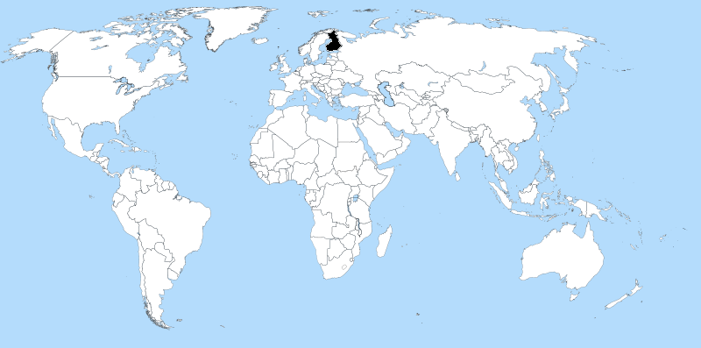
Finnish higher education landscape
14 Universities
25 Universities of Applied Sciences
300,000 students (2017)
53 % women – 47 % men
Source: Statistics Finland

Slide 18
Quality assurance framework

Slide 19
Quality assurance framework
Main responsibility for quality and improvement of education and other activities
Establish their own QA systems
Participate in external evaluations of their operations and quality systems

Slide 20
Quality assurance framework
Steering and decision-making through legislation, performance agreements, performance-based funding, operating licenses (UAS), etc.
Main responsibility for quality and improvement of education and other activities
Establish their own QA systems
Participate in external evaluations of their operations and quality systems

Slide 21
Quality assurance framework
Steering and decision-making through legislation, performance agreements, performance-based funding, operating licenses (UAS), etc.
Main responsibility for quality and improvement of education and other activities
Establish their own QA systems
Participate in external evaluations of their operations and quality systems
Carries out quality audits and other national evaluations
Supports HEIs in evaluation activities and quality management

Slide 22
Enhancement-led evaluation
Participation
Continuous interaction with stakeholders
Respect and trust
Between FINEEC and HEIs
Responsibility
HEIs enhance the quality of their operations
The goal: HEIs identify strengths, good practices and development areas in their own operations, therefore helping them achieve their strategic objectives and foster continuous development.

Slide 23
Does the approach work?
According to higher education institutions¹, the audits have:
Enhanced the operations
Fostered trust and interaction
Built confidence in the professionalism of the evaluators.
94 % gave a positive answer to the question:
“Have you used the information from FINEEC’s evaluations in your work/unit/the organisation you represent?”²
1) Audited between 2010-2017, N=56
2) Stakeholder survey 2018, N=46

Slide 24
Best practices
6

Slide 25
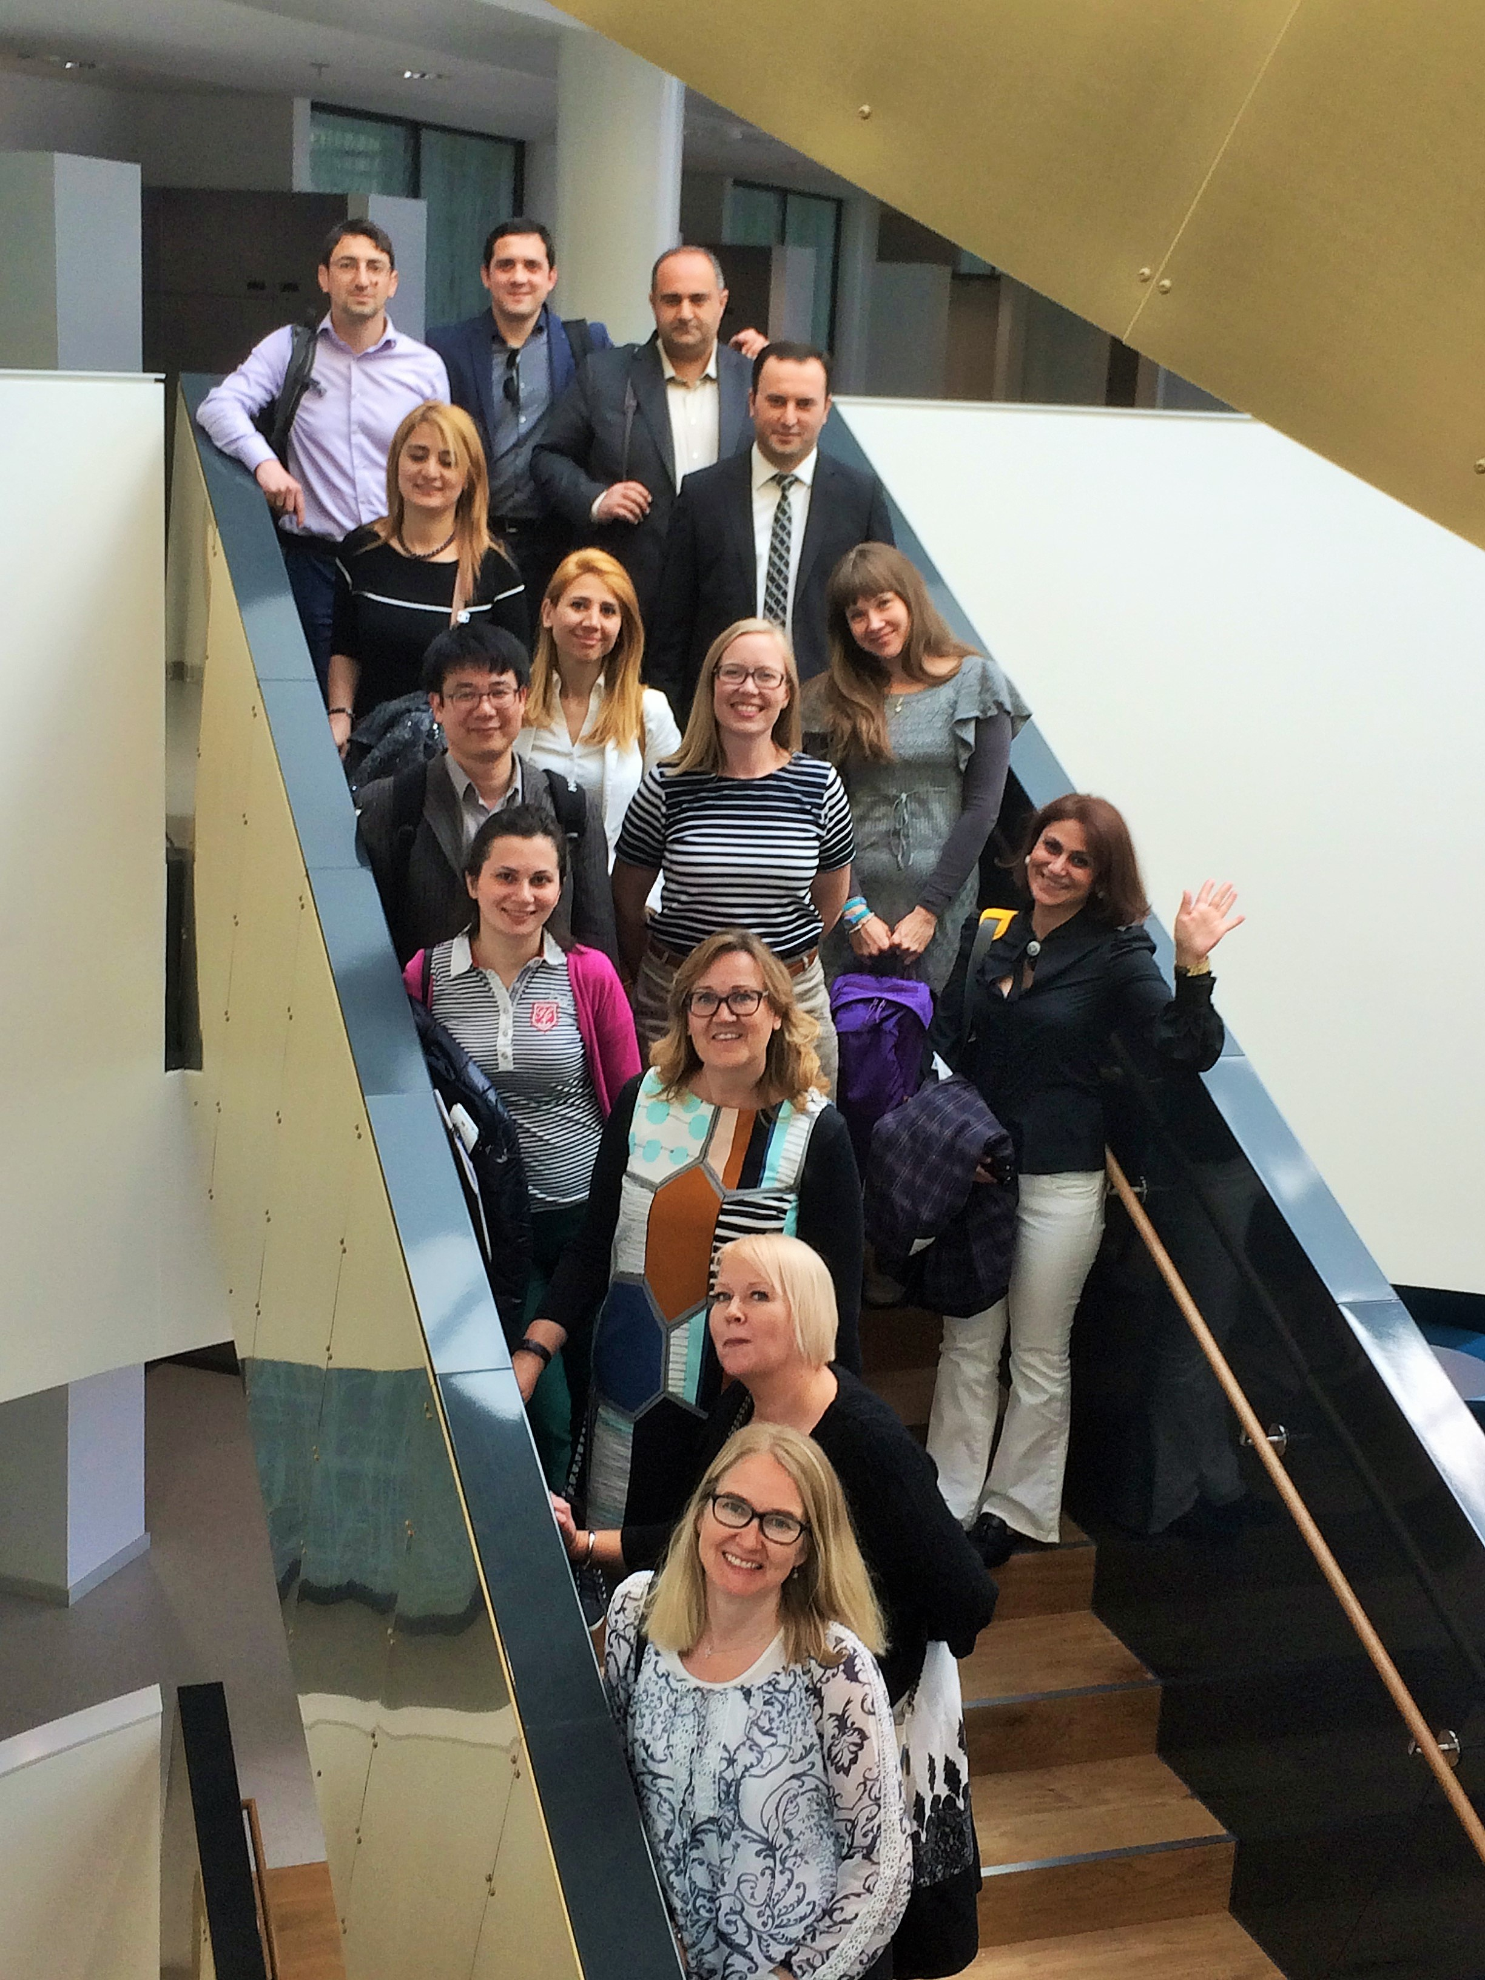
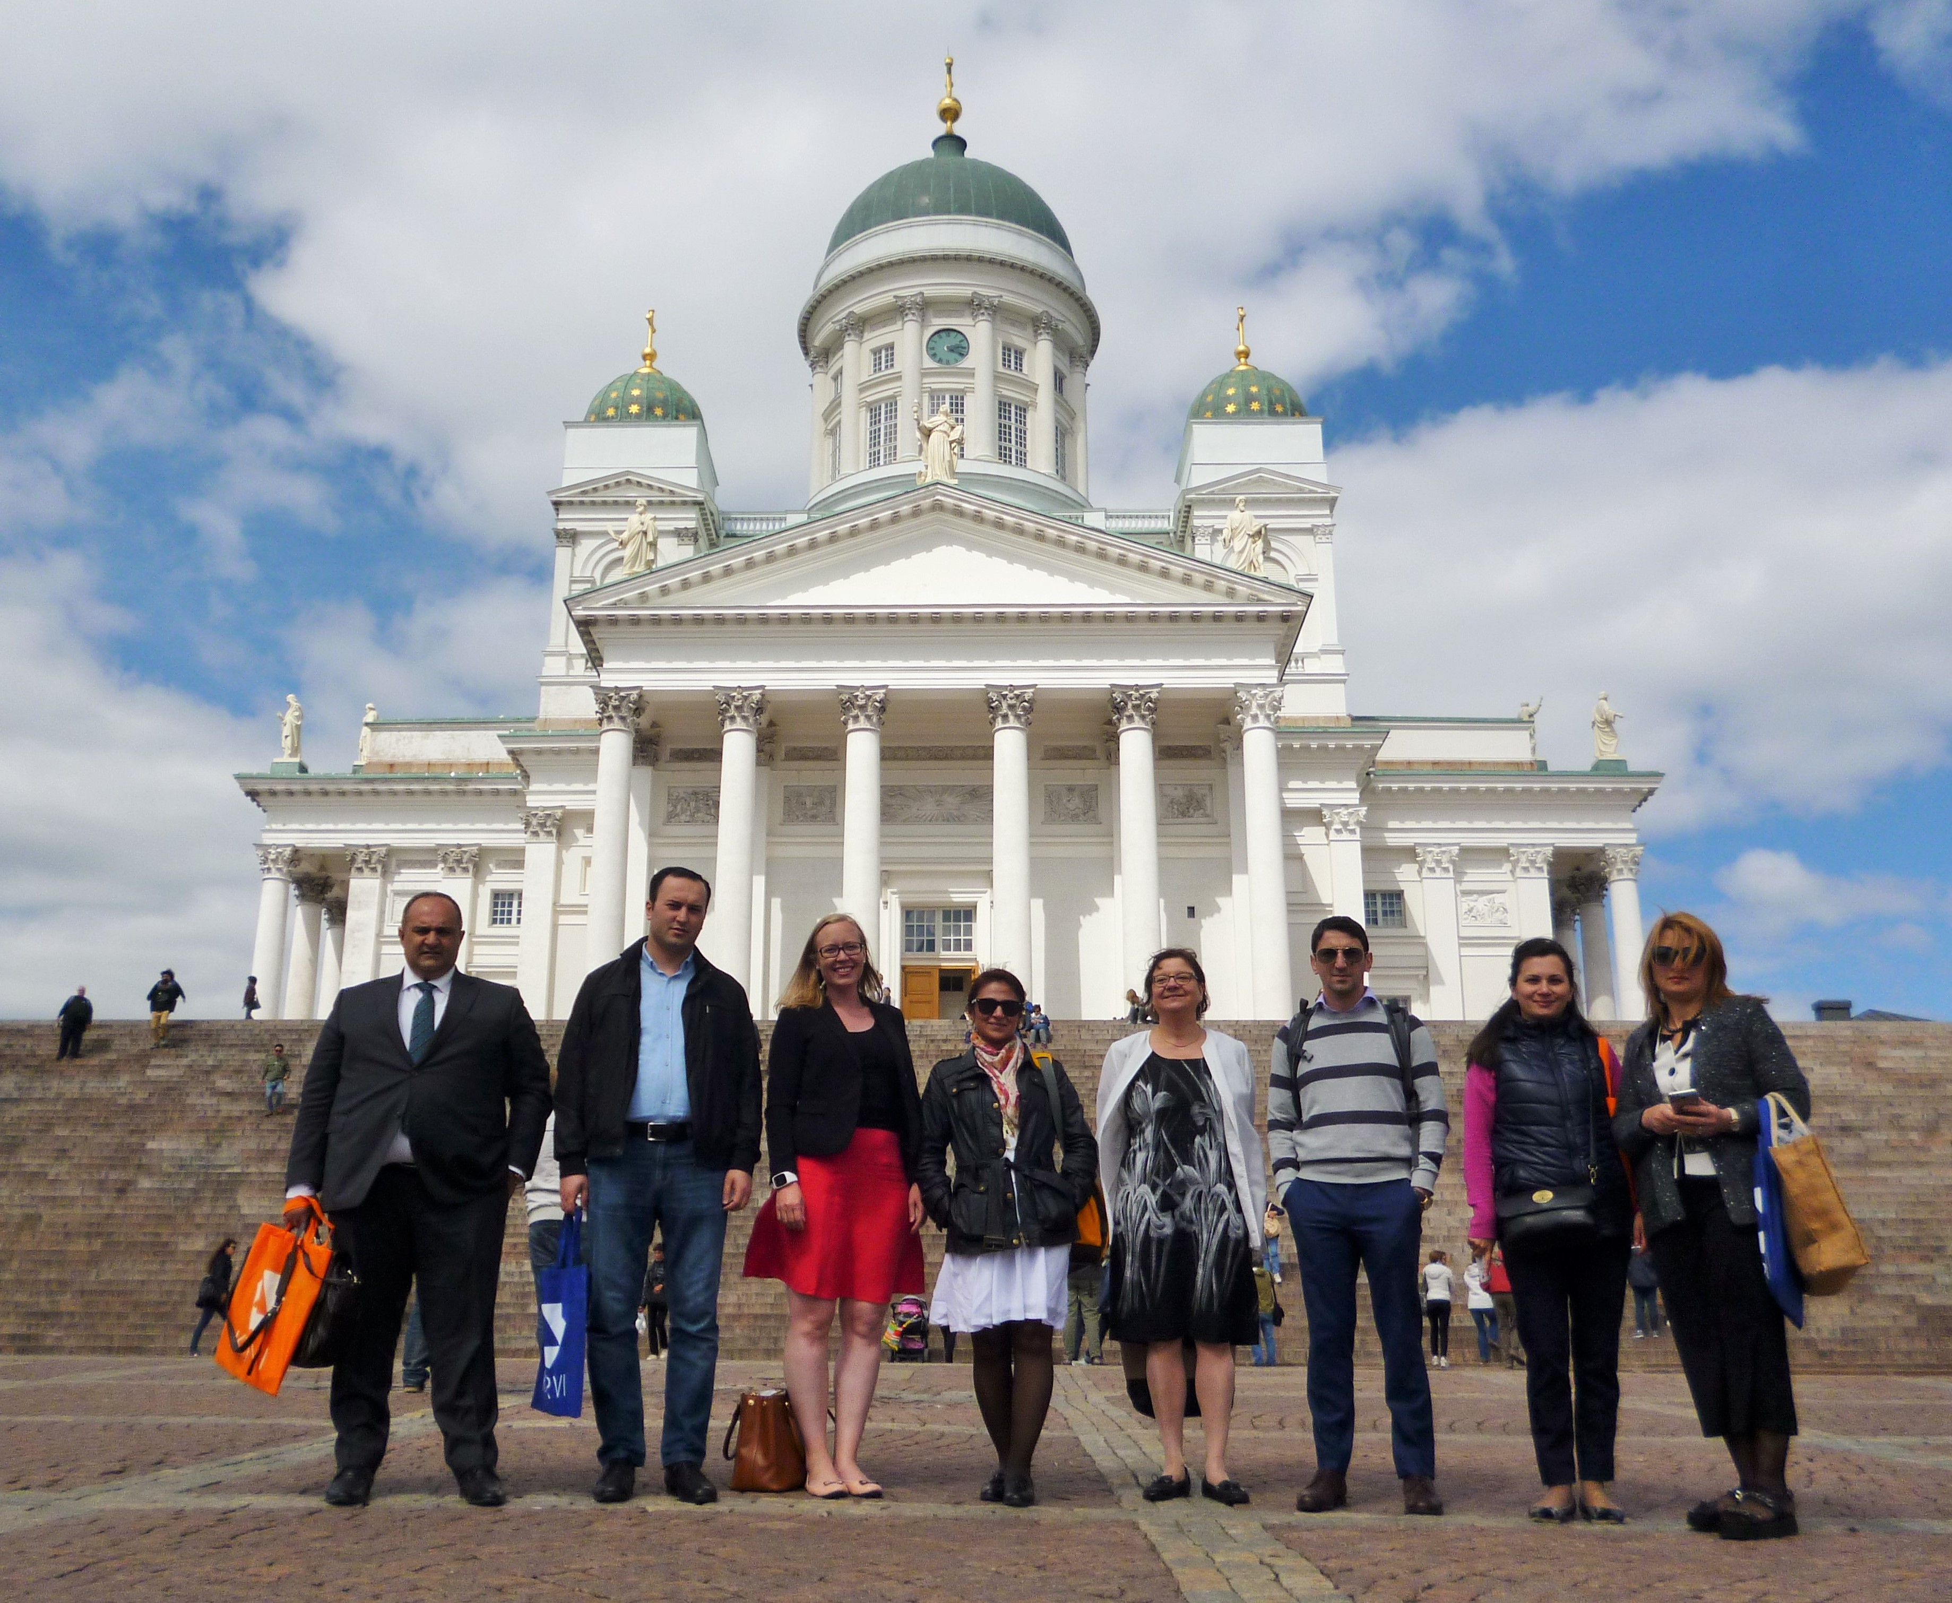
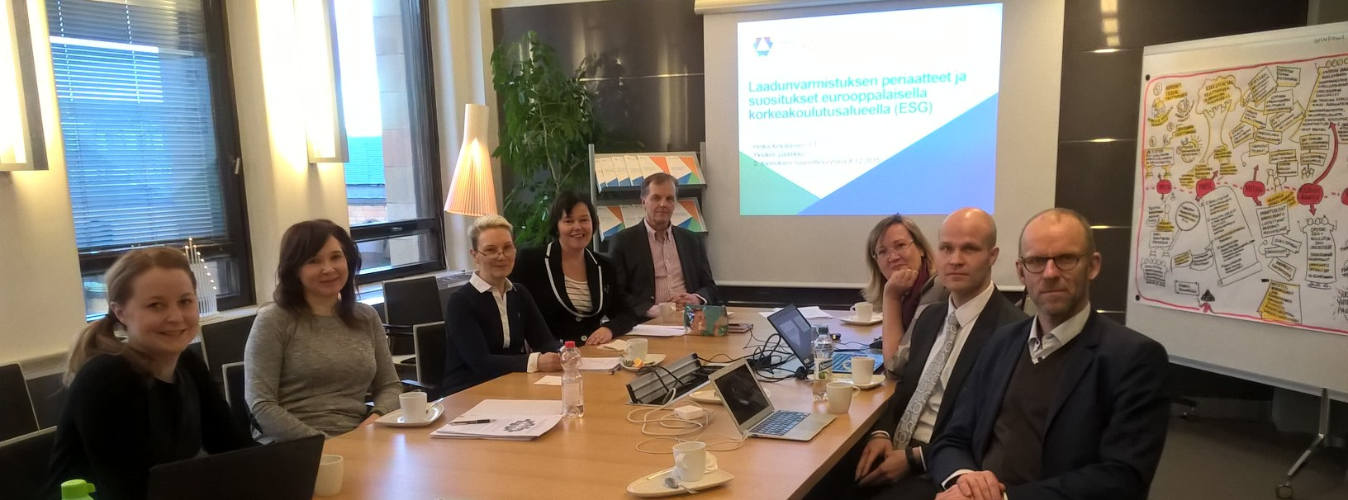
Trust through stakeholder engagement
The planning and design of evaluations
Carrying out evaluation projects
Formal decision-making
Feedback

Slide 26
Planning the new audit model
Workshop with Rector’s conference (Arene)
Workshop with students
Meeting with the Ministry of Education
National seminar
ENQA and EUA feedback
January-March
July-Sept
Oct-Dec
April-June
2016
Evaluation council meeting
Workshop with Rector’s conference (UNIFI)
Quality networks
Peda-Forum
Workshop with Evaluation Committee
Notes:
Planning group: representatives from universities, universities of applied sciences, students, professional world/working life, FINEEC.

Slide 27
Audits foster stakeholder engagement
Self-evaluation
Development of operations
Site visit interviews
HIGHER EDUCATION INSTITUTION

Slide 28
Conclusions

Slide 29
What can we conclude from the case studies?
QA as an accountability instrument
Link between trust and quality management
Stakeholder engagement as a component of building trust
QA can help restore public trust in HEIs
Weaker trust relations – compliance – rationalist
Stronger trust relations – enhancement – normative
Balancing accountability and enhancement purposes

Slide 30
Impactful stakeholder engagement
In order to foster trust, stakeholder involvement should be…
Systematic and continuous
Meaningful and impactful
Authentic
Transparent

Slide 31
Important to keep in mind
Significance of cultural context
Models are not mutually exclusive
Role of HEI management in mediating between internal and external interests
Further theoretical and empirical examination of trust in higher education and QA is needed
More cross-disciplinary application of trust models

Slide 32
Thank you! hilla.vuori@karvi.fi rediet.abebe@tuni.fi

