Slide 1
Identifying Quality in Innovation in Higher Education: A Data-Driven Approach INQAAHE 15th Biennial Conference 2019 Quality Assurance, Qualifications and Recognition: Fostering Trust in a Globalised World
Jessica S. Dunn, Ph.D.
THE UNIVERSITY COUNCIL OF JAMAICA
March 27, 2019

Slide 2
Thesis
The charge to foster trust is also a challenge to hone a quality culture that is robust and defensible, and yet agile, responsive and adaptable
This quality culture is marked by a holistic understanding of stakeholder characteristics and priorities.
Students/Graduates
Higher Education Providers (& Internal Quality Assurance)
Business/Industry/Labour Market
External Quality Assurance

Slide 3
Thesis
We will move closer to cultivating trust when we can reliably demonstrate knowledge and understanding of the:
broad demographic spectrum of learners enrolled in higher education
diversity of HE providers
range of learning modalities
requirements of business, industry and the world of work
The evaluation tools/mechanisms not always tailored to suit the various disciplines and environments (including online) currently being utilised in HE.

Slide 4
Thesis
This paper posits that building organisational knowledge management systems within internal and external quality assurance societies in Higher Education will better equip us to manage the constant and significant change taking place in contemporary global society.
This can be achieved through increasing reliance on data as evidence of the changing trends and practices in HE.
Knowledge puts us in a position to be proactive.
“We are called to be architects of the future, not its victims”
(R. Buckminster Fuller)

Slide 5
Focus of Paper
In the changing landscape of global Higher Education, UCJ has seen:
diversified profile of local and international HE providers
new innovations in technology-enhanced teaching and learning (including Online and Distance Education)
How do we safeguard quality and value disruptive technological change in global Higher Education?
Exploring the opportunity for external quality assurance through a more organised system of data gathering, analysis and knowledge sharing.
UCJ iQAMS Project

Slide 6
The UCJ
The University Council of Jamaica (UCJ)
National External Quality Assurance Agency (EQAA) for higher education in Jamaica. Established by legislation in 1987.
Facilitates institutional registration and the review of institutions, programmes and short courses for accreditation and recognition.
The UCJ also sees the mission of external quality assurance as developmental
seeks to enable institutions to (i) enhance their internal quality assurance systems, (ii) demonstrate institutional effectiveness and (iii) facilitate student success.

Slide 7
Jamaican HE Sector
A diverse, semi-autonomous and independent composite of institutions and programmes
Sector has seen a striking increase in local and overseas providers and varied modalities for knowledge exchange.
Universities, University Colleges, Teachers Colleges (Education, Business, Science, IT, Health Science Specialty Colleges (Sports, the Arts, Theological Studies, Tourism and Hospitality)
Tertiary Institutes, in service training organisations, post-secondary training centres, vocational training institutions offering tertiary-level programmes (face-to-face and online)
Overseas universities with satellite campuses and online programmes

Slide 8
Changing Profile of HE in Jamaica
Diversification
Types of institutions – Public, Private, For Profit, Non-Profit, Brokers (new)
Types of programmes – (i) traditional and non-traditional HE, (ii) face-to-face, correspondence, online mixed-modalities
This diversity also presents the challenge of finding effective approaches to maintaining an integrated and coherent system that meets the occupational needs of the country and the global labour market.

Slide 9
Changing Profile of HE in Jamaica
Strategic Government imperatives:
Increase percentage of population holding a degree from 15% to 80%
Establish parity of esteem between General (Academic) Higher Education and Technical Vocational Education and Training
make HE more responsive to labour market requirements
Operationalise the National Qualifications Framework and promote internationalisation and trade in educational services
Increase technological resources to support HE
Promote quality orientation

Slide 10
UCJ Research and Environmental Scanning
Indicates there is need for a more systematic approach to tracking changing trends at two levels:
EQAA
Institutional
Interdisciplinary literature on disruptive technology points to the following developments:

Slide 11
Our Universities: Designed mainly in the 19th and 20th centuries are in need of substantial reform to address the realities of the 21st century and beyond.

Slide 12
“The world is now “at the beginning of a Fourth Industrial Revolution (4IR).
Developments in genetics, artificial intelligence, robotics, nanotechnology, 3D printing and biotechnology...are all building on and amplifying one another.
This will lay the foundation for a revolution more comprehensive and all-encompassing than anything we have ever seen.”
Schwab (2017), World Economic Forum

Slide 13
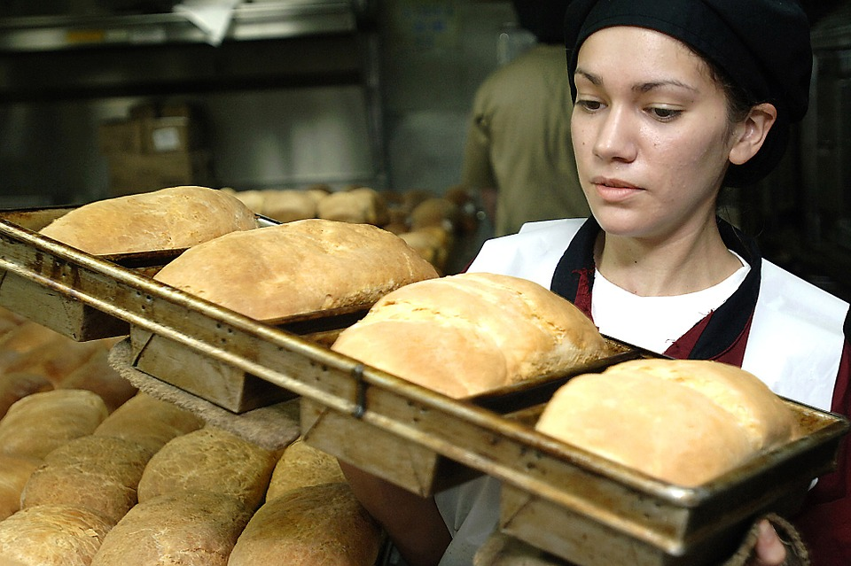
The traditional College or University system concentrates too much on preparing for jobs and not enough on mentoring own-account business leaders
It sometimes leaves behind that cohort of secondary school leavers who did not excel in the traditional Arts or Science subjects based on the unreconstructed matriculation requirements of these universities and colleges.
Many such youth cohorts are among the most creative, flexible and hands-on group, capable of learning unconventional skills, leading news businesses and operating joint enterprises.

Slide 14
Some students are classified into discipline specific faculties and subject specific departments that lead to narrowly focused, traditional career options
Graduates and employees are looking for new job types and different skillsets

Slide 15
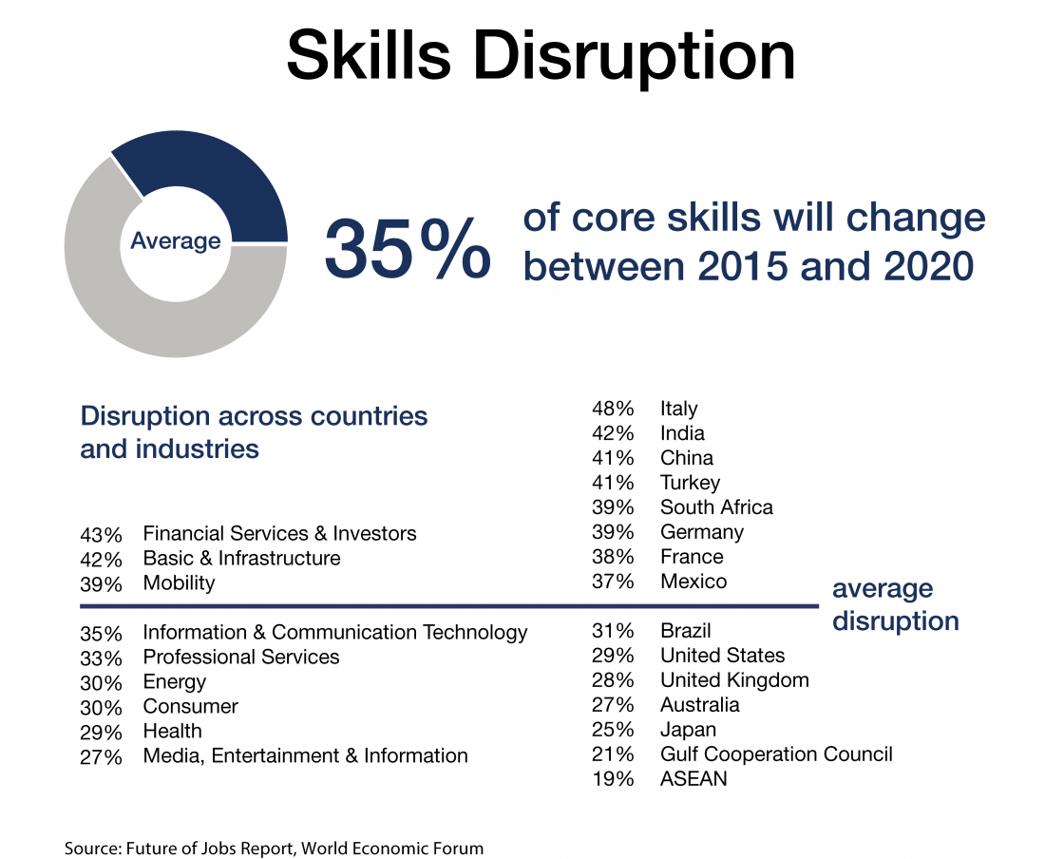
Several jobs that were high in demand in 2010 often did not exist in 2004.
We are trying to educate students for jobs that don’t yet exist, using technologies that haven’t been invented in order to solve problems we don’t know are problems yet.”
Source: Former US Secretary of Education Richard Riley

Slide 16
Work in Agriculture and Personal Care
Future of Jobs discussion remains incomplete without recognising that a significant share of the Global South workforce remains employed in agriculture. This sector needs training in modern skill-sets.
There is also optimism about growth in personal care, health and service jobs due to rising stress, fatigue and other occupational and social dysfunctions.

Slide 17
HEIs and EQAAs must continue to give attention to the changing trends and anticipate the need for evaluation of programme learning outcomes that are more concentrated on new and diverse professional competences and interpersonal skills in areas such as:
Entrepreneurship for innovators
Business and Science ethics
Data mining and data analytics
Web management and cyber security,
Emotional intelligence
Communication and Self Presentation/Branding

Slide 18
Christensen (2017) on dealing with disruptive innovation
In book The Innovator’s Dilemma: When New Technologies cause Great Firms to Fail, Christensen (2017) argues that the solution to disruptive technologies cannot be found in the standard toolkit of good management.
Chistensen suggests that it is those that learn to understand and harness the principles of technological change that are better equipped to deal with it.
External QA has an important role to play in lead this charge to embrace innovation in the Higher Education sector

Slide 19
Online teaching & Learning

Slide 20
Perspectives on Online and Distance Learning
Cassey (2008) – “the delivery of HE in the online modality holds greater promise and is subject to greater suspicion than any other instructional mode in the 21st Century” (p.45)
Difficult to define and establish clear measures of online education because of the diverse approaches to its adoption.
Content of Evaluations: Internal and external QA evaluations may include review of evidence such as: (i) viewing the platform, (ii) examining discussion fora, (iii) student feedback mechanisms, (iv) screen captures of online assessment, (v) marking schemes, (vi) peer review observations.

Slide 21
Institute for Higher Education Policy (IHEP) 1998-2000
Confirmed the need to increase research conducted in online learning programmes and the quality of such programmes
IHEP identified 24 quality indicators for online programmes grouped into 7 overarching themes:
institutional support
course development
teaching and learning
course structure
student support
faculty support
evaluation and assessment methods

Slide 22
Dilbeck (2008)
Surveyed 200+ community college administrators using IHEP indicators to ascertain their perceptions of the efficacy of their online education provision.
Found that tool was useful, but omitted quality enhancement/improvement (Campbell & Rozsnyai, 2002; Vlasceanu et al, 2007)
Assert that the onus is on institution to make the best use of its autonomy and freedom to demonstrate quality in online learning.
This should draw on stakeholder feedback

Slide 23
Shelton (2010)
Modified IHEP (2000) quality online indicators
Used Delphi method to examine the views of experts from 43 HEIs
Delphi: An interactive method to collect anonymous input from experts using various techniques
Developed a Quality Scorecard for the evaluation of online programmes
Weighted: Evaluates the quality and effectiveness irrespective of the size of the institution

Slide 24
UCJ Distance Education Standards (2014)
Governance
Academic Programmes
Curricula and Materials
Learner Services and Support
Learner Assessment, Achievement and Satisfaction
Technology Services
Human Resource Management
Financial Management
Advertising and Promotion
Research and Development

Slide 25
Reflections on Online Learning
Regardless of the nature of the technology enhanced modality, good practice suggests quality evaluations should:
Be designed for the intended purpose
Incorporate interactive elements (in some cases face-to-face contact is recommended)
IT Support (students and faculty)
Professional development and pedagogical support for faculty
include a check on mechanisms to monitor, evaluate and improve the provision (Dottin, 2015)
Monitoring can prove challenging when there is variable and unregulated adoption of online learning in institutions.
This issue can be addressed by documenting various forms of online learning being used, tracking their various features and assessing how they have advanced learning outcomes

Slide 26
Adopting a data-driven approach

Slide 27
The Value of Data Analytics in Organisational Development
Data is at the heart of the strategic power of organisations.
Data analytics facilitate monitoring of changing trends in organisational performance.

Slide 28
The UCJ and QA Process Automation
The UCJ’s Automation Project commissioned by the UCJ Council.
The Integrated Quality Assurance Management System (iQAMS) is designed to automate several aspects of the administration of the UCJ’s Quality Assurance (QA) processes, which have historically been manual.
Registration
Programme and Institutional Accreditation
Transnational Recognition

Slide 29
Introducing an Automated Application Process
iQAMS will use an online form in a secure platform to facilitate electronic submission of applications and supporting documents.
Notes:
Designed to make the application process more efficient, ‘greener’ (more environmentally friendly) and less unwieldy
ETA: Later this year. There is a phased implementation. The UCJ Executive Office will provide details to institutions in due course

Slide 30
Why introduce iQAMS?
Digitises and streamlines core quality assurance processes
Reduces historically time consuming and tedious manual processes
Facilitates preparation of more data-driven submissions by HEIs
Ensures consistency of information
Increases high-value work productivity of review panels
Provides a secure electronic database for storage of quality assurance case management data: submission for review, UCJ reports and institutional responses
Generates reports on aggregated data on HE landscape which can inform institutional planning as well as national HE policy development

Slide 31
Research Underpinning Online Application System
Alignment to UCJ Quality Assurance Standards and benchmarked international standards
Collects aggregated data on pertinent matters for national development
Technical Team conducted extensive research on online learning, TVET and General Academic Tertiary-level education

Slide 32
Conclusions and Reflections for QA
Recent literature points to the need for QA to continue to monitor:
The effectiveness of its guidelines on online and distance education taking into account rapid pace of change
Forces of technological change must be understood and embraced by QA and HEIs to facilitate adaptation and the relevance of standards by which higher education is evaluated.

Slide 33
Reflections for QA
In view of technological disruption QA (internal and external) must invest in research and other forms of data gathering to ensure continued relevance of standards and to demonstrate understanding of the evolving nature of HE
This research should always include stakeholder consultation
The actions of QA must continue to be data driven to inform policy.
Some HE quality standards are agnostic of change [face-to-face vs online].

Slide 34
Reflections for QA
As we promote continuous improvement with institutions, we must continue to evaluate what we are doing well methodologically and what can be done more effectively.
The posture of QA should be to openness to institutional innovation and as an enabler/facilitator of the achievement of quality.

Slide 35
Key References
Cassey, D.M. (2008). A Journey to Legitimacy: The Historical Development of Distance Education through Technology. TechTrends: Linking Research to Practice to Improve Learning, 52 (2):45-51.
Christensen, C.M. (2016). The Innovator’s Dilemma: When New Technologies Cause Great Firms to Fail. Boston: Harvard Business Review Press.
Dottin, P. (2015). A Quality Scorecard Approach to Analysing Quality in Distance Online Education
Perkins, A.K (Ed.). (2015). Quality in Higher Education in the Caribbean. Kingston, Jamaica: University of the West Indies Press.
Schwab, K. (2017). The Fourth Industrial Revolution. Geneva: World Economic Forum and London: Penguin.
Shelton, K. (2010). A Quality Scorecard for the Administration of Online Education Programs: A Delphi Study. PhD Dissertation. California state University Hayward
University Council of Jamaica. (2014). Standards for Distance Education. Kingston: UCJ Press.

Slide 36
References
European Association for Quality Assurance in Higher Education. (2019). Work and Policy Areas: The European Quality Assurance Register for Higher Education. URL: https://enqa.eu/index.php/work-policy-area/enqa-the-bologna-process/eqar/
EQAR: European Quality Assurance Register for Higher Education. URL: https://www.eqar.eu/

