Slide 1








STUDY ON THE ATTENTION LEVEL OF SRI LANKAN UNDERGRADUATES DURING A 1-HOUR LECTURE
Manoharan Kesavan
Department of Construction Technology,
Faculty of Technology,
Wayamba University of Sri Lanka,
Sri Lanka.

Slide 2

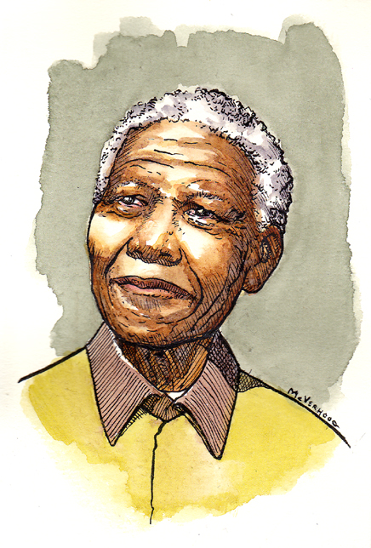
“No country can really develop
unless its citizens are educated”

Slide 3

















‘FREE EDUCATION’

Slide 4
The courses are taught to the students using various teaching methods. But, lecturing is used as the major teaching method in Sri Lankan universities.

Slide 5
Lecturing is not simply a matter of standing in front of the students and sharing what the lecturer knows.
It is vital to conduct the lectures in such a way that motivates and inspires the students for creative thinking.

Slide 6

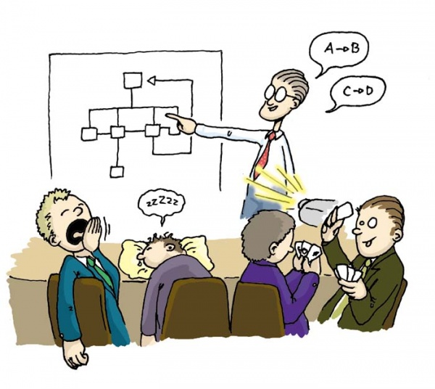
Students Attention Level

Slide 7




Students Attention Level

Slide 8
Lecturers’ responsibility is to prepare the students for achieving the learning outcomes of the courses by utilizing effective learning methods, strategies and assessment methods.

Slide 9
It is important for the students to pay attention and concentrate during the lectures, because it enhances their competency to memorize the content for a longer period of time, while broadening the understanding on subject related concepts.

Slide 10


Think & Act Globally

Slide 11
STUDY ON THE ATTENTION LEVEL OF
SRI LANKAN UNDERGRADUATES
DURING A 1-HOUR LECTURE

Slide 12


Assess the students’ attention level during a 1-hour lecture

Slide 13

LITERATURE STUDIES
Sausa,(1998)
Peak period for learning within the concept of class activity is the first 10 minutes. Lecturers are encouraged to use this time slot for teaching ne concepts.

Slide 14
LITERATURE STUDIES
Sonica et al. (2014)
Major Factors Affecting the Attention and Concentration Levels of Students
  Duration of the lectures
  Methods of teaching
  Nature of the topic
  Surrounding environment
  Health and emotional status

Slide 15



QUESTIONNAIRE SURVEY
Total No. of Responses = 120
  1st year students (30)
  2nd year students (30)
  3rd year Students (30)
  4th year Students (30)

Slide 16
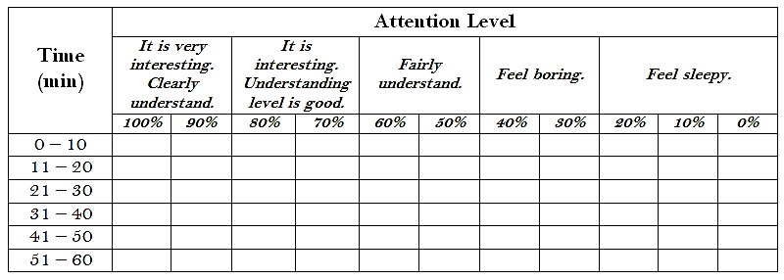

QUESTIONNAIRE
Table 01: The attention level of the students during a 1-hour lecture without any break

Slide 17

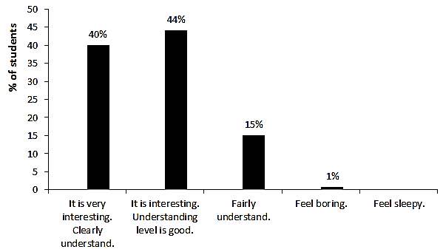
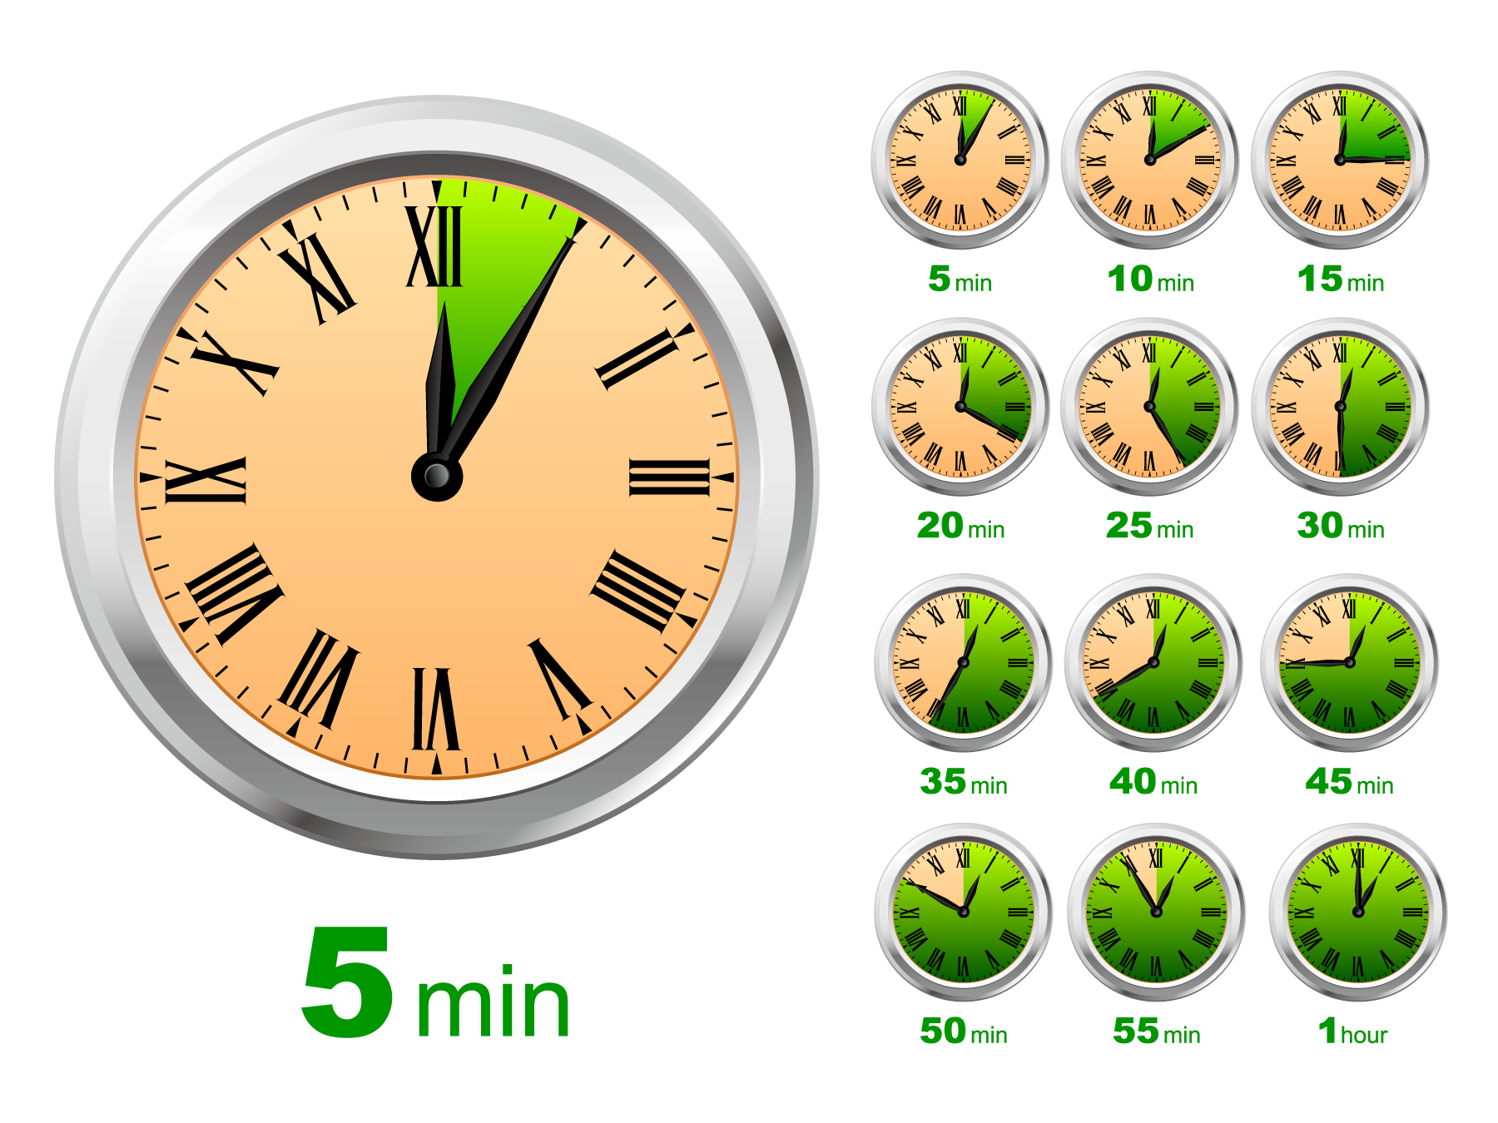



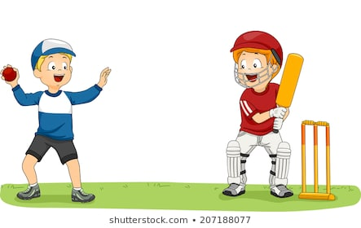
It is interesting...
STUDENTS ATTENTION LEVEL
😃
0 – 10 min
4
Understanding Level

Slide 18

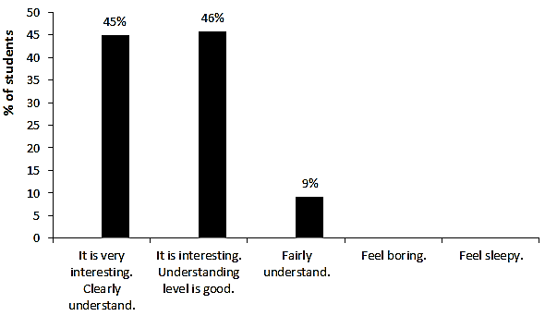


STUDENTS ATTENTION LEVEL
Wow...
It is very interesting...
10 min – 20 min
4
6
Understanding Level

Slide 19

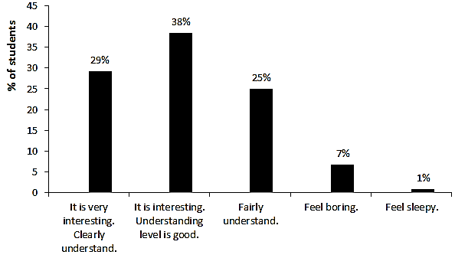


It is Good.
But, Power has started to reduce.
STUDENTS ATTENTION LEVEL
20 min – 30 min
4
6
2
6
6
6
Understanding Level

Slide 20

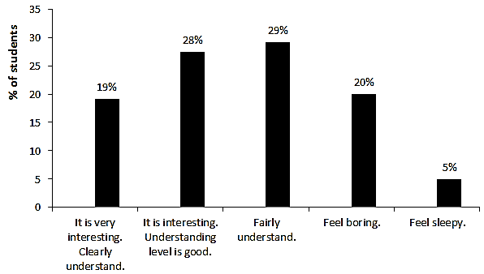


STUDENTS ATTENTION LEVEL
Feeling confused…
30 min – 40 min
4
6
2
1
Understanding Level

Slide 21
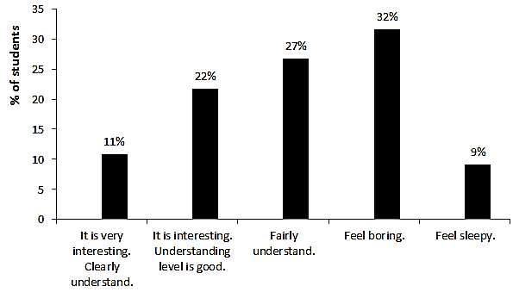



STUDENTS ATTENTION LEVEL
Feeling bored and tired…
40 min – 50 min
4
6
2
1
.
Understanding Level

Slide 22

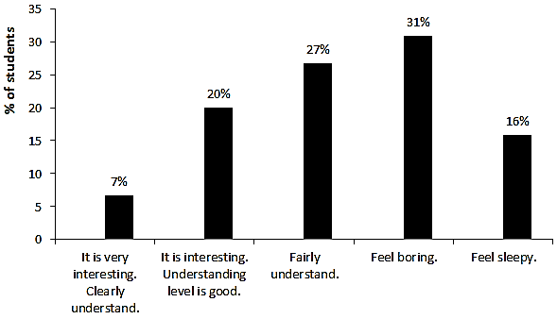


STUDENTS ATTENTION LEVEL
Feeling sleepy…
50 min – 60 min
4
6
2
1
.
W
Understanding Level

Slide 23
STUDENTS ATTENTION LEVEL
0-20 minutes, more than 80% of the students have felt interested in the lectures.
Only 27% of the students have maintained their attention level at ’interested level‘ till the end of the lecture.

Slide 24
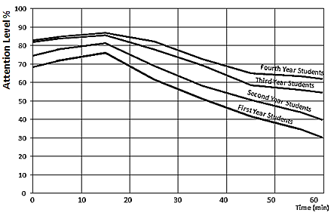

STUDENTS ATTENTION LEVEL
For 1st year students, Students Attention Level
It decreases by 30% between 15 minutes and 45 minutes.
It approximately dropped up to 30% at the end of the lecture (60 minutes).

Slide 25
STUDENTS ATTENTION LEVEL
For 2nd year students, Students Attention Level
It decreases by 30% between 15 minutes and 45 minutes.
It approximately dropped up to 40% at the end of the lecture (60 minutes).

Slide 26
STUDENTS ATTENTION LEVEL
For 3rd year students, Students Attention Level
It decreases by 25% between 15 minutes and 45 minutes.
It approximately dropped up to 55% at the end of the lecture (60 minutes).

Slide 27

STUDENTS ATTENTION LEVEL
For 4th year students, Students Attention Level
It decreases by 20% between 15 minutes and 45 minutes.
It approximately dropped up to 60% at the end of the lecture (60 minutes).

Slide 28

STUDENTS ATTENTION LEVEL
Attention level of students during lectures increased with the level (maturity) of the students.

Slide 29


STUDENTS ATTENTION LEVEL
Attention level of students significantly decreased between 15-45 minutes

Slide 30

STUDENTS ATTENTION LEVEL
To
Maintain the attention level
in acceptable range

Slide 31

An effective method to allow the level of attention to recover.

Slide 32
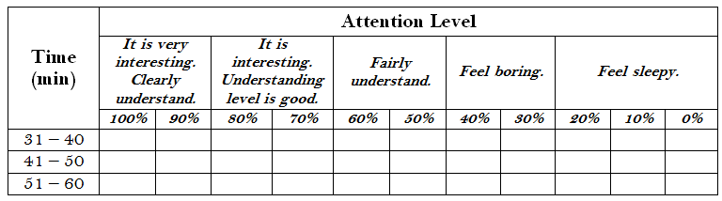
QUESTIONNAIRE
Table 02: The attention level of the students during a 1-hour lecture,
if a break is given at 30 minutes

Slide 33
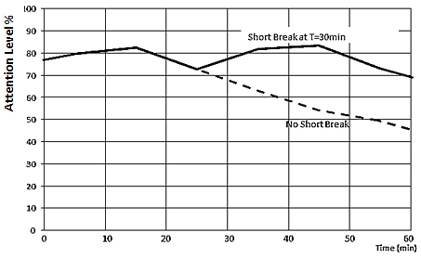
STUDENTS ATTENTION LEVEL
A 30% drop of attention level could be expected, if no lecture break was given.
The least attention level of 45% was reported at the end of the lecture.

Slide 34
STUDENTS ATTENTION LEVEL
A short break would improve the attention level of students and maintain it within the range of 70% and 85%.

Slide 35

STUDENTS ATTENTION LEVEL
In addition to provision of short lecture breaks,
a variety of other tools could be used to improve the attention level of students in lectures.

Slide 36
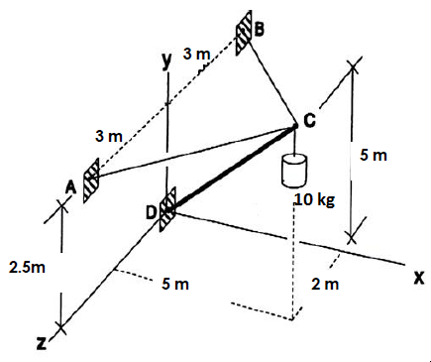



Problem
Determine the forces in cables.
Dear students,
please divide into groups of 5 members to solve this problem.

Slide 37

Joints of the Bridges
Today, I am going to start the lectures with an interesting story related to joints of the bridges.

Slide 38

Structural Analysis
Let’s discuss about the structural components in Twin Tower.

Slide 39
Question Time
What are the advantages of ready mix concrete?
1. High quality
2. Low amount of labour needs
3.
Sir, it saves a lot of time.

Slide 40
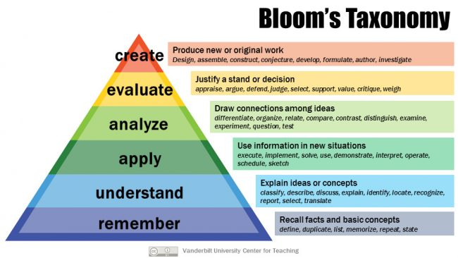


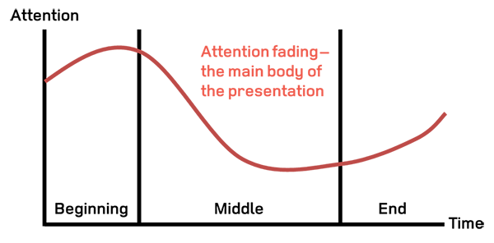








Sir, could you please suggest any ideas to improve the attention level of the students during the lectures?
IQAU
Internal Quality Assurance Unit
Wayamba University of Sri Lanka

Slide 41


Slide 42




ACKNOWLEDGEMENT
Prof. E.M.P. Ekanayake
The Vice-Chancellor
Wayamba University of Sri Lanka
Sri Lanka
Prof. Renuka Silva
The Director - Internal Quality Assurance Unit
Wayamba University of Sri Lanka
Sri Lanka
IQAU

Slide 43


ACKNOWLEDGEMENT
Prof. J.M.U.K. Jayasinghe
The Director – Staff Development Center
Wayamba University of Sri Lanka
Sri Lanka
Prof. B.P.A. Jayaweera
The Dean – Faculty of Lifestock, Fisheries & Nutrition
Wayamba University of Sri Lanka
Sri Lanka
SDC

Slide 44

ACKNOWLEDGEMENT
Lecturers & Students

Slide 45







INQAAHE 15thBiennial Conference 2019
Quality Assurance, Qualifications, and Recognition: Fostering Trust in a Globalised World
Hosted by
University Grant Commission Sri Lanka
Sub theme
Thinking and acting globally: The role of QA in qualifications frameworks and student and talent mobility: challenges and opportunities
Study on the Attention Level of Sri Lankan Undergraduates
during a 1-Hour Lecture
M.Kesavan
kesavan@wyb.ac.lk/
k7efac@gmail.com

