Slide 1
The Roles of National Quality Assurance Agencies on Development of Qualification Framework in Asia and the Impacts on Student Mobility - A Lesson Learned by Taiwan
Angela Yung Chi Hou
Professor, National Cheng Chi University, Taiwan
Executive Director, Higher Education Evaluation & Accreditation Council of Taiwan
Sheng Ju Chan
Professor, National Chung Cheng University
Higher Education Evaluation & Accreditation Council of Taiwan
Grace Lu, and Hau Chi Hou
Higher Education Evaluation & Accreditation Council of Taiwan

Slide 2
Introduction
Higher education expansion in Asia
Increased global and regional student mobility due to economic growth
Quality of qualifications and regional qualifications reference frameworks
Connection between quality assurance and qualification framework

Slide 3
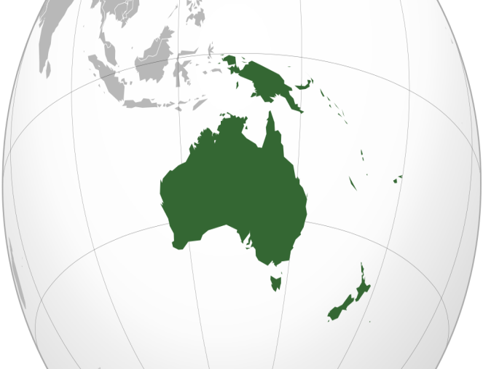
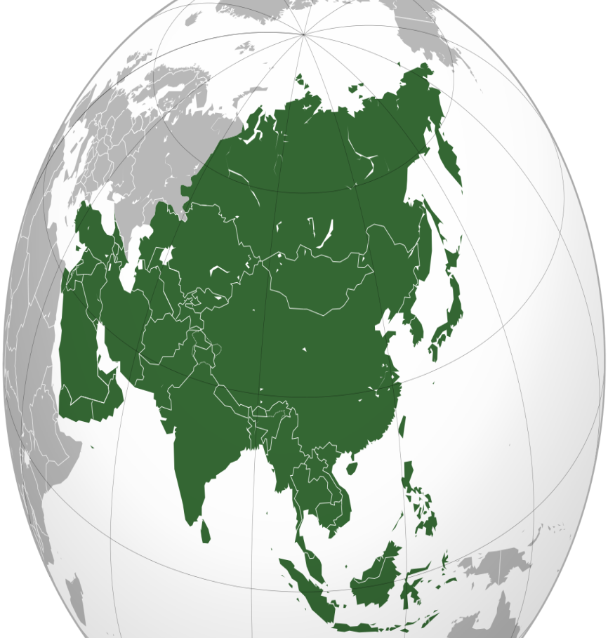
Overall View of the Asia Pacific Region Higher Education and QA System
Total of Universities:
76,387
Total No. of Student Population:
349,617,534
Total No. of Quality Assurance Agencies:
87
No. of Public QAA:
48
No. of Private QAA:
39
Countries with NQF:
32
Countries without NQF:
19

Slide 4
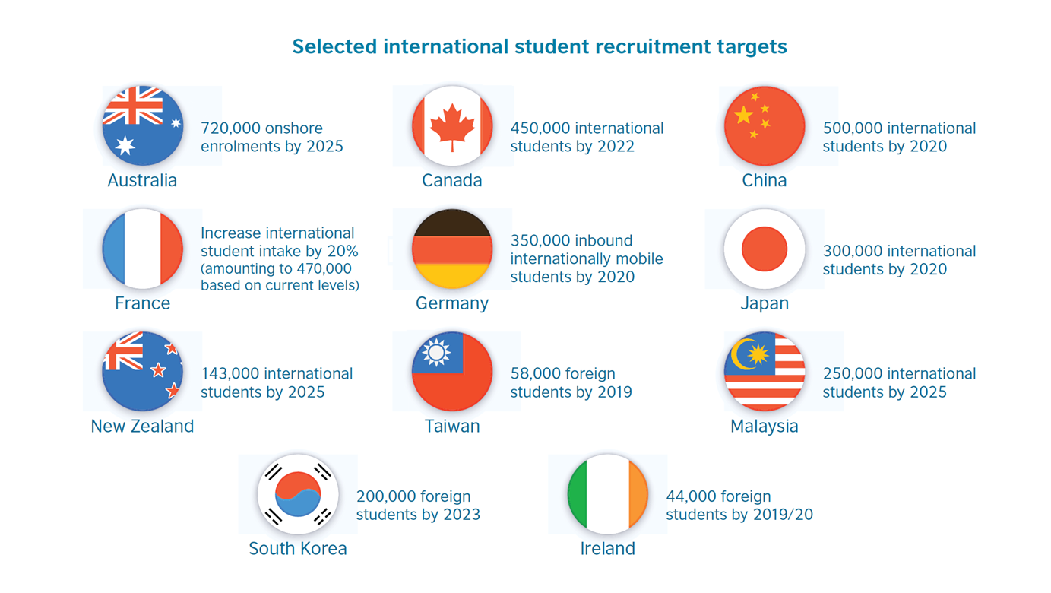
Ambitions for international recruitment

Slide 5
Recognition of an Oversea Qualification
Concerning diversity in educational systems and type of cross-border mobility, “a formal acknowledgement of a foreign credential” is even more complicated” (UNESCO Bangkok, 2013)
a foreign qualification will be accepted only if it has no substantial difference from a local degree after being reviewed by recognition body.

Slide 6
Quality assurance
quality assurance is defined as “a process of establishing stakeholder confidence that provision (input, process and outcomes) fulfills expectations or measures up to threshold minimum requirements” (INQAAHE, 2018).
quality assurance (QA ) mechanisms of varied types based on a range of purposes and processes
auditing, accreditation, evaluation, ranking, benchmarking
with internal and external dimensions
self assessment / onsite visit / peer review
Quality assurance is often associated with an educational policy by the government
serve as a quality gatekeeper of local providers and programs
More than 100 countries with 250 QA agencies around the world

Slide 7
Qualification Framework
“Qualification Framework” is defined
as an educational system structure, which has a series of instrumental regulatory logics, such as inclusion of all types of higher education providers, developing national standards for all level of education in terms of learning outcomes (Jarvis, 2014).
“makes hierarchical distinctions between qualifications and categorize them by level”, in which learners can earn credits and accumulate all skills and knowledge in different learning periods and paths (Hanf & HIPPACH-SCHNEIDER, 2005, p.9)
Currently, there are six regional Qualification Reference Framework with more than 150 jurisdictions involved in the development and implementation of NQFs.

Slide 8
Table 1: Description of 6 regional qualification frameworks
Name of Framework | Est. | Level | Domains | Countries
The European qualifications framework | 2008 | 8 | Knowledge, skill, autonomy and responsibilities | European Union (EU) Member States: Belgium, Bulgaria, the Czech Republic, Denmark, Germany, Estonia, France, Ireland, Greece, Spain, Croatia, Italy, Cyprus, Latvia, Lithuania, Luxembourg, Malta, the Netherlands, Hungary, Austria, Poland, Portugal, Romania, Slovenia, Slovakia, Finland, Sweden and the UK Not members of the EU: Albania, Bosnia and Herzegovina, the former Yugoslav Republic of Macedonia, Iceland, Kosovo, Liechtenstein, Montenegro, Norway, Serbia, Switzerland and Turkey (39)
The Pacific qualifications framework | 2011 | 10 | Knowledge, skill, application and autonomy | Cook Islands, Micronesia, Fiji, Kiribati, Nauru, Niue, Marshall Islands, Palau, Papua New Guinea, Samoa, Solomon Islands, Tonga, Tuvalu, Vanuatu and Tokelau (15)
Southern African Development Community regional qualifications framework | 2011 | 10 | Knowledge, skill, autonomy and responsibilities | Angola, Botswana, the Democratic Republic of the Congo, Lesotho, Madagascar, Malawi, Mauritius, Mozambique, Namibia, Seychelles, South Africa, Swaziland, Tanzania, Zambia and Zimbabwe (15)
The Gulf qualifications framework | 2014 | 10 | Knowledge, skill, autonomy and responsibilities, Role in context Self-development | Bahrain, Kuwait, Oman, Qatar, Saudi Arabia and the United Arab Emirates (UAE) (6)
The ASEAN qualifications reference framework | 2016 | 8 | Knowledge, skill, application and responsibilities | Brunei Darussalam, Cambodia, Indonesia, Lao People’s Democratic Republic, Malaysia, Myanmar, Philippines, Singapore, Thailand and Viet Nam (10)
The Caricom qualifications framework | 2017 | 10 | Knowledge and understanding; application and practice; communication, numeracy and ICT; life skills; autonomy, accountability and working with others. | Antigua and Barbuda, Bahamas, Barbados, Belize, Dominica, Grenada, Guyana, Haiti, Jamaica, Montserrat, Saint Lucia, Saint Kitts and Nevis, Saint Vincent and the Grenadines, Suriname, Trinidad and Tobago (15)

Slide 9
Functions of Qualifications Frameworks
as a policy instrument
demonstrate a further manifestation of government intervention under neoliberalism
education system reform in order to connect educational pathways flexibly within the national systems
lifelong learning objective
act as a quick reference guide on the recognition of foreign qualifications
economic growth, social equity and sustainability should be embedded

Slide 10
Development and Models of QF in Asia
33 nations in Asia have developed national qualification framework. There remain 19 states without the system.
In general, all ASEAN countries developed qualification frameworks, including Malaysia, Indonesia, Thailand, Cambodia, etc.
In contrast, East Asian nations did not develop qualification framework yet, such as Japan, Taiwan.
Four types
Enabling, Strong, Complete but not yet Unified, and Partial Frameworks

Slide 11
Development of national qualifications frameworks of ASEAN states
 | Malaysia | Thailand | Indonesia | Philippines | Brunei | Vietnam | Cambodia
organization responsible | Malaysian Qualifications Agency (2007) LAN 1997 | Office of National Education Standards and Assessments 2000 | Badan Kualifikasi Nasional (pending) 2013? NAAHE 1994 | Commission on Higher Education | Brunei National Accreditation Council | MOLISA/ MOET/ world bank | National Training board
Qualifications Framework | Malaysian Qualifications Framework | Thai Qualifications Framework | Indonesian National Qualifications Framework | Philippines Qualifications Framework | Brunei National Qualifications Framework | Vietnam National Qualifications Framework | Cambodian Qualifications Framework
Sector coverage | 3 -Skills TVET Academic | Higher education | 4- Education, Industry, Prior learning, Professional certifications | 3- Basic education TVET Higher education | 2- School, TVET Higher education | Basic education, TVET and higher education | TVET and higher education
Key Features | Levels, level LO descriptors, credits (academic load), pathways, sectors, | Levels, LO descriptors, credits | Levels for formal and non formal education, work related, credits, pathways, professional titles | Level, LO descriptors, credits | Levels, credits, Level LO descriptors | Levels | Levels for formal and non- formal
Levels | 8 | 6 | 9 | 8 | 8 | 8 | 8
Learning /competencies domains | 8 domains | 5 domains Ethical and Moral Development, Knowledge ,Cognitive Skills Interpersonal Skills and Responsibility, Analytical and Communication Skills | 5 domains Science, knowledge, know-how, skills ,affection,& competency | 5 domains Thinking, behavioral, academic, technical, ethical-defined by disciplines, community of scholars/industry | 5 domains knowledge and understanding, applied knowledge and understanding, generic cognitive skills, communication, ICT and numeracy skills, autonomy, accountability and teamwork | --- | 5 domains Knowledge, cognitive skills; interpersonal skills and responsibility; Communication, Information Technology & Numerical Skills; psychomotor skills;
Developmental model | Enabling | Partial | Strong | Complete but not yet Unified | Strong | Strong | Strong

Slide 12
Comparison between QA and QF
 | QA | QF
Nature | Governmental / quasi-governmental | Governmental
Function / Roles | Policy instrument | Policy instrument
Context | Local | Regional / global
Focus | Learning outcomes based / self enhancement / fitness for purpose | Learning outcomes based /compliance / standardization
Approach | External review | Documentation review
beneficiary | Universities | Individual
Impact | University governance and management | Talent mobility and lifelong learning

Slide 13
Taiwan Context
Without Qualification Framework but having a well-structured qualification system from elementary school to post secondary
National QA system was established in 2005
Higher education Evaluation & Accreditation Council (HEEACT) was founded by MOE and all universities and colleges
Undertake mandatory institutional and program accreditations
Self accreditation policy launched in 2012
4 self-funded professional accreditors
HEEACT and MQA signed Mutual Recognition in 2012
HEEACT was commissioned by MOE to conduct a pilot study on Development of Taiwan Qualification Framework under NEW Southbound policy

Slide 14
Research Questions
What are the roles of Asian quality assurance agencies in qualification framework development?
What are the challenges for qualification framework implementation from Asian quality assurance agencies’ perspectives?
What would quality assurance and qualification framework affect student mobility in Asia?
What are the major concerns in developing Taiwan national qualification framework?

Slide 15
Methodology
Online survey over 10 Asian quality assurance agencies
Two international focus groups
One national focus groups
Field trips

Slide 16
Major findings
Engagement of QA agencies in qualification framework development and implementation in Asia
Taiwan’s practice

Slide 17
Engagement of QA agencies
Three are three models of QA engagement in QF
Convergence model
MQA
Divergence model
BAN PT/ Thailand
Separatist approach (No role )
Taiwan and Japan
Enhancement of students’ learning outcomes and employability is the main reason for QA engagement
Working with varying stakeholders is the most challenging QA agencies as QF developer

Slide 18
Taiwan Practice
Recognition of prior learning in different levels of education is the main purpose of qualification framework development
Taiwan qualification Framework would be able to facilitate talent mobility
Taiwan Qualification Framework needs to be inclusive, transparent and systematic
Postsecondary education could be focus of the initial development of TWQF with three domains, knowledge, skills and competencies in compliance with ASEAN qualification reference framework
Engagement of varying stakeholders is necessary
From Partial model to Enabling model

Slide 19
Discussions
Convergence or Divergence model ?
Partiality, inclusiveness and transparency would characterize Taiwan Qualification Framework
Would NQF lead to an isomorphism phenomenon?

Slide 20
Conclusion
Triangulation among regional qualification frameworks, governments and quality assurance agencies has been developed
Assessment of educational outcomes is core for QA and QF
A global qualification framework?

Slide 21
Quality Assurance Agencies
Regional qualification reference work
National regulatory framework

Slide 22
Thank you for your attention
Higher Education Evaluation & Accreditation Council of Taiwan
National Chengchi University, Taiwan
yungchi@nccu.edu.tw

