Slide 1
Framework for quality assurance of e-assessment
Esther Huertas, AQU Catalunya
Maria Kelo (ENQA); Roger Roca (AQU Catalunya); Paula Ranne (ENQA); Anaïs Gourdin (ENQA); Martin Foerster (EQANIE)
Colombo, 26th March 2019
Project Number: 688520 – TESLA – H2020-ICT-2015/H2020-ICT-2015 Agreement Number: 688520

Slide 2
Introduction
Framework for QA of e-assessment
Results
Conclusions
INDEX

Slide 3
INTRODUCTION
DIGITAL AGE
Main reasons
Globalisation
Worldwide internet
https://edition.cnn.com/2013/05/29/opinion/mystreet-digital-anthropology/index.html

Slide 4
EDUCATION 2030
Incheon Declaration and Framework for Action for the implementation of SDG 4 (2015)
http://unesdoc.unesco.org/images/0024/002456/245656e.pdf
Ensure inclusive and equitable quality education and promote lifelong learning opportunities for all

Slide 5
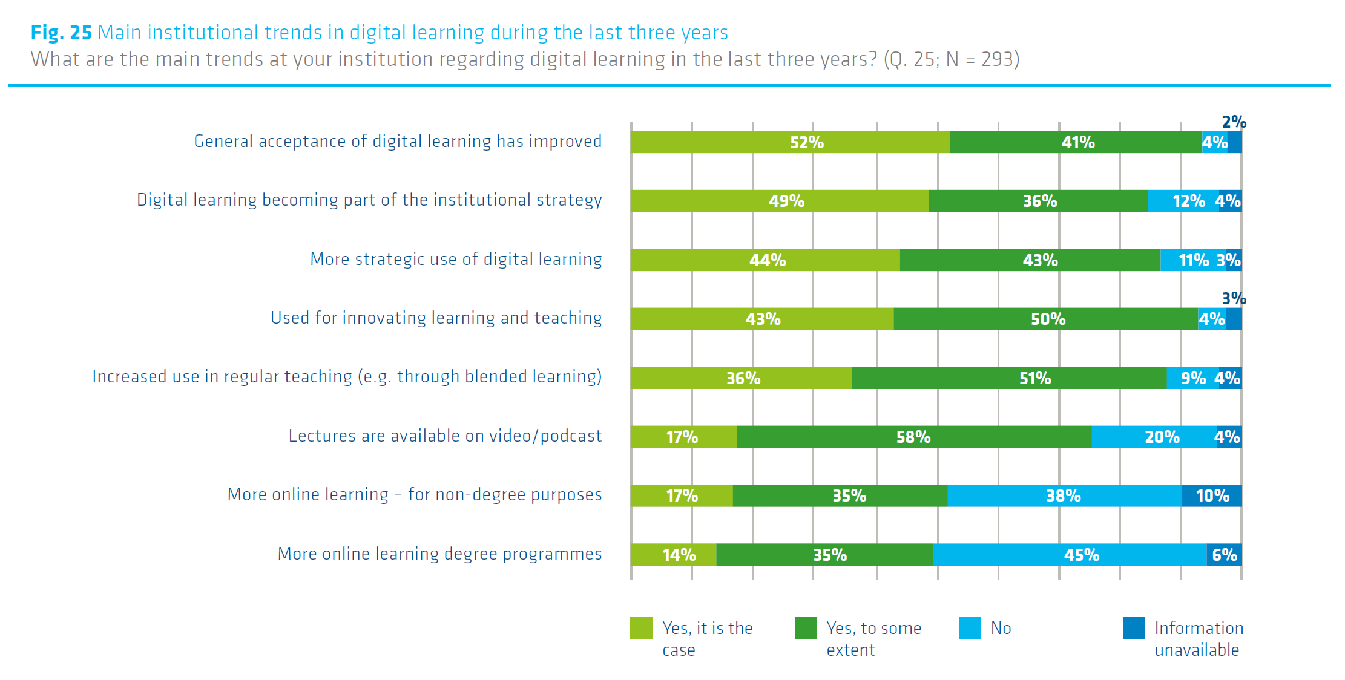
E-LEARNING IN EUROPE
https://eua.eu/downloads/publications/trends-2018-learning-and-teaching-in-the-european-higher-education-area.pdf

Slide 6
E-LEARNING IN EUROPE
http://www.ehea.info/media.ehea.info/file/2018_Paris/77/1/EHEAParis2018_Communique_final_952771.pdf

Slide 7
WHAT’S FIRST?
Learning
Technology
SCL
1st
2nd

Slide 8
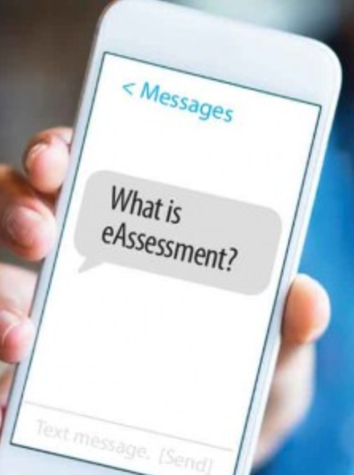
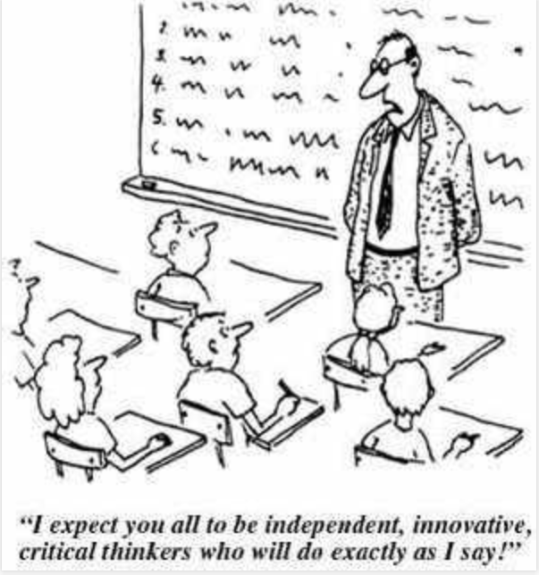
E-ASSESSMENT DEFINITION
Methods and practices that utilise digital technologies in order to measure, evaluate and support learners’ learning.
Mobilis in Mobili Blog.
http://maggiese-learningreflections.blogspot.com/2012/03/teacher-centered-vs-learner-centered.html

Slide 9
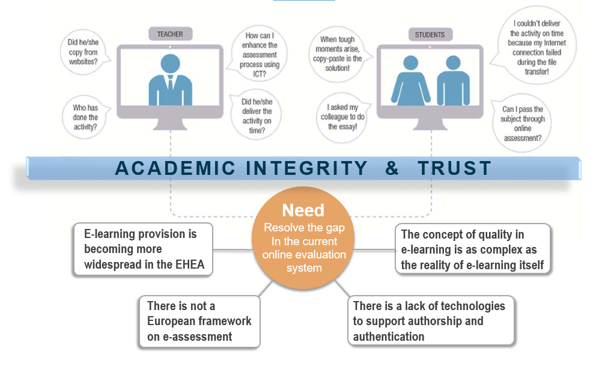
TeSLA PROJECT

Slide 10
TeSLA PROJECT GOALS
Define and develop an e-assessment system, which ensures learners authentication and authorship in online and blended learning environments while avoiding the time and physical space limitations imposed by face-to-face examination.
Support any e-assessment model (formative, summative and continuous) covering teaching and learning processes as well as QA aspects, privacy and ethical issues, and technological requirements.
http://tesla-project.eu/

Slide 11
CONSORTIUM
18 Partners
8 Universities
3 QA bodies
4 Research Centers
3 Enterprises

Slide 12
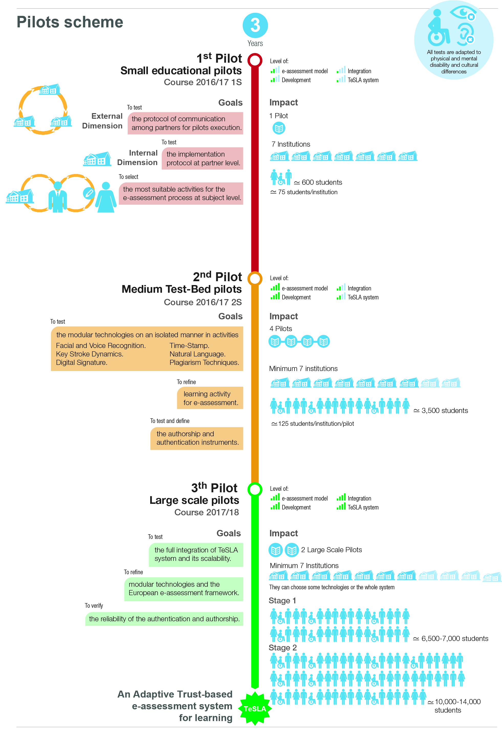
METHODOLOGY

Slide 13
TeSLA INSTRUMENTS
DOCUMENT ANALYSIS
Involves the analysis of written material using a qualitative analysis package that describes discourse and its interpretation
BIOMETRICS
Allow the clear identification of humans based on some specific physical characteristics or special behaviour
SECURITY TECHNIQUES
Deploy a security service provided by a layer of communicating systems
AUTHORSHIP
Plagiarism tools
AUTHENTICATION
Facial recognition
CONFIDENCE
Timestamp
Analyses written material and detects similarities among various written documents
Analyses facial expressions in two stages: facial detection and recognition
Generates a sequence of encoded information identifying when an event is recorded
Forensic analysis
Voice recognition
Digital signature
Determines the authorship verification and authorship attribution of written documents based on the comparison of current documents with stored data
State-of-the-art audio description method. Speaker segmentation and cluster grouping
Guarantees the authenticity
of a digital message or document by
a mathematical scheme
Keystroke dynamics
Measures how the user writes in regards to pressure and time-based measuring

Slide 14
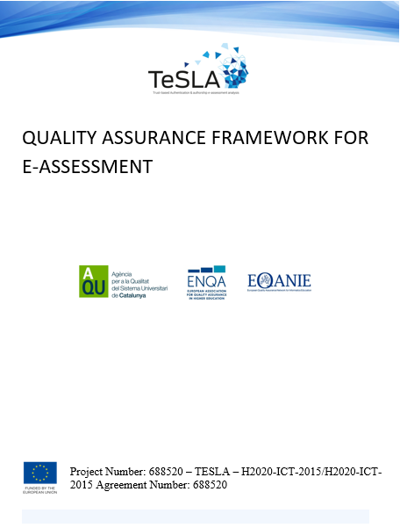
QA FRAMEWORK OF E-ASSESSMENT
QUALITY ASSURANCE FRAMEWORK OF E-ASSESSMENT

Slide 15
QA FRAMEWORK OF E-ASSESSMENT
STANDARDS
Policies, structures, processes for QA of e-assessment
Assessment of learning
Authenticity and authorship
Infrastructure and resources*
Learner support
Teaching staff
Learning analytics*
Public information*
INDICATORS
EVIDENCE

Slide 16
External experts analyse e-assessment practices, based on QA framework of e-assessment.
External evaluation 7 pilot universities (site visit).
Review reports: - Good practices. - Areas for improvement.
QA FRAMEWORK APPLICATION
A TOTAL OF 102 RECOMMENDATIONS

Slide 17
RATING OF RECOMMENDATIONS
Not at all easy
Not very easy
Somewhat easy
Very easy
EFFORT
1
2
3
4
Not at all useful
Somewhat useful
Very useful
Not very useful
USEFULNESS

Slide 18
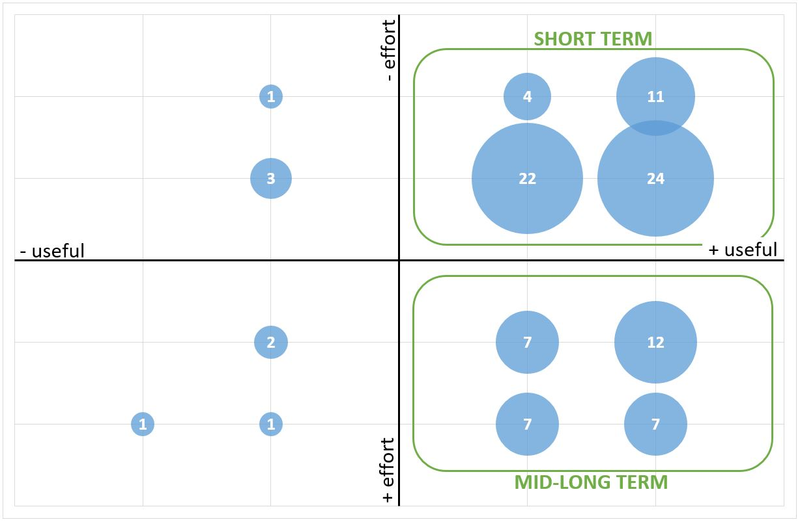
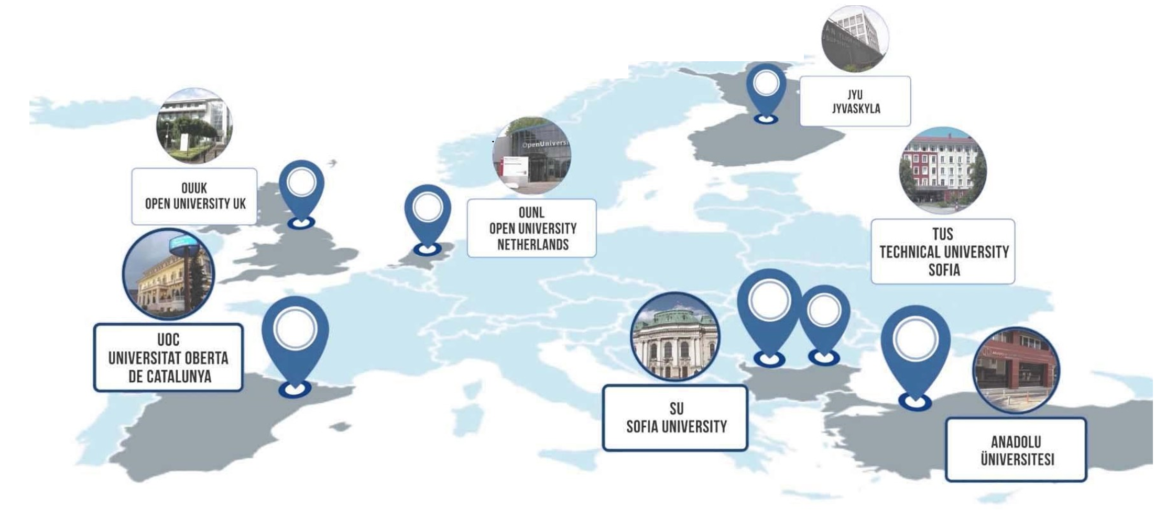
CLASSIFICATION OF RECOMMENDATIONS
TOTAL RECOMMENDATIONS: 102
Short-term application: 61
Mid-long-term application: 33
Not applicable: 8

Slide 19
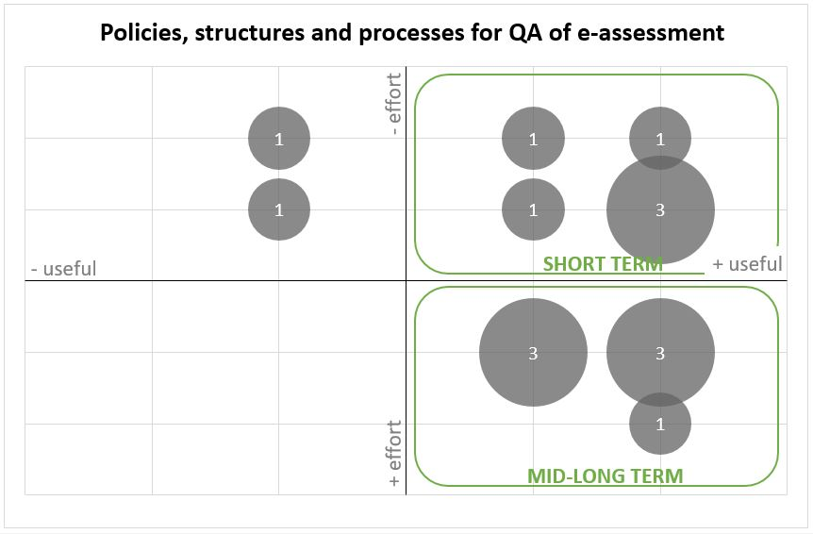
RESULTS
1. Policies, structures, processes and resources for qa of e-assessment
Two different scenarios in regard to e-assessment policies:
e-assessment is permitted.
e-assessment is not permitted.
All HEIs have well defined policies and processes for QA procedures in place (general purposes).
Traditional universities that have recently included blended and online provisions should develop specific policies on e-learning and e-assessment.
New ethical and legal issues, national and European regulations, need to be revised and updated.
The institution has appropriate policies, structures, processes and resources to ensure that e-assessment conforms with ethical and legal considerations. Besides, the proposal for the e-assessment is aligned with the pedagogical model of the institution and ensures the constant achievement of its objectives.

Slide 20
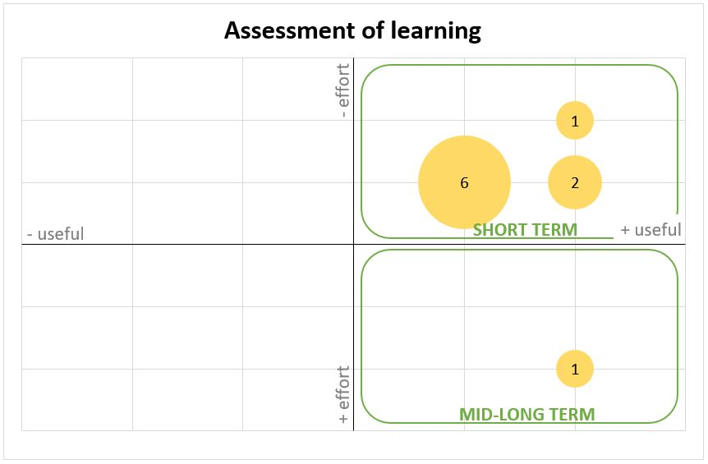
RESULTS
2. Assessment of learning
E-assessment methods are varied, facilitate pedagogical innovation and determine rigorously the level of achievement of learning outcomes. They are designed to assure a timely and fair assessment of learning. As such, they are consistent with learning activities and resources. Digital assessment should also promote the participation of learners and adapt to their diversity as well as of educational models.
Diversity of assessment methods is applied in all HEIs (SCL).
HEIs offer diversified methodology for assessing SEND learner (SCL).
Chosen assessment methods are aligned with learning outcomes.

Slide 21
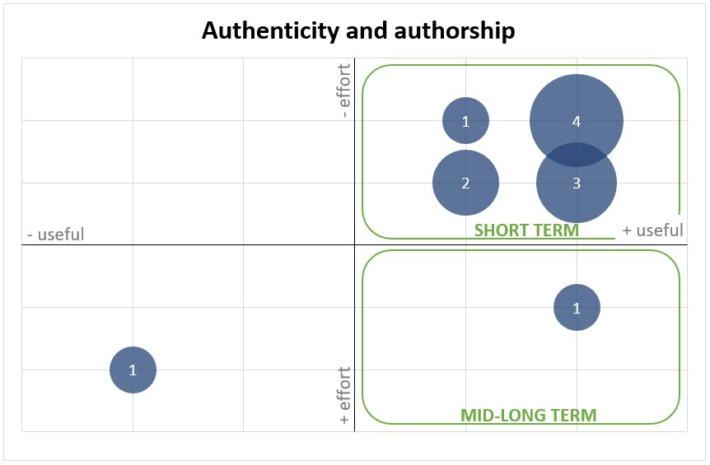
RESULTS
3. Authenticity and authorship
The development and implementation of the e-assessment include protective measures that guarantee learner authentication and work authorship. The e-assessment system is secure and fit for purpose.
All HEIs address academic integrity issues (plagiarism). However, they need to define the threshold level of normal behaviour vs. suspicious behaviour.
Learners need to be provided with enough information to be confident enough to share personal data.
Implementation of a full register of external attacks and technical problems needs.

Slide 22
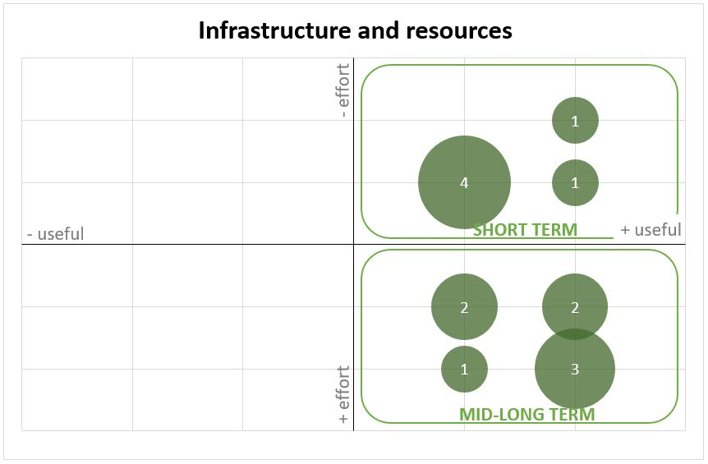
RESULTS
4. Infrastructure and resources
The institution utilises the appropriate technologies that the learning expectations, and enhance and expand learning opportunities.
Different VLE are used by HEIs.
HEIs should have centralized technical support in place (ticketing system, guidance and procedures for technical staff…).
HEIs should collect feedback from all key stakeholders on the use of the VLE.

Slide 23
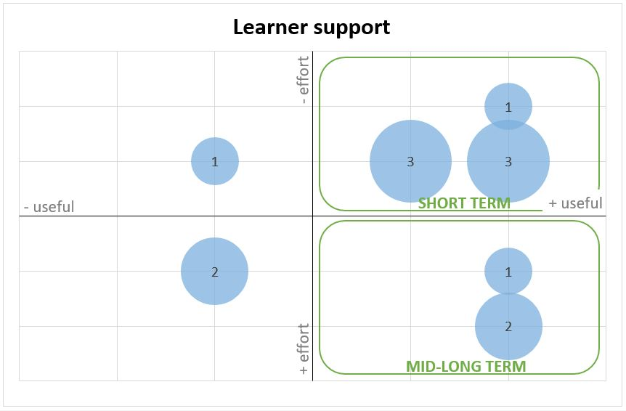
RESULTS
5. Learner support
All HEIs have well-established support mechanisms to meet all learners needs (administrative, technical and pedagogical).
SEND learner receive an appropriate and wider range of support.
Learners should be provided with technical guidance.
Learner’s feedback need to be revised and redesigned (when necessary) in order to improve support services.
Learners are aware, have access to and use effective and well-resourced support services for counselling, orientation, tutoring and facilitation in order to increase retention and success. Learner support covers pedagogical, technological and administrative related needs and is part of established institutional policies and strategies.

Slide 24
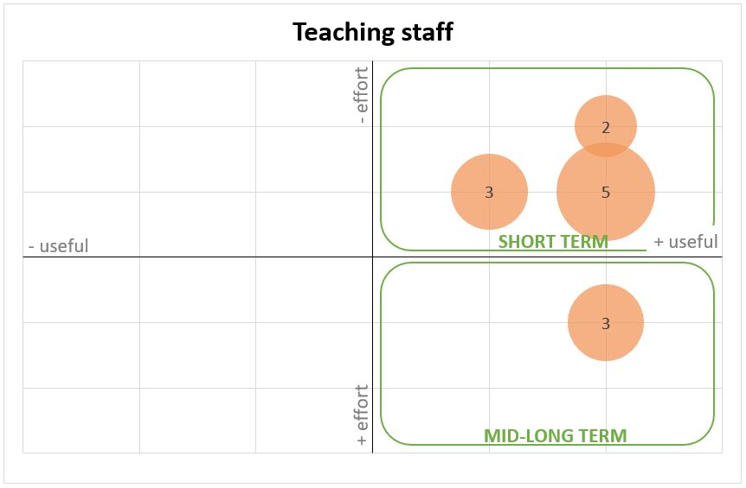
RESULTS
6. Teaching staff
Teaching staff are skilled and well-supported in relation to technological and pedagogical requirements and e-assessment methods.
Teaching staff should be trained on the innovation of the pedagogical practices (including e-assessment) and should receive technical training.
Teaching staff should be provided with updated information, guidelines and well-defined procedures to deal with the academic integrity and the implementation of a new assessment system.
Procedures for the evaluation of teaching staff feedback should be in place.

Slide 25
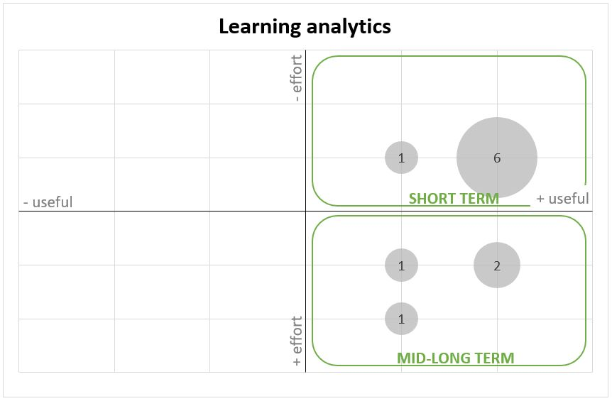
RESULTS
7. Learning analytics
The institution has an information management system (IMS) that enables agile, complete and representative collection of data and indicators derived from all aspects related to e-assessment methodology and authenticity and authorship technologies.
All HEIs agree on the potentiality and value of having an IMS in place for the improvement of the learning process.
HEIs need to enhance an IMS for the systematic collection of data related to the QA of e-assessment.
HEIs should clearly define the process around the use and analysis of personal data (build trust).

Slide 26
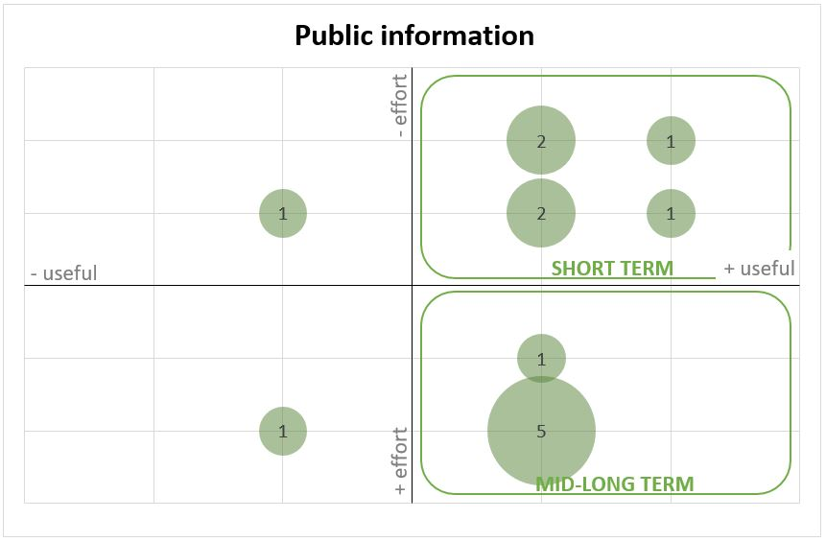
RESULTS
8. Public information
All HEIs have well-established systems and accurate information available.
HEI websites are:
student-oriented;
easy to navigate;
structured based on the needs and requirements of users.
and provide transparent information on:
how new technologies for assessment ensure fair and correct results;
software and hardware requirements.
The institution appropriately informs all stakeholders of e-assessment methods and resource requirements. Learners should be made aware of the hardware requirements and learning resources technology and technical support provision.

Slide 27
The framework has been proven to be useful for the enhancement of QA in HEIs that implement e-assessment.
E-assessment should be perceived from a holistic approach. Review procedures should analyse how each HEI integrates e-assessment within its teaching and learning process and organizational culture.
Fully online universities comply with most of the elements included in the framework, while traditional universities offering distance education should take into consideration the elements included in the framework.
Further development is needed from HEIs towards the implementation of e-assessment.
CONCLUSIONS

Slide 28
THANK YOU FOR YOUR ATTENTION
Esther Huertas (AQU Catalunya): ehuertashidalgo@aqu.cat
Maria Kelo (ENQA); Roger Roca (AQU Catalunya); Paula Ranne (ENQA); Anaïs Gourdin (ENQA); Martin Foerster (EQANIE)
ACKNOWLEDGEMENTS This work is funded by the TeSLA project (Grant Agreement Number: 688520 – TeSLA – H2020-ICT-2015/H2020-ICT-2015).Thanks are also given to head panel members: António Teixeira (Universidade Aberta, Portugal), Stephen Jackson (Assessment, Research & Evaluation Associates Ltd, United Kingdom), Esther Andrés (ISDEFE, Spain), Inguna Blese (University of Latvia, Latvia)

