Slide 1
Accreditation for Online Learning Programme (OLP)
INQAAHE Biennial Conference 2019
Quality Assurance, Qualifications, and Recognition: Fostering Trust in a Globalised World
New Technologies, Innovation and Quality Assurance
Ms Anne LAU
Registrar, HKCAAVQ
2019.3.26

Slide 2
Definition of OLP
Approach of OLP Accreditation
Important Considerations
Way Forward

Slide 3
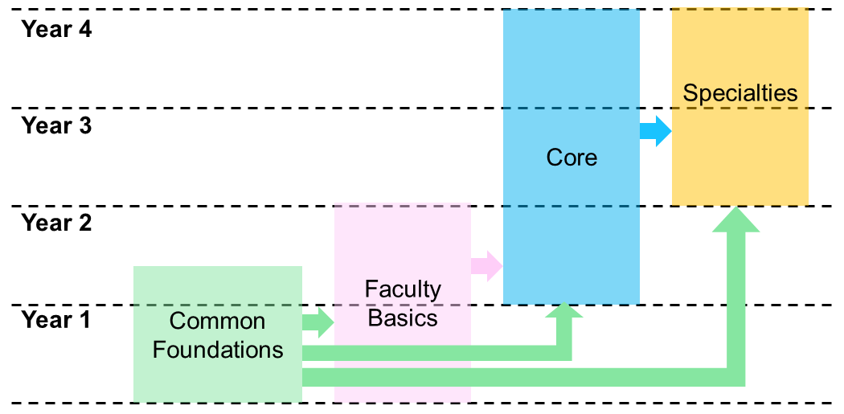
Definition of OLP
“Online delivery is defined as delivery that is enhanced by the use of technology and is delivered through a digital learning platform to provide structured teaching, learning and assessment. Learning programmes with more than 50% of instruction delivered online will be accredited with reference to the additional evidence requirements.”
structured teaching, learning and assessment

Slide 4
Definition of OLP
“Online delivery is defined as delivery that is enhanced by the use of technology and is delivered through a digital learning platform to provide structured teaching, learning and assessment. Learning programmes with more than 50% of instruction delivered online will be accredited with reference to the additional evidence requirements.”
delivered through a digital learning platform

Slide 5
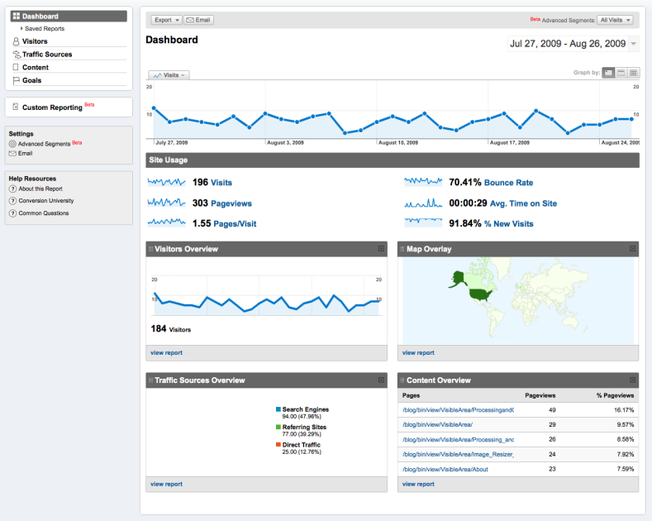
Definition of OLP
“Online delivery is defined as delivery that is enhanced by the use of technology and is delivered through a digital learning platform to provide structured teaching, learning and assessment. Learning programmes with more than 50% of instruction delivered online will be accredited with reference to the additional evidence requirements.”
enhanced by use of technology

Slide 6
Definition of OLP
“Online delivery is defined as delivery that is enhanced by the use of technology and is delivered through a digital learning platform to provide structured teaching, learning and assessment. Learning programmes with more than 50% of instruction delivered online will be accredited with reference to the additional evidence requirements.”
more than 50% of instruction delivered online

Slide 7
Definition of OLP
“Online delivery is defined as delivery that is enhanced by the use of technology and is delivered through a digital learning platform to provide structured teaching, learning and assessment. Learning programmes with more than 50% of instruction delivered online will be accredited with reference to the additional evidence requirements.”

Slide 8
Approach of OLP Accreditation
Eligibility
Common Standards
Outcome-based
Different Learning, Teaching & Assessment
Different Evidence
OLP

Slide 9
1. Eligibility Requirement
demonstrated competence in operating recognised programme
Non-local institution
Recognsed status in home country
Local institution
At least ONE accredited programme recognised under HKQF

Slide 10
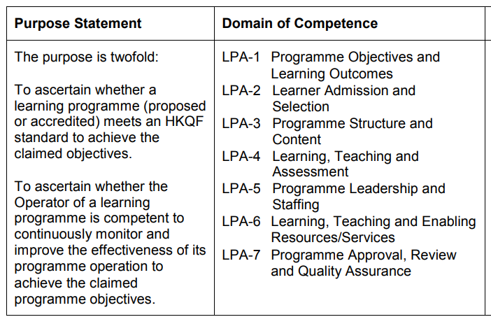
2. One Common Set of Accreditation Standards

Slide 11
3. Outcome-based Approach
Organisational Outcomes
Mission & Vision
KPI
Programme Outcomes
Graduate Articulations
Stakeholder Feedback
Learner Outcomes
Assessment Results
Programme Completion

Slide 12
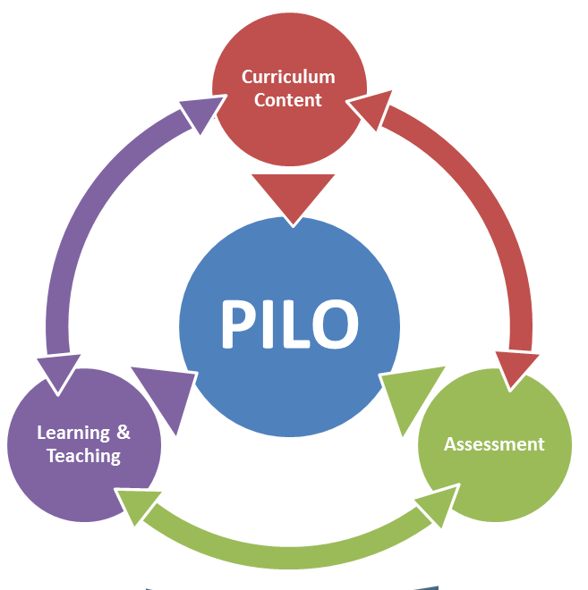
4. Different Learning, Teaching and Assessment
“Online delivery is defined as delivery that is enhanced by the use of technology and is delivered through a digital learning platform to provide structured teaching, learning and assessment. Learning programmes with more than 50% of instruction delivered online will be accredited with reference to the additional evidence requirements.”
Support
Investment in IT infrastructure
Resolving OLP-specific issues
Accessibility
Time zone differences
Technical support
Timely feedback
PILO – Programme Intended Learning Outcomes

Slide 13
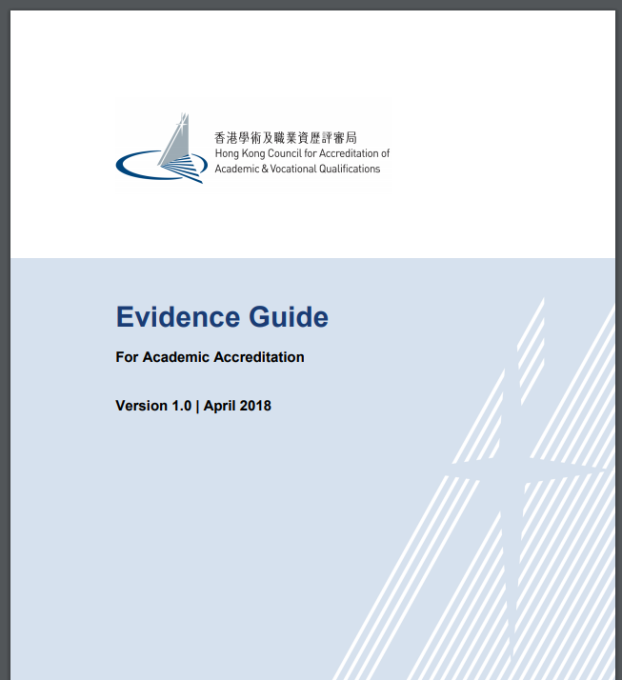
5. Different Evidence Requirements

Slide 14
Important Considerations for OLP
Organisational Level
Clearly defined and appropriate education objectives.
OLP development as one of the strategic goals supported by top-down policies and procedures.
Programme Level
Learning, teaching and assessment activities effective in delivering content and assessing attainment of intended learning outcomes.
Qualified teaching staff well equipped with pedagogies for online teaching.
Clear targets and milestones.
…
Effective Learning Management System.
…

Slide 15
Way Forward
OLP Service Launched
Market Demand Survey
Briefing and Workshop
Collective Exercises
April 2018
July - August 2018
October 2018
January 2019
November 2019
March 2020

Slide 16
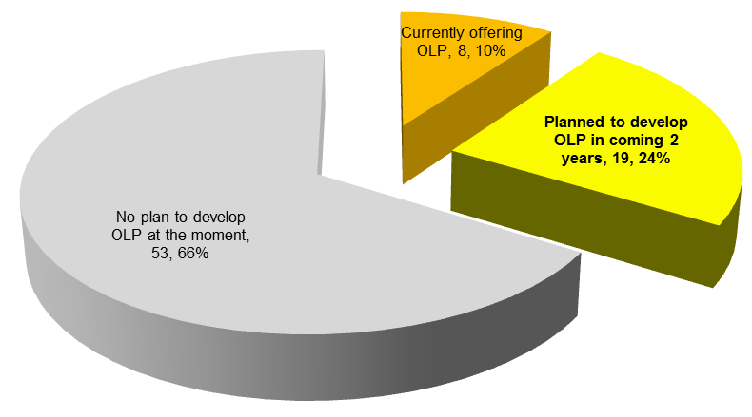
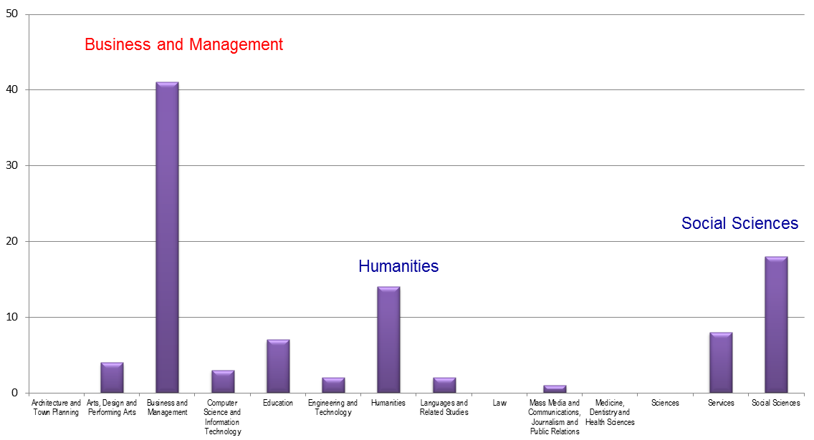
Market Demand Survey

Slide 17
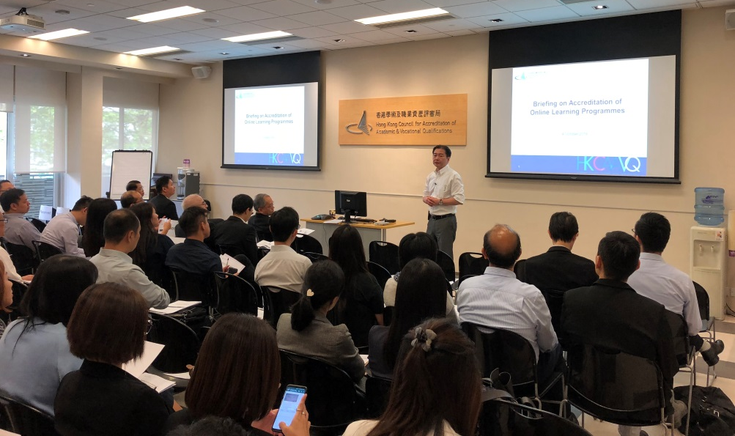
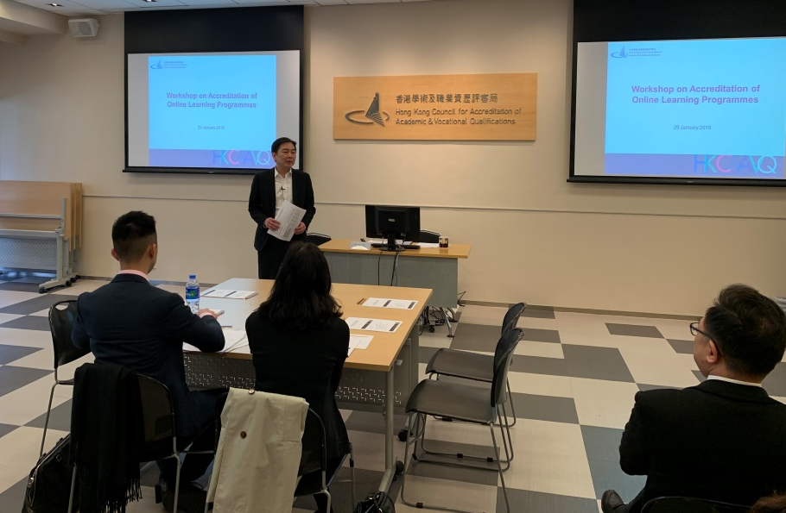
Briefing and Workshop on OLP
Briefing in November 2018
66 participants 40 institutions
Workshop in January 2019
19 participants 8 institutions

Slide 18
Collective Accreditation Exercises
Collective Exercise
Similar Nature
Focused & Efficient
Timely Advice
Clear Timelines
One Panel
Generate & Share Knowledge of OLP Accreditation
Explore Innovative Arrangements
Video conference → Site visit
…

Slide 19
OLP Accreditation A Learning Process

Slide 20
Thank You
Anne LAU
 annelau@hkcaavq.edu.hk
Copyright 2019 © HKCAAVQ.
All Rights Reserved.
The copyright of this presentation (printed and electronic) belongs to HKCAAVQ and that any use of the printed materials in full or in part must be under prior written consent by HKCAAVQ and with clear reference made to HKCAAVQ as the material source.

