Slide 1

Sub theme 3:
Ensuring and Promoting
Trust in a Globalized Context

Slide 2

Inclusion of International Reviewers
in
Institutional Reviews to Promote Trust
in
External Quality Assurance
Deepthi C. Bandara and Jianxin Zhang
Quality Assurance Council, University Grants Commission, Sri Lanka
Yunnan Higher Education Evaluation Center (YHEEC), China

Slide 3
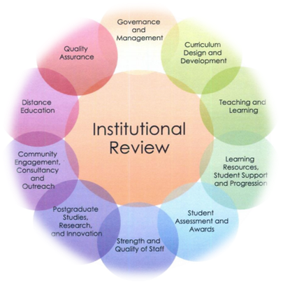
Institutional Review (IR) in Sri Lanka
Background of QA system in Sri Lanka
One QA system operational for the Sri Lankan State Universities
under the aegis of the Quality Assurance Council (QAC) of the University Grants Commission (UGC)
an External Quality Assurance (EQA) system and the Internal Quality Assurance (IQA) system in each University
work in tandem

Slide 4


Slide 5

Summary of the First Cycle of IR
Institutional reviews (IR) was initiated in 2006
first cycle was completed with reviewer panels comprising totally of local reviewers
a guideline manual for the reviewers which evaluated Universities on 8 criteria

Slide 6

II. New initiative in Second Cycle: Inclusion of International Reviewers
Rationale:
It is imperative that tertiary education provision and its quality assurance is an essential commodity to be ensured by any country that is aspiring to be in the global arena of higher education

Slide 7



UGC- the apex body in providing higher education and maintaining standards through its QAC
created a new dimension to the external quality assurance mechanism in its second cycle of IRs of Universities
inclusion of an international reviewer to each reviewer panel

Slide 8

Objectives of this initiative
to promote trust through transparency
enhance credibility and scope of the review
be accountable to all stakeholders in higher education

Slide 9
all local reviewers were professors and senior professors in the State University system
had required credentials and experience to serve in the review panel
QAC belief- inclusion of an international reviewer would heighten the trust of stakeholders in the IR which is conducted in a 6-year cycle.

Slide 10

in 2018,
two international reviewers successfully participated in 2 review panels of the IR of two of the State Universities
together with the local reviewers in the panels

Slide 11

Methodology
All reviewers (local and international) provided with a self- evaluation report
submitted by the University to be reviewed written by them according to specific guidelines
All reviewers used the “Manual for Institutional Review of Universities and Higher Education Institutes in Sri Lanka”
submitted an individual desk evaluation report on a template provided by the QAC for this purpose
Proceeding to the respective sites
evaluation was on 10 criteria
site evaluation was conducted under the guidance of the review panel chairman
the self- evaluation report submitted by the University on which the desk evaluation was done was validated by observing evidence provided by the University
total site visit - six days

Slide 13

III. Advantages of Inclusion of International Reviewers

Slide 14

Sri Lanka being a small island nation- academics serving as reviewers are known to each other well
this initiative was hoped to eliminate even the smallest bias in judgments
build sustainable stakeholder relationships while developing partnerships and working together
in the important endeavor of providing higher education of acceptable international quality to students of diverse backgrounds and varied expectations

Slide 15

the expertise and experience of the international reviewers would assist to conduct the review more objectively since they would be reviewing a system which was less known to them but one where they were yet able to practice the fundamental principles of quality assurance

Slide 16

the international reviewers (from China and Russia) could share their experiences as reviewers from countries where the QA mechanism has advanced to a stage higher than in Sri Lanka

Slide 17

Documents
provided the QAC, local reviewers and reviewed University to gain insight in to their views/comments on the types of documents that were expected to be shown
- their appropriateness, and potential documents that could be provided for each criterion and the standards therein

Slide 18

Stakeholder meetings
review schedule included meetings with all potential stakeholders of the University and the visiting of University facilities which enabled it to serve as a higher education provider for the State
- provide feedback on the adequacy of manner in which the meetings were conducted –in order to obtain the “real picture” of the situation of the myriad of aspects that contribute to a total educational experience of students

Slide 19
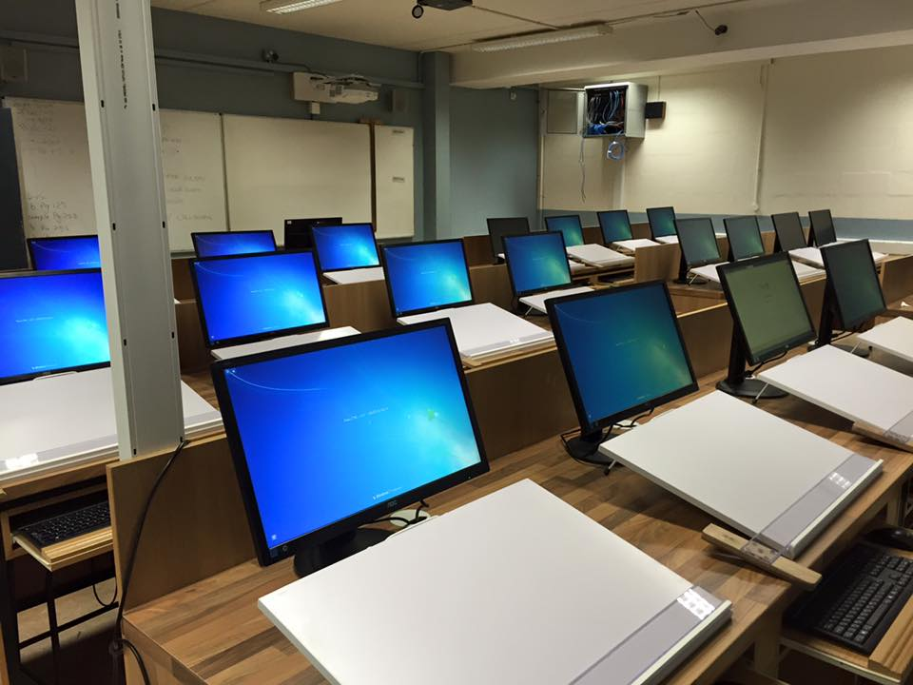
Facilities
observation of facilities for teaching/learning/assessment-
gave them opportunity to express their view on possible interventions that could be made to “modernize” learner and outcome based education with new technology

Slide 20

QA mechanisms in other countries
provide the QAC, local reviewers and the reviewed University the opportunity to gain valuable insight regarding QA mechanisms in other countries
this opportunity to the
administrative hierarchy
academics
support staff
alumni
industry partners
students –the primary beneficiaries of QA reviews

Slide 21

Exchange of knowledge
provided exchange of knowledge regarding
international benchmarks
qualification frameworks
codes of practices
constructive mechanisms for the function of internal quality assurance units of Universities

Slide 22

Recommendations
Effective communication of the review team members
eventful site-visit program
an impressive list of documents provided by the University
strong internal quality system which is incorporated via IQAUs and IQACs at each faculty of the University were worthwhile attributes noted by the international reviewers which allowed to carry out a profound review
formulate a list of recommendations
helpful for the further enhancement of the University and strengthen its reputation locally and abroad

Slide 23

IV. Challenges of International Reviewers

Slide 24

Context and Culture Specificity
Stakeholder engagement like many other aspects of education and quality assurance is context and culture specific

Slide 25

Reviewer Profile
extreme care had to be exercised in the selection of international reviewers who had to be experts in evaluation of Universities/Institutes
appreciated the diversity of students and staff and respected the values and norms of the culture and country at large
profile had to be made available to the university to be reviewed in order to maintain transparency and request their acceptance
cost of having institutional reviewers is significant and has to be justifiable

Slide 26

Survey
conducted with
local reviewers
international reviewers
reviewed Universities of this review cycle

Slide 27

Beneficial aspects of inclusion of international reviewers
University education must have universal standards. If the Institutional review (IR) committee comprises only local members no comparison could be done with other universities in the world
Foreign members invited for the IR review panels are conversant with quality assurance processes of their own country. The feedback for the improvement of quality assurance process itself and best practices are also important for the improvement of the quality

Slide 28

Future trends in higher education are dynamic and recommendations for new directions for development of programs or orientation of existing programs are important to improve competitiveness of our programs.
Therefore, external feedback from foreign expertise is gainful.
Experienced international reviewers help to build the confidence in the evaluation team by the university been evaluated. They lack any personal prejudice and hence they are most welcome by the University being reviewed

Slide 29

It also blends the international level quality expectation in to local reviews and improves the quality of local reviewers by -sharing international expectations with respect to local standards
Since the international reviewers do not know the local context adequately they would be able to provide input in comparison with good universities overseas

Slide 30

Aspects of concern to be considered in future
When the team comprises 5 local to 1 international-possibility that the opinions of the visitor is not well heard, especially since a majority of the team experienced persons
arrival of the international reviewers very close to the site visit and driven straight to the University under review, gives them minimal time and inadequate information to understand the local context

Slide 31

The views of the visitor may be important to have in a reviewer training also. Hearing views from a couple of international expert reviewers would be useful
If our standards are good, this will be a good medium of propaganda

Slide 32
There should be discussions between local IR panel and the foreign expert before commencing the site visit process during the desk review time.
Otherwise, it makes them depend on what the other reviewers inform them and hence guided by them rather than they be able to guide the locals in situations where their expertise would be important
The persons should be well aware of the system operative in Sri Lanka and possess adequate experience in relation to international reviews.

Slide 33
However, it is very important to select and appoint experienced and flexible reviewers, who would not try to impose or dominate

Slide 34

V. Solutions and Way Forward
The QAC would continue to include international reviewers in future IRs too considering the positive responses received from local reviewers and reviewed Universities
QAC should maintain a database of such reviewers who are willing to and work in Sri Lanka at a reasonable honorarium

Slide 35

VI. Conclusion
In an era where student mobility in higher education is ever increasing and recognition of qualifications and benchmarks have to go global, the QAC sincerely believe that this initiative marked an important milestone in QA of higher education in Sri Lanka and that it would also be an incentive to other nations who have yet not embarked on internationalizing their external review process so that trust could be ensured and promoted in a globalized context

