Slide 1
The new student management system and quality assurance at Pacific Adventist University: trials and triumphs
INQAAHE 15th Biennial Conference 2019, Sri Lanka: Quality Assurance, Qualifications and Recognition: Fostering Trust in a Globalised World.
Daphne Oevi-Artango
Academic Quality Assurance Manager

Slide 2
Outline
Context
University10 ecosystem
Trials
Triumphs
Conclusion

Slide 3
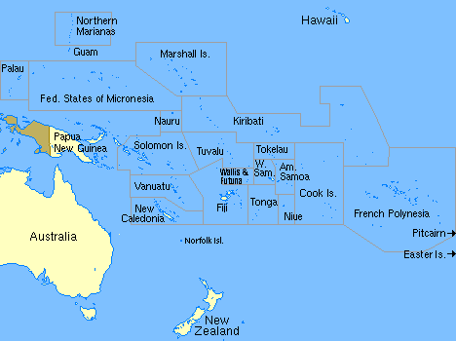

Slide 4

Notes:
Campuses: Koiari Park, Atoifi Campus – Solomon Islands, Fulton University College in Fiji
Affiliated Institutions: Sonoma Adventist College & Enga College of Nursing

Slide 6

Notes:
Location
Establishment
Is the one of the 2 faith-based universities in PNG plus 4 state-owned universities.

Slide 7

Notes:
Adventist Christian education: ethos and philosophy
Capacity Training Program
Bird Sanctuary
4 Schools

Slide 8




Notes:
Diversity of cultures: staff & students
Spiritual emphasis in all areas of life at PAU
Current enrolment: 1151

Slide 9

Notes:
BEST Graduates
Employment in the Church, government, NGOs and private sector all around the Pacific region
1984: graduated 25 students in the Theology and diploma programs
2018: graduated 201 students from the diploma, bachelor and postgraduate courses from the 4 Schools.

Slide 10
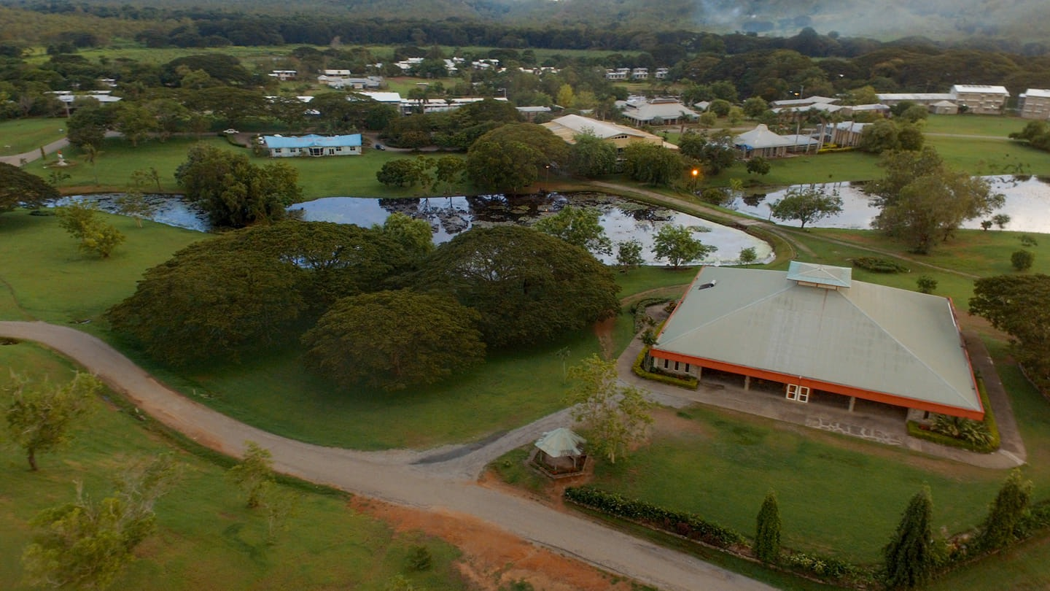
Notes:
While the discussions may seem nothing new to tertiary education institutions (TEIs) in developed countries with advanced technology and quality assurance systems, this is a milestone achievement for a privately-run university in a developing country and in a sector where the national government has since 2010 pushed the agenda of quality. Key principles applied to realise the importance of quality assurance in implementing the new software will conclude this paper.

Slide 11
Context: New Developments in 2017
Internal
Cyclical re-accreditation
Cyclical program review
Implementation of University10 (U10) and
Establishment of the Academic Quality Assurance Office
External
National directive to align all programs to the second edition of the PNG National Qualifications Framework (PNGNQF) and
National Online Selection & Application Systems (NOSS) (NOAS) for Grade 12 school leavers.
Notes:
1: Mapped the AAA 13 Standards against the 12 DHERST Standards for the visiting team to use to report against.
2: Aligned the undergraduate courses to the second edition of the PNGNQF
3: University10
Define ‘implementation’ – building the system to PAU’s context
4: AQAM took office in August 2017
5: NOSS

Slide 12
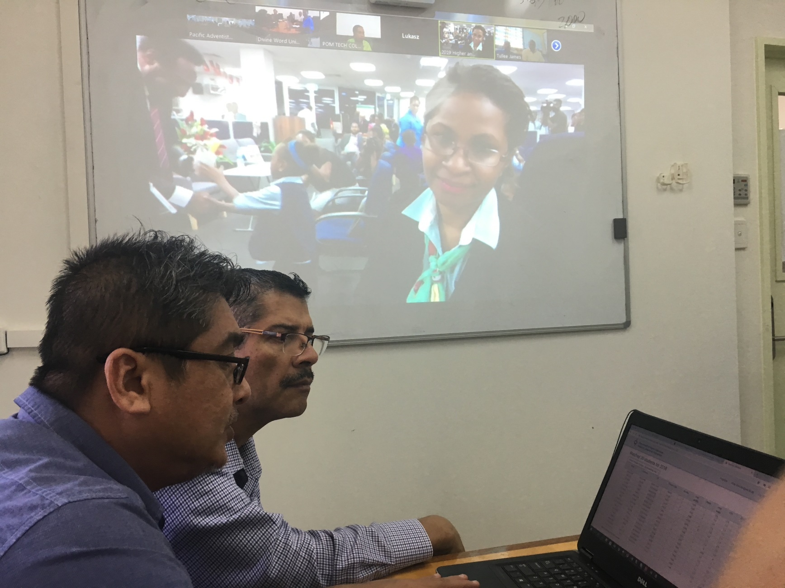
National Online Selection of Grade 12 School Leavers into tertiary institutions
Notes:
About 26000 plus Grade 12 school leavers were selected into the 187 programs; about 14000 plus meeting the entry requirements.
Improves efficiency and addresses many quality concerns.

Slide 13
University10 (U10) ecosystem
Dean’s Office
Dormitory10
Virtual Academy
Meals
Residence
Capacity Training Program
Student portal
Lecturer portal
Registration
Notes:
Minimum application server and WWW server: virtual machine. Dual-core processor 2.4 GHz, RAM 16 GB, free hard disc space 40 GB, two network card Ethernet 1000 Mbps, operating MS Windows Server 2008 Standard or higher
Supported database: Microsoft SQL Server 2012 or higher
The implementation process flowed as now information from PAU was provided to PCGA to build the various modules.
Meetings were held with the front-end users for each of the modules: responsibility, ownership, accountability, communication, mutual agreement, assessing the current processes to see how efficiency can be achieved in the new system, understand the relationship of their particular module to the others.
Modules were tested with feedback provided.
Deployment of the modules:
Registration – built specifically for PNG University
Dean’s Office –
Lecturer Portal
Student Portal
Meals – upgraded student ID card system
Template created to extract NOSS details and import directly into the DO.

Slide 14
Trials
Strategic but an ambitious move
Simultaneously building, trialling, using and improving
Quality concerns
Inconsistent and unstable network connection
Lack of communication and timely sharing of information with everyone
No prior training for key features for some modules.
Notes:
Simultaneously building, trialling, using and improving: priority features of the system
Disruptive technology: new ways of doing things that disrupt or overturn the traditional business methods and processes. Often has performance problems because it is new; appeals to a limited audience; yet to have a proven practical application
Quality concerns: implementing the new curriculum; limited access of DO to School Deans & Course Coordinators; very late issuing of the Semester 1 grades.
Training was done afterwards when there was time. Manuals were provided to the Lecturers to use to enter grades.

Slide 15
Triumphs
Greatly enhances the business processes at PAU, student management and administration.
Moved away from manual to online processing; less paper used during registration
Integration of existing software, Attaché & SALTO, NOSS
U10 now houses the programs aligned to the PNGNQF
Policy gaps were identified with measures put in place.
Notes:
The appointment of the AQAM as the project coordinator of University10 was strategic as the officer was active in the curriculum review processes and is well versed with the academic systems and processes, thus ensuring academic and student management requirements are applied into the system.
Policy gaps: Revised or new policies developed were benchmarked for comparability, consistency and credibility and factored into Uni10.
Integration: Existing software used in the different departments are integrated with Uni10 so that work is not duplicated and each system maintains a source of truth which is then shared with the other system.
NOSS & NOAS: Fortunately for PAU, the Uni10 developer is the same company that is working with the Department of Higher Education, Research, Science and Technology (DHEST) to implement the new Grade 12 National Online Application and Selection Systems (NOASS). Selections for the Grade 12 school leavers at the national level into PAU’s revised undergraduate courses is linked directly into University10. This has greatly improved the selection processes and addressees many quality concerns.

Slide 16
Conclusion
The key principles of: communication, responsibility, accountability, mutual agreements and internal reviews were necessary in the implementation of Universtiy10 and the revised curriculum.
Universtiy10 has slowly transformed the way PAU conducts its business processes.
Notes:
The key principles of communication, responsibility, accountability, mutual agreements and internal reviews are necessary in effectively rolling out new academic developments. University10 will transform the way PAU conducts its business processes but taking into account also the purposes of accountability and enhancement will create trust in PAU’s performance in implementing the new system and the revised curriculum. These can collectively contribute to quality assurance and enhancement at PAU.
Considering QA in the implementation of U10 and in the process, establishing the AQA system of PAU beginning with the basic processes to improve efficiency as well as reviewing policies to meet new developments and creating new policies and procedures to cover up the gaps.
Going forward:
Implementation of the D10 & Meals modules
Training for all the front-end users

Slide 17
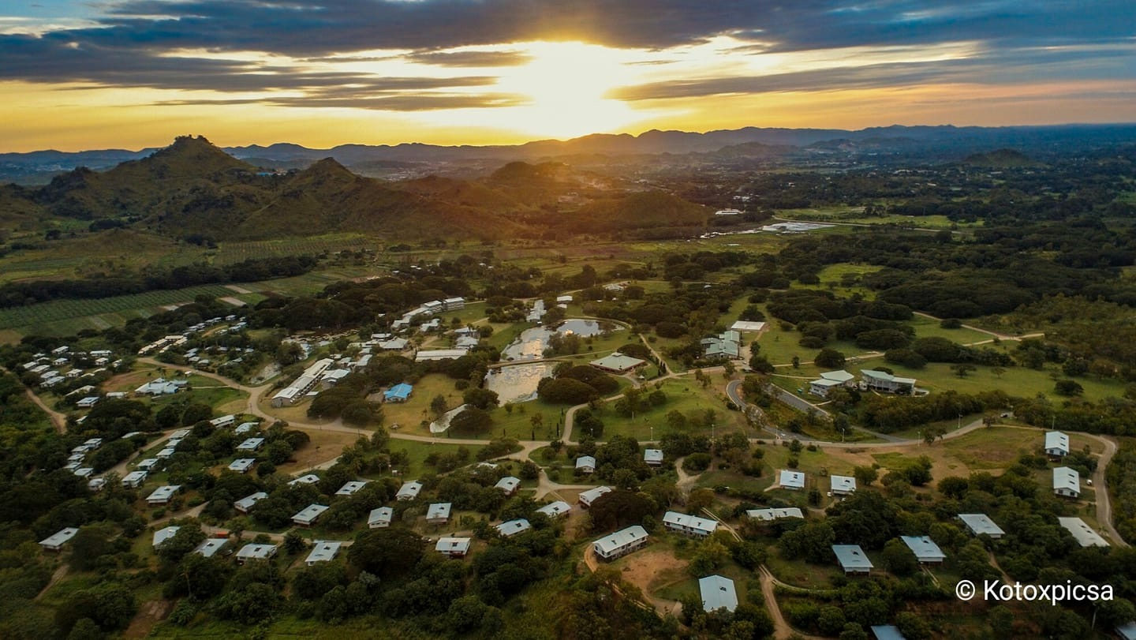
Thankyou
Notes:
A stone throw in the great Pacific ocean.
QA in the HE sector.
Importance of participating in the 2 QA conferences. Experiences gained and network established will assist PAU in its operations and will contribute to the QA development in the sector and even further, contribute to the development of the other Pacific Island countries through the graduates of PAU.
Thankyou.

