Slide 1
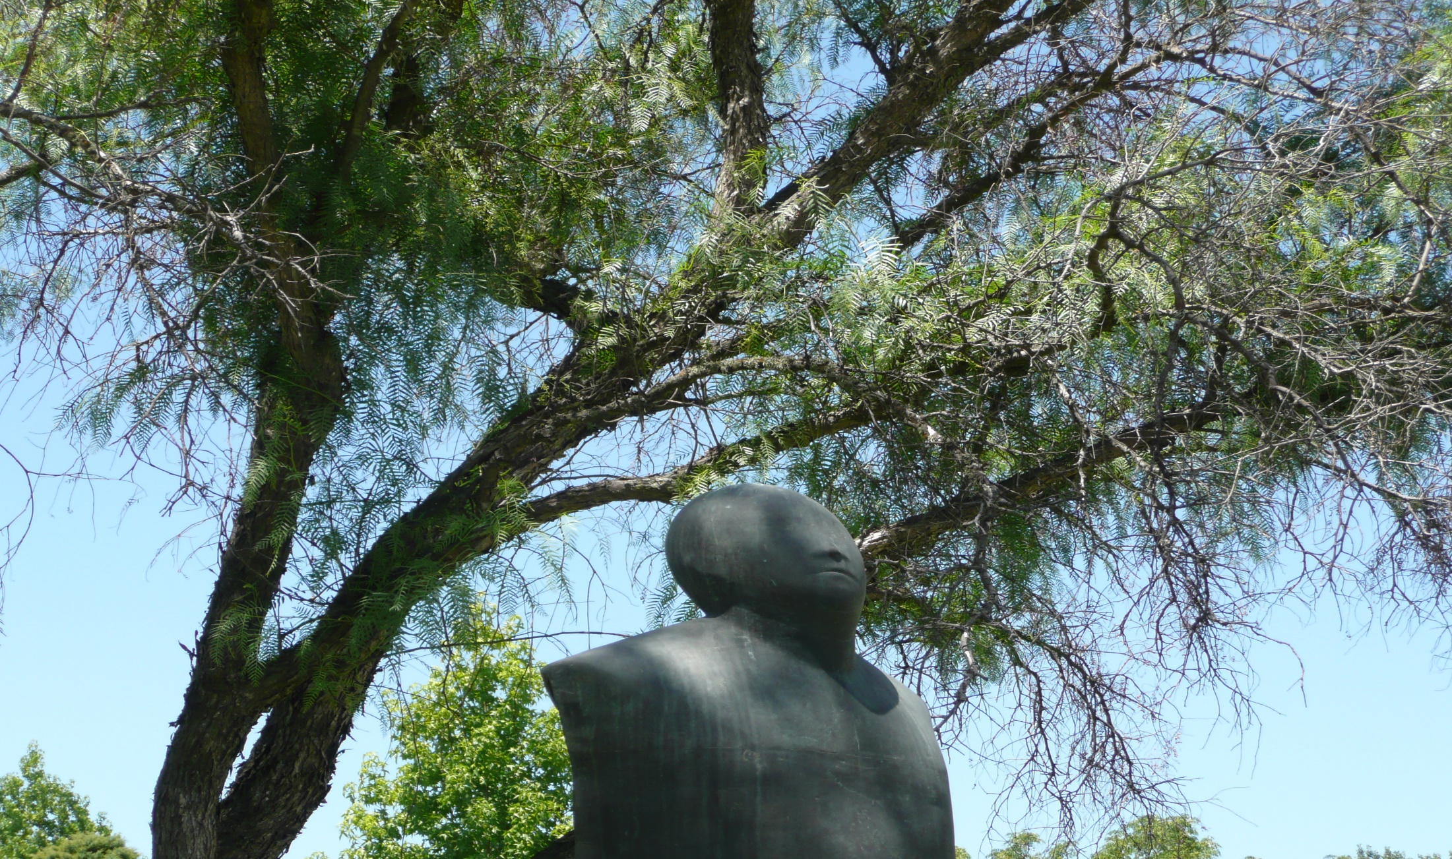
Recognition of Qualifications
in an International Perspective:
New Opportunities for Quality Assurance
UGC / INQAAHE, 26 March 2019

Slide 2
Outline
A Changing and Challenging World
The Rising Tide of Quality Assurance

Slide 3
Notes:
Massification
Today 207 million students world-wide, up from half that number in 2000

Slide 4
Internationalization
International students
2 m in 2000
5 m in 2016
Plus study abroad students
Foreign institutions / campuses

Slide 5
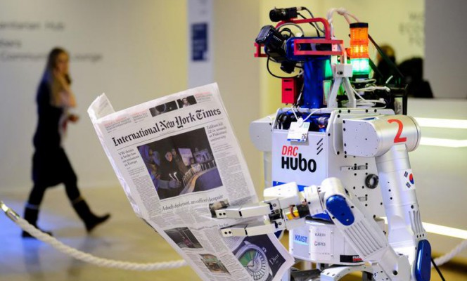

Slide 6
The future of jobs (labor markets in the digital era)
Jobs that disappear (700 professions)
New jobs

Slide 7
Jobs that did not exist 10 years ago
App developer
Social media manager / YouTube content creator
Digital risk manager
Smart city / smart building architect
Driver-less car engineer
Cloud computing specialist
Big data analyst
Sustainability manager
Drone operator

Slide 8
The future of jobs (labor markets in the digital era)
Jobs that disappear (700 professions)
New jobs
Jobs that are undergoing transformation (47%)

Slide 10
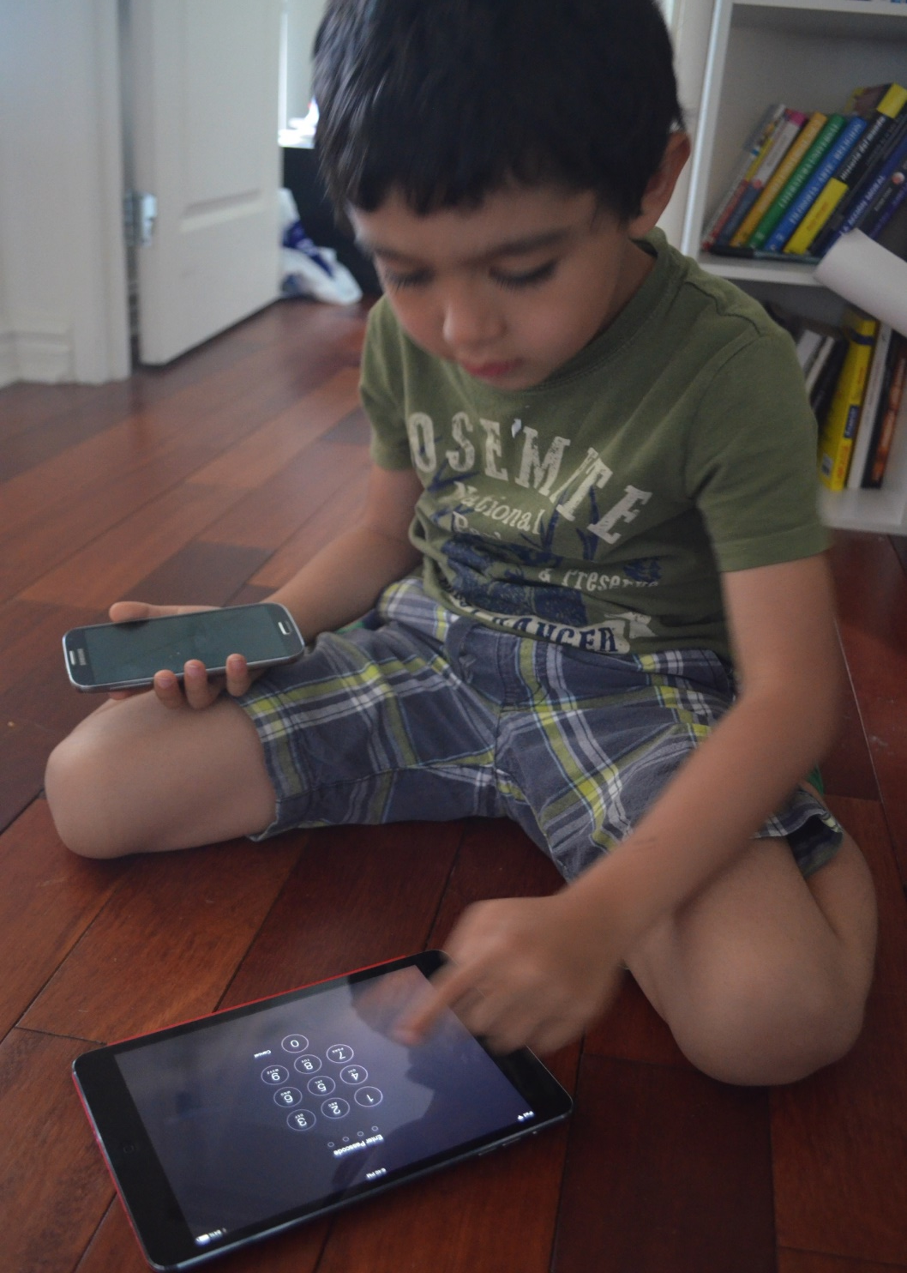
Profile of the learners
Notes:
Buildings are 19th century, teaching is 20th century, but students are in the 21st century,” as Sung Chull Lee, senior vice-president at South Korea’s Hanyang University, put it.
Conectados, expertos en uso de las nuevas tecnológias, curiosos
interacción

Slide 11
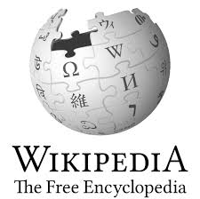
E-Generation

Slide 12
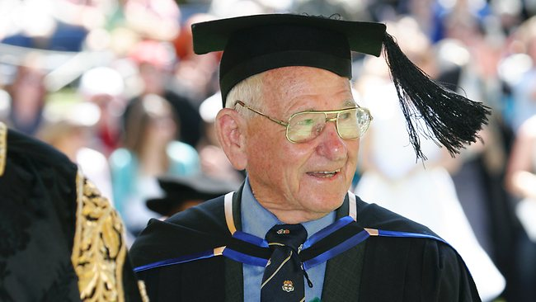
… hasta la sabiduria
Notes:
Aussie, 97, world's oldest graduate
AUSTRALIAN man Allan Stewart became the world's oldest graduate in 2006 at the age of 91. On Friday, he got his masters in clinical science at Southern Cross University.
Sign up for your free 2 month trial
"I have just been blessed with good genes," Stewart said.
The degree is his fourth.
"I think I can hang up my mortar board and academic robes after this one -- although I said that after my last degree, and then I got bored. I have so much time on my hands these days, and I like to keep mentally active," he added.
He got his degree in dentistry with honors at the University of Sydney in 1936 and a Doctor of Dental Surgery from Chicago's Northwestern University before practicing in Coonabarabran in regional New South Wales, in Sydney and in London.
Stewart got a law degree from Australia's University of New England in 2006.
Sonya Brownie, one of his supervisors during his two and a half year masters program, said he is a "living legend and such a tremendous inspiration to those who aspire to age well and pursue lifelong learning."
Brownie added, "His willingness to embrace new learning technologies, and his competency using different online learning applications, is truly incredible. It was not unusual for Allan to be the first student to register in the online discussion board forums or to Skype me to discuss something about the unit."
Stewart, whose masters is in complementary medicine, said, "I wanted to apply my knowledge in the area of healthy aging -- both for myself, my family and the wider community. People are always coming to me for advice on how to live longer and healthier lives, and now I feel I have some credibility in giving out that advice."

Slide 13
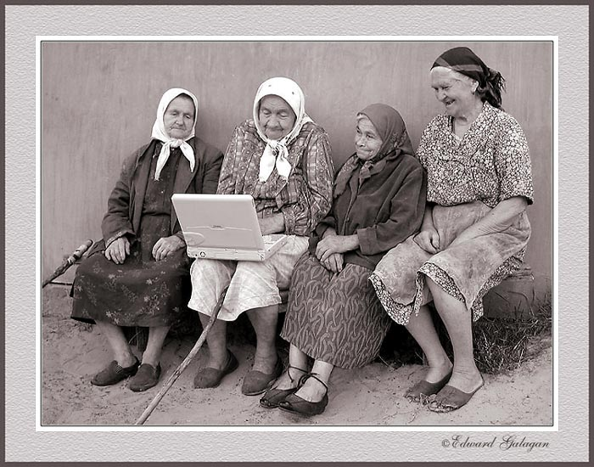

Slide 14
Curricular innovations
Problem-based / Design-based Learning (Maastricht, Roskilde, Aalborg)
Experiential learning (coop, service learning, simulations, role playing, learning games)
Multi-disciplinary programs
Amsterdam University College
U of Queensland School of Chemistry and Molecular Biosciences
Competency-based learning
Western Governors’ University
Notes:
Cooperative programs, service learning, simulations, role playing
(oportunidades para que los estudiantes tengan una carrera en ciencia con énfasis en artes/humanidades)

Slide 15
Pedagogical Innovations
E-learning / Self-learning (AI facilitated)
Peer learning (clickers, flipped classroom)
Team-based learning
Notes:
Moving from traditional teaching to active and intereactive learning

Slide 16
New Technologies
Computers and Internet
Artificial intelligence
Big Data
Blockchain
Virtual Reality / Augmented Reality
3-D Printing
Collaborative Platforms

Slide 17
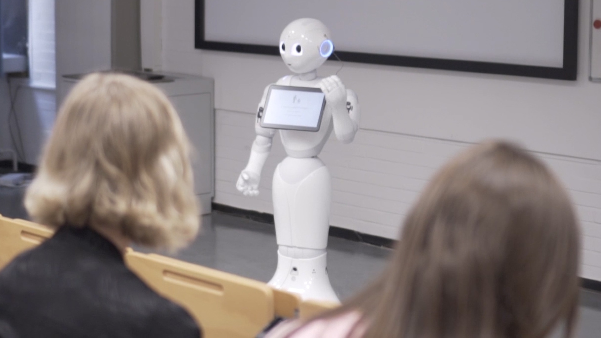
Notes:
U of Marburgd

Slide 18
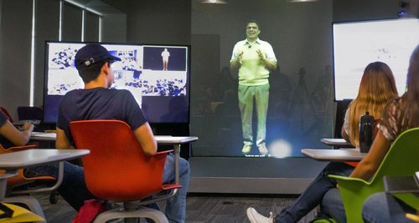
Notes:
Tech de Monterrey

Slide 19
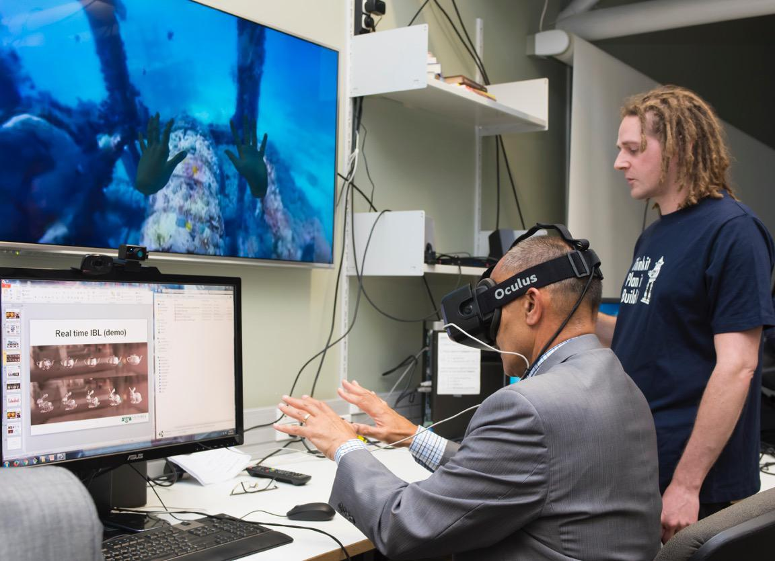

Slide 20
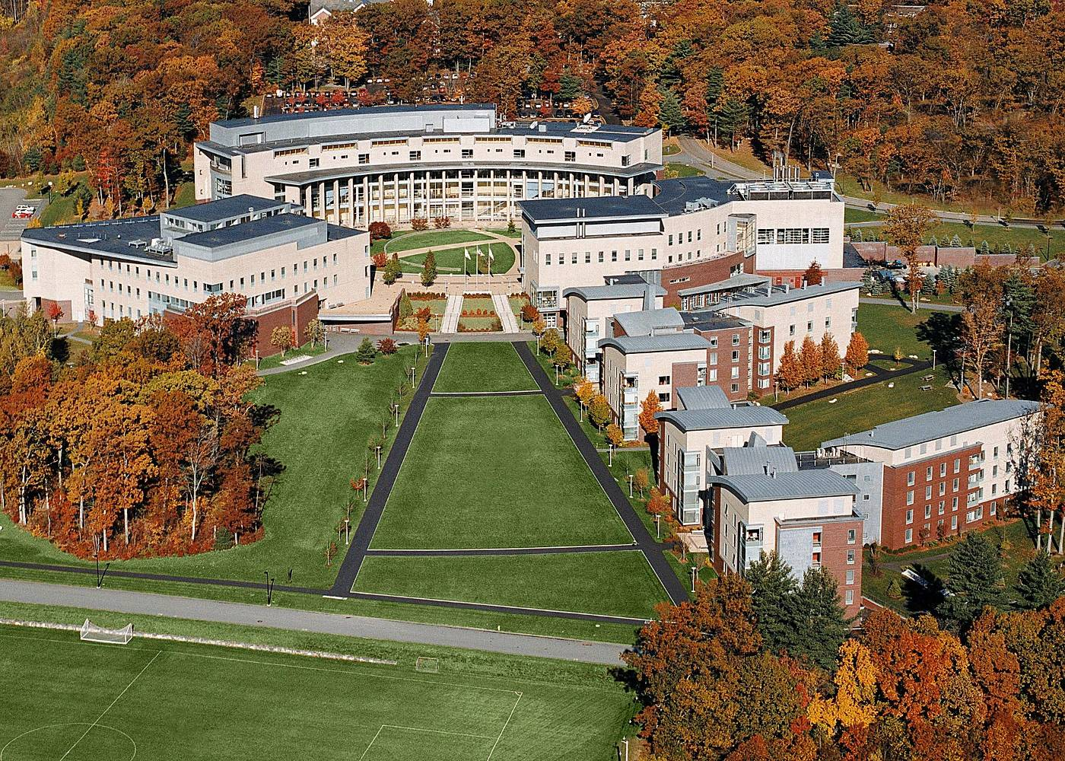

Slide 21
Olin College of Engineering
Designed-based learning (as teams)
Multi-disciplinary
No academic departments / no tenure
Integration of engineering, entrepreneurships and humanities
Notes:
Transfer from CC to U
Registered in one main institution but courses from other universities
Regular degree with online certificates from professional institutions (Yacine Toronto, U of Dar Es Salaam)

Slide 22
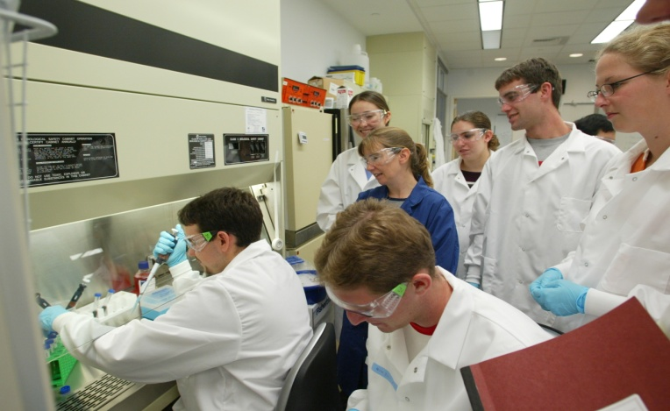
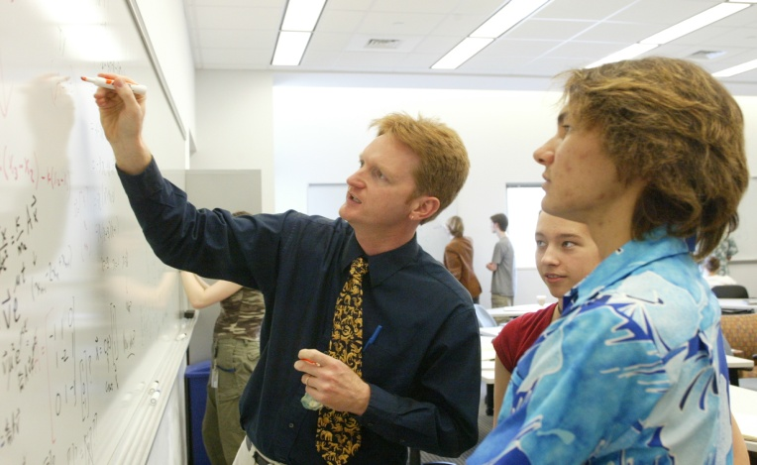
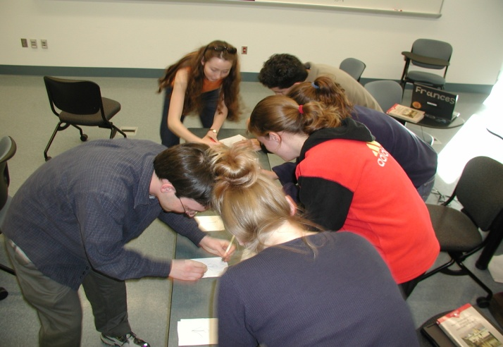
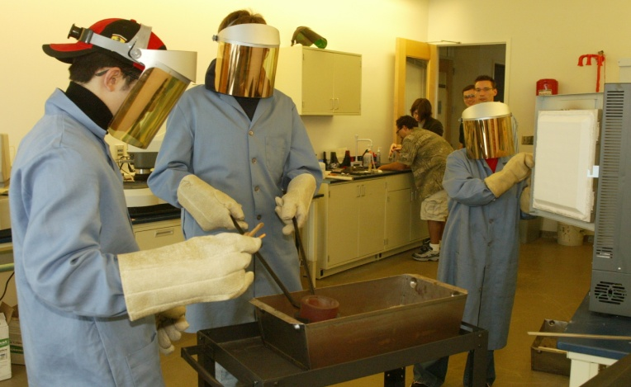
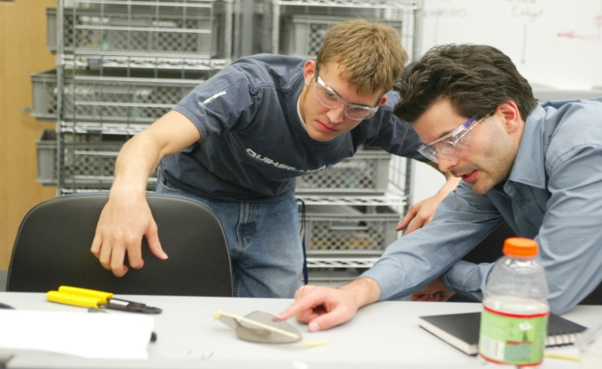
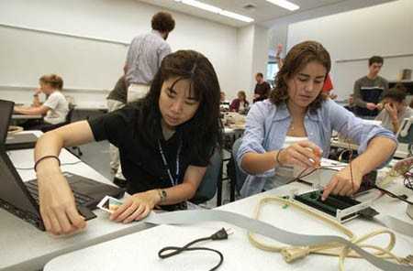
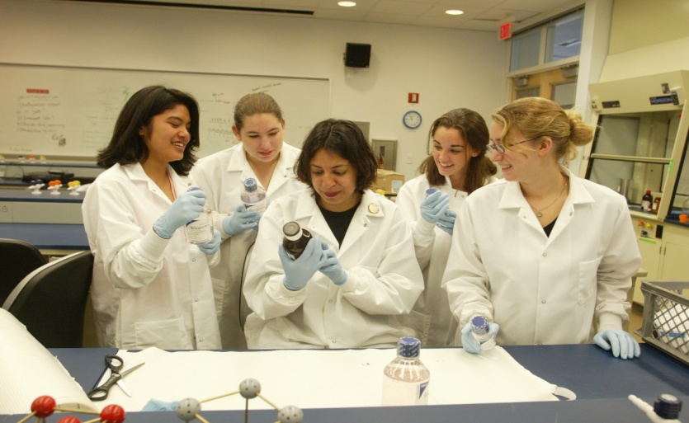
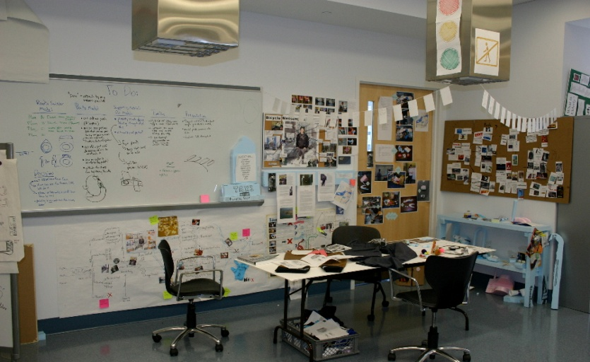
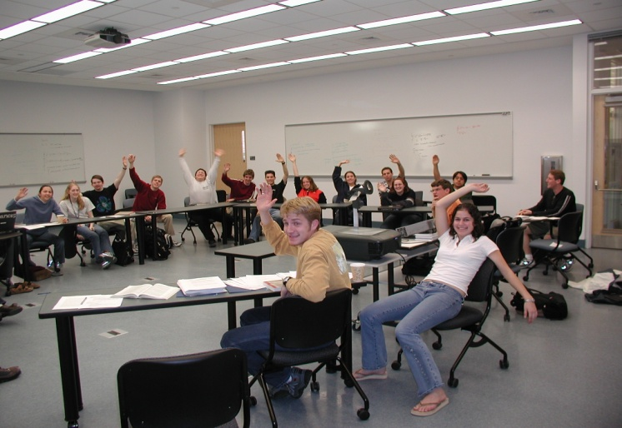
MODES OF TEACHING AND LEARNING
AT OLIN, WE TEACH, AND STUDENTS LEARN, IN
A VARIETY OF MODES
HANDS-ON PROJECT-BASED LEARNING
LABORATORY-BASED EXPERIENCES
SEMINAR-DISCUSSION
INTERACTIVE LECTURE
STUDENT-BASED INDEPENDENT LEARNING
TEAM-BASED INDEPENDENT LEARNING
INDIVIDUAL AND TEAM MENTORSHIP BY FACULTY
Notes:
Extensive (but not exclusive) project-based pedagogyIntegrated, coordinated and interdisciplinary curricular themes Entrepreneurial thinking and practiceDesign as creative, innovative, distinctive engineering processEngineering in social and technical contextsImportance of the liberal artsRigorous fundamentalsCommunication, teamworkAuthenticity of experience and assessment of outcomesOlin Expo each semester

Slide 23
Western Governors University
Virtual university, started in 1997 as initiative of Governors of Western States, taking advantage of the Internet
Competency-based learning model: students progress based on reaching levels of competencies (learning results rather than time)
Aimed at adult students who can study at their own pace independently of place and time
110,000 students in 2018
Notes:
The Best-Kept Secret among Online Colleges

Slide 24
The “new” university
Moocs
Boot camps
Minerva (online face-to-face elite U)
Ecole 42 (free computing school with no teachers, no degrees and no high school requirements)
Kaospilot http://www.kaospilot.dk/
Hyperisland https://www.hyperisland.com/
Notes:
Universidades disruptivas, así se enseña fuera de lo convencional
Hay universidades que admiten no tener la clave para que sus alumnos encuentren un trabajo en el futuro. Según su planteamiento, ningún experto es capaz de predecir cuáles son los conocimientos necesarios para afrontar profesiones que aún no existen. Estos centros reconocen que por primera vez profesores y alumnos están igualados en un aspecto: nadie sabe cuáles serán las reglas del mercado laboral en una década.
Kaospilot (Dinamarca), Hyper Island (Suecia) o Minerva (Estados Unidos) son algunas de las universidades que están transformando el método de enseñanza tradicional y enterrando las clases magistrales. Su método consiste en el aprendizaje basado en la prueba-error y en la propia experiencia de los alumnos. El precio de matrícula ronda los 10.000 euros al año.
“Cada vez más familias aceptan programas no oficiales para sus hijos”, asegura Antonio Rodríguez de las Heras, profesor de la Universidad Carlos III. El modelo actual de enseñanza superior en España es, en su opinión, difícilmente sostenible porque no responde a los “profundos” cambios sociales. Considera que el mundo digital ha roto la forma de empaquetar el conocimiento en grados de cuatro años con un número determinado de horas y de créditos. “En cuatro años cambian las demandas del mercado y surgen las frustraciones de los graduados, que no encajan en los nuevos perfiles”.

Slide 25
Shape of degrees
Traditional degrees (Bs, Ms, PhD)
Courses from several institutions / joint degrees
Micro-credentials and nano-courses
Certificates, badges, etc.
Mini-masters
Separation of learning / credentials
Notes:
Transfer from CC to U
Registered in one main institution but courses from other universities
Regular degree with online certificates from professional institutions (Yacine Toronto, U of Dar Es Salaam)

Slide 26
Aspiring Minds
Indian company administering the AMCAT competency test (job employability)
1,100 Universities use AMCAT
5 million people tested in 2018
Now active in Bangladesh, China, Malaysia, the Philippines, the Middle East, and the USA
Notes:
Indian firm AMCAT test

Slide 27
The Credit Bank of Korea
Open educational system
Recognition of learning acquired in-school and out-of-school
Degree granting
Fully recognized degrees
Notes:
Transfer from CC to U
Registered in one main institution but courses from other universities
Regular degree with online certificates from professional institutions (Yacine Toronto, U of Dar Es Salaam)

Slide 28
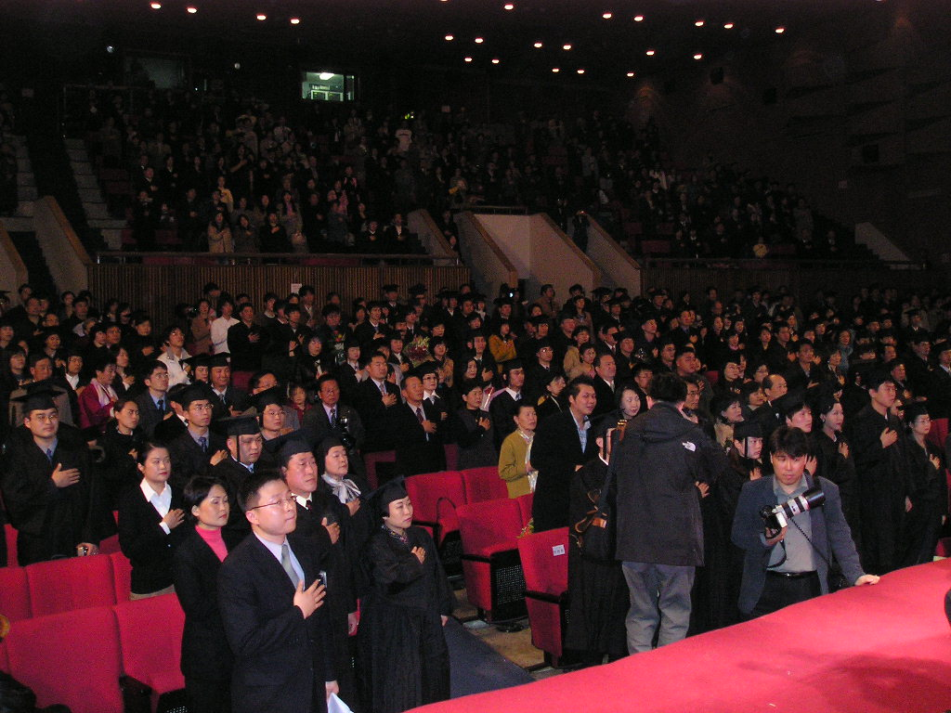
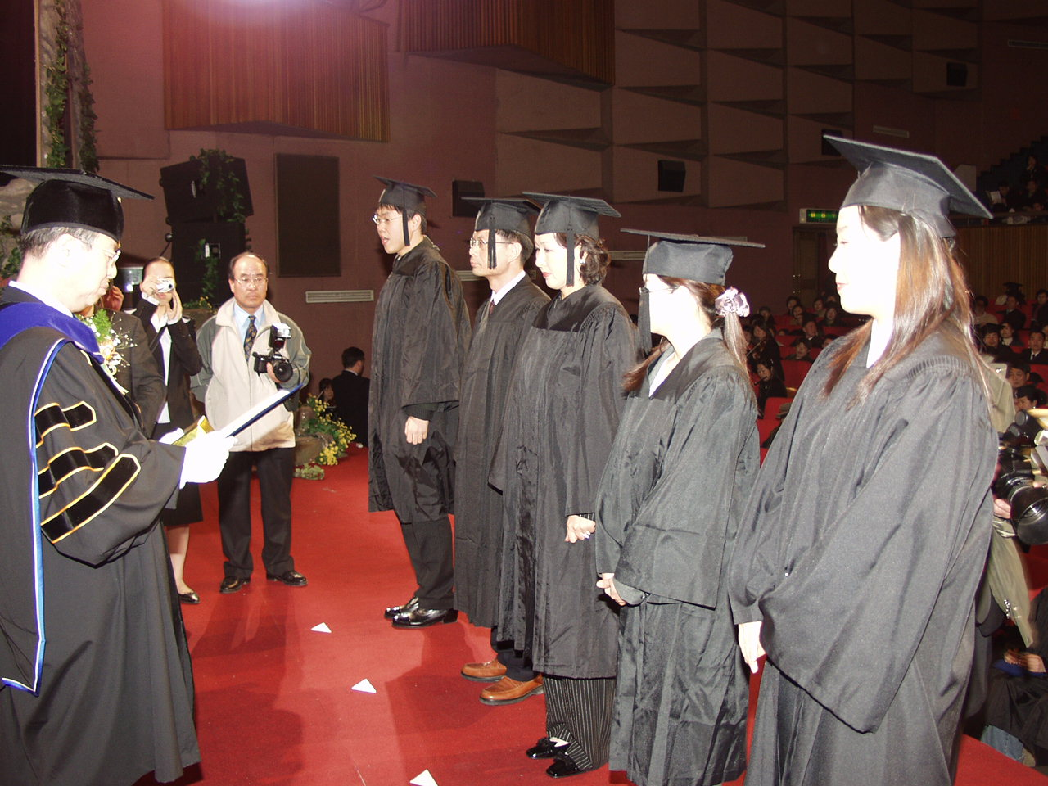
Graduation ceremony at the Korean Credit Bank

Slide 29
Outline
A Changing World
The Rising Tide of Quality Assurance

Slide 30
Impressive progress
Quiet revolution of quality assurance
International and regional QA networks
CIGQ – International Quality Group (CHEA)
International and regional agreements

Slide 31
International Agreements
UNESCO – OECD Guidelines on Quality Provision in Cross-Border Education (2005)
Draft Global Convention on the Recognition of Higher Education Qualifications in the works (UNESCO in the lead)
To be approved this year

Slide 32
Regional Agreements
Standards and Guidelines for Quality Assurance in the European Higher Education Area (2005, revised in 2015)
ASEAN Quality Assurance Framework (2015)
African Standards and Guidelines for Quality Assurance (2018)
Latin America still pending (sub-regional) – broad principles in 1974
Arab States (1978)

Slide 33
Core Principles
Role of external QA agencies
QA standards, criteria and processes
Internal Quality Assurance
Qualifications frameworks (sometimes separate, as in Europe)

Slide 34
Credit Transfer Agreements
Not one international agreement yet
Europe: ECTS
Africa: under consideration
Latin America: CLAR
Asia: AUN-ACTS, UMAP-UCTS, and AIMS

Slide 35
Challenges
The rankings distraction
Recognition of disruptive practices
Assessment

Slide 36
Assessment
“Assessment is the killer of learning”
Need for alignment (E / C / P / A)
Multi-dimensional assessment: general education, key competencies, trajectory
Formative assessment feeding into the learning process
e-portfolios as self-evaluation and growth assessment instruments

Slide 37
Refugees
68.5 million world-wide
25.4 internationally
40 internally displaced
3.1 asylum seekers
Innovative “qualifications passport for refugees” (Norway & Europe)

Slide 38
Repression
Turkey etc.
Threats to free movement of academics and students
Trump’s travel ban
Visa restrictions
Threats to academic freedom
Threats to scientific rigor and progress

Slide 39
Fraudulent Practices
Degree mills (esp. online)
Accreditation mills
Fake academic journals and conferences
Plagiarism
Fraud at exams
Admission (latest US scandal)
Notes:
How many ministers have had to resign: Germany Defense and Education, Hungarian president, Korean parliament members, one of Trump’s nominees

Slide 40
Conclusion:
Rising Up to the Challenge

Slide 41
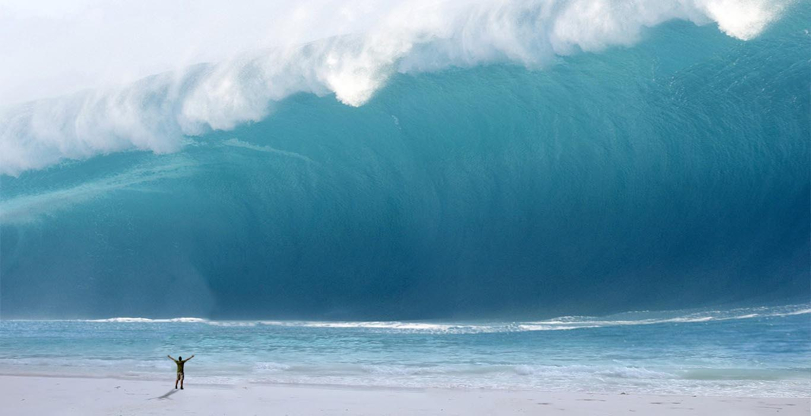
Notes:
John Hennessy, Stanford U President, in 2012, speaking about online education
A tsunami is coming:
Universities in the digital era

Slide 43
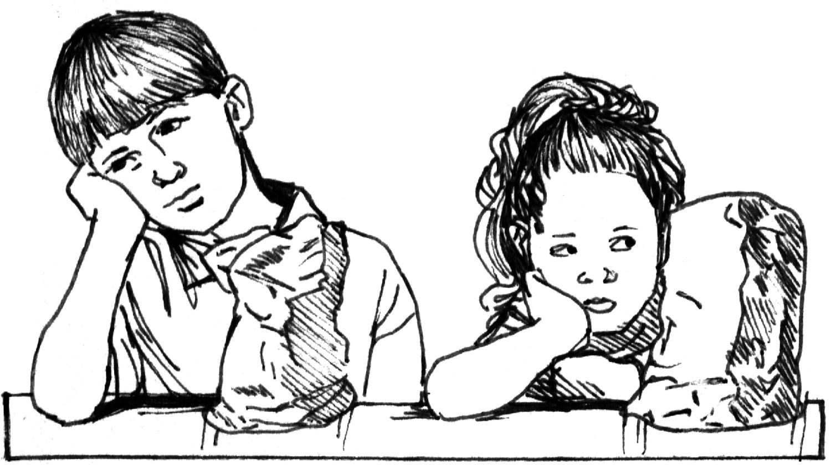
Learning is not a spectator sport
Notes:
Student-centered
Active, interactive, experiential
Lifelong learning

Slide 44
Student-Centered Learrning
Sparking Curiosity
Igniting Passion
Unleashing Genius
One size fits all / let a thousand flowers bloom?
Notes:
Martin quote

Slide 45
Thriving under disruption
International and regional agreements
Innovative dimensions in accreditation criteria
Inclusion of new accountability measures
Cultivate core values of QA
Notes:
U presidents in jail in Chile

Slide 46
Innovative features
Embrace curricular and pedagogical innovations
Incorporate innovations in admission, assessment and degree configuration
Focus on outcomes and added value
Learning achievement
Competencies acquired
Notes:
U presidents in jail in Chile

Slide 47
Integrate valid elements of new accountability instruments
Voice of the students (student engagement)
Voice of society (labor market / employers)
Recognition of new credentials
Rely on predictive analytics
Notes:
U presidents in jail in Chile

Slide 48
Cultivate and strengthen what makes accreditation unique
International and regional convergence / collaboration
By and for the members
Intellectual and institutional independence
Flexibility
Notes:
U presidents in jail in Chile

Slide 49
Role of QA in an International Perspective
Trust (example of refugees)
Transparency
Relevance
Notes:
Transfer from CC to U
Registered in one main institution but courses from other universities
Regular degree with online certificates from professional institutions (Yacine Toronto, U of Dar Es Salaam)

Slide 50
Role of QA in an International Perspective
Collaborative platforms for sharing of experience and capacity building
Outcome-based quality assurance open to innovative practices
Framework to recognize new forms of qualifications
Notes:
Transfer from CC to U
Registered in one main institution but courses from other universities
Regular degree with online certificates from professional institutions (Yacine Toronto, U of Dar Es Salaam)

Slide 51
Aligned Multi-layer QA System
Trust & Transparency
I & R QA
Agreements
& Networks
Trust & Transparency
National Quality Assurance
Internal Quality Assurance

Slide 53
Notes:
Expiry principle

Slide 54
Beta mode
Continuous change and adaptation
Open mind to accept innovation
Humility: learning as you go
Notes:
All-in-One
Lotus Notes
Outloock
Gmail
Yahoo
Mark Twain: I love progress, it’s change I don’t like

