Slide 1
Qualifications and recognition: quality assurance as a tool to promote recognition of higher education outcomes
INQAAHE 2019 Workshop 3
Dr Tess Goodliffe and Emeritus Professor Debbie Clayton
25 March 2019

Slide 2
Aims/objectives of the workshop
By the end of the workshop, participants will:
Be aware of the approaches that a number countries and regions use to recognise local and foreign higher education qualifications
Have identified challenges facing the recognition of qualifications in the frames of global developments
Have considered the dependence of qualification recognition on the underpinning mechanisms for quality assurance and the fostering of trust
Have identified and discussed implications of the challenges and development in this area for their own national context

Slide 3
Workshop outline
Introductions
Presentation on current approaches and challenges
Consideration of case studies and focus questions
Feedback discussion on focus questions
Conclusions
Individual reflection and buddying

Slide 4
Sustainable development goals (SDG) 2030: goal 4
Ensure inclusive and equitable quality education and promote lifelong learning opportunities
for all
https://www.un.org/sustainabledevelopment/sustainable-development-goals/

Slide 5
SDG Goal 4, target 4.3:
Indicative strategies
Ensure quality assurance, comparability and recognition of tertiary education qualifications and facilitate credit transfers between recognized tertiary education institutions.
Strengthen international cooperation in developing cross-border tertiary and university education and research programmes, including within the framework of global and regional conventions on the recognition of higher education qualifications, to support increased access, better quality assurance and capacity development

Slide 6
What are the approaches to facilitating the recognition of qualifications?
Notes:
Brainstorm in groups

Slide 7
Approaches to facilitating the recognition of qualifications
Government policy (such lists of approved institutions)
Agencies for recognition and comparison of qualifications (such as the NARIC network)
Qualifications Frameworks (allowing comparison of foreign qualifications)
Metaframeworks (such as the EQF, ASEAN qualifications reference framework)
Conventions (such as Lisbon Convention, Tokyo Recognition Convention, future Global Convention)
Free trade agreements/intranational service agreements
Notes:
This is just the starting point – these can be added to from group discussions

Slide 8
Definition of A Qualifications framework
A qualifications framework is an instrument for the development and classification of qualifications. In their most basic sense NQFs can be understood as classifiers specifying the relationship – horizontally and vertically - between different qualifications within a national system. A comprehensive qualifications framework is one that covers all levels and types of education, both academic and vocational.
European Area of Recognition Project Manual 2012 http://www.eurorecognition.eu/emanual/Chapter%207/introduction.aspx

Slide 9
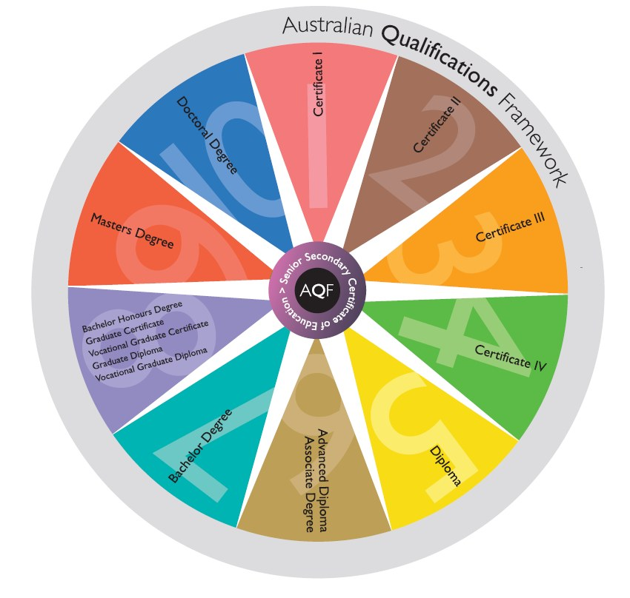

Slide 10
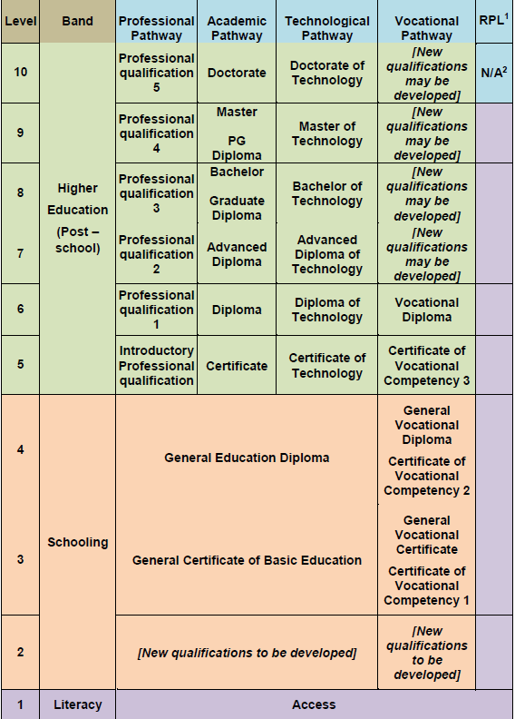
Oman Qualifications Framework Diagram
2018

Slide 11
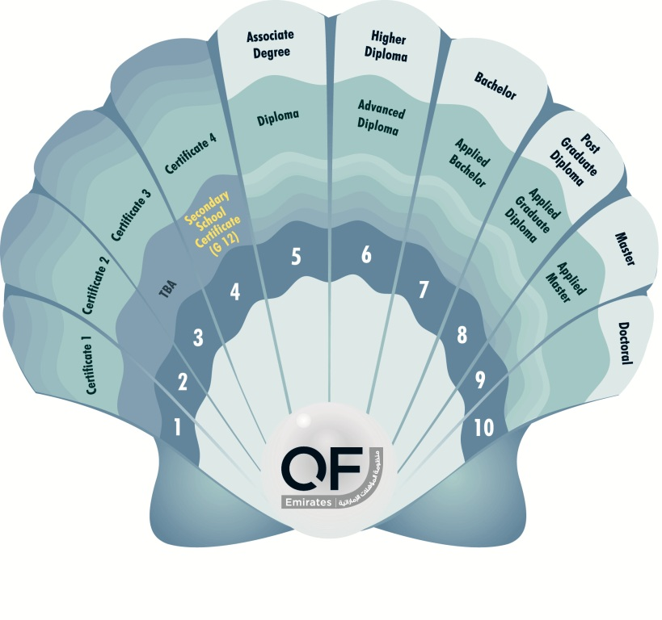
QFEmirates
 | Higher education
 | Vocational education and training
 | General (secondary) education

Slide 12
Global concept of national qfs
Modern NQFs can…be described as ‘instruments with a vision’ questioning current education and training practices, and challenging existing professional and sectoral interests.
Designing an NQF is thus something more than agreeing on a set of technical features ([for example] as a grid of levels and descriptors), it is about creating a platform for cross-institutional and cross-sectoral dialogue and – eventually – mutual trust.
Bjornavold & Coles (2009) ‘The added value of national qualifications frameworks in implementing the EQF’ cited in https://www.etf.europa.eu/sites/default/files/m/720E67F5F1CC3E1DC125791A0038E688_Transnational%20qualifications%20frameworks.pdf

Slide 13
trust
To be of any value, a qualification must be trusted. Whether a certificate or diploma can be used for employment or further education largely depends on the learning outcomes acquired by the individual who has completed a programme and passed the required exams. Systematic quality assurance arrangements underpin trust…Qualifications frameworks aim to make it easier for individuals to use qualifications across institutional and national borders. This requires describing qualifications as learning outcomes. Systematic quality assurance makes it possible to judge whether there is real value in the [qualification] presented by the candidate.
Monitoring the use of validation of non-formal and informal learning 2016
http://www.nki-latvija.lv/content/files/Briefing-Note-March-2013_en.pdf

Slide 14
How do you trust a qualification?
To understand how a qualification can be trusted it is important to look at the definition of qualification and identify the key elements that need to be quality assured. These are:
(a) the learning outcomes: the knowledge, skills and competences that the holder of a qualification should have;
(b) the assessment and validation process;
(c) the standards against which learning, assessment and validation have taken place.
UNESCO Global inventory of regional and national qualifications frameworks 2017 p.87
http://uil.unesco.org/lifelong-learning/qualification-frameworks/global-inventory-regional-and-national-qualifications-0
Notes:
There are now more than 140 countries reported to be planning, developing or implementing National Qualification Frameworks – a rational response to economic and social pressures of globalization

Slide 15
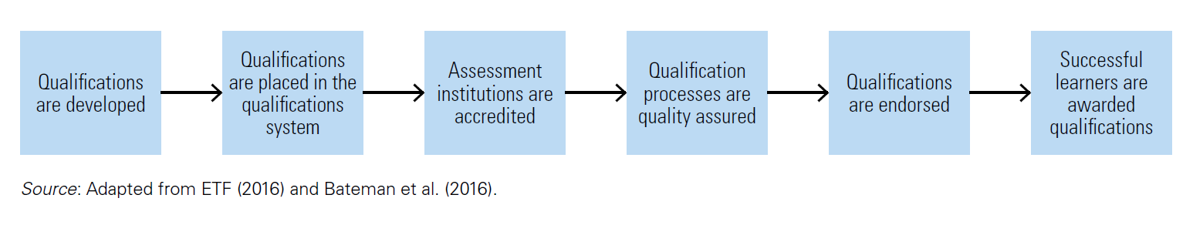
Quality Assurance of the Qualifications Process
UNESCO Global inventory of regional and national qualifications frameworks 2017 p.87
http://uil.unesco.org/lifelong-learning/qualification-frameworks/global-inventory-regional-and-national-qualifications-0

Slide 16
Value and comparability
Examination results are social facts. Like bank notes they depend for their value on the status that is accorded to them within a social system…all attempts to define ‘equivalence’ independently of the social setting in which they are created have failed, and indeed are bound to fail.
Two qualifications are comparable only to the extent that there are people who are prepared to believe that they are comparable, and trust awarding institutions or bodies equally.
Allais (2010) The implementation and impact of National Qualifications Frameworks: Report of a study in 16 countries https://www.ilo.org/wcmsp5/groups/public/@ed_emp/@ifp_skills/documents/meetingdocument/wcms_126589.pdf

Slide 17
What are the challenges facing the recognition of local and/or foreign qualifications in your country or context?
Notes:
Brainstorm in groups

Slide 18
challenges
A number of different bodies may be involved in recognition within a single jurisdiction
Growth in micro credentials
Recognition of delivery methods, e.g. online delivery
Different quality assurance approaches and practices managed by different bodies; accreditation
International reputation of higher education providers
Qualifications as context-specific indicators of learning
Language in which qualification was taken
Divide between developed and developing worlds
Fake degrees/degree mills
Trust

Slide 19
Case studies

Slide 20

Case study 1: Australia
Recognition of qualifications, qualifications frameworks, shorter form credentials, and the role of quality assurance

Slide 21
Case study 1: Australia
What system does your country use to recognize qualifications? Are shorter form qualifications recognized? And, if so, how is this done?
What are the challenges of recognizing shorter form qualifications?
What systems could be put in place to quality assure shorter form qualifications so that they are “trusted” for inclusion in a qualifications framework?
Is there a role for Quality Assurance agencies to develop a set of guiding principles (or tools) to assist recognition considerations of shorter form qualifications?

Slide 22

Case study 2: china- Australia
Transnational Education, qualifications recognition, delivery mode and the role of quality assurance

Slide 23
Case study 2: china- Australia
Describe the transnational delivery activity undertaken by your country. What systems are in place to ensure that programs delivered by TNE are quality assured?
How important are free trade agreements for the recognition and mobility of qualifications?
What challenges does your country face in having TNE delivered qualifications recognized? If TNE programs are delivered online include this in your consideration.
What could be the role of Quality Assurance agencies in developing a set of guiding principles (or tools) to assist recognition considerations of TNE delivered qualifications? Include consideration of programs delivered online.
Do what extent can regional conventions support the recognition of TNE qualifications? To what extent can they support the recognition of different modes of delivery, e.g. online?

Slide 24

Case study 3: OMAN
Joined-up approaches to accreditation, implementing the qualifications framework and quality assurance

Slide 25
Case study 3: OMAN
Which bodies are responsible for (1) accreditation/external quality assurance (in higher education) and (2) qualifications frameworks/recognition of qualifications in your country or a context that you are familiar with?
How do these bodies liaise? Is there a joined-up approach?
What mechanisms are in place to support the quality assurance of qualifications in your country or in a context you are familiar with?
Are there clear pathways from vocational to higher education qualifications? Vice versa? What is the role of quality assurance in the different sectors?

Slide 26

Case study 4: UAE
Portability of qualifications and mobility of learners

Slide 27
Case study 4: UAE
To what extent do you think the Sustainable Development Goals have the potential to drive change in terms of comparability and recognition of qualifications in your country or a context that you are familiar with?
Are you familiar with challenges facing in-country recognition of qualifications, either earned in country or as a result of studying overseas? How can these be addressed?
Do the different approaches to external quality assurance have an impact on recognition of qualifications from one educational context to another?
To what extent can international or regional conventions support the recognition of qualifications, either within a single country or from one educational context to another?

Slide 28
What can we learn from these case studies?
What actions can be taken to support recognition of higher education outcomes?

Slide 29

Find a Buddy

Slide 30
Thank you
To Prof Ian Cumbus, Qualifications Framework Expert, UK
To Margaret Cameron, Oman Qualifications Framework Project, Oman Academic Accreditation Authority, Oman
To our workshop participants
Our contact details:
tessgoodliffe@gmail.com
claytoninternational@me.com

