Slide 1
National Quality Assurance Framework:
Establishment and Operationalisation
Prof Kevin Kinser, Pennsylvania State University, USA
and
Prof Deepthi Bandara, University Grants Commission, Sri Lanka
INQAAHE 15th Biennial Conference 2019
25 March 2019

Slide 2
Organization of Workshop
Introductions (5 minutes)
Overview of topic (20 minutes)
US Case: Current context and reform (20 minutes)
Sri Lanka Case: Proposal for Quality Assurance and Accreditation Commission for Higher Education (25 minutes)
Comparative analysis of Sri Lanka case (10 minutes)
Break (10 Minutes)
Small group task and reporting (45 Minutes)
Summary and suggestions for future QA development (15 minutes)

Slide 3
National Quality Framework
“an NQF is an instrument used to classify qualifications in a hierarchy of levels, each level defined by a set of descriptors indicating the learning outcomes at that level. A qualification system is all the arrangements – schools, institutions, stakeholders, laws, quality assurance measures and the framework of qualifications – which ultimately deliver better qualifications for employability and lifelong learning.”
-Global Inventory of Regional and National Qualifications Frameworks, 2017

Slide 4
National Quality Framework
“an NQF is an instrument used to classify qualifications in a hierarchy of levels, each level defined by a set of descriptors indicating the learning outcomes at that level. A qualification system is all the arrangements – schools, institutions, stakeholders, laws, quality assurance measures and the framework of qualifications – which ultimately deliver better qualifications for employability and lifelong learning.”
-Global Inventory of Regional and National Qualifications Frameworks, 2017

Slide 5
National Quality Framework
“an NQF is an instrument used to classify qualifications in a hierarchy of levels, each level defined by a set of descriptors indicating the learning outcomes at that level. A qualification system is all the arrangements – schools, institutions, stakeholders, laws, quality assurance measures and the framework of qualifications – which ultimately deliver better qualifications for employability and lifelong learning.”
-Global Inventory of Regional and National Qualifications Frameworks, 2017

Slide 6
National Quality Framework
“an NQF is an instrument used to classify qualifications in a hierarchy of levels, each level defined by a set of descriptors indicating the learning outcomes at that level. A qualification system is all the arrangements – schools, institutions, stakeholders, laws, quality assurance measures and the framework of qualifications – which ultimately deliver better qualifications for employability and lifelong learning.”
-Global Inventory of Regional and National Qualifications Frameworks, 2017

Slide 7
National Quality Framework
“an NQF is an instrument used to classify qualifications in a hierarchy of levels, each level defined by a set of descriptors indicating the learning outcomes at that level. A qualification system is all the arrangements – schools, institutions, stakeholders, laws, quality assurance measures and the framework of qualifications – which ultimately deliver better qualifications for employability and lifelong learning.”
-Global Inventory of Regional and National Qualifications Frameworks, 2017

Slide 8
National Quality Framework
“an NQF is an instrument used to classify qualifications in a hierarchy of levels, each level defined by a set of descriptors indicating the learning outcomes at that level. A qualification system is all the arrangements – schools, institutions, stakeholders, laws, quality assurance measures and the framework of qualifications – which ultimately deliver better qualifications for employability and lifelong learning.”
-Global Inventory of Regional and National Qualifications Frameworks, 2017

Slide 9
National Quality Framework
“an NQF is an instrument used to classify qualifications in a hierarchy of levels, each level defined by a set of descriptors indicating the learning outcomes at that level. A qualification system is all the arrangements – schools, institutions, stakeholders, laws, quality assurance measures and the framework of qualifications – which ultimately deliver better qualifications for employability and lifelong learning.”
-Global Inventory of Regional and National Qualifications Frameworks, 2017

Slide 10
National Quality Framework
“an NQF is an instrument used to classify qualifications in a hierarchy of levels, each level defined by a set of descriptors indicating the learning outcomes at that level. A qualification system is all the arrangements – schools, institutions, stakeholders, laws, quality assurance measures and the framework of qualifications – which ultimately deliver better qualifications for employability and lifelong learning.”
-Global Inventory of Regional and National Qualifications Frameworks, 2017

Slide 11
National Quality Framework
“an NQF is an instrument used to classify qualifications in a hierarchy of levels, each level defined by a set of descriptors indicating the learning outcomes at that level. A qualification system is all the arrangements – schools, institutions, stakeholders, laws, quality assurance measures and the framework of qualifications – which ultimately deliver better qualifications for employability and lifelong learning.”
-Global Inventory of Regional and National Qualifications Frameworks, 2017

Slide 12
National Quality Framework
“an NQF is an instrument used to classify qualifications in a hierarchy of levels, each level defined by a set of descriptors indicating the learning outcomes at that level. A qualification system is all the arrangements – schools, institutions, stakeholders, laws, quality assurance measures and the framework of qualifications – which ultimately deliver better qualifications for employability and lifelong learning.”
-Global Inventory of Regional and National Qualifications Frameworks, 2017

Slide 13
Purpose
Economic impact (neoliberal) to human development (Economic-social equity-Sustainability)
Catalyst for lifelong learning
Learning outcomes as common language
International communication and cooperation

Slide 14
Features
Country specific but with common features
  Legal and regulatory framework
    Functions, Criteria, Tasks
  Stakeholder involvement and dialogue
    Specific roles and vested interest
    With or without “agency”
  Institutional arrangements
    Coordinating institution; skills/sector councils; assessment and QA bodies
  Quality assurance systems
    Identify standards, assessments; provide certification

Slide 15
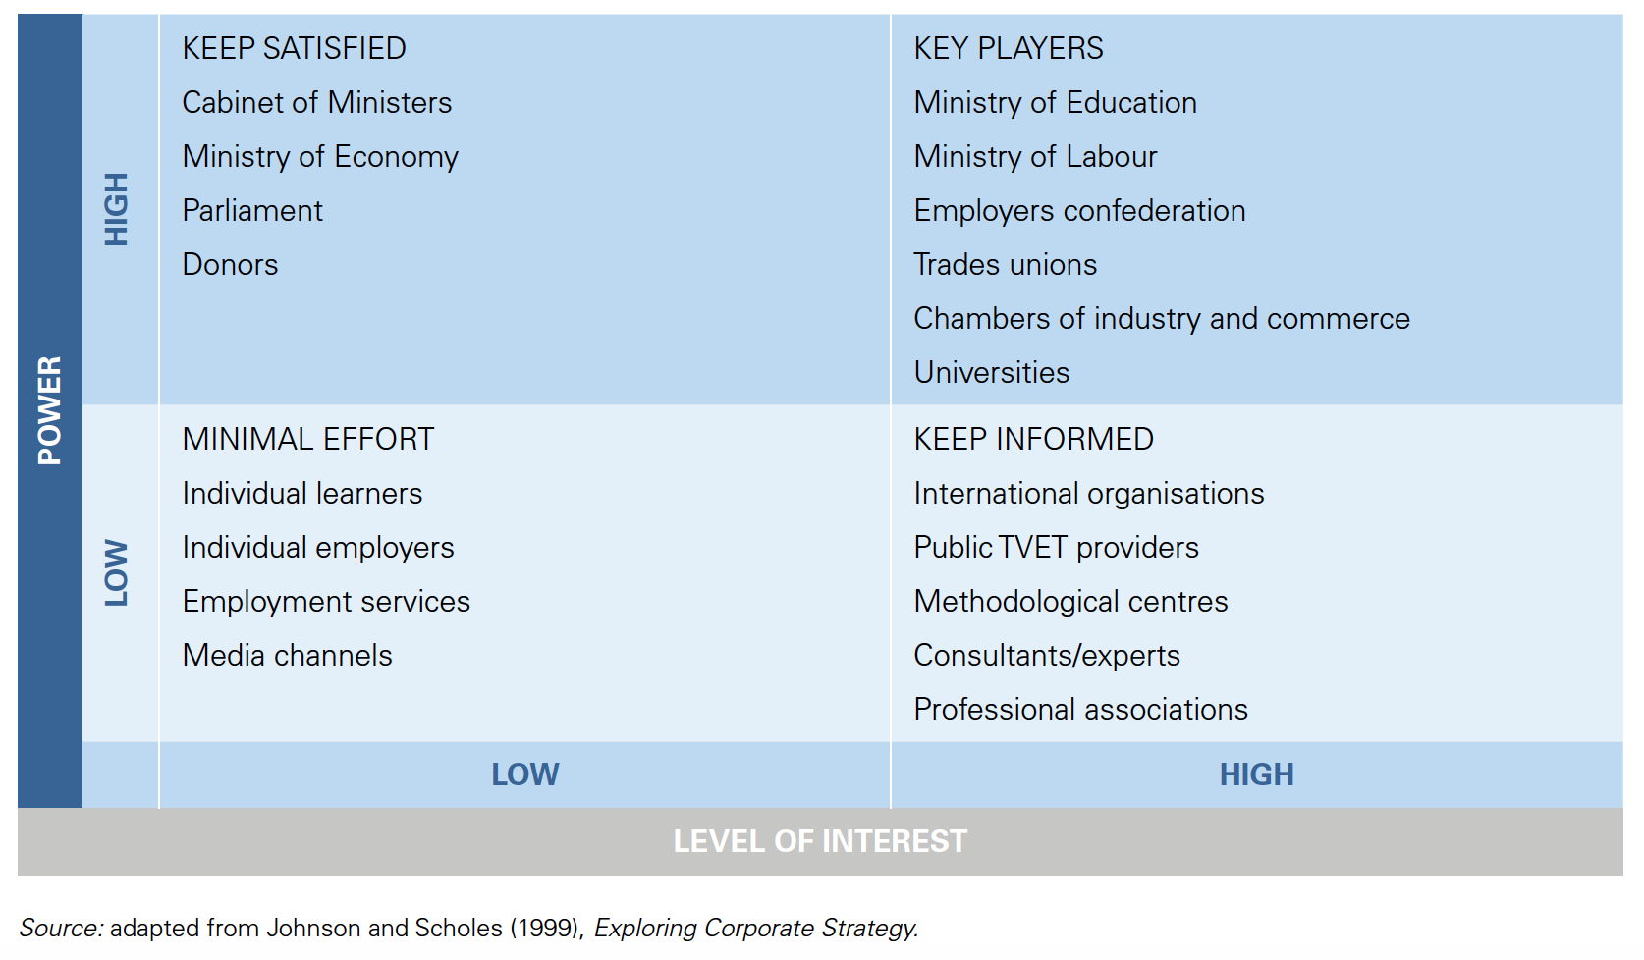

Slide 16
Addressing “Wicked” Problems

Slide 17
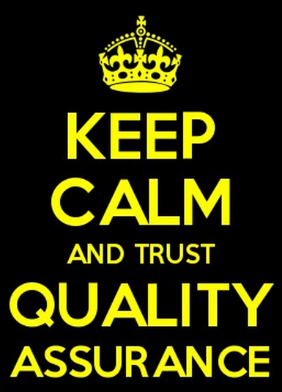

Slide 18
Quality Assurance: Background
Long history of informal quality assurance
  Patronage: Church and Crown
  Sponsorship: industry, apprentices
  Markets: Agora or Acropolis
  Reputation: Longevity and legitimacy
  Nationalism: Language and culture
  Prestige: Rankings and research
  Pride: Self-interest and integrity

Slide 19
Quality Assurance: Background
US/UK goes back 100+ years
1990s: Current global trend begins
  Diversification of higher education
  Student demand
  Private sector
  Internationalization
Now necessary for a modern educational system

Slide 20
Quality Assurance: Background
Tension in implementation
Reflecting the “Public Good”
Focus is national system
Government controlled or endorsed
Trust vs. Accountability

Slide 21
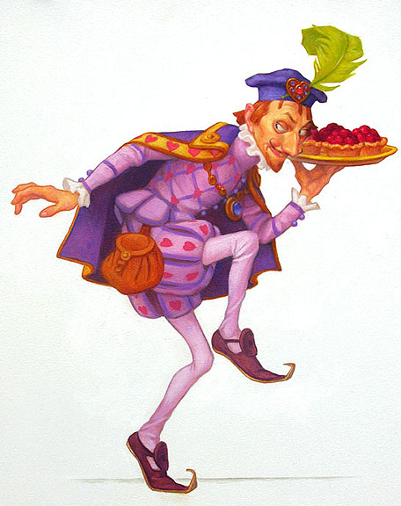

Knights and Knaves in Public Service
LeGrand, 2003
Knights nobly fulfill the public mission
Knaves act for self-interest

Slide 22
Knights and Knaves in Public Service
LeGrand, 2003
Internal QA
  Knights, trust and voice
  Intrinsic motivation, noble pursuit of truth
External QA
  Knaves, Mistrust and choice
  Quality validated by outside stakeholders

Slide 23
What is Quality?
Fitness of purpose
  Is education relevant to societal needs?
  Quality for the public good
    For the benefit of society as a whole
    Greater than the benefit to any single individual
  Purpose is externally imposed

Slide 24
What is Quality?
Fitness for purpose
  How well does education fulfill its objectives?
  Quality determined by mission
    World-class is equal to vocational
    Not measured by hierarchy, rankings, prestige
  Purpose internally determined

Slide 25
What is Quality?
Fitness to Standards
  Does education meet performance criteria?
  Quality is objectively measured
    Precision within standards frame
    Standards vary over time: debatable
  Quality via stakeholder agreement (socially constructed)

Slide 26
Quality Assurance and Legitimacy
  “A generalized perception or assumption that the actions of an entity are desirable, proper, or appropriate within some socially constructed system of norms, values, beliefs, and definitions”
  (Suchman, 1995)

Slide 27
Quality Assurance and Legitimacy
Pragmatic legitimacy
  Practical value that an organization has to a particular group of constituents
Cognitive legitimacy
  Adopting an organizational form that is widely viewed as acceptable
Moral legitimacy
  The organization is doing the right thing, fundamentally altruistic

Slide 28
Quality Assurance as Information Resource
Information for decision-makers
  Which program best meets students’ needs?
  Supports and encourages choice, competition
    Value for investment of time and resources
  Guide allocation of resources
    Incentivize behavior
    Monitor compliance

Slide 29
QA as a Public Good
What purpose should QA serve?
Who should be its constituents?
How much power should external QA have?
Who should determine the standards?
What should be the balance between consistency and innovation?

Slide 30
QA in a Competitive Market
Transnational QA
Exporting QA
QA and education-as-trade
QA as consumer information

Slide 31
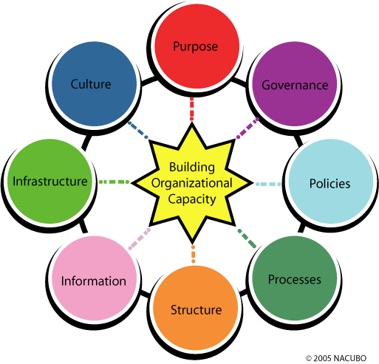

Building Organizational Capacity for Quality Assurance

Slide 32
Architectural Drawing
Engineering schematic

Slide 33
Key Questions for Assessing Capacity
What do you know about what your institution is doing?
  Big picture and specific details
  Culture of evidence
What incentives are in place?
  Explicit and Implicit
  Encouraging and Discouraging
  Internal and external
What are your relative strengths?
  Elevator pitch targeted to each audience
What is your current focus for improvement?

Slide 34
United States Case

Slide 35
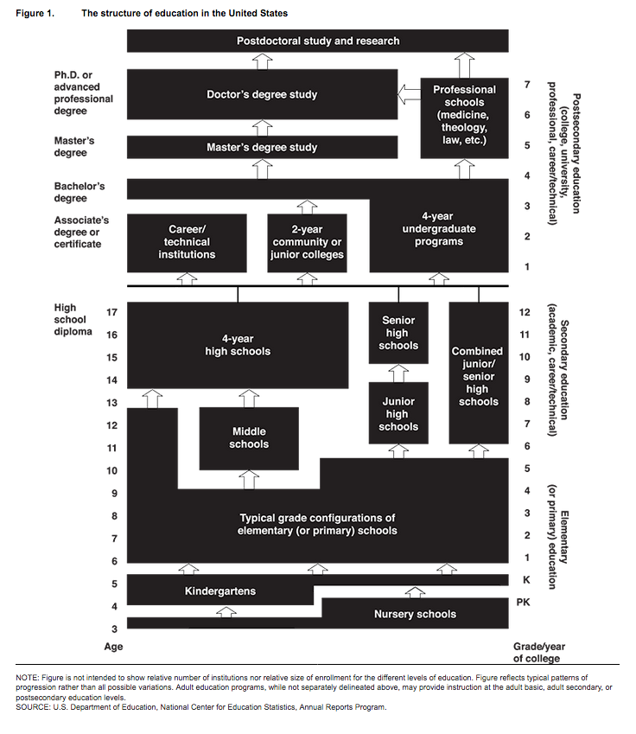

Slide 36
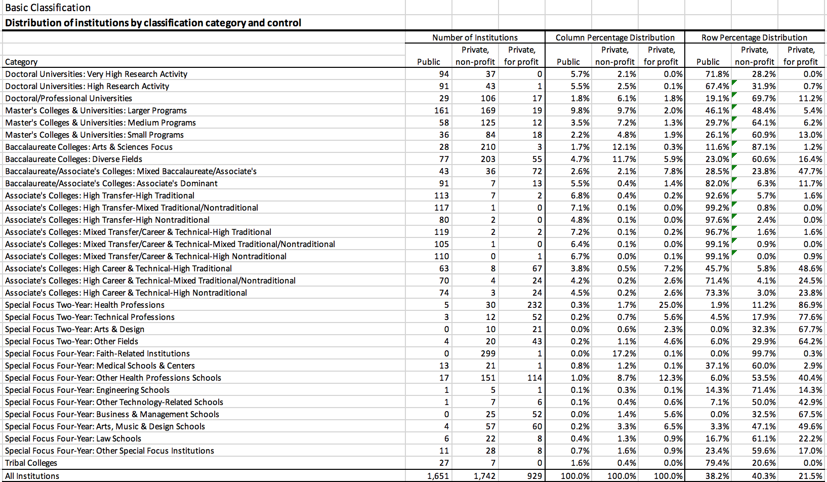
Carnegie Classification of Higher Education

Slide 37
United States Higher Education:
Many Missions, Many Masters
    Triad: Federal, State, Accreditation
    Public, Private, For-profit
    Elite and Mass
    Autonomy and Accountability
    Teaching, Research, Service
    Innovative and Traditional
    Diversity, Choice, Selectivity

Slide 38
United States Quality Assurance Systems
Voluntary, Non-governmental Accreditation
Linked to eligibility for financial aid
Over sixty agencies: Institutional and program
Main agencies have a sub-national (regional) focus
Confidential peer review
Standards vary, but with reciprocity

Slide 39
Challenges
Large and complex organization
Faculty autonomy
Discipline-based reward system
Administrative constraints and shared governance
Information asymmetry
Conflicting stakeholder demands
Notes:
Leadership challenges

Slide 40
“A Fight is Brewing in Washington over College Accreditors” (Washington Post, 2015)
“The Watchdogs of College Education Rarely Bite” (Wall Street Journal, 2015)
“Senate Investigative Panel Opens Inquiry about College Accreditors” (Inside Higher Ed, 2015)
“Who Keeps Billions of Taxpayer Dollars Flowing to For-Profit Colleges? These Guys” (ProPublica, 2015)
“Predator Colleges May Thrive Again” (New York Times, 2017)
“It Oversaw For-Profit Colleges That Imploded. Now It Seeks a Comeback” (New York Times, 2018)
Accreditation . . .
on the Edge

Slide 41


Slide 42
Accreditation on the Edge
“US accreditation as it exists now is the worst form of oversight in higher education, except for anything else we have come up with.”

Slide 43
Accreditation on the Edge
Why does the system look like this?
What could be different in a reimagined accreditation world?

Slide 44
Perfect Storm
New providers
Alternative delivery mechanisms
Scandals and Consumer protection
Public support
Student debt

Slide 45
Accreditation on the front burner
Is accreditation working as a reliable authority of quality?
Can it identify bad actors and take action against them?
Does it have too much authority, or not enough?
How much higher ed do we want to pay for?
Is it a good investment?
Will graduates get good jobs?
Will taxpayer dollars be safe?

Slide 46
“New Normal” for accreditation
Can accreditors do the job they have been given?
Should they even have that job?
If not them, then who?

Slide 47
Accreditation future in the US?
Its time has passed
The needs of the higher education system outstrip its ability to perform
The interests of the many stakeholders are irreconcilable
Tracking the transformation of higher education
Re-envisioning its mission
Shaping a high-quality 21st century educational system
OR…

Slide 48
Current debates and problematic solutions
Challenges of a messy and complicated system
Measuring quality in higher education
Who controls accreditation policy?
Information and transparency
Addressing emerging and innovative providers

Slide 49
A high-quality 21st century educational system
Is trustable and trusted
Catches the bad actors
Helps those who falter improve
Makes room for new models and methods
Makes best use of the peer- and disciplinary expert review process
Respects the uniqueness of institutional mission and also the common mission of higher education in the US
Encourages institutions to stay on their toes (but not necessarily dance in the same way)
Recognizes and incorporates the increasingly global realities of higher education
Provides information about quality that helps the public make their education decisions
Has accountability for oversight across federal, state, and accrediting actors
Recommits us to mission, academic freedom, and institutional autonomy--while redoubling efforts to put student learning at the center of a transparent quality assurance process.

Slide 50

NAtional Quality Assurance Framework:
Establishment and Operationalisation
Prof Kevin Kinser
Pennsylvania State University, USA
and
Prof Deepthi Bandara
University Grants Commission, Sri Lanka
INQAAHE 15th Biennial Conference
25th March 2019

Slide 51
Higher Education In Sri Lanka
Past – only State Universities
Present –
State Universities
Non State Higher Education Institutes - NSHEIs
Trans National Education

Slide 52
Quality Assurance of
Higher Education in Sri Lanka
Initiated – around 2004
QAAC – established around 2006
In State Universities,
First cycle of QA completed – Institutional and Subject Reviews
2nd cycle in progress – Institutional and Program Reviews
NSHEIs
IRs and SRs at inception

Slide 53

Short title and date of operation
Higher Education (Quality Assurance and Accreditation) Act No. ……….2018

Slide 54

Establishment of the Quality Assurance and Accreditation Commission for Higher Education
Commission will be established – named the Quality Assurance and Accreditation Commission for Higher Education
Would be referred to as Commission
Would be the National Authority for Quality Assurance and Accreditation for Higher Education

Slide 55

Objects of the Commission
To establish a System of QAA based on the principles of good governance to maintain the high standard of quality of educational Institutions
To act as the apex body for QAA at National level
To map the different qualifications in accordance with the Sri Lanka Qualifications Framework (SLQF) to facilitate the cross mobility

Slide 56

Constitution of the Commission
Commission – will have 9 members appointed by the President from a panel of 15 persons nominated by the Minister
The President shall appoint a member as the Chairman having regard to the members experience in dealing with matters relating to QA in higher education
At least 5/9 members would be full time

Slide 57



determine policies, standards and criteria and update standards, criteria and procedures as appropriate for Accreditation and QA of HEIs in accordance with the prescribed manuals, tools, devices or relevant international standards

Slide 58

Powers and Functions of the Commission
SLQF
formulate, implement and update SLQF
Cooperation with QAA bodies
establish and maintain liaison and cooperation with any professional or any statutory or any regulatory body or QAA bodies in HE within and outside Sri Lanka on matters relating to QAA

Slide 59


Quality auditors
appoint trained and experienced quality auditors to conduct institutional and program audits and external quality assurance reviews
Accreditation
grant provisional and or full accreditation to HEIs and to Programs and review such accreditation from time to time

Slide 60
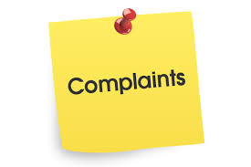
Revoke Accreditation
revoke full or provisional accreditation granted to HEIs and Programs conducted thereof that are not keeping up with the required quality and standards determined by the Commission
Complaints and Action
inquire in to complaints relating to the noncompliance with accreditation requirements by a HEI or a Program and to take appropriate action

Slide 61

Foreign Qualifications
evaluate foreign degrees, diplomas and other academic distinctions for the purpose of recognition or accreditation of such degrees, diplomas or academic distinctions in consultation with the relevant professional or statutory or regulatory body or foreign academic institution where necessary

Slide 62
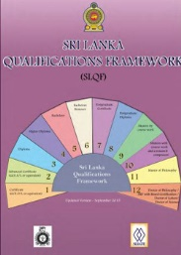
Minimum admission criteria
evaluate from time to time where necessary in consultation with the relevant professional bodies or statutory bodies or regulatory bodies whether the minimum admission criteria for student enrollment in to academic programs are in compliance with the SLQF

Slide 63
Qualification compliance with SLQF
assess whether the degrees and qualifications awarded by the HEIs are in compliance with the qualification descriptors and learning outcomes as set in the SLQF
Recommend qualification level
make recommendations on the appropriate level of qualifications according to the SLQF to be adopted for HE programs and vocational and technical training programs offered by HEIs

Slide 64

Mapping for cross mobility
map higher educational qualifications against vocational qualifications including SLQF and NVQF to facilitate cross mobility of students
Recommendations for engagement in HE
recommend to the HEIs to provide opportunities to persons based on their abilities, experiences and capacities including any exemptions on age limitations, enabling such persons to engage in HE

Slide 65

make recommendations for quality improvements in HEIs
Maintain a register
collect, disseminate information relating to HE and maintain and update a register of accredited HEIs and accredited programs and publish the names of such accredited HEIs and accredited programs in the print and electronic media

Slide 66

Commission staff appointments
appoint officers and employees to the staff of the Commission and to appoint experts and committees to the Commission
Fees
levy fees or charges for any service rendered by the Commission

Slide 67

Agreements and contracts
enter in to such agreements, contracts as may be necessary or expedient for the performance and discharge of the duties and functions
Circulars
issue circulars from time to time to all HEIs and to their professional and academic staff as may become necessary in connection with the performance and discharge of their duties and functions

Slide 68
System for accreditation
design and administer a system prescribed by regulations for accreditation of HEIs providing HE, and other organizations or bodies of persons who either directly or indirectly offer or provide any service relating to or connected with providing HE

Slide 69
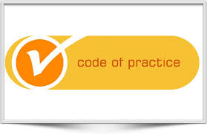
Codes of Practice and Monitoring
develop and publish codes of practice relating to the content, delivery and technical standards for HE services and monitor compliance with such codes

Slide 70

Recognition
recognize a professional or statutory or regulatory body local or foreign in the manner prescribed by regulations under section 52
Require Minimum Standards
require the relevant professional or statutory or regulatory body to determine minimum standards relating to the grant of accreditation of a professional program or qualification

Slide 71

Engage in Research
engage in research, development studies and technical cooperation projects relating to or connected with the discharge and performance of the functions and duties of the Commission
Gazette notifications
specify by notification in the Gazette the levels of accreditation or certification and inspection marks, logos approved and granted by the Commission to HEIs and its programs and control the use of such marks and logos

Slide 72
Property
acquire by way of purchase or otherwise, any movable or immovable property and hold, take or give on lease or hire, mortgage, pledge and sell or otherwise dispose of in accordance with the provisions of this Act, any such movable or immovable property of the Commission

Slide 73

Accounts
open and maintain bank accounts with any bank as determined by the Commission and authorize any person to operate such account or accounts on behalf of the Commission
Member
become a member of an affiliate or any international body, the functions and duties of which are similar to the functions of the Commission by or under this Act

Slide 74

Consultancy services
provide within or outside Sri Lanka consultancy services or any technical, managerial or other services in any area whether by itself or in association with any other authority, in which the Commission possess the skill or expertise

Slide 75
Grants and Services
receive grants or contributions from any sources whatsoever and to raise funds by all lawful means and apply such funds in the performance and discharge of the duties and functions of the Commission

Slide 76

Provide training
provide training in QA, A and SLQF whether by itself or with the cooperation of any other person as the Commission thinks fit, to the officers and employees of the Commission or any other person involved in providing HE at any HEI and to award scholarships for such training

Slide 77

Rules
make rules in respect of the matters for which rules are required to be made under the Act
Engage in Acts
do all such acts which are not inconsistent with the provisions of this Act as may be expedient for the accomplishment of the objects of this Commission

Slide 78
Thank you

Slide 79
Small Group Task
Considering the Sri Lanka and US cases, and the background information, please consider the current position of your country with respect to its quality assurance framework. Looking five years out, what do you expect the future to be for your framework? What do you think will need to be added, changed, or implemented?
Focus your attention on the four common features of national quality frameworks discussed in the session:
  Legal and regulatory frameworks
  Stakeholder involvement
  Institutional arrangements
  Quality assurance systems
Please report your main ideas on a single slide that will be projected so all workshop participants can consider and discuss your points

