Slide 1




2019 APQN Academic Conference
28– 31 March, 2019Colombo, Sri Lanka
APQN Quality Label:
Regional/International Accreditation of Student Learning Outcomes(SLOs)
Chair: Jianxin Zhang, JagannathPatil and Galina Motova from APQN
Time: 11:50-12:50 on March 30, 2019
Venue: Orchid of BMICH, Colombo, Sri Lanka

Slide 2
APQN Quality Label:
Accreditation of Student Learning Outcomes(SLOs)
C
1. Development trend of global assessment of the SLO
ONTENTS
2. Asia-Pacific Quality Label: Student Learning Outcome” (APQL-SLO)
3. 5 characteristics of the APQL-SLO

Slide 3
Introduction to APQL on International Accreditation of SLO
The university is not a magic box where a group of qualified graduates can spontaneously come out after a 4-year study.
What experience did students learn during the 4 years of university learning?
What kind of learning achievements have they obtained?
Have the expected goals of the programs been achieved?
How can we evaluate a qualified university graduate?”
Based on the theoretical & practical experiences of international organizations in assessing students’ learning outcome (SLO) such as CHEA International Quality Group (CIQG), APQN has launched the initiative of “Asia-Pacific Quality Label: Student Learning outcome” (APQL-SLO)

Slide 4




Development trend of global assessment of the SLO
1
In 1979, Eisner proposed “the SLO” for the first time
AHELO （Assessment of HE Learning outcome) launched by OECD assess the SLO, focusing on students’ “general skills” & “discipline-specific skills”.
NSSE: National Survey of Student Engagemen; CAAP :Collegiate Assessment of Academic Proficiency; CLA : Collegiate Learning Assessment
3 categories of the main survey tools of the students’ learning assessment : (1) Input stage; (2) learning process; (3) learning outcome.

Slide 5



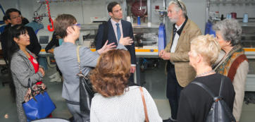
The SLO “OPPTTC” of CHEA/CIQG Platform in China
Key Ele. | Description of OPPTTC
Outcome | To review the matching between actual & expected outcome, verifying the degree of consistency of the SLO’ expected goals & actual goals, i.e. the educational goal-referenced outcome
Product | To review the Product of students’ ability improvement & their personal development, verifying the education provider’s “product” quality
Process | To review the whole process of students’ learning, curriculum implementation, the SLO, verifying the changes before, during & after students’ learning behaviors
Transformation | To review the transformation of student credits & sustainable development of the students’ learning behaviors, verifying whether the SLO can be successfully applied in other similar providers
Transparency | To review whether the provider develops & provides reliable, easily accessible & readily understandable information to the public, verifying the process openness of the providers
Comparability | To review the comparison of the quality & importance of the SLO with other similar providers, verifying the international standards & procedures
2015, CHEA/CIQG reviewed DeTao Academy Advanced Class on the SLO to accept on “the Program of Quality Platform Provider”, 2018, review DTAC again.

Slide 6
Asia-Pacific Quality Label: Student Learning Outcome” (APQL-SLO)
2
The SLO: the statements of what students should learn, know, understand & apply and/or be able to demonstrate after completion of a process of learning.
3. what are
S able
to do?
3. what
distinguishes
your S
from others?
2. what skills
have S
acquired?
5. what
lifelong-learning
ability have
S achieved
what
knowledge
will S
learn?
SLO

Slide 7
“Three-P Study Model”
L.Presage
（学习预备）
Students’ personality & characteristics
Environment & the HEIs’ key factors
L.Process
（学习过程）
Learning contents
Learning styles
L.Outcome
（学习结果)
Student learning outcome
(SLO)

Slide 8

Purpose
1. To establish the criteria of SLO, & determine the best way to sustainably deploy SLO in the Asia-Pacific Region
2. To establish the standardization of the QA system of the SLO, & facilitate the all kinds of student activities (mobility）
3. To encourage HEIs to shoulder social responsibility to meet the needs relative stakeholders for the quality of graduates
4. To promote the excellent quality of the SLO in the Asia-Pacific Region, & even the whole globe

Slide 9
Criteria & Indicators
Criteria | Indicator
1. Domain-Specific Skills | 1.1 the process of enrolment and graduation 1.2 the expected objectives of the programme 1.3 learning process of the programme 1.4 experimental process 1.5 graduation thesis / graduation design 1.6 professionalism (professional papers, scientific research, publications, etc.) 1.7 teaching and learning evaluation system on the whole (student transcripts, subject examination, credits, graduation rate, etc.) 1.8 career planning and personal development（including Job hunting） 1.9 supportive campus environment 1.10 enrich education experience
2. Domain-General Skills | 2.1 ability of analyzing-solving problems 2.2 writing ability 2.3 oral communication ability 2.4 proficiency of foreign languages 2.5 communicating ability 2.6 systematic thinking 2.7 critical-thinking ability 2.8 comprehensive analysis 2.9 ability to use modern learning tools such as information processing 2.10 level of academic challenge, including self-learning ability
3. Core Competencies | 3.1 communication and cooperation skills 3.2 social and emotional skills 3.3 Civic mindedness 3.4 implementation capacity 3.5 organization and management capacity 3.6 leadership capacity 3.7 creation and innovation capacity 3.8 internationalization capacity 3.9 life-long learning capacity
4. Survey of Students Satisfaction on the SLOs | The APQL review panel will distribute “Online Survey of Students Satisfaction on the SLOs” after the SER has been received 2 months before site review and analyze the survey. There are over 50 indicators.
3 criteria, 29 indicators , as well as “Online Survey of Students Satisfaction on the SLOs”:

Slide 10


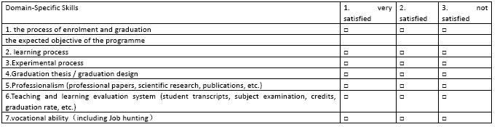
Survey of Student Satisfaction
Basic Information
Part I: Domain-Specific Skills
Part II: Domain-General Skills
Part III: Core Capabilities
Part IV: Learning Opportunity & Resources

Slide 11
Process of Quality Label
1. Expression of interest (EoI) by the HEI to APQN Secretariat
2. Acceptance of eligibility by the APQL Council
8. Outcome by APQN Council and Board
3. Self-Evaluation Report(SER) by the HEI or Programmes
5. Desk review of SER by the review panel organized by the APQL Council
6. On-Site Visit by the review panel: 1) validation of SER; 2) qualitative & quantitative evaluation
7. Finalizing the review report by the panel and getting approved by the HEI
4. OnlineSurvey of Students Satisfaction on the SLOs by the review panel

Slide 12
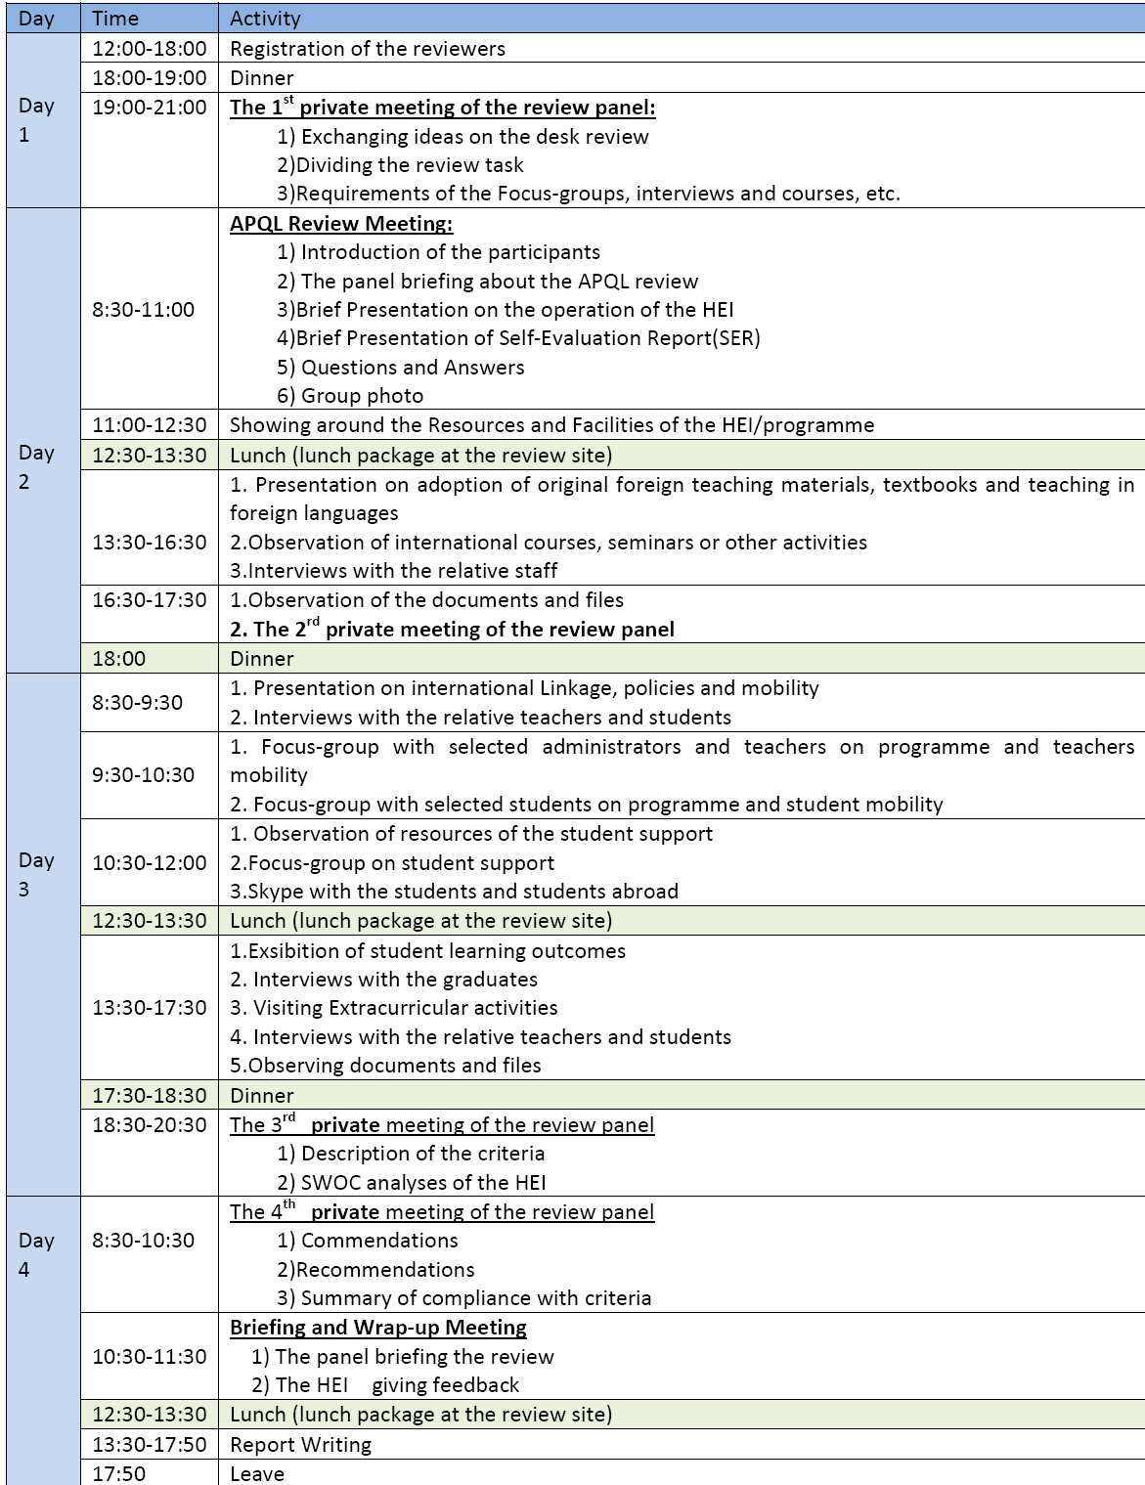
Schedule of Review Visit

Slide 13
Review Result of Quality Label
fully achieved
Partially achieved
Non‐achieved
Substantially achieved
The review result is valid for a period of five years.

Slide 14

Logo of Quality Label

Slide 15

Cost of the Review
S/N | Item Amount | US$
1 | Services of APQN Secretariat for Quality Label | 3000
2 | Honorarium for 3 reviewers (one reviewer 800 USD as a lump-sum amount, while the reviewer who is responsible for the online survey & submits the survey report is expected 300 USD) | 2700
 | Total | 5700
Air fare + accommodation + related expenses – to be borne by the applicant HEI/Programme directly

Slide 16
3
5 characteristics of the APQL-SLO
Result-based assessment of both actual & expected goals of the programme
1
Process-based assessment of students’ learning experiences
2
3
Product-based assessment of the SLO
Satisfaction-based assessment of the students themselves to the SLO
4
5
Development-based assessment of students’ career planning & lifelong learning ability

Slide 17
Concluding Word:
5-development stage: “DPCAA” of the SLO
Define the SLO (objectives)
Adopt the SLO to improve future academic experiences (improvement)
Provide learning opportunities & academic experiences (implementation)
Collect evidences of the SLO
(proof)
Assess the SLO (assessment)

Slide 18



APQL: a Continuous Quality Improvement Cycle
A
(Approach)
I
(Improvement)
D
(Deployment)
R
(Results)

