Slide 1
Asia Pacific Quality Label
Workshop (Sri Lanka, March 30)

Slide 2
What is quality? Compliance with the discussed, adopted and published uniform standards or exceeding the standards or distinguishing peculiarities?
What is quality label? Recognition of HEI's results or Award of Achievements?
What is scope of QL? World-Class quality or Excellent quality on national (international) level?

Slide 3
National level: GL (ACQUIN, FIBAA), Grade system (NAAC), Star system (NCPA)
International level: DEQAR

Slide 4
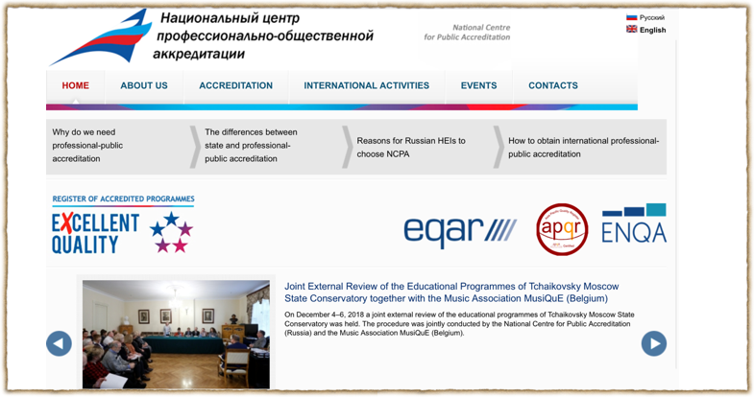
National Center for Public Accreditation (NCPA)
www.ncpa.ru

Slide 5
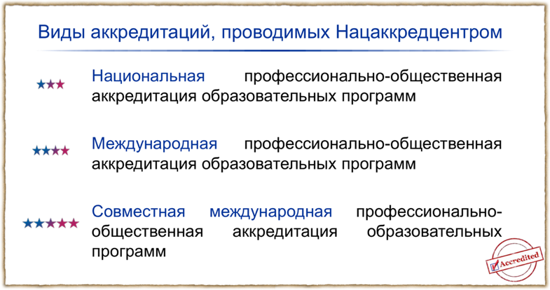
Star system

Slide 6
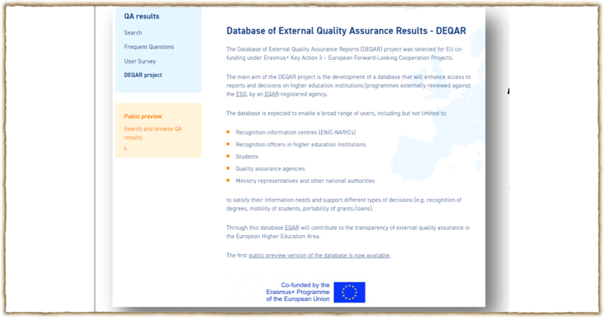
Ministerial Conference (Bologna Process)
May 24-25, 2018, Paris

Slide 7
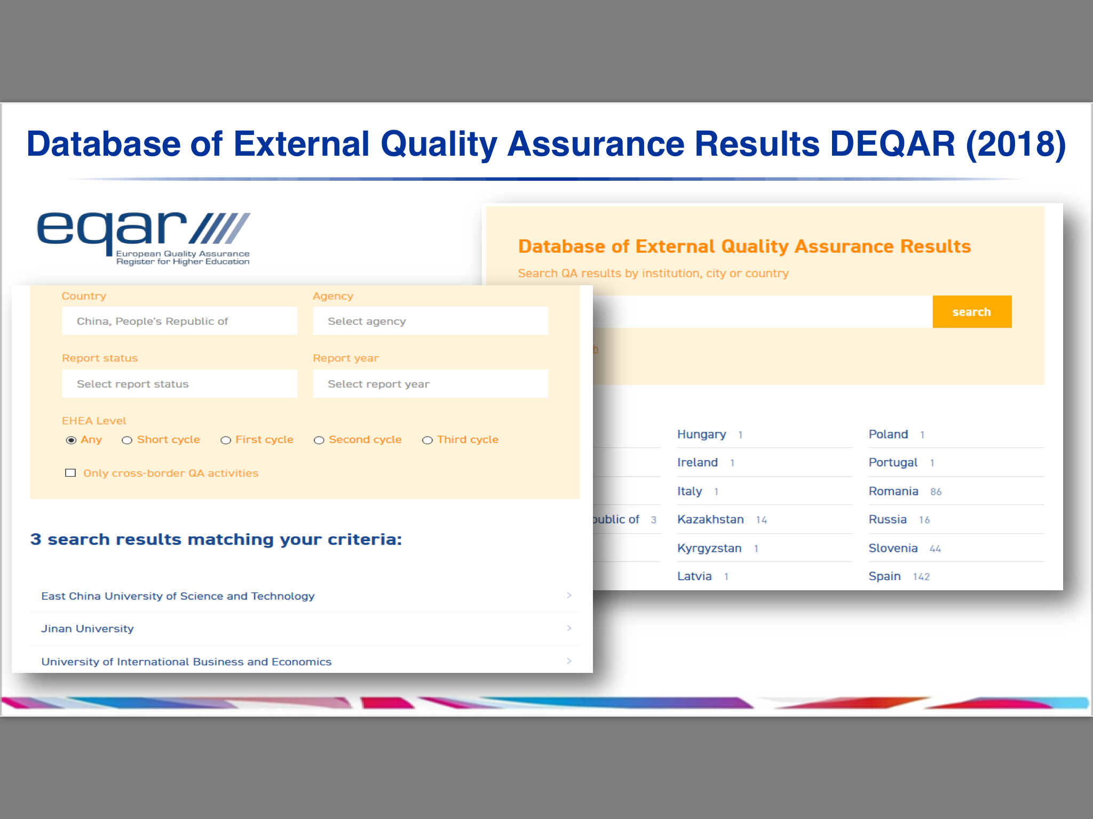

Slide 8
APQL
(International award)
Mission & Vision
Main aims
Target group of HEIs / programmes
Standards and criteria (Chiba Principles?)
Evaluation process (site visit or desk review)
Recognition of results and decisions

Slide 9
Discussion & Suggestions

