Slide 1
Management Reform
in Undergraduate Stage of Medical Elite Education under the Background of Mass Higher Education
The Third Affiliated Hospital of Kunming Medical University, China
Dong Jian, Sun Wen
Notes:
Dear experts and friends, good morning. Entrusted by professor Dong jian , I have the pleasure today of standing here to give you a brief report.
The topic of my report is Management Reform in Undergraduate Stage of Medical Elite Education under the Background of Mass Higher Education.
On the basis of the paper already submitted, we have made some improvements and adjustments.

Slide 2
ABSTRACT
Medical education in undergraduate stage has higher professional and application accuracy requirements. The setting of entrance threshold in the context of mass higher education does not meet the objective needs of undergraduate medical education. Therefore, there is necessary to make the educational reform. In this paper, the management reform strategy of medical elite education in undergraduate stage is studied.
Notes:
Medical education in undergraduate stage has higher professional and application accuracy requirements. The setting of entrance threshold in the context of mass higher education does not meet the objective needs of undergraduate medical education. Therefore, there is necessary to make the educational reform. In this paper, the management reform strategy of medical elite education in undergraduate stage is studied.

Slide 3
CONTENTS
01
02
03
Comparative analysis of undergraduate medical education at home and abroad
Analysis of the causes of the problems in domestic medical undergraduate education
Management reform measures of medical elite education in undergraduate stage
Notes:
Our report focuses on the following 3 areas:
1.Comparative analysis of undergraduate medical education in China and abroad;
2.Analysis of the causes of the problems in China's medical undergraduate education;
3.Management reform measures of medical elite education in China's undergraduate stage.

Slide 4
01
Difference of enrollment pattern
Comparative analysis of undergraduate medical education at home and abroad
Difference of culture style
Resources and curriculum differences
Notes:
Ok, let’s start the first part.

Slide 5
Difference of enrollment pattern
Abroad
China
The enrollment plan:
the higher medical schools can make their own enrollment plans
The way of admission：
not reflected in the undergraduate stage.
The enrollment plan : completed by the Ministry of Education and the local administrative departments of education.
The enrollment object : the fresh high school graduate, the same as other major.
Notes:
The first difference is enrollment pattern.
Foreign colleges and universities have their own admission autonomy wheh they recruit students. They usually follow the policies issued by the government institutions, take the meeting point between the needs of scientific research institutions as the basis for recruiting students, and can choose the specific recruitment groups. Such as Japan, when medical students are enrolled, it is the tutor in the hospital who analyzes the students. Only when the object of assessment has a certain ability can it be selected as the target of enrollment.
Only when students complete the undergraduate stage and obtain a bachelor's degree in pre-medical education can they enter into the higher medical education.
The enrollment of medical students at the undergraduate level in China is mainly completed by the Ministry of Education and the local administrative departments of education, with the same way as other majors.
In addition, the undergraduate enrollment of medical majors is also issued by the Ministry of Education. Meanwhile, the local administrative department is responsible for the control. For this reason, the admission standards of medical students in the undergraduate stage and the admission standards of other specialties cannot reflect the differences of the major.

Slide 6
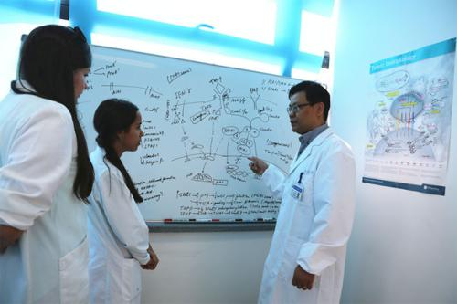
Difference of cultivation style
China
The goal is relatively general
Abroad
The emphasis is on basic education
Notes:
The second difference is cultivation style.
The basic level of education is the main focus at the undergraduate level abroad.
Since the undergraduate stage is not a professional medical education in abroad, the undergraduate medical education is about general knowledge and skills. Through the undergraduate study, students can enter the stage of higher elite education and learn more about medical knowledge.
After the completion of the study, students can be a doctor or community doctors, researchers, and so on.
For example, in the United States, the basic level of education is the main focus at the undergraduate level.
In China，the goal of medical education at undergraduate stage is relatively general, which is usually guided by the standard of "Chinese Undergraduate Medical Education".

Slide 7
Resources and curriculum differences
Abroad
China
Although there are a lot of funds invested in the construction of electronic education facilities in China's undergraduate medical schools, the occupation rate and utilization rate of modern medical education equipment are not high because of the expansion of enrollment scale in colleges and universities.
Most medical schools at the undergraduate level spend a great deal of money on infrastructure, which enables they to have more than one set of modern educational equipment in each classroom .
TEACHING RESOURCES
Notes:
In term of resources , there are also big differences between China and foreign countries.
Most medical schools at the undergraduate level spend a great deal of money on infrastructure, which enables they to have more than one set of modern educational equipment in each classroom .
Taking a clinical major in a European university as an example, its infrastructure includes computer courseware, simulation model, electrocardiogram, supersonic instrument and other modern equipment .
Although there are a lot of funds invested in the construction of electronic education facilities in China's undergraduate medical schools, the occupation rate and utilization rate of modern medical education equipment are not high because of the expansion of enrollment scale in colleges and universities.

Slide 8
Resources and curriculum differences
Abroad
China
different and Various
Unified
COURSES
Notes:
In terms of curriculum, it's generally different with different colleges and universities abroad, and even if it's the same course, different teachers will choose the appropriate teaching materials based on the students' needs and their own teaching characteristics .
In China, there are unified national standards for curriculum, and the selection of teaching materials is generally the same. We mainly choose the standardized textbooks of the Ministry of Education. For example , the "internal medicine" published by the people's Health Publishing House is widely used as the main teaching material .

Slide 9
Analysis of external cause
02
Analysis of the causes of the problems in medical undergraduate education
In China
Analysis of internal cause
Notes:
The above is our enrollment model at home and abord, training mode, as well as some of the curriculum comparision.
Let’s start our second part. We will discuss it form external cause and internal cause.

Slide 10
Difference of culture style
Analysis of external cause
The social level and the educational development level
Admission autonomy
The requirements of medical education
The employment problem
Notes:
According to the analysis and comparison of the current educational environment in China, it is found that the social level and educational development level have strong impact on undergraduate education.
First of all, in terms of enrollment standards, China has issued the independent enrollment policy of relevant colleges and universities. However, under the environment of college entrance examination, most of colleges and universities are still very passive in the enrollment choice.
Apart from that, the medical education in undergraduate stage in China is highly professional and rigid in terms of training objectives. As a result, it cannot be consistent with the mass enrollment methods of other specialties. At present, the general public and the competent department of education have higher requirements for the enrollment scale and the popularization of enrollment. Indeed, the simple results of the college entrance examination cannot reflect the overall quality of students.
The third point is the employment problem of students in the context of the expansion of enrollment. The number of clinical graduates in undergraduate stage increases year by year, while it is difficult for graduates and hospital employers to reach a consensus.

Slide 11
Analysis of internal cause
MODE AND ORIENTATION OF UNDERGRADUATE MEDICAL EDUCATION
EDUCATION HARDWARE
TEACHING METHODS
Notes:
Internal reasons ,we are still from three aspects to analyze.
There is some fuzziness in the mode and orientation of undergraduate medical education in China, and some colleges and universities still remain in the concept of "high-level medical talents" in the aspect of cognition so that medical students pay too much attention to theory but ignore practice, which makes the ability training of students lag behind.
With regard to education hardware, medical education colleges and universities in China's undergraduate stage have insufficient teaching capital input capacity. At the same time, most of the schools still have deficiencies in teaching infrastructure. Students can only carry out learning and practical training in very limited educational resources. For students, it not only affects the learning efficiency but also significantly influences the cultivation of learning enthusiasm, initiative and learning ability.
In terms of teaching methods, most of undergraduate medical teachers have the traditional educational ideas. First of all, teacher-centered, teaching-material-centered and classroom-centered teaching methods still exist. What is more, teachers lack of cognition to students. At the same time, there are more theory courses, but less practical courses and humanistic literacy curriculums. All in all, these factors have exerted negative impact on students.

Slide 12
Reform measures of educational link
Enrollment reform
Reform of talent training model
Curriculum reform
03
Management reform measures of medical elite education in undergraduate stage
Reform of management link
Educational administration reform
Teacher training reform
Teaching reform and teaching research
Quality monitoring reform
Notes:
Reform is imminent.

Slide 13
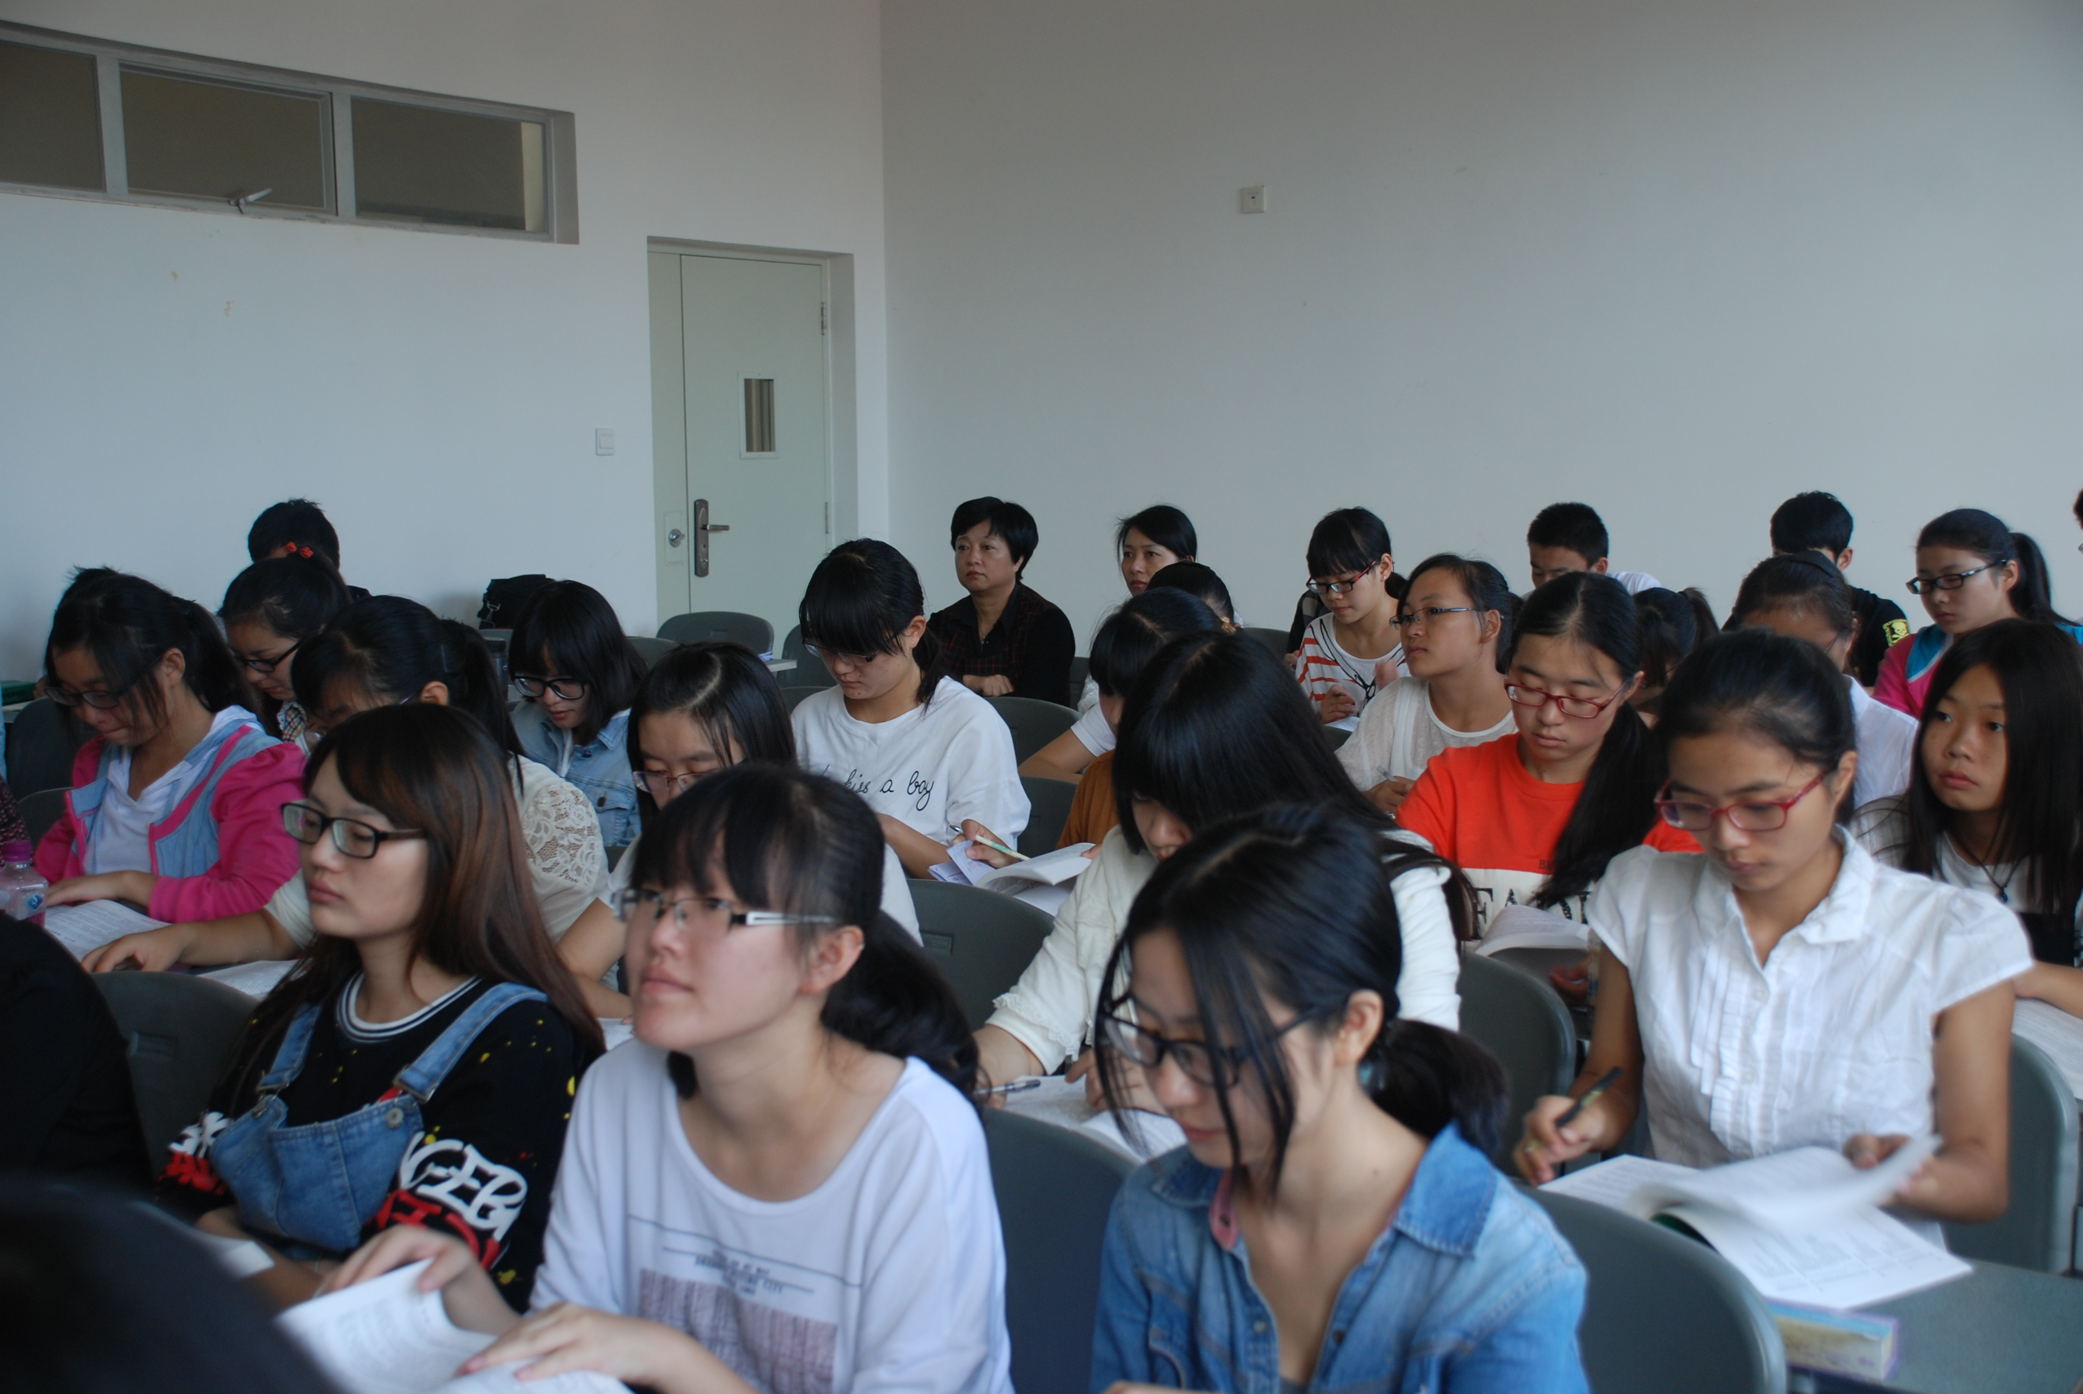
Reform measures of educational link
Macro-control
ENROLLMENT REFORM
Autonomony
Notes:
First of all, it is necessary to make it clear the macro-control responsibilities of government agencies in admission standards, and at the same time, it needs to give colleges and universities the right to recruit students of medical specialty. The colleges and universities can choose students suitable for medical study according to the standard, so as to lay the foundation for medical professional education and elite education.

Slide 14
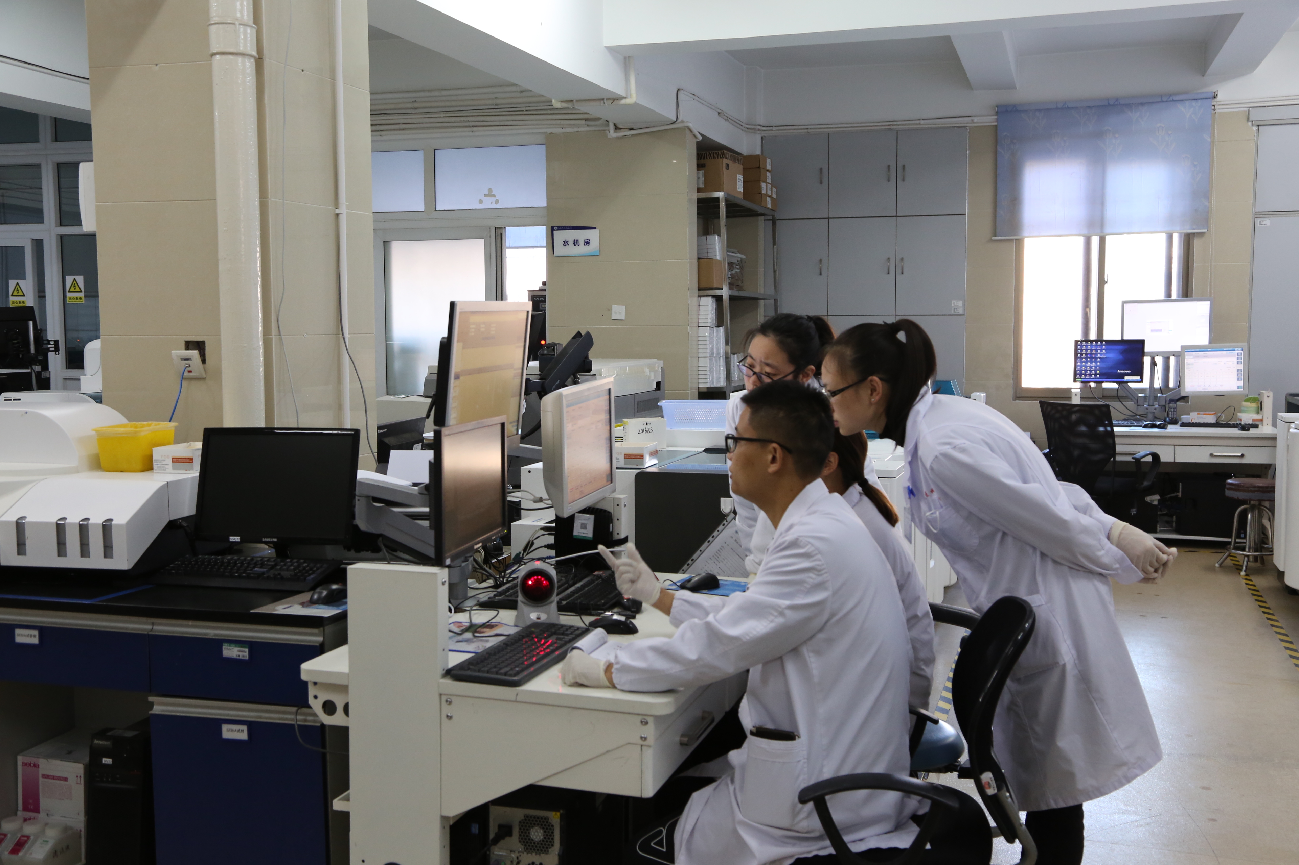
Reform measures of educational link
Reference
REFORM OF TALENT TRAINING MODEL
Improvement
Notes:
In the reform of talent training model, we can learn advanced experience form foreign countries.
the concept of talent training in the developed countries, the curriculum setting of excellent colleges and universities, and the active means of communication can all be used as reference resources for China undergraduate education.
When it comes to the curriculum reform of elite education, China's undergraduate colleges and universities should deeply analyze the disadvantages of training methods as well as the relevant construction methods of talent training standards. For instance, based on the “international standards for undergraduate medical education” proposed by the VFME, an educational and training method that conforms to the China's environment is formed and a corresponding curriculum plan is formulated. In this way, it further highlights the elite characteristics and pertinence of medical education.
Besides, we should also strengthen the education of humanistic quality and social science knowledge.

Slide 15
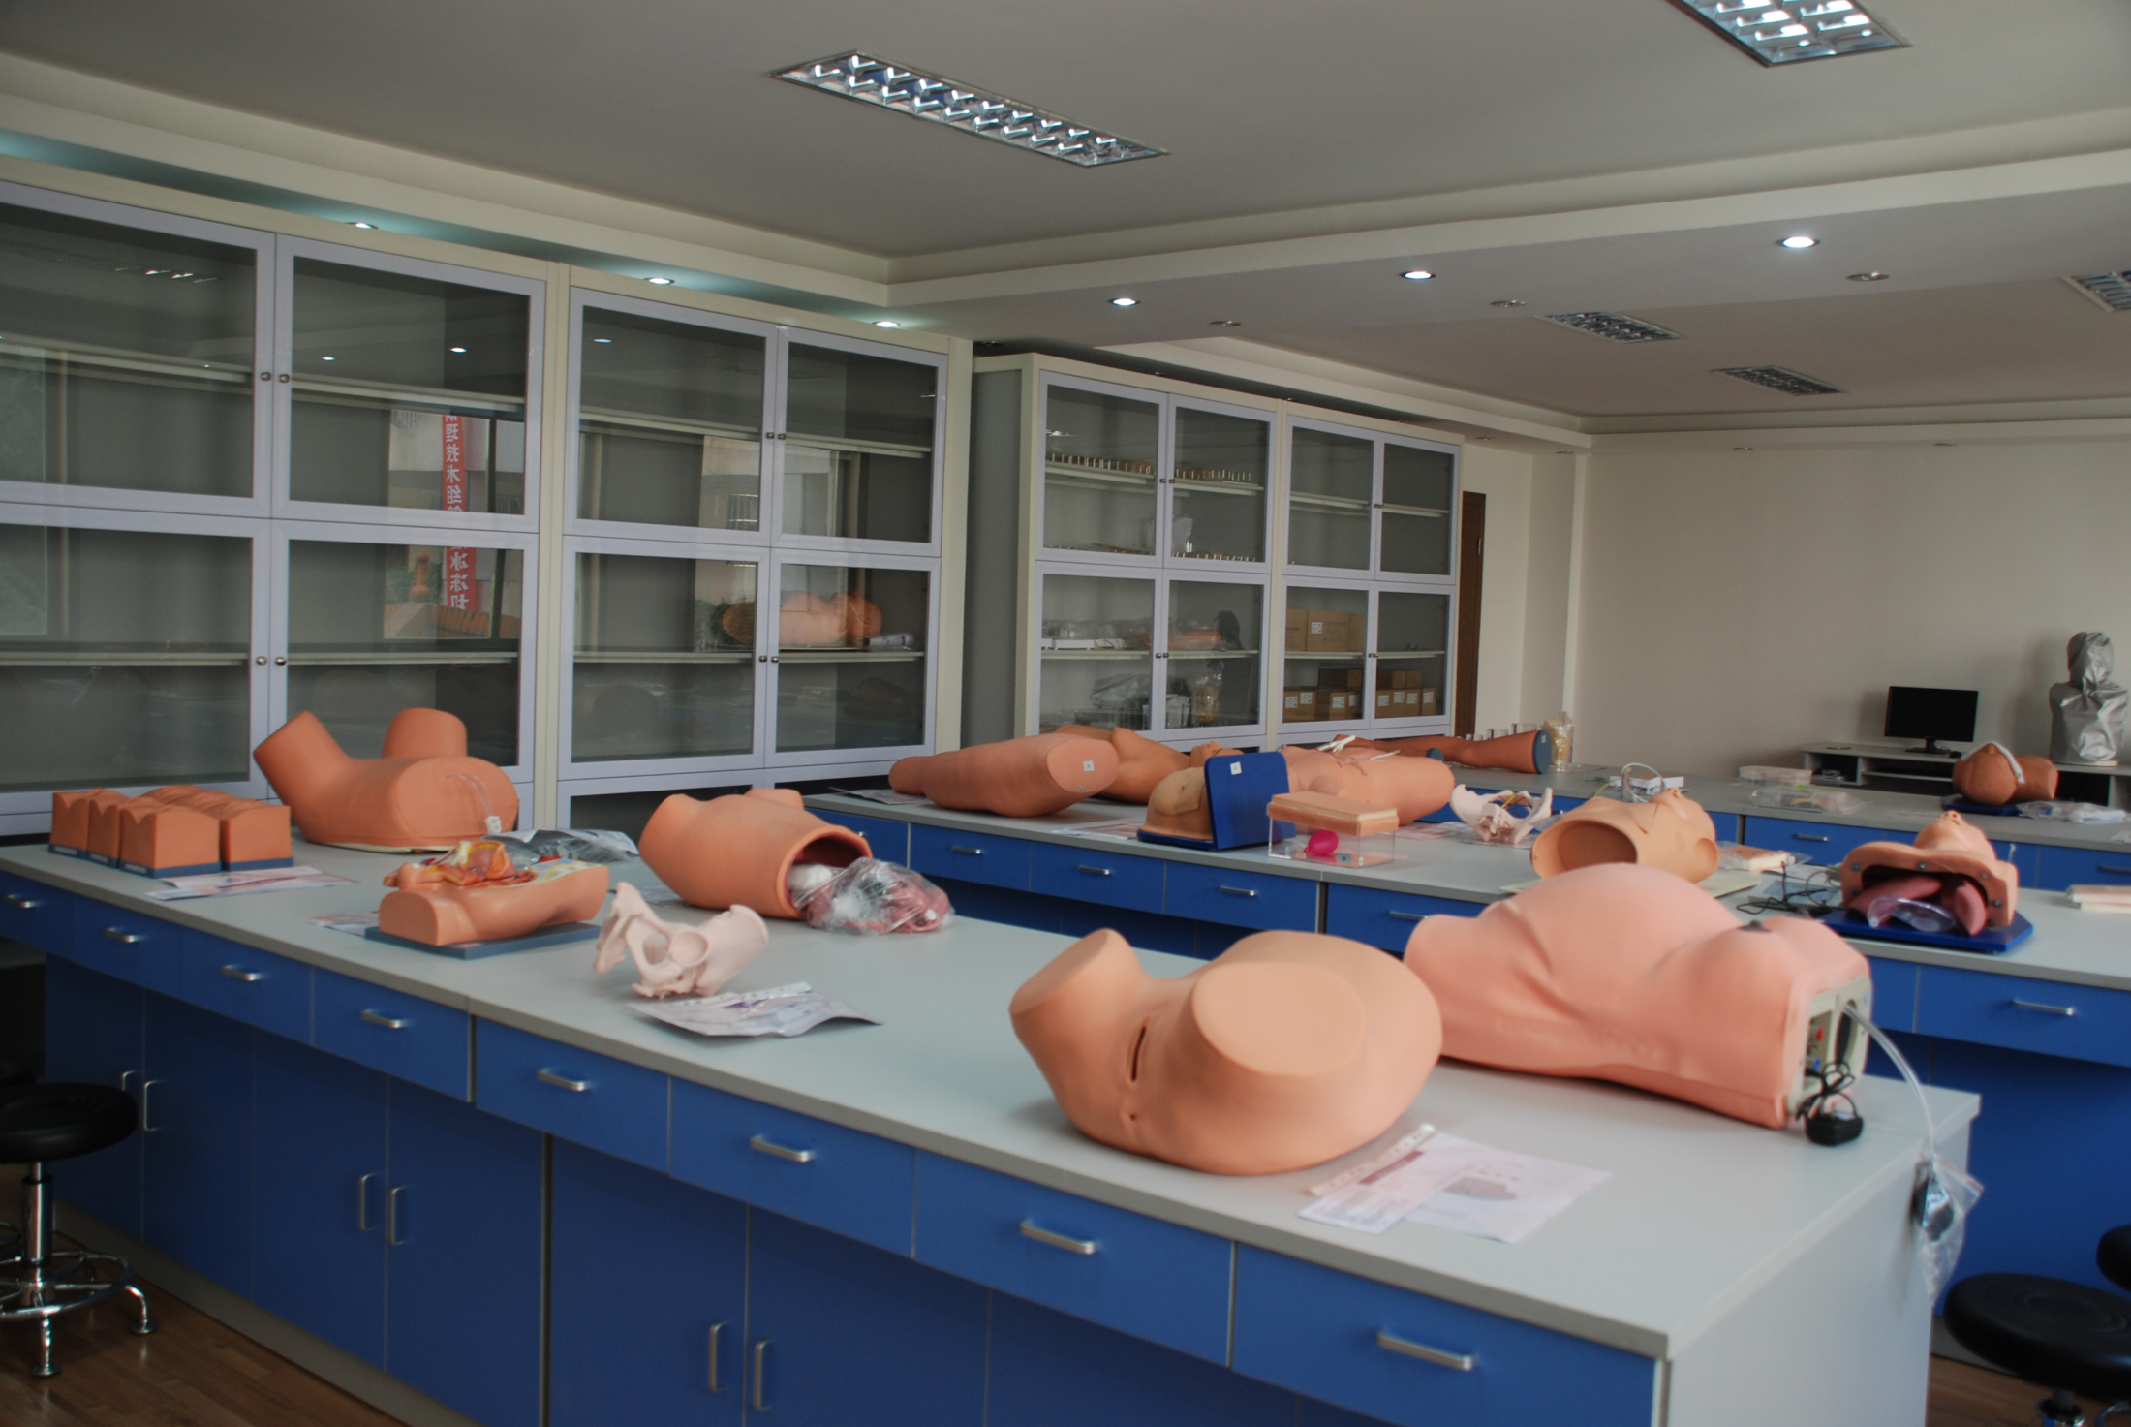
Reform measures of educational link
Improve the allocation
INFRASTRUCTUER REFORM
Increase investment
Notes:
Colleges and universities should not only identify the current problems but also further optimize the training system through active management reform. To be specific, the colleges and universities should actively improve the allocation of school resources, create a perfect and three-dimensional training infrastructure, increase investment, make reasonable control, and take advantage of various strategies to ensure that students can study with modern educational equipment and form the ability of applying theory.

Slide 16
Reform of management link
EDUCATIONAL ADMINISTRATION REFORM
Complementary Advantages
Resources Sharing
MEDICAL SCHOOL
AFFILIATED HOSPITAL
Notes:
The subordinate relationship used in undergraduate medical education is generally the relationship between medical school and affiliated hospital. In the process of reform and adjustment by The administrative department for education and clear the subordinate relations, can help to obtain resources and medical education and research and development in colleges and universities. At the same time, strengthening the guidance of affiliated hospital education through the ministry of education can promote the complementary advantages between medical school and affiliated hospital. The environment of the affiliated hospital can also help students understand theoretical knowledge and practical methods.

Slide 17
Reform of management link
Teacher training reform
The level of teachers and the ratio of teachers and students are also the main strategies in the adjustment and optimization of the training mode in colleges and universities.
ADJUST THE
“T-S”RATIO
BUILD
“DOUBLE TEACHERS”
PROVIDE A GOOD PLATFORM
Notes:
The level of teachers and the ratio of teachers and students are also the main strategies in the adjustment and optimization of the training mode in colleges and universities.
we can try to build "double teachers" to enrich teachers' teaching and practical abilities, and promote teachers' guiding ability.
Strengthen the cultivation, improve the examination and incentive mechanism, and provide a good platform for the development of university teachers.
In the aspect of teacher-student ratio, teachers and students should be closely combined by means of structural adjustment.

Slide 18
Reform of management link
Quality monitoring reform
Education quality monitoring is the main method of educational quality evaluation.,The teaching level in higher education stage is evaluated by means of data searching and data statistics.
The national data platform can be regarded as the main platform for the quality monitoring of education in undergraduate stage of medical education.
In terms of the platform, information technology and network technology can analyze the general rules in the course of undergraduate medical education, and make use of teaching state and online data collection to form a professional annual database.
At the same time, combined with the specific information, the basic situation of the school, the content of teaching monitoring is classified and it's finally presented objectively in the form of report forms.
Notes:
Education quality monitoring is the main method of educational quality evaluation. The teaching level in higher education stage is evaluated by means of data searching and data statistics.
The national data platform can be regarded as the main platform for the quality monitoring of education in undergraduate stage of medical education.

Slide 19
To sum up, undergraduate medical education is undertaking an important social responsibility, and needs to make active efforts in the way of enrollment and the quality control of talents. Under the background of mass higher education, the undergraduate medical education should not change according to changing circumstances, but should adopt management reform measures to build a perfect and comprehensive elite education program so as to improve teaching quality and talent training ability and to provide medical talents to the society
Conclusion

Slide 20
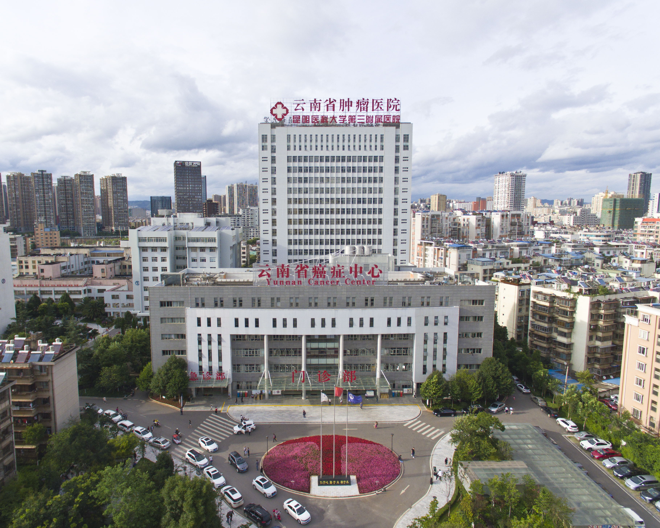
THANK YOU!

