Slide 1
Faculty initiatives for enhancement and assurance of quality in teaching & learning at SLIIT
Anuradha Karunasena, Windhya Rankothge, Colin N. Peiris
Sri Lanka Institute of Information Technology(SLIIT)

Slide 2
Overview
Quality in higher education
Quality Enhancement and Quality Assurance
Initiatives taken to enhance and assure quality at SLIIT
Impacts of quality initiatives

Slide 3
What does quality mean in HE?
Generally the term quality refers to
  adherence to pre-defined standards,
  fitness to purpose of the product or service developed,
  meeting customer needs (Seyyed-Hashemi & Leitner, 2004)
In the context of education, quality may refer to as
  fitness for purpose of academic standards
  producing qualified and competent graduates at a reasonable cost,
  transforming the students to professionals (Harvey & Green, 2002)

Slide 4
Quality Enhancement and Quality Assurance
Quality Enhancement is
  more focused on improvement and development
  a formative process
  focuses on present and the future (Elassy, 2015)
Quality Assurance
  more associated with assessment and accountability
  a summative process
  focuses on the past (Elassy, 2015)

Slide 5
SLIIT
A leading non-state degree awarding institute established in 1999.
Member of the ACU, IAU and APQN.
More than 13000 alumni
Initiatives for quality are taken by
  Internal Quality Assurance Unit(IQAU) and
  Faculty Quality Cells (FQCs)

Slide 6
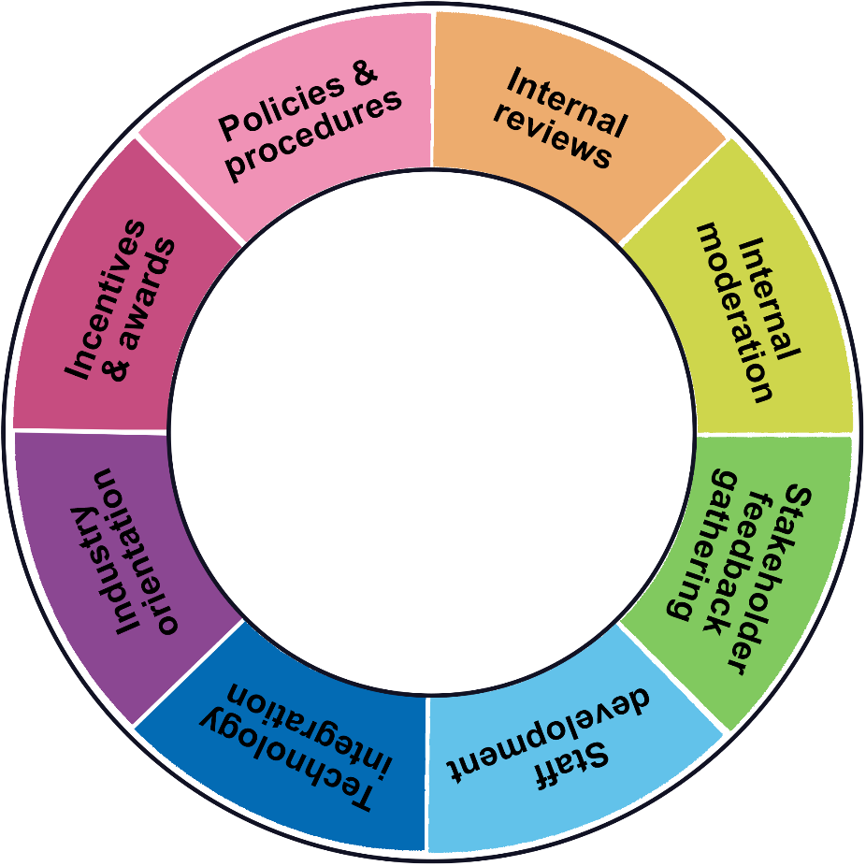
Quality Enhancement Initiatives at SLIIT
Quality
Enhancement

Slide 7
1. Policies and Procedures
Policies
  graduate attribute policy,
  assessment policy,
  the academic integrity policy
Procedures
  approval of modules/programs,
  revising modules/programs,
  setting assessments,
  using learning management systems
  archiving materials
  publishing results

Slide 8
2. Reviews
Program level reviews
  external reviewers prior to program approval,
  reviews conducted within departments and
  reviews conducted by industry consultative boards
Module reviews
  a self-review of reflection summarizing
    best practices
    student feedback
    moderator feedback
    improvements to be made in future

Slide 9
3. Moderation
Assessment moderation
  conducted internally as well as externally
  factors considered :
    whether learning outcomes are met,
    marks distribution is appropriate,
    questions are suitable for the level of study of the module
Marking moderation
  assess whether the marking is conducted in a consistent manner
  feedback on how the marking can be further improved is given

Slide 10
4. Stakeholder Feedback Gathering
Student Feedback
  collected via a student feedback form on
    module : module content, workload & etc
    lecturer : teaching methods, motivation, support & etc.
Employer feedback
  feedback obtained during internships
  HR forum
  industry consultative boards

Slide 11
5. Staff Development
Staff Development Center of SLIIT
  120 hours course on teaching and learning
  seminars, workshops and other courses
Funding to participate in external programs
  Ex: Certification programs

Slide 12
6. Technology Integration
Technological solutions to provide effective teaching and learning
  recording lectures
  publishing learning materials
  conduct examination and marking of answer scripts
  communication between staff and student
  checking for violations of academic integrity
  access to online resources such as e-books and scholarly articles via library portal

Slide 13
7. Industry Orientation
Initiatives are taken to familiarize students with industry practice
  mandatory internships instilled in programs
  having lectures conducted by industry experts
  obtaining feedback through industry consultative boards

Slide 14
8. Performance-based Incentives & Awards
Yearly performance evaluation of academic staff members
  considers best practices of teaching and learning
Annual Staff Awards Night of SLIIT
  recognizes teaching innovations

Slide 15
Quality Assurance Initiatives at SLIIT
Quality assurance
Satisfactory surveys and employability surveys
Accreditations
External reviews and validation
External moderation and examination

Slide 16
Quality Assurance (Contd.)
Satisfactory and Employability Surveys
  Conducted annually
  used as an indicator of fitness of purpose of academic programs
Accreditations
  accreditation by professional bodies to validate fitness for purpose.
    all the programs offered by the faculty are accredited by IET
    accreditation CSSL

Slide 17
Quality Assurance (Contd.)
3. External reviews and validation
  review conducted by MoHE of Sri Lanka
  external bodies such as Australian Computer Society(ACS).
4. External examination
  learning outcomes, assessments
  external examination of research work

Slide 18
Impacts of Quality Initiatives
Visible via a wide range of indicators
  Accreditations
  Student Achievements
  Public entrustment

Slide 19
Impacts of Initiatives - Accreditations
Quality of teaching and learning is an major consideration for external bodies accrediting academic programs
Programs of FoC received
  IET Accreditation
  CSSL Accreditation
Degree offered by SLIIT from Curtin University is accredited by ACS

Slide 20
Impacts of Initiatives – Student Achievements
SLIIT students have kept abreast with students from state universities in both national and international arena
  Ganindu Nanayakkara, creator of the iHelmet won $500,000 as first runner-up in the Verizon 2015 Powerful Answers Award contest
  3 gold awards, 2 silver awards, 2 bronze awards and 13 merit awards at NBQSA during last 5 years
  Merit award representing Sri Lanka at APICTA in Hong Kong
  Gold award at E-Swabhimani
  Produced several renown entrepreneurs in Sri Lanka

Slide 21
Impacts of Initiatives – Public Entrustment
During the past few years FoC received a large number of applications for enrollment.

Slide 22
Thank you !

