Slide 1
Staff Reward and Recognition Scheme to Motivate Academic Staff in Higher Education:
Case Study in
Sri Lanka Institute of Information Technology
Windhya Rankothge, Anuradha Karunasena, Colin Peiris

Slide 2
Outline
Staff reward and recognition schemes for higher education institutes
Effect on staff motivation and performance
Challenges
Related Work
Case study at Sri Lanka Institute of Information Technology (SLIIT)

Slide 3

Introduction
The academic staff of higher education institution is a key resource to institution’s success.
The performance of academic staff determines the quality of the higher education
and has a significant impact on student learning.

Slide 4

Performances and Rewarding Schemes
The Vroom’s expectancy theory of motivation [1] suggests that
employees are motivated to perform well when there is a link between their performances and the reward they receive.
Rewarding systems can serve the purpose of
retaining, motivating the academic staff, and assisting achieving academic staff objectives.
[1] Fred C. Lunenburg, Expectancy Theory of Motivation: Motivating by Altering Expectations, International Journal of Management, Business and Administration, Volume 15, Number 11, 2011

Slide 5

Implementing a Staff Rewarding Scheme
Challenges
How the scheme can capture all aspects of staff work output?
Is the scheme having the capability to complement quality of the staff work output?
What types of rewards and recognitions can be offered?
How do they contribute positively to job performance and motivation?

Slide 6


Related Work
Identify academic staff rewards related problems at Jimma University, Ethiopia.
Determine the effects of reward on employee job performances in Kenyatta University.
Studying the job satisfaction of academic staff in the higher education sector of United Arab Emirates.
Studying the impact of total rewards on organizational commitment among academic staff in higher education institutions.

Slide 7

Staff Rewarding Scheme:
Sri Lanka Institute of Information Technology
A leading non-state higher education institute in Sri Lanka.
Approved by the University Grants Commission (UGC) under the Universities Act.
A member of the Association of Commonwealth Universities (ACU) and the International Association of Universities (IAU).
SLIIT introduced a performance-based evaluation scheme in year 2015.

Slide 8
Staff Rewarding Scheme:
Sri Lanka Institute of Information Technology
Objectives
Provides a clear understanding about the academic staffs’ goals, required outcomes, and how the success of the contributions will be assessed.
Helps academic staff to accomplish both personal development and institutional goals.
Provides legal, ethical, and visible evidence that academic staff were actively involved in understanding the requirements of their jobs and their performance.
Provides evidence of non-discriminatory promotion, pay, and recognition processes.

Slide 9

Staff Rewarding Scheme:
Sri Lanka Institute of Information Technology
Evaluating the academic staff performances:
Quantified evaluation
Subjective evaluation

Slide 10

Staff Rewarding Scheme:
Sri Lanka Institute of Information Technology
Quantified evaluation
Based on the standard academic activities a faculty member should engage with (work load).
Provide a balance between staff who are teaching modules with a larger number of students with staff who are engaged in teaching larger number of modules

Slide 11
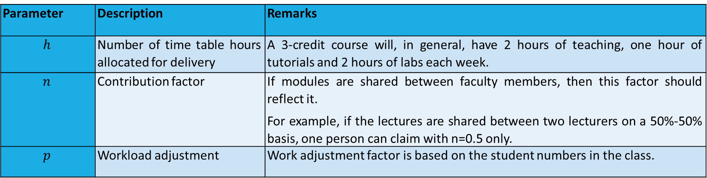
Staff Rewarding Scheme:
Sri Lanka Institute of Information Technology
Quantified evaluation Cont.
Parameter | Description | Remarks
$$h$$ | Number of time table hours allocated for delivery | A 3-credit course will, in general, have 2 hours of teaching, one hour of tutorials and 2 hours of labs each week.
$$n$$ | Contribution factor | If modules are shared between faculty members, then this factor should reflect it. For example, if the lectures are shared between two lecturers on a 50%-50% basis, one person can claim with n=0.5 only.
$$p$$ | Workload adjustment | Work adjustment factor is based on the student numbers in the class.

Slide 12
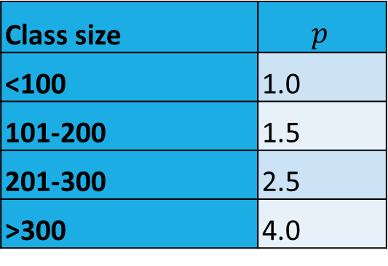
Staff Rewarding Scheme:
Sri Lanka Institute of Information Technology
Quantified evaluation Cont.
The workload adjustment parameter p balances between staff who are teaching modules with a larger number of students with staff who are engaged in teaching larger number of modules
Class size | $$p$$
<100 | 1.0
101-200 | 1.5
201-300 | 2.5
>300 | 4.0

Slide 13
Staff Rewarding Scheme:
Sri Lanka Institute of Information Technology
Subjective evaluation
A self-evaluation of the SLIIT academic staff contribution presented to the HOD/Dean for review.
It focuses on two aspects:
    Research output: journal publications, conference publications and any other research related activities.
    Self-improvement: contributions to the institute, country and self within the past year.

Slide 14
Staff Rewarding Scheme:
Sri Lanka Institute of Information Technology
Recommendations for the performances
Once the performance-based evaluation forms are duly filled and submitted by the academic staff member,
it is evaluated confidentially by the HOD and Dean of the Faculty together with the academic staff member.
The HOD and Dean of the Faculty together will make their recommendations for the performances of the academic staff.

Slide 15
Staff Rewarding Scheme:
Sri Lanka Institute of Information Technology
Recommendations for the performances Cont.
Scale Value | Description | Increment status
1 | Poor performance | Maybe ineligible for an increment
2 | Needs improvement | Conditional eligibility for an increment
3 | Satisfactory performance | Eligible for an increment.
4 | Good performance
5 | Exceptional performance

Slide 16
Staff Rewarding Scheme:
Sri Lanka Institute of Information Technology
Ethical Aspects
Performance-based evaluation should never be used to penalize the academic staff.
The evaluation should be impartial and justifiable and the reasons for management staff judgment, positive or negative, should be made known to the academic staff member being evaluated at a meeting conducted with the evaluator.

Slide 17
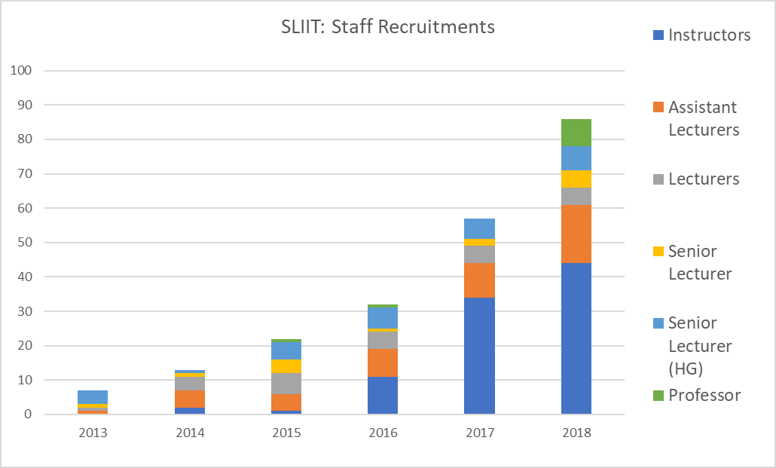
Staff Rewarding Scheme:
Sri Lanka Institute of Information Technology
Impact of the performance-based evaluations

Slide 18
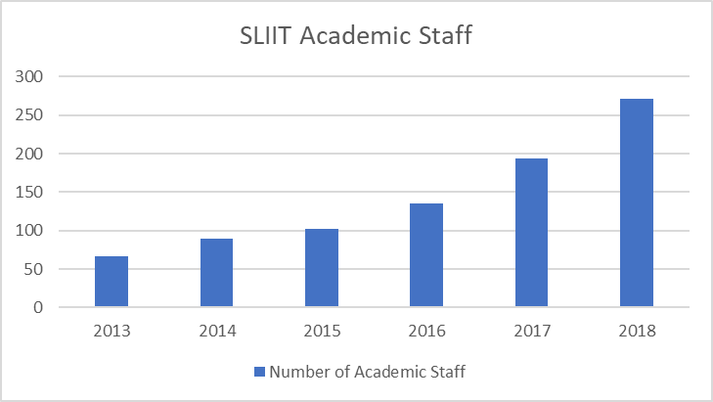
Staff Rewarding Scheme:
Sri Lanka Institute of Information Technology
Impact of the performance-based evaluations Cont.

Slide 19
Final Remarks
Staff reward and recognition schemes.
Effect on staff motivation and performance.
Case study at Sri Lanka Institute of Information Technology (SLIIT).
SLIIT has gained a good reputation as a satisfied place to work.
Attract lots of high calibrated academic staff.
Existing academic staff is satisfied with SLIIT working environment.
They are retaining in the institute.

Slide 20
Acknowledgements
SLIIT Management
SLIIT Human Resource Management Division
SLIIT Academic staff
SLIIT Non-academic staff

Slide 21


