Slide 1
IN THE NAME OF ALLAH, THE COMPASSIONATE, THE MERCIFUL

Slide 2
Fostering Internal Quality Assurance: Nurturing Quality Research Culture In Higher Edu Institutions
Abdul Saboor Zahid, Muhammad Asif & Qurat Ul Ain
NDU, Pakistan

Slide 3
Sequence
About NDU
Abstract
Introduction
Literature Review
Challenges
Strategies to Improve Research
Conclusion
Recap

Slide 4
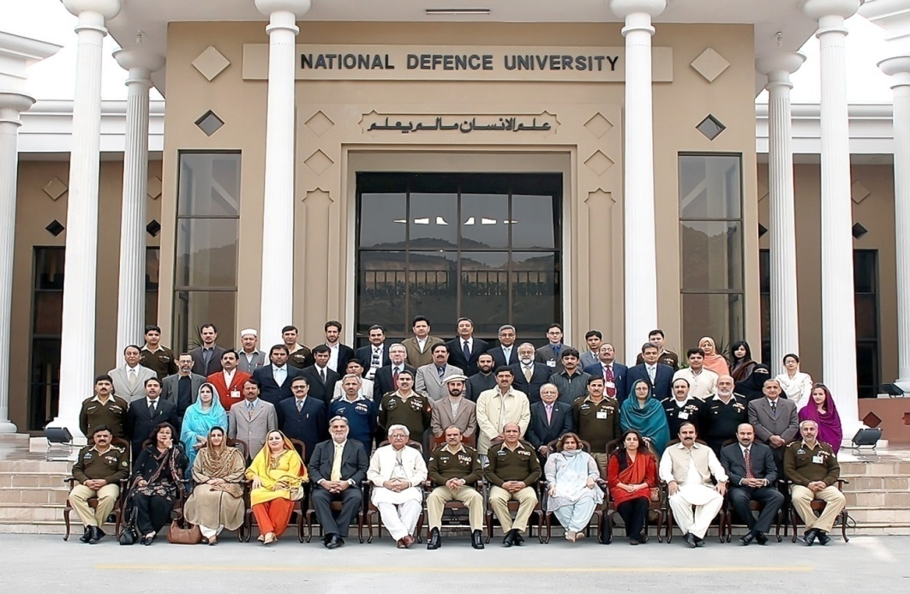
College in 1947
University on 27 January 2007

Slide 5
MISSION
Prepare future leadership from public and private sectors of Pakistan and friendly countries through multi-disciplinary educational and research programs, professional exchanges and outreach, focusing on security and contemporary studies

Slide 6
ORGANIZATION
Chancellor
President NDU
Faculty of Security Studies (FSS)
Faculty of Contemporary Studies
(FCS)
A DIvision
ISSRA
Dept of
Govt & Pub Policy
B Division
Dept of
Peace & Conflict Studies
Dept of Strat Studies
AOD
Dept of
Ldrship & Mgmt Studies
Dept of
Intl Relation

Slide 7
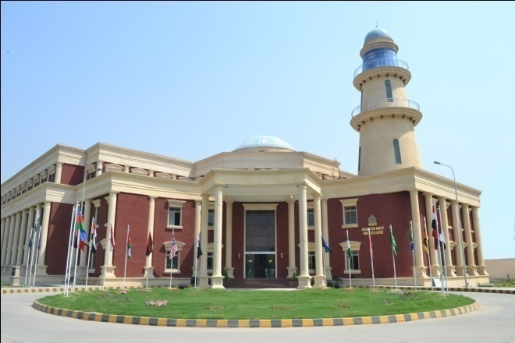
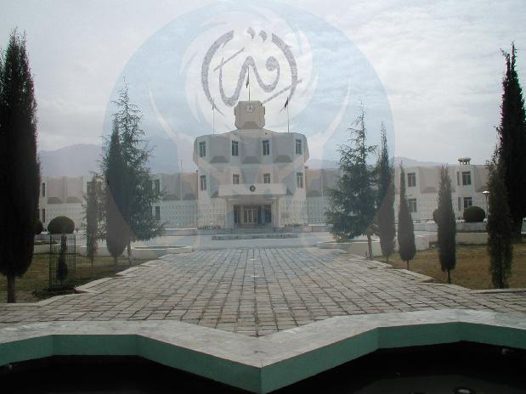
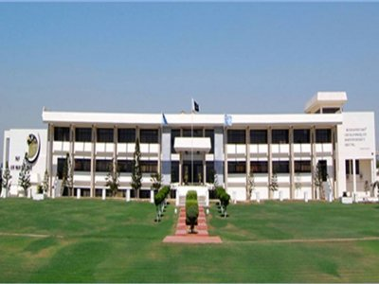
AFFILIATED COLLEGES
Naval War College
Lahore
(15 Dec 2007)
Command & Staff College, Quetta
(15 Dec 2007)
Air War College
Karachi
(15 Dec 2007)

Slide 8
FACULTY OF SECURITY STUDIES

Slide 9
ALLIED PARTICIPANTS NSWC
Asia - 24
America / Europe - 7
Africa - 12
Australia - 1
1
2
1
1
1
3
1
1
1
1
1
1
2
1
2
1
1
6
1
1
5
2
6
1
1
1
1
Total 44

Slide 10
ALLIED PARTICIPANTS SINCE 1988
Flag | Cty | Upto NSWC-18 | NSWC 19
 | Australia | 20 | 1
 | Azerbaijan | 1 | -
 | Bangladesh | 33 | 2
 | Bahrain | 4 | -
 | Brazil | 3 | 1
 | Brunei Darussalam | 4 | -
 | Bosnia & Herzegovina | 2 | -
 | Canada | 2 | -
 | China | 45 | 3
 | Egypt | 21 | 2
Flag | Cty | Upto NSWC-18 | NSWC 19
 | France | 6 | -
 | Germany | 7 | -
 | Indonesia | 6 | 1
 | Iran | 13 | 1
 | Italy | 2 | -
 | Iraq | 2 | -
 | Jordan | 45 | 1
 | Kuwait | 2 | -
 | Lebanon | 11 | 1
 | Libya | 4 | 1

Slide 11
ALLIED PARTICIPANTS SINCE 1988
Flag | Cty | Upto NSWC-18 | NSWC 19
 | Malaysia | 37 | 1
 | Myanmar | 1 | 1
 | Nepal | 18 | 2
 | Netherlands | 1 | -
 | Nigeria | 115 | 5
 | Oman | 15 | 2
 | Palestine | 2 | 1
 | Qatar | 18 | -
 | KSA | 71 | 5
 | S. Africa | 4 | -
Flag | Cty | Upto NSWC-18 | NSWC 19
 | S. Korea | 1 | -
 | Sri Lanka | 51 | 7
 | Sudan | 3 | -
 | Turkey | 20 | 1
 | Turkmenistan | 7 | 1
 | UAE | 23 | 1
 | UK | 17 | 1
 | USA | 40 | 1
 | Zimbabwe | 7 | 1
Total |  | 683 | 44

Slide 12
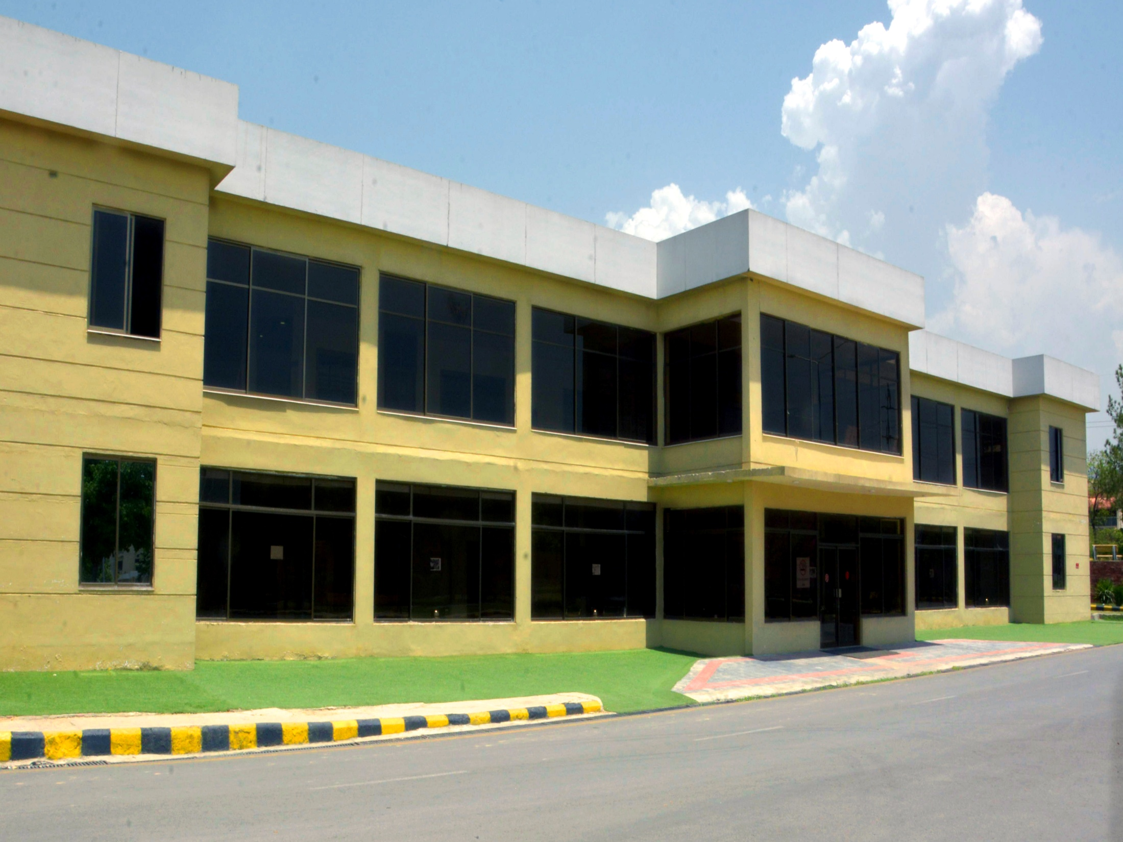
FACULTY OF CONTEMPORARY STUDIES

Slide 13
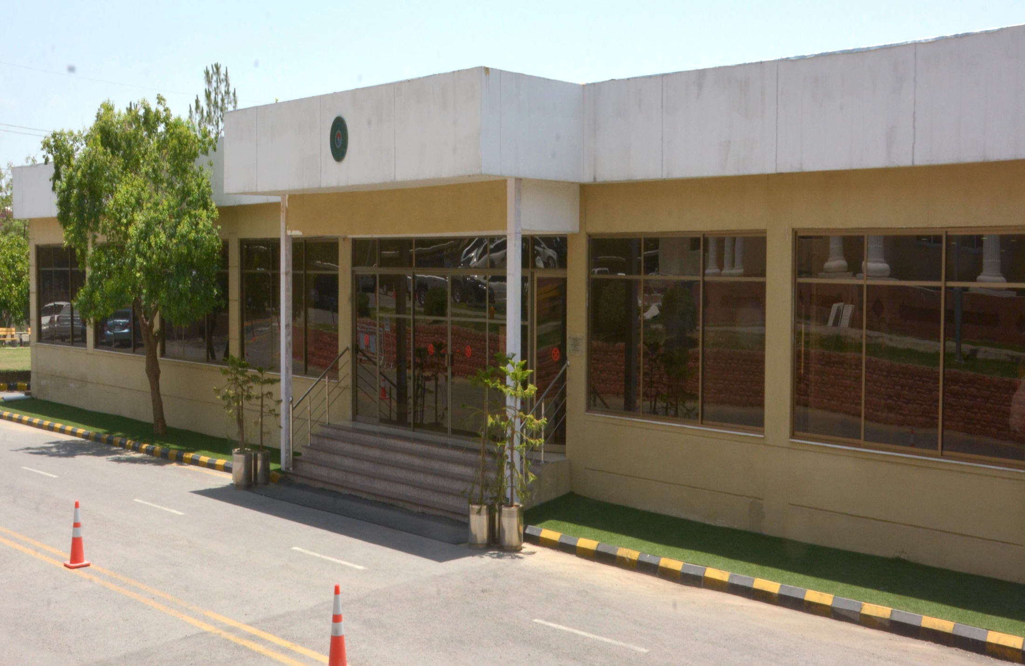
AIM OF FCS
To offer BS, MS/ MSc, MPhil and PhD programs to public and private sectors in disciplines specific to national security

Slide 14
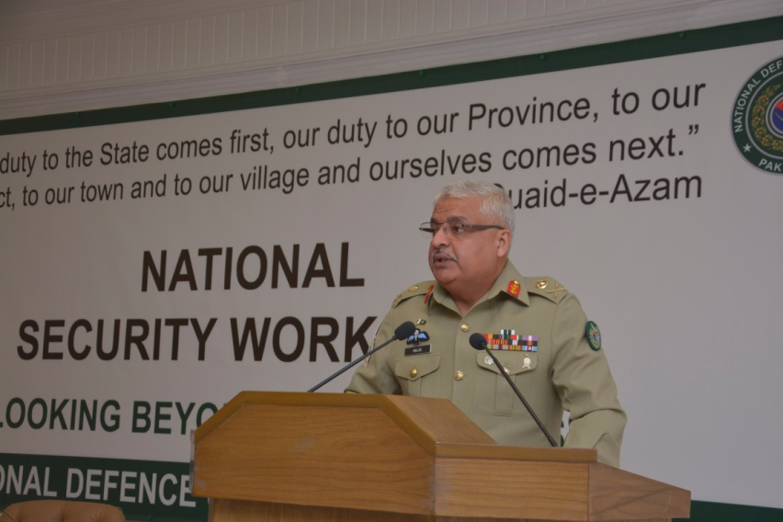
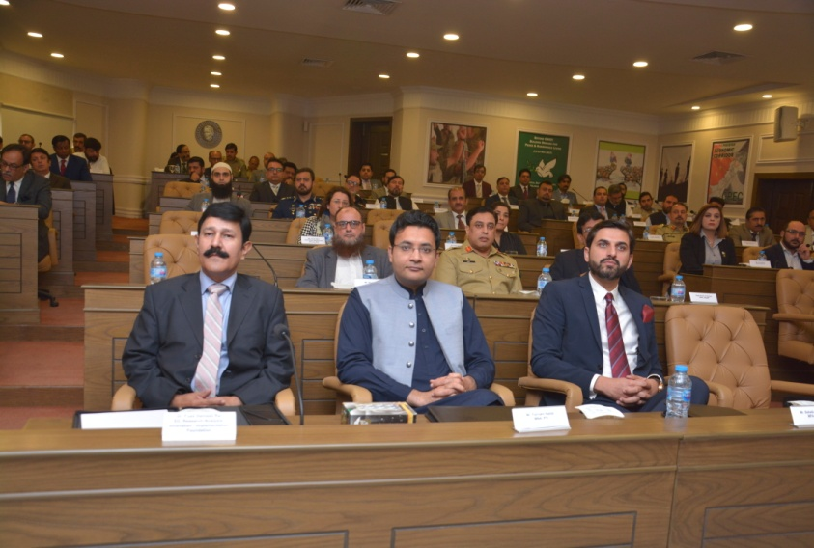
NATIONAL SECURITY WORKSHOP (NSW)
Duration : 5 x weeks
Held annually
1109 individuals have participated in 20 workshops since 2003
Participants:-
Parliamentarians
Senior Bureaucrats
Senior Armed Forces Officers
Representatives from Civil Society
Businessmen
Industrialists
NSW – 20 (20 Oct -23 Nov 18)

Slide 15
COLLABORATION

Slide 16
NDU COLLABORATION
Canadian Forces College
(CFC)
Sep 2006
MoD
Mar 2010
MoD
Nov 2014
Russian Institute of Strategic Studies (RISS)
Apr 2014
South Asian Strategic Stability Institute (SASSI)
Jul 2010
BILGESAM
Oct 2015
Central Committee of the Communist Party of China” Party School (CPS)
Apr 2007
Center for Mil Strat Research (CMSR)
Aug 2015
Italian Centre of Defence Higher Studies (CASD)
Jan 1997
NIDS
Jun 2016
John Hopkins University
Oct 2015
Arab Thought Forum
(ATF)
Nov 2014
NDU China
Mar 2012
Cen for Def Strat Research
Feb 2016
Promotion of Edn in Pak (PEP)
Mar 2014
Nasser Military Academy
Apr 2015
Kotelawala National Defence University
Apr 2015
Key
MoU: Memorandum of Under Standing
MoC: Memorandum of Cooperation
ACA: Academic Cooperation Agreement
SoI : Statement of Intent
Naseer Higher Mil Academy Jan 2018
Naif Arab University of Security Sciences (NAUSS)
Dec 2012
Lakshman Kadirgamar Institute
Apr 2015
Gulf Research Center, Dubai (GRC)
Mar 2007
23 x MoUs / ACAs signed with Institutes of 17 x countries
5 x Domestic Institutes
17 x MoUs / ACAs under process with 12 x countries

Slide 17
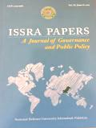
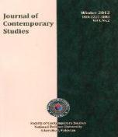
NDU PUBLICATIONS
Margalla Papers - Annual (X Cat) Upgraded Mar 18
NDU Journal - Annual (Y Cat)
ISSRA Papers - Biannual (Y Cat) Upgraded Mar 18
Strategic Thought - Annual In Process
Journal of - Annual (Z Cat) Approved in 2017
Contemporary
Studies

Slide 18
NDU PUBLICATIONS
Regular Publications
NDU Journal - Annual (X Cat)
Margalla Papers - Annual (X Cat)
ISSRA Papers - Biannual (Y Cat)

Slide 19
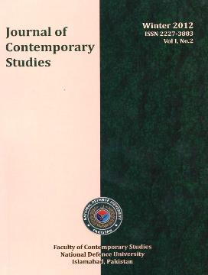
NDU PUBLICATIONS
Regular Publications
2015
An annual publication
of FCS
NDU Monograph
A quarterly publication

Slide 20
NDU WEBSITE

Slide 21
NDU
A PICTORIAL OVER VIEW

Slide 22
Abstract
This study provides a factual over view that how challenges are converted into opportunities in case of Higher Education Institutions (HEIs) of Pakistan
There is a growing understanding that Higher Education Institutions should nurture a ‘quality culture’ in which structural and psychological elements act in synergy to continuously improve research in higher education

Slide 23
Abstract
It is pertinent to note that different models are being used in different HEIs to ensure creation of research culture in their respective Institutions
In Pakistan, Higher Edu Commission (HEC) has also adopted a research incentives based approach for the uplift of faculty and research activities in Higher Edu Institutions

Slide 24
Abstract
Novelty of this study is to introduce innovations for enhancement of research culture in Higher Edu Institutions
The model of this study can also be improved by incorporating innovative ideas and good practices by researchers in other HEIs

Slide 25
Abstract
National and intl Higher Edu Institutions may take lead from this study while planning and undertaking new research incentives and models

Slide 26
Introduction
Quality enhancement of higher education is largely dependent on the quality of research being produced by a University
Strong linkage with the Socio-Economic development of the Country
“A quality education providing institute always proves to be a model for modern civil societies” (Batool and Qureshi, 2007)”

Slide 27
Introduction
Fundamental improvements should be made by introducing new research incentive model
National Defence University (NDU) Islamabad-Pakistan, though a new University, the critical role of research has been fully appreciated and ingrained in its vision

Slide 28
Introduction
This paper is intended to highlight the research initiatives taken by NDU to give respect and credit to scholars by recognizing their original scholarly accomplishments
It lays down NDU zero tolerance towards plagiarism and other unbecoming practices related to research pubs

Slide 29
Literature Review
“Higher education has a key role in economic development and social growth of a nation. Higher Education Institutes (HEIs) are mostly responsible for Higher Education through creation of knowledge based society via research that transforms a nation (Meek et al., 2009; Bonn Declaration 2007)”

Slide 30
Literature Review
“Various measures have been taken to enhance performance of the University staff by Higher Edu Commission (Batool and Qureshi, 2007)”
The faculty / research scholars are highly encouraged to make research publications. This study not only contributes towards their personal academic growth but also helps improve research standard of the University

Slide 31
Challenges – 2012/13
Absence of QA mechanism
Non existence of research culture
Reluctance for research
Lack of awareness
Lack of motivation
Only 12 articles in 2013

Slide 32
Strategies
Strategy 1. Establishment of QA mechanism
HEC research / performance based grant
HEC Internal and External Reviews
University Bi annual departmental review
Strategy 2. Research incentives
Strategy 3. Awards
Strategy 4. Corrective Measures

Slide 33
Strategy 1. Estab of QA Mechanism
QAA
Internal QA
(QEC)
External QA
(HEC)
IPE Review
PhD / Mphil Progms Reviews
SAR / EAT Review Visit
Bi-Annual Dept Review
Legend:
QAA= Quality Assurance Agency
SAR= Self Assessment Report
EAT=External Assessment Team
IPE= Institutional Performance Eval

Slide 34
Bi Annual Review-Publish or Perish
“Publish or Perish”, is the popular quote in all progressive and growth oriented Universities. Research is a critical activity and must be assigned high priority, particularly in universities offering research degrees (MS/MPhil/PhD)

Slide 35
Bi Annual Review-Publish or Perish
Every faculty member must publish at least 01 research paper preferably in HEC recognized Journals (minmum ‘Y’ cat) in one calendar year (Jan - Dec)

Slide 36
Strategy 2. Research Incentives
Monitory Benefits
Eligibility: 2 – 3 research papers (mix category of W, X and Y)/ only 01 x ‘W’ category
Incentive Amount:
W- Cat = Rs.25,000 ($ 179)
X-Cat = Rs.15,000 ($ 107)
Y- Cat = Rs.12,000 ($ 86)

Slide 37
Strategy 2. Research Incentives
Reduction in Teaching Workload
Eligibility: 02 x ‘W’ and 01 x ‘X’ category research paper(s) in a calendar yr (Jan-Dec)
Reduction of one course if rendering svc to the University/ department other than his/ her teaching work load
This incentive may be given in addition to Incentive-1 under exceptional circumstances

Slide 38
Strategy 2. Research Incentives
Exemption of Teaching Courses for a Semester
Eligibility: Faculty should demonstrate:-
Successful completion of research supervision of minimum 05 x PhD/ M.Phil theses in a semester
03 x research articles (min 01 x ‘X’ + 02 x ‘Y’ category) by students out of thesis

Slide 39
Strategy 2. Research Incentives
Credit for Publication of Book
In order to boost the culture of writing books and monographs, University may give monetary benefits as a token and recognition of the intellectual effort
Research book = Rs. 50,000/- ($ 358)
Monograph = Rs. 25,000/- ($ 179)

Slide 40
Strategy 2. Research Incentives
Funding for Paper
Presentation (Nat / Intl lvl)
University may consider providing funding within the approved research budget allocation as per available finances
Components of Fin Asst incl:
Air Ticket
Conference Fee
Travelling Allowance

Slide 41
Strategy 2. Research Incentives
Provision of Teaching Research Assistant (TRA)
The faculty member who brings in research funding (1.0 M & above) may be provided with 01 x TRA by the University
A faculty member be allowed to use university platform for submission of project proposal to public, pvt orgs and intl Think Tanks, for getting funded research projects

Slide 42
Strategy 3. Awards
To improve the quality of research excellence of university, three categories of awards are open for competition:-
Best Research Article of the Year Award
Best Young Researcher of the Year Award
Best Book of the Year Award

Slide 43
Strategy 4 - Corrective Measures
Plagiarism: “Taking & using the thoughts, writing and / or inventions of another person as one’s own”
This amounts to stealing and can be classified as ‘character failing’ for which penalties vary from letter of warning to removal from svc, depending upon the severity and extent of the offense
Failing to contribute article in a year

Slide 44
Conclusion
The focus of this study was to provide a comprehensive overview of strategies to boost the research culture in the Higher Education Institution (HEI)
The strategies contained in this paper are formed on the basis of Pakistan HEC guidelines and best practices of reputed universities

Slide 45
Conclusion
It aims at supporting and advancing Research and Publication culture at university for ultimate benefit of the faculty, students, institution and the Society
This study can also be improved by incorporating innovative ideas and good practices by researchers in other HEIs

Slide 46
Conclusion
After successful implementation of these strategies at NDU, Islamabad-Pakistan, research publications have considerably increased as indicated below
268

Slide 47
Recap
Gap | Challenges | Strategies-HEC | Strategies-NDU | Outcome
Focus on Research was lacking | Absence of QA mechanism Non existence of research culture Reluctance for research Lack of awareness Lack of motivation Only 12 articles in 2013 | Establishment of QA mechanism Research /performance based grant External reviews | Internal review University Bi annual review Research incentives Awards Corrective measures | Challenges converted into opportunities 12 - 268

Slide 48
Thank You

Slide 49
References
Batool, Z and Qureshi, R.H. (2007) Quality Assurance Manual for Higher Education in Pakistan, Higher Education Commission, Pakistan
Bonn Declaration (2007), ―University- Enterprise Cooperation: Building on New Challenges from Past Experiences‖. Bonn Declaration, Socrates Project, Accompanying Measure Project No. 130023 AM-06-EMC

Slide 50
References
Khan, A. H. (1997), ―Education in Pakistan: Fifty Years of Neglect‖. The Pakistan Development Review, Pakistan Society of Development. Economists. Islamabad. Vol. 36 No. 4 part-II pp.647-667
Birnbaum, R. (2000), ―Management Fads in Higher Education‖. San Francisco, CA: Jossey-Bass. Bounds, G. (1994), ―Beyond Total Quality Management‖. New York: McGraw-Hill

Slide 51
THANK YOU

Slide 52
MOUs / ACA (SIGNED)
Ser | Country | Institute / Org | Nature | Date of Sig
1. | China | The National Defence University of The Chinese People’s Liberation Army | MoC | 27 Mar 2012
 |  | Party School of the Central Committee of the Communist Party of China | MoU | 18 Apr 2007
2. | Canada | Canadian Forces College (CFC) | “ | 7 Sep 2006
3. | Italy | Italian Centre of Defence Higher Studies (CASD) | “ | 22 Jan 1997
4. | Jordan | Arab Thought Forum, Amman Jordan | ACA | 30 Oct 2014
5. | KSA | Naif Arab University of Security Sciences (NAUSS) | “ | 8 Dec 2012
6. | Russia | Russian Institute for Strategic Studies (RISS) | MoU | 10 Apr 14
 |  | MoD Pak- MoD Russia – GoP | “ | 20 Nov 2014
7. | Sri Lanka | Lakshman Kadirgamar Institute of International Relations & Strategic Studies (LKIIRS) | ACA | 6 Apr 2015
 |  | Sir John Kotelawala Defence University (KDU) | “ | 27 Jun 14

Slide 53
MOUs / ACA (SIGNED)
Ser | Country | Institute / Organization | Nature | Date of Sig
8. | UAE | Gulf Research Centre, Dubai (GRC) | MoU | 7 Mar 07
9. | Kazakhstan | Center for Mil Strat Research (CMSR) | “ | 26 Aug 15
10. | Qatar | Strategic Studies Center (SSC) | MoU | 10 Feb 16
11. | USA | Johns Hopkins University - FCS | ACA | 7 Oct 15
 |  | Promotion of Edn in Pakistan (PEP), USA | MoU | 20 Mar 14
12. | Iran | Centre for Defence Strategic Research | ACA | 15 Feb 16
13. | Turkey | BILGESAM | “ | 8 Oct 15
14. | Germany | MoD Germany and MoD Pakistan – GoP | “ | 13 Mar 12
15. | Japan | National Institutes for Defence Studies of Japan | SoI | 14 Jun 16
16. | Denmark | Royal Danish Defence College (RDDC) Denmark | ACA | 3 Feb 17
17. | Egypt | Nasser Higher Military Academy | MoU | 10 Jan18

Slide 54
MOUs / ACA WITH PAKISTANI INSTITUTES (SIGNED)
NDU has signed ACAs/MoUs with fol institutions / estbs as under:-
Planning Commission of Pakistan (PCP)
Konrad Adenauer Stiftung (KAS)
Konrad-Adenauer-Stiftung is one of the political foundation / Think Tank of Germany based at Islamabad
School of Mil Int (SMI) Murree
South Asian Strategic Stability Institute (SASSI)
Center for Pakistan & Gulf Studies (CPGS)
Pakistani Research Institute on Global Security, Geo Politics, Peace building & Conflict Resolution at Islamabad

Slide 55
MOUs - UNDER PROCESS (9)
Country | Institute / Organization | Nature of Agreement
USA | Near East South Asian Centre for Strat Studies (NESA), NDU Washington | MoU
Australia | Australian Institute of International Affairs (AIIA) | MoU
Nigeria | National Defence College (NDC) | MoU
Kazakhstan | National Defence University | MoU
Oman | National Defence College | MoU
Australia | Australian Strat Policy Institute (ASPI) | MoU
Jordan | National Defence College (NDC) | MoU
KSA | National Defence University | MoU
Uzbekistan | NDU Uzbekistan | MoU

Slide 56
ACAs - UNDER PROCESS (8)
Country | Institute / Organization | Nature of Agreement
France | Institute Des Hautes Etudes De Defence National (IHEDN), Paris | ACA
Thailand | Strategic Studies Center (SSC) | ACA
Iran | Supreme National Defence University | ACA
China | Henan Normal University (HNU), China | ACA
China | Institute of International Studies | ACA
China | Grand View Think Tank | ACA
UK | Royal United Svc Institute | ACA
Behrain | Behrain Centre for Strat, Intl & Energy Studies | ACA

