Slide 1
Campus Management System (CMS): A tool to ease Continual Quality Improvement (CQI) implementation process in Outcome Based Education (OBE) Approach
Presented By Ms. Sheema Haider
Director QEC, Indus University, Pakistan
AT
THE ASIA-PACIFIC QUALITY NETWORK (APQN) 2019 APQN ACADEMIC CONFERENCE (AAC)

Slide 2
Agenda
Abstract
Introduction
Analysis
PEO Electrical Electronics Engineering
CLO Electrical Electronics Engineering
Literature Review
Methodology
PLO Electrical Electronics Engineering
Analysis through Formative Assessment
Results
Recommendations and Future Research
Reference

Slide 3
Abstract
Rationale:
Effectiveness of Campus Management System (CMS)
Loop of CQI Plan on Course Level & Program Level
Overall attainment of PLOs
Objective:
To Implement Course wise CQI plan in BE degree program
To find student wise attainment of PLOs through direct assessment
To find program wise attainment of PLOs through indirect assessment

Slide 4
Introduction
Outcome based education
The OBE is the approach that target program objectives after
completion of any degree program
Program Learning Outcome
To be defined for the program level that will be achieved at the
time of graduation
Continual Quality Improvement (CQI)
The purpose of this plan is to guide the continuous improvement
of engineering programmes

Slide 5
Literature Review
To achieve program objectives, the curriculum is designed in such a way that student get learned all Program Learning Outcomes (PLOs).
OBE works through assessment process by means of evaluation system, to evaluate PO two survey methods have been designed namely direct and indirect survey.
The Literature review shows that course wise PLOs attainment have been measures by examination result on excel.

Slide 6
Methodology
There are two important types of assessment in OBE approach.
We have implemented the whole technique in our in-house Oracle based CMS.
we have selected a specific course i.e. Electronic Devices and Circuit that was offered for 2nd semester of Fall-2017 batch students.

Slide 7
Analysis
OBE approach initiates with defining the outcomes that are necessary for the market.
There are three categories of outcomes namely,
Programme Educational Objective (PEO)
Programme Learning Outcomes (PLO)
Course Learning Outcomes (CLO)

Slide 9
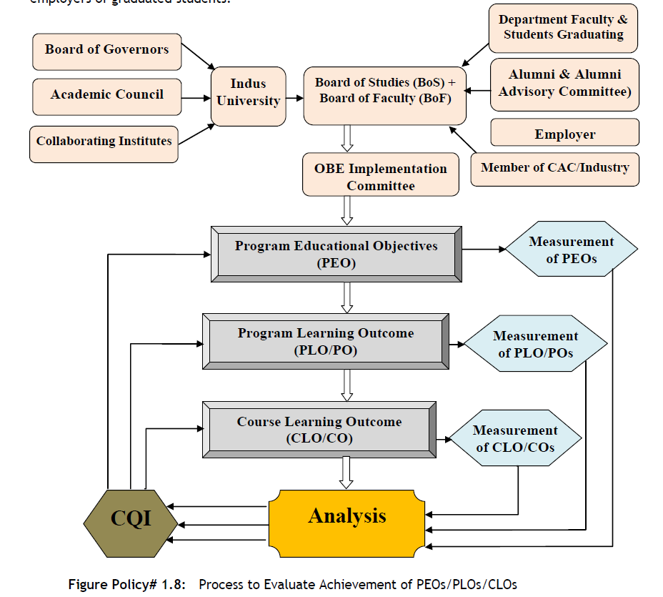

Slide 10
Programme Educational Objectives (PEO)
S. No. | PEO Statement
1 | Graduates should have effectiveness to demonstrate solid engineering knowledge through analysis, synthesis, design and entrepreneurial skills for qualifying them to get immediate employment or postgraduate studies.
2 | Graduates should effectively exhibit professionalism, leadership quality and teamwork through communication skills in multidisciplinary engineering environment.
3 | Graduates should make contributions to knowledge and establish best engineering practice through research and development, as to assume positions of technical and/or managerial leadership as their careers develop.
4 | Graduates should express an ethical commitment to the community and the profession through involvement with professional organizations and society.
5 | Graduates should engage in lifelong learning that will enable them to continue their professional development either through advanced course work or continuing self-directed learning and development activities.

Slide 11
Programme Learning Outcome (PLO)
PLO # | PLO Statement
PLO-1 | Engineering Knowledge
PLO-2 | Problem Analysis
PLO-3 | Design/Development of Solutions
PLO-4 | Investigation
PLO-5 | Modern Tool Usage
PLO-6 | The Engineer and Society
PLO-7 | Environment and Sustainability
PLO-8 | Ethics
PLO-9 | Individual and Team Work
PLO-10 | Communication
PLO-11 | Project Management and Finance
PLO-12 | Life-long Learning

Slide 12
Course Learning Outcome (CLO)
Course Outcomes (CO) | CO Description After completion of this course students will be able to: | Program Outcomes (PO)
CLO-1 | Understand the properties of semiconductor devices, Diodes and discuss their biasing, models & operations | Engineering Knowledge (PO-1)
CLO-2 | Classify various types of diodes their working principle and applications | Engineering Knowledge (PO-1)
CLO-3 | Study and Implement BJT and FET as an amplifier & switch through illustration of their structure & operation | Engineering Knowledge (PO-1)
CLO-4 | Analyze and differentiate various applications of BJT and FET | Problem Analysis (PO-2)

Slide 14
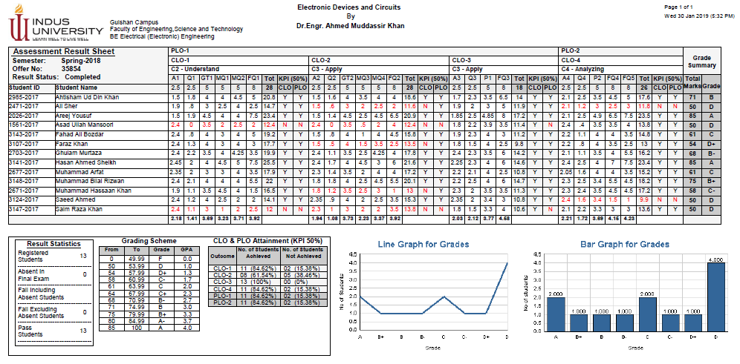
Analysis through formative assessment
XYZ
OBE Assessment Result Sheet generated by Campus Management System (CMS)

Slide 15
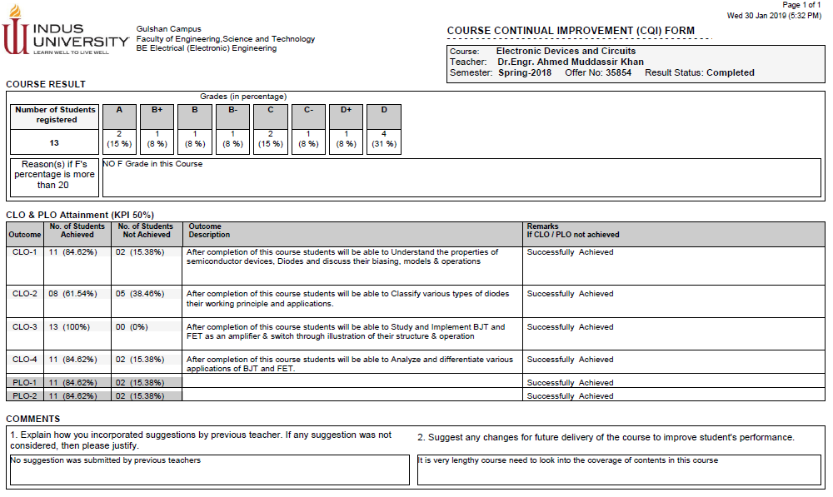
Analysis through formative assessment
OBE Assessment Result Sheet generated by Campus Management System (CMS)

Slide 16
Analysis through Graduating Survey
Parameters Graduating Survey | POs
The program is effective in developing analytical and problem solving skills | PO-1
Ability to analyze and evaluate data Research & Quantitative skills | PO-2
The program is effective in developing planning abilities | PO-3
Ability to analyze and evaluate data | PO-4
Ability to analyze and evaluate data | PO-5
Research & Quantitative skills | PO-6
Research & Quantitative skills | PO-7
Appreciations of the ethical values | PO-8
The program is effective in enhancing team-working abilities Independent thinking Ability to work in teams | PO-9
The program is effective in developing oral & written communications skills | PO-10
Professional development Time management skills | PO-11
Provide the strong foundation necessary to build career startup Professional development | PO-12
Graduating Student Survey mapping with PLOs

Slide 17
Analysis through Graduating Survey
Graphical Representation of PLOs attainment through graduating student survey

Slide 18
Results
This research reveals the effectiveness of our In-house Oracle based Campus Management System (CMS)
Reports prepared through the CMS.
The system generates the report and CQI were prepared accordingly
Implication of technology made the whole process easier

Slide 19
Recommendations and Future Research
Future research required on PEO attainment level and based on the result of those PEOs attainment
CQI needs to be prepared and implemented on program level

Slide 20
References
Kaliannan, M., & Chandran, S. D. (2012). Empowering students through outcome-based education (OBE). Research in Education, 87(1), 50-63.
Ab Rahim, A. A., Thamrin, N. M., Abdullah, N. E., & Hashim, H. (2010, December). Modern Control Systems in Electrical Engineering course assessment using the Outcome Based Education approach. In Engineering Education (ICEED), 2010 2nd International Congress on (pp. 145-150). IEEE.
Custodio, P. C., Espita, G. N., & Siy, L. C. The Implementation of Outcome-Based Education: The Case of the University of Perpetual Help System DALTA Las Piñas Campus.
Tshai, K. Y., Ho, J. H., Yap, E. H., & Ng, H. K. (2014). Outcome-based Education–The Assessment of Programme Educational Objectives for an Engineering Undergraduate Degree. Engineering Education, 9(1), 74-85.
Chan, A., & Chan, C. H. (2009). A new outcome-based curriculum: its impact on student core competence. Journal of Applied Research in Higher Education, 1(2), 24-32.

