Slide 1
Certification Association “Russian Register”
INNOVATIVE TECHNOLOGIES FOR ESTABLISHING AN INSTITUTIONAL SYSTEM FOR QUALITY ASSURANCE AND ITS INDEPENDENT ASSESSMENT
Aleksandra Zvezdova
Project Manager, PhD in Economics

Slide 2
COOPERATION OF RUSSIAN REGISTER WITH EDUCATIONAL ORGANIZATIONS – universities, institutes, HEIs
Term “educational organization” is regulated by the current national legislation in the scope of education of the Russian Federation
2000
start of cooperation with educational organizations
development and implementation of internal institution education quality management system in higher education institutions based on the example of the model of Moscow Institute of Steel and Alloys
2004
implementation of Integrated QMS model for educational organizations (integration of ESG ENQA and ISO 9001), in HEIs/SSEIs developed by SPbETU “LETI” (Federal Target Program of Education Development for 2006-2010)
2007
2010
cooperation with the Professional education quality control Coordination Board of the Russian Federal education and science control service
41%
2018
the Registrar of certified organizations is over 250 records about educational and scientific organizations

Slide 3
A new project in the area of QA of QAA "Russian Register" (RR)
What is the potential for improving the internal QA system (IQAS) of an educational institution?
An external independent evaluation based on the integration of approaches and principles to their creation and evaluation established by various international networks and quality organizations to improve the IQAS in accordance with the requirements of MS ISO 9000, 21001, the principles of CHIBA, CEN / TS 16555 integrated with the requirements of the ESG and GGP standards
For discussion: the typical drawbacks for the requirements and the management system of the accrediting Agencies, the background of QA in Russia, the main steps of the above mentioned project, the project aims and achievements for every step, the most suitable methodology and the expected results.

Slide 4
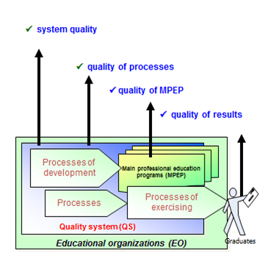
CONCEPT OF EDUCATION QUALITY «quality of system – quality of processes – quality of results»

Slide 5
The problem of choosing a methodology for building internal management systems in educational organizations
How to make a choice? What is the best decision?
Where to find out the best practice? Imagine that…
substantiating the principles of integrating basic approaches, models and standards in order to improve the system’s performance is under consideration within twenty years in Russia, since management systems are mostly based on approaches and standards that are traditional for this country. Moreover, the internal management systems existing in some educational organizations are occasionally sharpened into separate components of the system-wide category “quality” mainly for its control and provision, less often for elements of its planning and monitoring, without touching other important modern aspects of quality management, such as system, process approaches, the principle of continuous improvement and risk management.

Slide 6
Management system’ base: control vs PDCA cycle. RR is ready to contribute to a project
How to reach a new level of development of management in the global market of educational services?
The same drawbacks are also typical for the requirements and the management system of the accrediting Agencies as providers of external assessment of the quality of education.
Within the challenges of the current system QAA "Russian Register" (RR) is ready to contribute to development of worked-out approaches and offers Universities to improve their current management systems through establishing a modified institutional integrated system for QA and its independent assessment as a new project in the area of QA.
It is aimed at exploring the potential for improving the internal QA system (IQAS) of an educational institution and its external independent evaluation based on the integration of approaches and principles to their creation and evaluation established by various international networks and quality organizations to improve the IQAS in accordance with the requirements of MS ISO 9000, 21001, the principles of CHIBA, CEN / TS 16555 integrated with the requirements of the ESG and GGP standards. The possibility and relevance of such integration, which is unique to date, is the main feature of this project.

Slide 7
Considering the background of QA in Russia
The quality of higher education is closely interrelated with the following processes running in Russia:
1. Creation and improvement of internal tertiary quality systems using the requirements and recommendations of international standards of the ISO 9000 (nowadays it’s possible to drive the process of spread of а new ISO 21001 standard for management systems in educational organizations because this standard is developed especially for them and contains the requirement for the whole management system but not only for quality management system) and other models of quality management, ESG ENQA, GGP INQAAHE standards.
2. Internationalization of education requires the development and improvement of state accreditation of Universities and criteria for assessing the quality of educational processes, their harmonization with the indicators and criteria used in evaluating QA systems of educational institutions in other countries.
3. In the field of education, Russian Government has implemented a number of large-scale educational programmes, i.e. “Development of the export of education in the Russian education system” which covers the development of mechanisms for the international recognition of Russian degree programmes on the basis of their international accreditation.

Slide 8
ISO 21001:2018 standard “Educational organizations. Management systems for educational organizations. Requirements, including application guidelines an innovative for educational organizations tool”
The benefits of implementing a management system based on the ISO 21001 standard for Universities can be the following:
- better alignment of the goals and activities of the University with its policy, mission and vision;
- increasing social responsibility through the provision of inclusive and equal quality of education for all students;
- personalized training and better response to the needs of all students, especially to the students with special needs, those who study on-line, with the possibility of creating LLL;
- interrelated assessment processes and tools to demonstrate and improve performance and effectiveness;
- improvement image of University;
- demonstration of the commitment of University to the best management practices in education;
- introduction and development of the culture of organizational excellence;
- better participation of stakeholders;
- motivation for innovation and excellence.

Slide 9
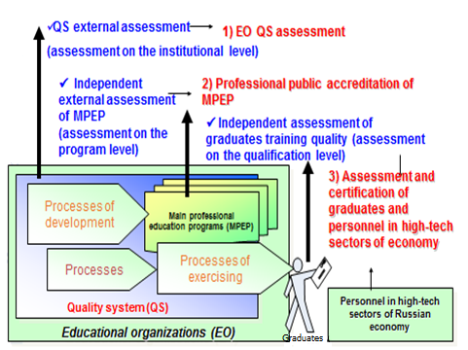
RR:CONCEPT OF EDUCATION QUALITY System of activities on independent education quality assessment
Notes:
tions, assessment of education organization quality systems (QS) for the purpose of quality management system certification and public accreditation of educational organizations (EO), professional public accreditation of the main professional education programs (MPEPs), as well as expert and methodology support of activities on implementation of education quality assurance mechanisms in educational organizations, represented in fig. 1.

Slide 10
RR is going on creating an internal quality management system and QA for an educational organization and using ISO 21001 standard
RR develops of a technology for creating an external independent assessment of the organization’s quality management system created before
The Black Suprematist square is the work of Kazimir Malevich, created in 1915, one of the most discussed and most famous paintings in Russian art.
Any internal quality management system and QA for an educational organization is the great secret, when we see outside.
If only we knew what was inside, there would be no need to think.
We don’t know so our system for creating an external independent assessment should be comprehensive one.

Slide 11
RR develops of a technology for creating an external independent assessment of the organization’s quality management system created before
What would be elements of integrated system aimed at an external independent assessment?
We consider such elements as integrated requirements of ISO 9001, Standards and Recommendations for Quality Assurance in the European Higher Education Area (ESG), Part 2: “Standards and Recommendations for External Quality Assurance of Higher Education”, part 2.1 “Accounting internal QA procedures”, part 2.2 “Development of appropriate external QA procedures”. Taking into account the processes of internationalization of education and harmonization of the requirements of international standards, it is supposed to supplement the integrated model based on the INQAAHE Guidelines of good practice (GGP). We also take into account the development of a quality management system for educational, research and innovation activities of a university.

Slide 12
FSES 3++is dealing to assessments
Modernization of Federal State Education Standard Version 3++ structure:
VII. Requirements for education quality assurance
Internal assessment of program quality
External assessment procedures
State accreditation
International accreditation
Professional public accreditation

Slide 13
It is time to adapt and implement the results
Implementation the results and the achievements
Achievements | Steps
1. Research of the potential for improving the creation of an internal quality management system of an educational organization and its external independent evaluation. | 1.1 Research of the potential for improving the technology of creating an internal quality management system of an educational organization
 | 1.2 Research of the potential for improving the technology of conducting an external independent assessment of the quality management system of an educational organization
2. Integration of approaches and principles | 2.1 Analyze and selection of methods for integrating large data arrays
 | 2.2 Development of an integrated approach, model or standard external independent assessment of the quality management system of an educational organization by a third party through a correlation analysis of internationally recognized best practices and standards.
3. Transfer of innovative technologies, competence and accumulated experience among the stakeholders interested in the development of internal and external institutional systems for ensuring the quality of education (Agencies, universities, their networks). | 3.1 Pilot the developed innovative approach, model or standard for building an internal quality management system of an educational organization
 | 3.2 Implementation of the developed innovative approach for building the internal quality management system of an educational organization
 | 3.3. Implementation of the developed innovation process of external independent assessment of the quality management system of the educational organization by accreditation agencies on the example of the project applicant

Slide 14
What project methodology can be the most suitable?
The PDCA methodology
The PDCA methodology is an algorithm for a project manager’s actions to manage its process and achieve its goals. PDCA begins with planning acting in a spiral due to the continuous improvement of each stage. Within this methodology, Planning is for setting goals, resourses and processes necessary to achieve these goals. Do stands for the execution of planned work. Check is for collecting information and monitoring the result. Act stands for eliminating the causes of deviations from the planned result, changes in the planning and allocation of resources.
In this project, PDCA cycle is applied multiple times at different intervals in the framework of achieving each project goal. The principles of PDCA methodology are used by project experts for internal quality management system of educational organizations and evaluation procedures of accreditation agencies.

Slide 15
What project methodology can be the most suitable?
Benchmarking
Benchmarking is the process of identifying, studying and adapting the best practices and experience of other organizations to improve the performance of their own organization (organizations with similar processes in their industry, regardless of industry, in their own country or abroad). This methodology will be used by project participants to ensure the achievement of outstanding results. Benchmarking fits perfectly into this project for improving the current approaches and processes of QA through analyzing the existing standards, for example, ESG and adding the benchmarking methodology to them. As a method of comparing the activities of one organization with another one and borrowing the ideas of competition, benchmarking has existed for quite some time, but in this project will be employed for the first time, because internationally recognized and widely used documents in different countries (for example, GGP, ESG, CHIBA principles, ISO 9001, 21001, 17065, CEN / TS 16555) will be the subject to comparison and comparison for the first time.

Slide 16
What project methodology can be the most suitable?
Correlation analysis
The next one is correlation analysis. This project is characterized by the presence of a sufficient number of variables (requirements and indicators for internal and external education QA systems embedded in the standards studied), and the goal of the project is to compare them, establish links, mutually enrich, supplement. Therefore, while working at the project at its second stage, the project team will apply correlation analysis capabilities, a data processing method to establish causal relationships between them by the means of empirical methods.

Slide 17
What project methodology can be the most suitable?
QFD (Quality Function Deployment) Methodology
QFD (Quality Function Deployment) Methodology has proved suitability as well. It is a flexible decision-making method used in the development of products or services. It can help with the most important characteristics designed for building internal quality management systems for educational institutions and external procedures for the independent assessment by accreditation agencies. Correlation analysis is also used at certain stages of the deployment of the quality function. To determine the closeness of the relationship when building a “quality house”, it is possible to conduct an expert survey, both in solving the problem of integrating the requirements of the basic approaches, models and standards, and in determining the closeness of the relationship between the activities of the partners involved into the project and the requirements of basic approaches, models and standards.

Slide 18
What project methodology can be the most suitable?
SWOT analysis
SWOT analysis is an effective tool in management, the essence of which is the analysis of internal and external factors, risk assessment and competitiveness of the object of the analysis. In this project SWOT analysis is the starting point of the second analytical phase. It also analyzes the project itself (progress and results).

Slide 19
What project methodology can be the most suitable?
Comparative analysis
Methodology of standard comparison and analysis of research objects is a method of comparative analysis is the general research method, which can be applied in this project as an epistemological core and guideline, giving a general direction to this study and regulating the interaction of all the methods and technologies used in it. In the project it is used as a basis for classification, estimation and forecasting. In the process of analysis at stages 1 and 2 of the project, each of the compared objects (for example, GGP, ESG, principles of CHIBA, ISO 9001, 21001, 17065, CEN / TS 16555) logically includes two elements: it reveals, on the one hand, the similar features with other objects, and on the other hand, what sets it apart from others objects. In other words, comparison is a necessary and basic element of the project, which determines its large methodological value in this study.

Slide 20
What project methodology can be the most suitable?
Change management
The final methodology employed to reach the goal of the project is change management. It is a structural approach to object transfer (in this project it is internal quality management system of an educational organization) from the current state to the desired future state, which is the goal of the 3 stages of the project and is demonstrated by the example of 2 partner organizations of the project. Change management is one of the key factors for the successful implementation of quality systems and the development of the organization as a whole, including educational. For example, when introducing and testing project results (the internal quality management system of an educational organization), change management will affect such fundamental elements of educational organizations as: personnel, processes, technologies, organizational system (structure, responsibility, interconnections), corporate knowledge, various control systems, etc. Regarding this project change management can be viewed as a management process, in which project changes are formally presented and approved.

Slide 21
Diffusion of innovation
The expected results of the project are:
to develop requirements for the internal quality management system of an educational organization;
to develop requirements for external independent assessment of the quality management system and internal systems of QA of accreditation agencies to improve their activities;
to spread this innovative approach for building an internal quality management system of an educational organization, which is a source of diffusion of innovation and the results of practical implementation of the developed innovation requirements;
the sustainability and exploitation of the project is rooted in the approbation of the innovative approach for building an internal quality management system of an educational organization using the examples of project partners which implies training the partner’s personnel;
the partners, Universities, become the source of the outgoing diffusion of organizations, process innovation, which is important for the educational area as a whole.

Slide 22
Diffusion of innovation
The impact of the developed innovative approach
The impact of the developed innovative approach is an incoming innovation aimed at improving the internal quality management system. In the future, it is possible to unite Universities into consortia or clusters, provide the participation of universities in the implementation of the Federal Program of the Ministry of Science and Higher Education of the Russian Federation.
Practical implementation of the developed innovation process by an external independent assessment of the quality management system of educational organizations of accreditation Agencies using the example of a project applicant would be contribute to the creation of an interregional network of the internal QA of accreditation agencies to simplify procedures of reciprocal recognition of Agencies - members of European, Asia-Pacific, Central Asian and other networks on QA in education.

Slide 23
Diffusion of innovation
The impact of the developed innovative approach
At the national level, the sustainability of the project is facilitated by the development of recommendations for regulating the market for services in the field of accreditation of the quality of higher education, as there is an urgent need to modify the state accreditation procedure and conduct an independent international accreditation of educational programs. The discussion was initiated by the rectors of leading Russian universities and brought to the government level, therefore, the development of criteria for admission of accreditation Agencies to external examination procedures is possibly a matter of the nearest future.

Slide 24
Russian QA Agencies demonstrate assessment
On the program level in the national register:

Slide 25
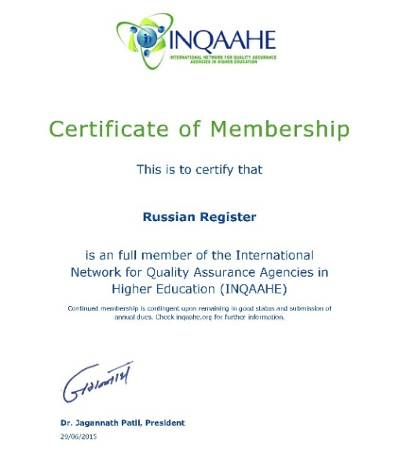
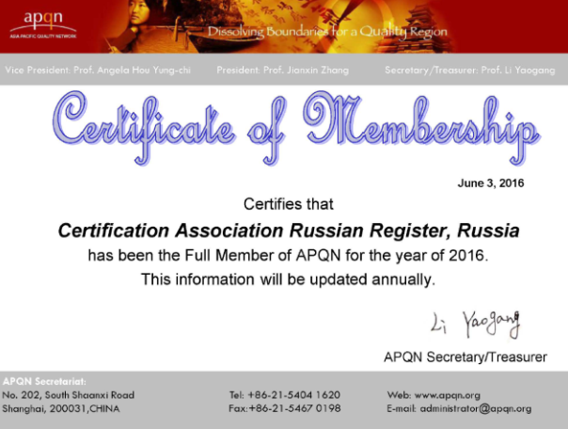
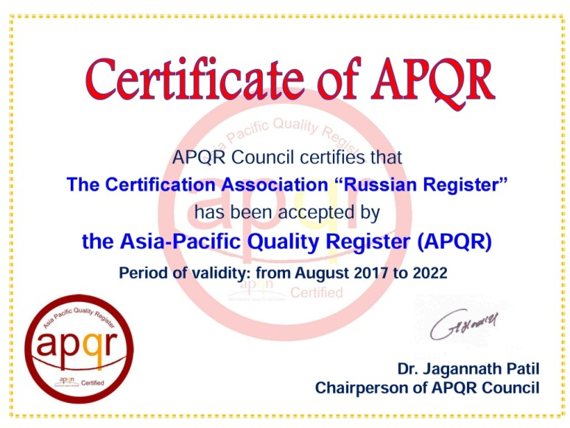
EXTERNAL RECOGNITIONS OF RR COMPETENCE
Asia-Pacific Quality Register

Slide 26
Join us and our project!
Russian Register is open for cooperation with universities and experts from Russia and abroad as well as another QA agencies
WELCOME!
Notes:
17.03.09 07:00 PM
26

Slide 27
THANK YOU FOR ATTENTION!
QUESTIONS?
Phone:+7 812 670 90 01 , Fax: +7 812 670 90 02
rr-head@rusregister.ru www.rusregister.ru

