Slide 1
Higher Education Evaluation and Accreditation Council of Taiwan, HEEACT
Comparing QA systems, Reviewing standards, Procedures and Transparency between Taiwan and Indonesia: Capacity of Building Transnational Education
Presented by PIN CHUAN HSU

Slide 2
Contents
1
Background
2
Project Goals
3
Methods and procedures
4
Comparative analysis
5
Joint Monitoring Model
6
Major Findings
2019 財團法人高等教育評鑑中心基金會 Higher Education Evaluation and Accreditation Council of Taiwan, HEEACT

Slide 3
Background
Cross-border higher education results from the increased mobility of students, academic staff, programs, and institutions.
Ensuring the quality of programs in meeting both local and international standards has become a significant challenge in many nations.
Students of Taiwan and Indonesia has been continuously mobilizing between the two nations .
Taiwan and Indonesian QA agencies, Higher Education Evaluation and Accreditation Council of Taiwan (HEEACT) and National Accreditation Agency for Higher Education (BAN-PT), have completed a comparative study.
Observations of the staff capacity building process between HEEACT and BAN-PT were carry out by ECA representatives. (Once in each agency)
2019 財團法人高等教育評鑑中心基金會 Higher Education Evaluation and Accreditation Council of Taiwan, HEEACT

Slide 4
Project Goals
To understand both countries higher education system and QA framework.
To compare review standards, procedures, and transparency between both agencies.
To realize the current development of cross border higher education between both countries.
To develop a tangible model for program accreditation between the two countries.
To increase the capacity of staff between two agencies.
2019 財團法人高等教育評鑑中心基金會 Higher Education Evaluation and Accreditation Council of Taiwan, HEEACT

Slide 5
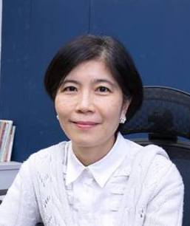
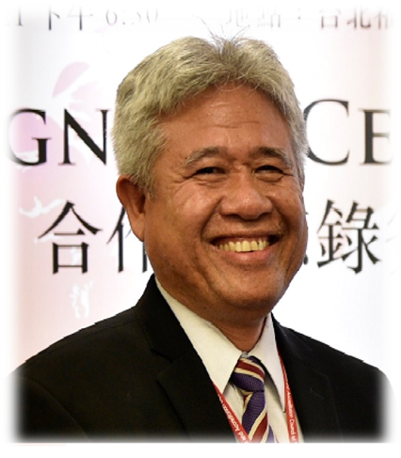
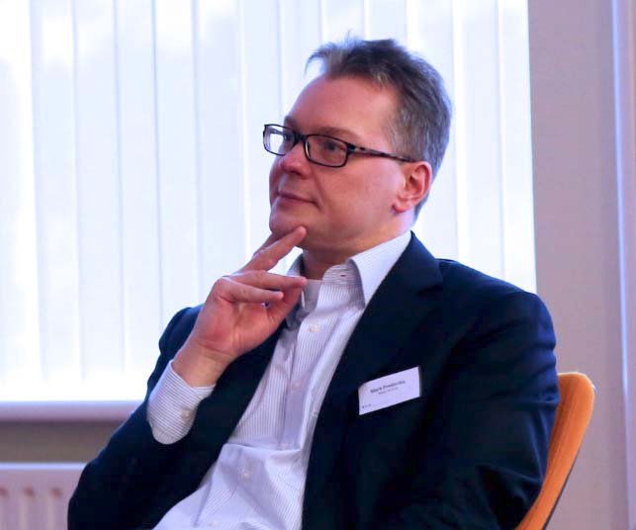
Participating Organizations & Members
Higher Education Evaluation & Accreditation Council of Taiwan (HEEACT)
Executive Director,
Prof. Dr. Angela Yung Chi Hou
BAN-PT, National Accreditation Agency for Higher Education (NAAHE)
Director,
Prof. Dr. T. Chan Basaruddin
The European Consortium for Accreditation in higher education (ECA)
Coordinator,
Dr. Mark Frederiks
Dean of Office of Quality Assurance, Dr. Shaw-Ren Lin
Research Fellow: Dr. Sheng-Ju Chan, Dr. Hua-Chi Chou,
Dr. I-Jung, Grace, Lu
QA Coordinator: Ms. Pin-Chuan Hsu, Ms. Mandy Yin-
Chia Shao, Ms. Monica Huei-Cih Tang, Ms. Kathy Hsiu-
Hui Wang
Executive Board member, Ph.D, Sugiyono
Secretary-General Executive Director, Dr. Agus Setiabudi
Coordinator, Dr. Eva Fernández de Labastida
2019 財團法人高等教育評鑑中心基金會 Higher Education Evaluation and Accreditation Council of Taiwan, HEEACT

Slide 6
Project Methods and Procedures
Understanding:
Documents sharing and analysis
Comparison:
Workshops and universities visits
Consultancy and presentation:
Joint seminar
Documents sharing in HE systems, QA frameworks, and cooperative programs, both agencies understand the current development and build trust on each other’s quality of higher education.
Two workshops were held, once by HEEACT in July 4th to 6th and once by BAN-PT on August 29th to 30th.
HEEACT Invited the BAN-PT representatives to share the initial results at international conference 2018 held on October 17th and October 18th .
Organize a administration joint committee
Share documents and information
Initiate analysis based on the integrated information.
Conduct a workshop and on-site visits (HEEACT)/
(ECA observation)
Conduct a workshop and on-site visit
(BAN-PT) /
(ECA observation)
Conduct a joint seminar and finalize the report
Complete and summarize the key findings and results
HEEACT, BAN-PT, ECA
February, 2018
SKYPE MEETING
Once a month
July3rd -5th
BAN-PT:2menbers
ECA:1menbers
Augest29th-30th
HEEACT:6menbers
ECA:1menbers
October 17th-18th
2018 HEEACT
International conference
2019 財團法人高等教育評鑑中心基金會 Higher Education Evaluation and Accreditation Council of Taiwan, HEEACT

Slide 7
Comparative Analysis(1)
Agency’s mission
ITEM | HEEACT | BAN-PT
Establishment | The Ministry of Education (MoE) and 153 universities and colleges under 2005 University Law Amendment | Ministry of Education and Culture Decree No. 032/U/1994
Funding | - The MoE Evaluation fees from applicant institutions (only program accreditation) | - The MoRTHE BAN-PT is not allowed to impose any charge of its activity
Mission | Conduct institutional and program-level accreditation for all higher education institutions in Taiwan Conduct researches of quality assurance in higher education Provide training courses, workshops and seminars for HEEACT reviewers and QA personnel Promote international recognition of Taiwan higher education | Conducting higher education institution accreditation Conducting program accreditation when the Subject-based Accreditation Agency (SAA) has not been established Evaluating the proposal of SAA establishment and monitoring and evaluating the SAA

Slide 8
Comparative Analysis(2)
QA mechanism
ITEM | HEEACT | BAN-PT
Types of accreditation | Voluntary program accreditation (since 2017), and Mandatory institutional accreditation | Mandatory for both program and institution
Accreditation Process | 1. preparation, 2. self-assessment, 3.on-site visit, 4.decision-making, and 5.follow-up | 1.registration, 2.desk evaluation,3. site visit, and 4.decision, and 5. follow-up
On-site review Panel size | Institutional: 4-16 (according to the university size) Program: 4-6 | Institution: 2-7 assessors (according to the program number) Program: 2 assessors
Policy on conflict of interest | Yes | Yes
Use of only trained reviewers | Yes | Yes
On-site visit | Both quantitative and qualitative information is used to support the accreditation process & result. The interviews with HE stakeholders will be held during site visits for multi-verification.

Slide 9
Comparative Analysis(3)
QA mechanism
ITEM | HEEACT | BAN-PT
Stages of Accreditation Decision | Institutional : 2-stage process: 1.the on-site visit; and 2.the decision of the Accreditation Review Committee Program: 3-stage process: 1. The on-site visit; and 2. Preliminary Accreditation Review Panel; 3.the decision of the Accreditation Review Committee | 3-stage process : Desk evaluation by the panel The site visit by the panel Decision and publication by BAN-PT Executive Board
Accreditation results | ‘’accredited’’, ‘’conditionally accredited’’, and ‘’denial’’ | ‘’accredited ‘’or ‘’non-accredited’’ If the result is accredited, it can be divided into three grades including Excellent, Very Good, and Good
Validity period | 6 years | 5 years
Result Publication | Yes | Yes

Slide 10
Comparative Analysis(4)
Cross border higher education
Regarding the joint/dual degree programs of cooperation between Taiwan and Indonesia, it shows that there is a gap in student mobility.
There is no assessment guideline for the joint/dual degree curriculum structure, faculty, and administrative support, etc.
A stable quality assurance structure hasn’t been introduced to ensure the quality of the joint/dual degree programs.
2019 財團法人高等教育評鑑中心基金會 Higher Education Evaluation and Accreditation Council of Taiwan, HEEACT

Slide 11
Joint Monitoring Model(1)
HEAACT and BAN-PT developed a joint monitoring model as a reference for cross-border higher education(dual degree) accreditation.
Criteria and the process for application
Application
Requirement
The dual degree, which is proposed to be the subject of this monitoring process, needs to be established for at least a full academic year.
The two institutions which provide the dual program, need to be accredited by at least one of the two agencies.
2019 財團法人高等教育評鑑中心基金會 Higher Education Evaluation and Accreditation Council of Taiwan, HEEACT

Slide 12
Joint Monitoring Model(2)
Composition of the on-site visit panel
The on-site visit panel consists of 3-5 reviewers from HEEACT, BAN-PT and the other nations respectively, with international experience/expertise (English).
The other relevant agencies can also recommend observers to participate in the on-site visit. There can be a maximum of two observers per on-site visit.
Standards
1. Eligibility and Objective | 4. Teaching, Learning and Assessment
2. Learning outcomes | 5. Support system
3. Program | 6. Internal quality assurance system
2019 財團法人高等教育評鑑中心基金會 Higher Education Evaluation and Accreditation Council of Taiwan, HEEACT

Slide 13
Major Findings
Improve the capacity building of staff
Staff can participate in different activities and learn about higher education and QA systems of
both countries.
Both agencies’ staff has not only increased their capacity but also broadened their horizons.
Deepen the partnership between QA agencies
Both agencies have established a close relationship and strengthened substantive cooperation
through face-to-face communication and site visits between workshops.
Sustaining the partnership, HEEACT and BAN-PT also plan to have further discussions on new
joint projects this year and an institutional/program site visit of both sides.
The possibility of promoting student mobility
The joint monitoring model provides a systematic scheme for the quality assurance of cross-
border education.
Attract more foreign students in taking the program, and promote student mobility between
Taiwan and Indonesia.
2019 財團法人高等教育評鑑中心基金會 Higher Education Evaluation and Accreditation Council of Taiwan, HEEACT

Slide 14
THANK YOU
Higher Education Evaluation and Accreditation Council of Taiwan, HEEACT

