Slide 1


APQN Annual Conference.
Colombo, Sri Lanka. March 30, 2019
South Asia: Challenges and Benefits of Research Collaboration in a Diverse Region.
Pointers for Action
Francisco Marmolejo
Lead Tertiary Education Specialist – India / South Asia
The World Bank
fmarmolejo@worldbank.org
@fmarmole

Slide 2
Why does it matter?

Slide 3
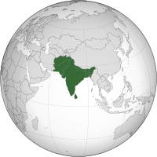
Why does it matter?
South Asia at crossroads, towards middle-income region with the world largest working population.
S.A. at a threshold, ready to take off
Need:
More competitiveness
Shared prosperity
Sound governance
Effective decentralization

Slide 4
The most populous and the most densely populated geographical region in the world. But…
More than 200 million live in slums, and about 500 million go without electricity
The region is home to over 10 million children of primary school age who are out of school.
Higher education is still a privilege of a few.

Slide 5
In an increasingly interconnected world, regional integration is key for development

Slide 6
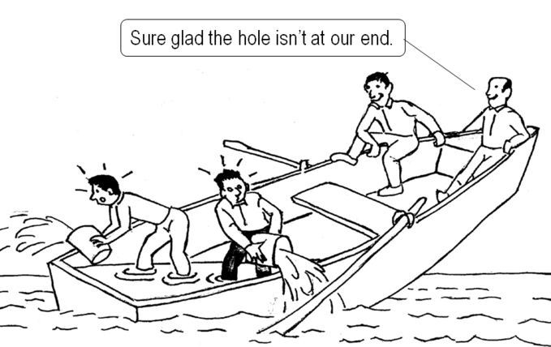
Why does it matter?

Slide 7

A new economy and society
Global
Knowledge Based
Constantly Changing
Technology driven
Highly Competitive

Slide 8

A globalized economy
Made in The Netherlands
With ingredients from Morocco.
Distributed by a Chinese company
For sale in Delhi.
Mexican Salsa

Slide 9
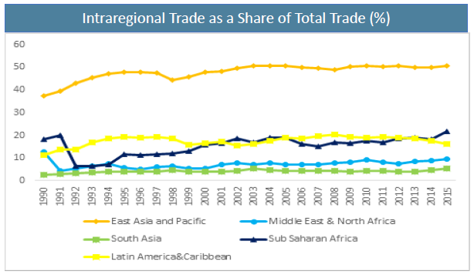
An unfortunate reality

Slide 10
A word of caution
For every complex problem there is an answer that is clear, simple,
H. L. Mencken
…and wrong.

Slide 11
Ten Pointers for Action

Slide 12
10 Pointers for Action
Funding and stimuli for STEM
Criteria for regional priority research areas
Greater quality and quantity of research produced in priority areas
More relevant research with increased the citation impact and patents
Capacity-building for better research proposals
Funding streams to support research collaboration
Research partnerships between academic institutions and the private sector
TTOs and business incubators on university campuses
Academic-corporate collaborations
Greater participation in international research programs funded by multilateral institutions.

Slide 13
Pointers for Action.
1
Increasing the quantity and improving the quality of tertiary education, with a focus on STEM

Slide 14
A remarkable progress
Tertiary enrollment grew by 300% between 2000 and 2015
Regional enrollment reaches more than 42 million students.
…but still access is low

Slide 15
Tertiary Education Enrollment per Region
Gross Enrollment Rate in Tertiary Education superior (ISCED 5 & 6), per region: 1970 - 2011
Fuente: UNESCO
Courtesy of Reema Nayar, The World Bank
Notes:
Gross enrolment ratio. Tertiary (ISCED 5 and 6). Total is the total enrollment in tertiary education (ISCED 5 and 6), regardless of age, expressed as a percentage of the total population of the five-year age group following on from secondary school leaving.
Sharper increases in TE enrolment in the past 10-15 years, particularly in LAC and EAP. We’re till far away from OECD levels.
From 2000 to 2011, the gross enrolment ratio in tertiary education increased by: 122% in EAP, 88% in SAR, 79% in LAC, 57% in AFR, 44% in ECA, 43% in MENA, 31% in the OECD.
From 1996 to 2011, the gross enrolment ratio in tertiary education increased by: 237% in EAP, 171% in SAR, 127% in LAC, 84% in AFR, 69% in ECA, 69% in MENA, 38% in the OECD.

Slide 16
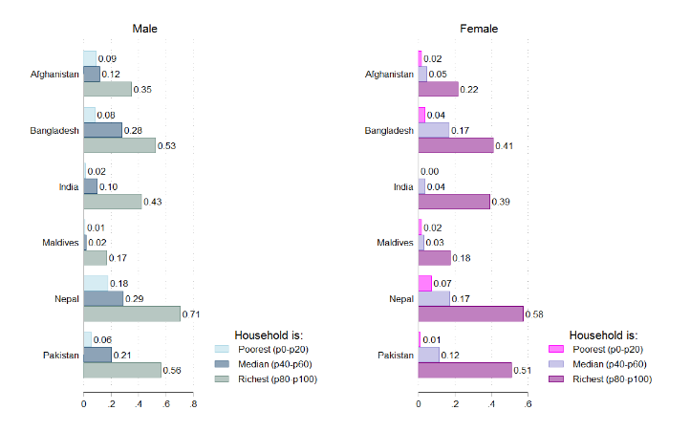
South Asia: Probability of accessing tertiary education by household wealth status
Source: Most recent Demographic and Health Surveys. Afghanistan 2015, Bangladesh 2014, India 2005-2006, Maldives 2009, Nepal 2011, Pakistan 2012-2013.
Notes: Numbers represent weighted proportion either currently enrolled or completed higher education. Restricted to respondents who are aged 20-24, excluding household heads.

Slide 17
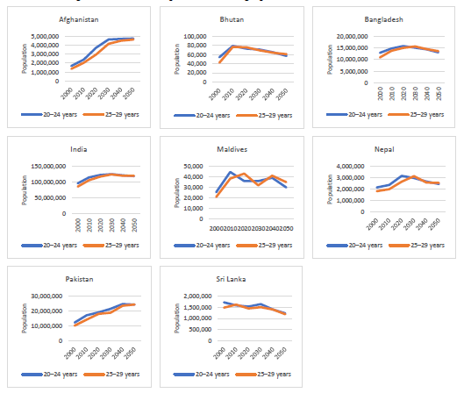
Demographic transition in South Asia, 2000–50

Slide 18
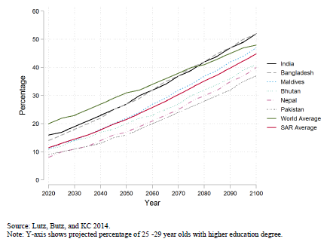
Enrollment in HE in South Asia is expected to keep growing

Slide 19
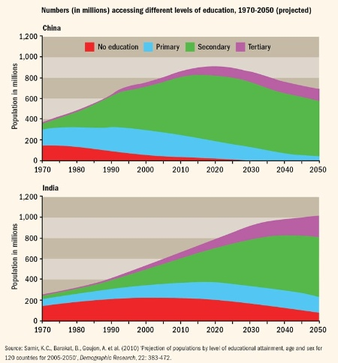
The case of China and India

Slide 20
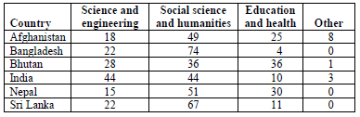
South Asia: Distribution of students in higher education by subject field
Latest available data (%)
Source: India, National Sample Survey 71st round (2014); Nepal, Educational Management Information System; all others, United Nations Educational, Scientific and Cultural Organization Institute of Statistics and World Bank EdStats database.
Note: Percentages for each country may not sum to 100 because of rounding

Slide 21
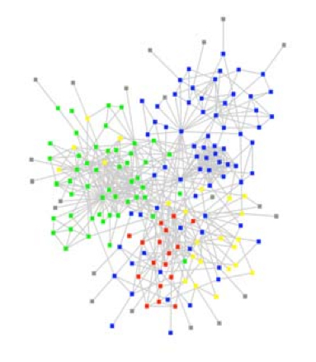
Pointers for Action.
2
Develop criteria to determine priority research areas at national and regional level

Slide 22
Pointers for Action.
3
Establish financial and administrative mechanisms to enhance the quality and quantity of research produced in priority areas, at national and regional level

Slide 23

Research or teaching?

Slide 24
Pointers for Action.
4
Encourage academic institutions to produce research that meets the needs of domestic and regional development, increasing the citation impact and number of patents submitted by academics while enhancing national and regional economic productivity and competitiveness

Slide 25
South Asia’s contribution to knowledge production.
Patent Applications - Residents
Out of the 2,128, 574 resident’s patents filed globally in 2017, South Asia contributed with 13,741 representing only 0.64% of the total.
Bangladesh 77
Pakistan 204
Sri Lanka 280
India 13,199

Slide 26
Pointers for Action.
5
Build the capacity of researchers to develop high-quality proposals, both for domestic and international projects

Slide 27
Pointers for Action.
6
Dedicate specific funding streams to support domestic, intraregional and extra-regional collaboration, including financial assistance, scholarships and fellowships for postgraduate students and postdoctoral research fellows

Slide 28
The share of doctoral students in the total student population in South Asia is well below level in the United States and the Russian Federation, latest available data
Source: United Nations Educational, Scientific and Cultural Organization Institute of Statistics and World Bank EdStats database.

Slide 29
Pointers for Action.
7
Promote research partnerships between academic institutions, the private sector and other relevant stakeholders.

Slide 30
Higher education does not always work as a system of connected actors.
Some disconnects
Between HEIs and
Industry
Employers
Governments
Graduates (alumni)
Research institutions
Community based organizations
Previous levels of education

Slide 31
Pointers for Action.
8
Establish TTOs and business incubators on university campuses to leverage the resources of the business community to support local research and development, while bolstering the competitiveness and productivity of the private sector

Slide 32
Pointers for Action.
9
Earmark funds for academic-corporate collaborations, build the capacity of patent offices, and provide training in intellectual property literacy to encourage academic institutions to produce more market-relevant research

Slide 33
Pointers for Action.
10
Encourage greater participation in international research programs funded by multilateral institutions, to alleviate fiscal constraints on the tertiary education sector while expanding national and regional networks of scholarly collaboration.

Slide 34
In summary, more and better collaboration is needed

Slide 35
Needed, more collaboration
Among higher education and research institutions
Inside HE and Research institutions

Slide 36

Is this a true prediction?
“Universities won’t survive…higher education is in deep crisis…The college campus won’t survive as a residential institution. Today’s [college] buildings are hopelessly unsuited and totally unneeded”
Peter Drucker, 1997
…or it is just an exageration?

Slide 37
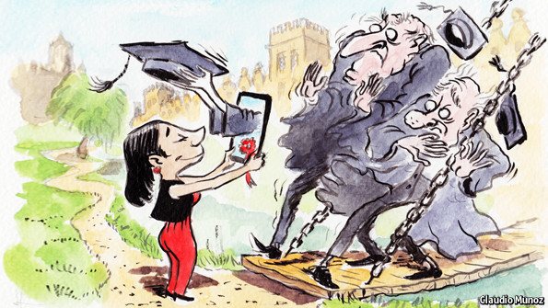
Who told us that the university shouldn’t and can’t change?

Slide 38
A paradox
Higher education institutions are the best laboratory for social change
...but they have a tendency to inhibit their innovation capacity

Slide 39
Is there room (and need) for collaboration? How?

Slide 40

What Type of Collaboration?

Slide 41


Slide 42


Slide 43


Slide 44

Golden key: Everybody’s contribution could make a big difference

Slide 45
In conclusion
@fmarmole
Email: fmarmolejo@worldbank.org

Slide 46
Shifting our paradigm
A good idea, but..
Too complex
Just about competing
A priority for “tomorrow”
Marginal
A critical need
Means for better education
About collaborating to compete
Mainstreamed
A priority for ”yesterday”

Slide 47
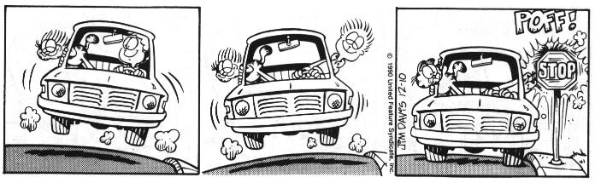
There is no magic formula…
What it may work in one case
…it is not necessarily the best solution in other cases

Slide 48

The future . . . Today!
@fmarmole
Email: fmarmolejo@worldbank.org

Slide 49

“ The trouble with our times is that the future is not what it used to be ”
Paul Valéry

Slide 50



Francisco Marmolejo
Lead Tertiary Education Specialist – India / South Asia
The World Bank
Email: fmarmolejo@worldbank.org
Twitter @fmarmole

Slide 51
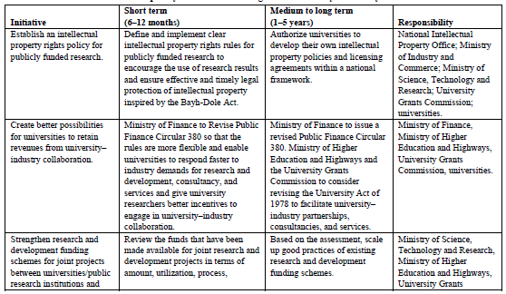
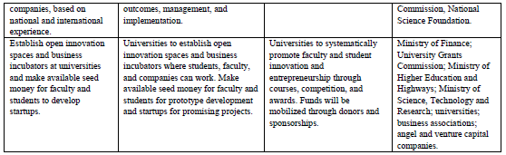
Source: Larsen, K., D. C. Bandara, M. Esham, and R. Unantenne. 2016. Promoting University–Industry Collaboration in Sri Lanka: Status, Case Studies, and Policy Options. Washington, DC: World Bank

Slide 52

Returns highest at Tertiary Level
Table 3: Returns to schooling by educational level and region (latest available year between 2000-2011)
Region | Primary | Secondary | Tertiary | GDP/pc (PPP 2005) | N
World | 10.3 | 6.9 | 16.8 | 6,719 | 74
Middle East and North Africa | 9.4 | 3.5 | 8.9 | 3,645 | 7
South Asia | 9.6 | 6.3 | 18.4 | 2,626 | 4
Eastern and Central Europe | 8.3 | 4.0 | 10.1 | 6,630 | 7
High Income Economies | 4.8 | 5.3 | 11.0 | 31,748 | 6
East Asia and Pacific | 11.0 | 6.3 | 15.4 | 5,980 | 6
Latin America and Caribbean | 9.3 | 6.6 | 17.6 | 7,269 | 20
Sub-Saharan Africa | 13.4 | 10.8 | 21.9 | 2,531 | 24
Source: Montenegro, C.E. & H.A. Patrinos (2013). Returns to Schooling around the World. The World Bank

