Slide 1
South Asia
Challenges and benefits of research collaboration in a diverse region
March 2019
Maria de Kleijn-Lloyd

Slide 2
Outline
Introduction
Key figures on South Asia’s research
Research collaboration
Knowledge transfer

Slide 3
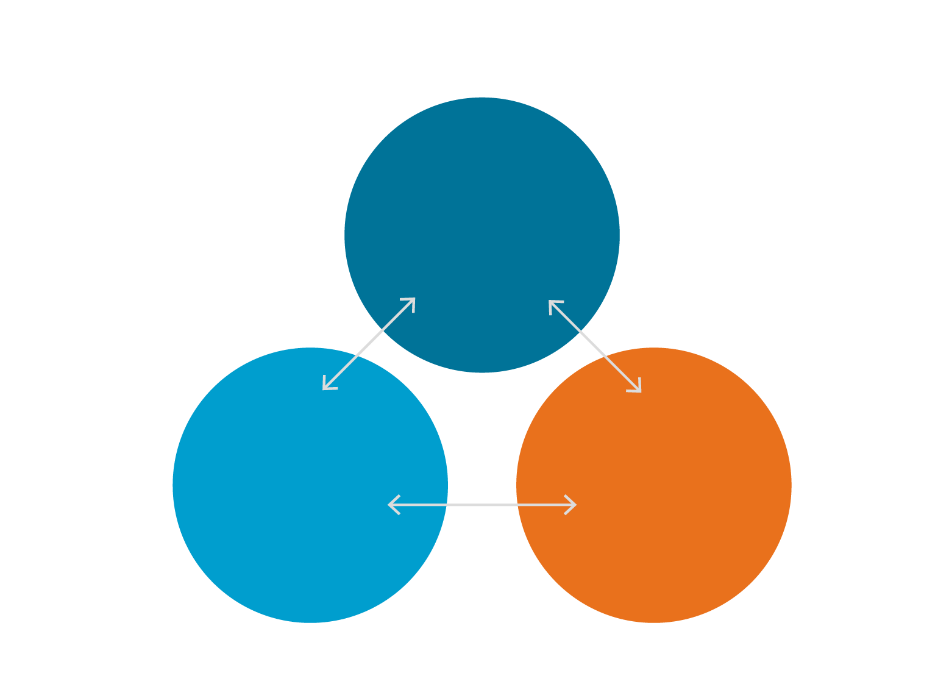
Insights based on database of peer reviewed literature from >5000 publishers
Article
70+ million
Journal, conference, & Book records
Insight areas
Output, impact, growth
Specialisation
Collaboration
Mobility
Knowledge Transfer
Author
16+ million
Author profiles
(active)
Affiliation
70,000+
Affiliation profiles

Slide 4
Outline
Introduction
Key figures on South Asia’s research
Research collaboration
Knowledge transfer

Slide 5
Great variety in research size and resources across South Asia (1/2)
Number of publications vs. GDP (left) and GERD (right)
Notes:
South Asian countries (and comparators) vary greatly in size and resources. This affects the size of countries’ respective economies, the amount they invest in R&D, and how many papers they publish.

Slide 6
Great variety in research size and resources across South Asia (2/2)
Number of publications vs. population (left) and number of researchers (right)
Notes:
All South Asian countries have relatively low scholarly output relative to their overall population because they tend to be highly populated relative to the size of their research enterprise. While most South Asian countries tend to publish relatively few papers relative to the size of their research base, South Asia as a whole, India, and Sri Lanka tend to have a relatively large scholarly outputs compared to their number of researcher FTEs, respectively.

Slide 7
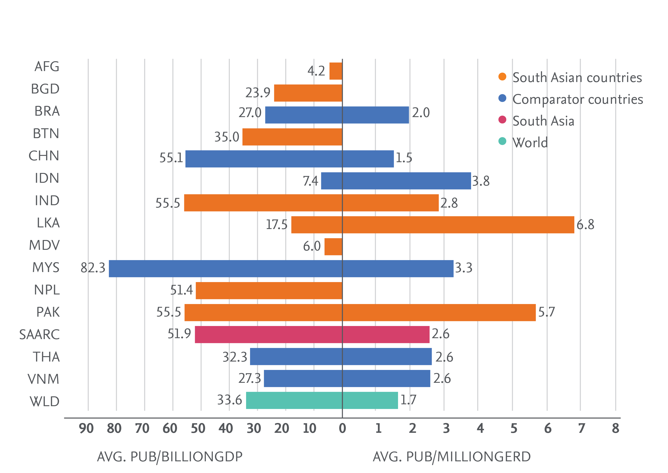
High research productivity across South Asia
Number of publications per billion US$ GDP (left) and GERD (right)
Notes:
South Asia overall, India, Pakistan, Nepal, and Bhutan publish more papers per GDP unit than the global average. Pakistan and Sri Lanka appear particularly productive in terms of number of scholarly papers per GERD unit.

Slide 8
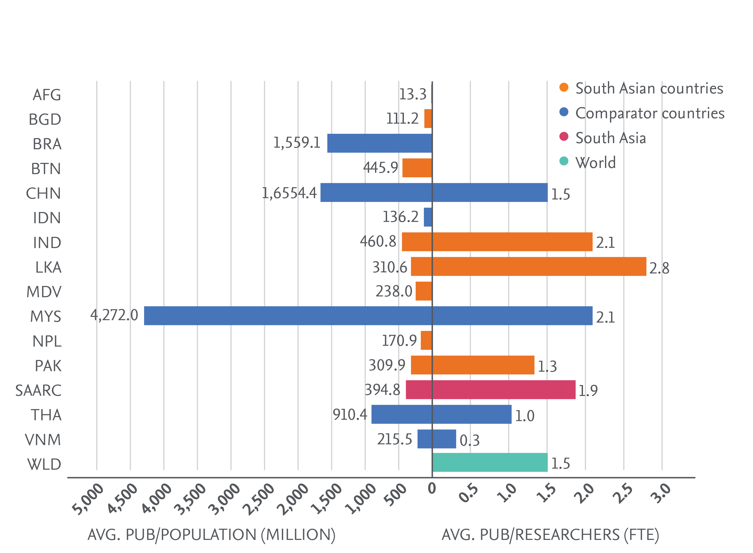
South Asian researchers are productive
Number of publications per million population (left) and per researcher (right)
Notes:
Malaysia towers over all comparators In terms of number of papers per population followed by China, Brazil, and Thailand. Bhutan leads among South Asian countries (from a small base), followed by India. Sri Lanka and India lead among South Asian and comparator countries in scholarly output normalised by number of researcher FTEs, followed by Malaysia and South Asia as a whole.

Slide 9
India accounts for 88% of South Asia’s output
Share of research output
Notes:
While South Asia published 679,571 papers in 2012-2016, accounting for 5.3% of the world’s scholarly output in 2012-2016, and growing in share by 1.7 percentage point over the period, most of the region’s research performance is driven by India, which accounts for 88% of South Asia’s output. South Asia’s citation impact overall is lower than the world average, but the citation impact of several individual South Asian countries (Bangladesh, Sri Lanka, Nepal, Afghanistan, Bhutan, the Maldives) is higher than the world average.

Slide 10
The region focuses on Engineering and Technologies, Natural Sciences and Agricultural Sciences
Relative Activity Index (red) and Field-Weighted Citation Impact (orange) compared to world average, per discipline
Notes:
South Asia has a strong focus on Engineering and Technologies (driven by India), the subject area in which its citation impact is closest to world average. Natural Sciences also emerges as an area of specialisation for South Asia, in particular for India, Bhutan, and the Maldives.

Slide 11
Specialisation in Agricultural Sciences is prominent
Top 100 most prominent concepts in South Asia’s output
Notes:
South Asia’s specialisation in the Agricultural Sciences is particularly visible in the list of top 100 prominent concepts for South Asia. The top 100 concepts include plants and crop names such as Pongamia, which appears in 233 papers published 2012-2016

Slide 12
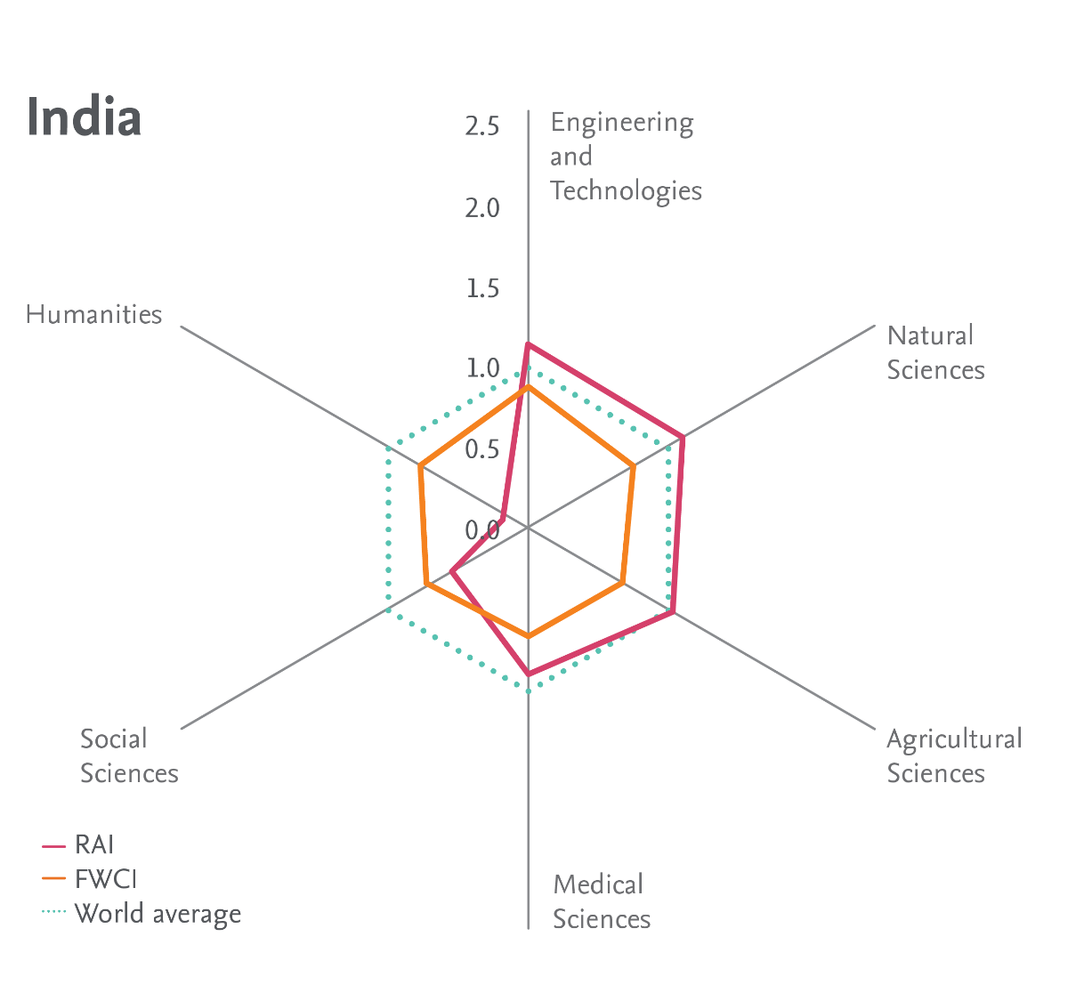
India focuses on Engineering and Technologies, Natural Sciences and Agricultural Sciences
Relative Activity Index (red) and Field-Weighted Citation Impact (orange) compared to world average, per discipline
Notes:
South Asia has a strong focus on Engineering and Technologies (driven by India), the subject area in which its citation impact is closest to world average. Natural Sciences also emerges as an area of specialisation for South Asia, in particular for India, Bhutan, and the Maldives.

Slide 13
Pakistan focuses on Agricultural Sciences and Natural Sciences
Relative Activity Index (red) and Field-Weighted Citation Impact (orange) compared to world average, per discipline
Notes:
South Asia has a strong focus on Engineering and Technologies (driven by India), the subject area in which its citation impact is closest to world average. Natural Sciences also emerges as an area of specialisation for South Asia, in particular for India, Bhutan, and the Maldives.

Slide 14
Bangladesh focuses on Agricultural Sciences and Natural Sciences, and is strong in Medical
Relative Activity Index (red) and Field-Weighted Citation Impact (orange) compared to world average, per discipline
Notes:
South Asia has a strong focus on Engineering and Technologies (driven by India), the subject area in which its citation impact is closest to world average. Natural Sciences also emerges as an area of specialisation for South Asia, in particular for India, Bhutan, and the Maldives.

Slide 15
Sri Lanka focuses on Agricultural Sciences and Natural Sciences, and is strong in Medical
Relative Activity Index (red) and Field-Weighted Citation Impact (orange) compared to world average, per discipline
Notes:
South Asia has a strong focus on Engineering and Technologies (driven by India), the subject area in which its citation impact is closest to world average. Natural Sciences also emerges as an area of specialisation for South Asia, in particular for India, Bhutan, and the Maldives.

Slide 16
Nepal focuses on Agricultural Sciences and Medical Sciences, at high quality
Relative Activity Index (red) and Field-Weighted Citation Impact (orange) compared to world average, per discipline
Notes:
South Asia has a strong focus on Engineering and Technologies (driven by India), the subject area in which its citation impact is closest to world average. Natural Sciences also emerges as an area of specialisation for South Asia, in particular for India, Bhutan, and the Maldives.

Slide 17
Outline
Introduction
Key figures on South Asia’s research
Research collaboration
Knowledge transfer

Slide 18
The smaller countries in South Asia show high international collaboration
Internationally co-authored papers and field-weighted citation impact
Notes:
Overall just under 1/5 of South Asia publications result from international collaborations. Among South Asian countries, there seems to be a relationship between size and international collaboration, with the smaller countries showing the highest level of reliance on their international networks for publications.

Slide 19
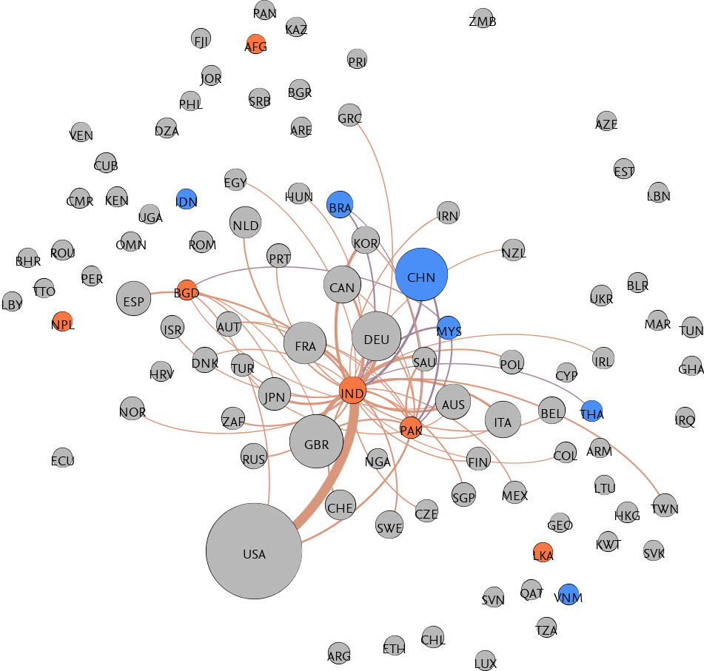
South Asian countries each have their own collaboration network
Internationally co-authored papers
Notes:
South Asian countries and comparators are scattered in the global international collaboration network, pointing to the preponderance of independent collaboration networks for each South Asian country, rather than across the region.

Slide 20
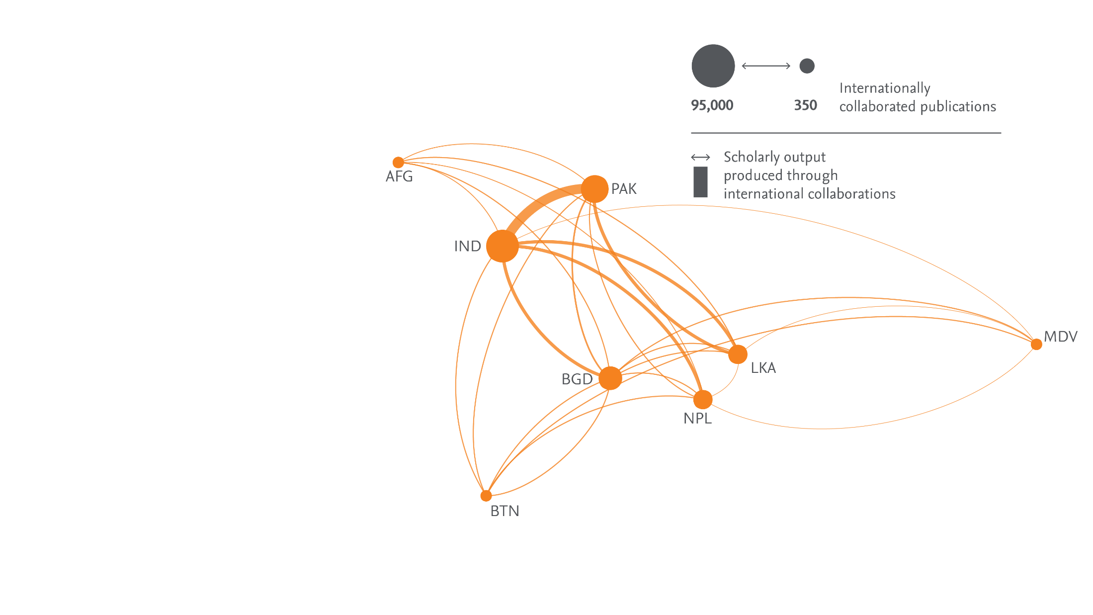
India and Pakistan form the nexus of intra-regional collaborations
Internationally co-authored papers, absolute figures
Notes:
Within South Asia, India and Pakistan have the strongest collaborative ties, forming the core nexus of intra-South Asia collaborations. This nexus is part of a central network also including Bangladesh, Nepal, and Sri Lanka, while the least prolific members Afghanistan, Bhutan, and the Maldives sit at the edge of the system.

Slide 21
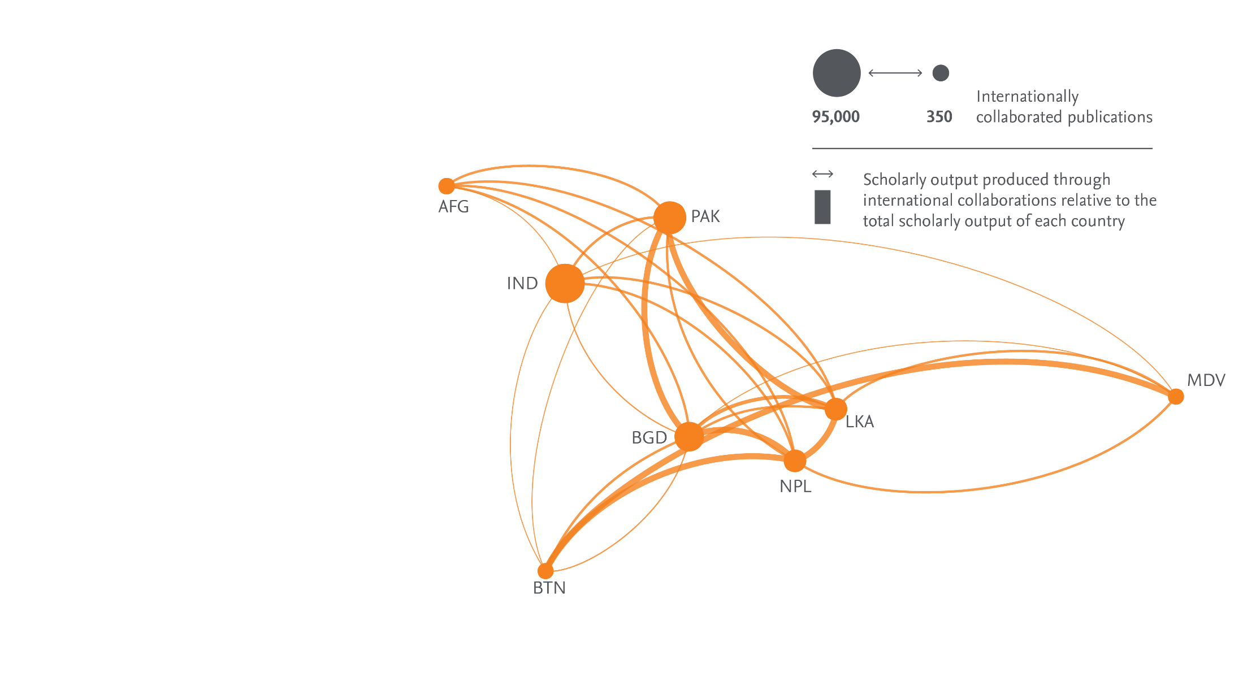
Strong ties between Pakistan, Sri Lanka, Bangladesh, and Nepal
Internationally co-authored papers, relative to output
Figure XX Description to go here
Notes:
Normalising the collaborations by the output of country pairs reveal strong ties between Pakistan and Bangladesh and Pakistan and Sri Lanka, as well as Nepal and Bangladesh and Nepal and Sri Lanka, and Bhutan and the Maldives.

Slide 22
Extra-regional collaboration focuses on the region itself
Top 100 most prominent concepts in South Asia’s output resulting from extra-regional collaboration
Notes:
Extraregional international collaborations display concepts relating to specific countries and geographies prominently. Several further terms relating to either hypercollaborated physics research or globally relevant medical studies are present, reflecting the influence of large-scale global collaborations.

Slide 23
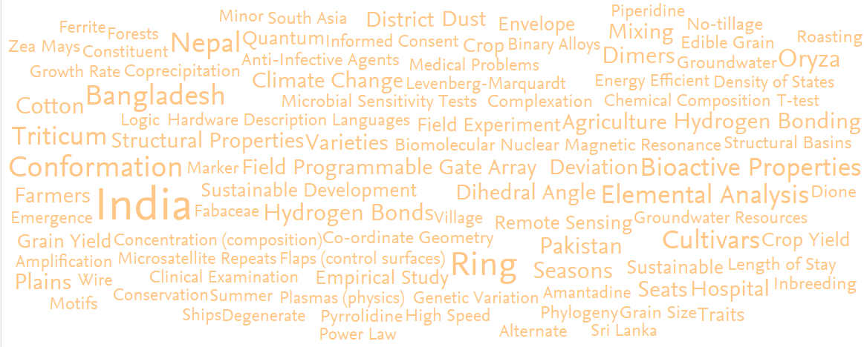
Intra-regional collaboration focuses on agriculture, climate, land
Top 100 most prominent concepts in South Asia’s output resulting from intra-regional collaboration
Notes:
Intraregional international collaborations also mention specific locations prominently. The overall South Asian agricultural focus is visible through words relating to crops, yields, and agriculture itself. Several of the concepts can be linked to geology, water, or the land. There are also concepts relevant to several sustainable development areas such as climate change or health.

Slide 24
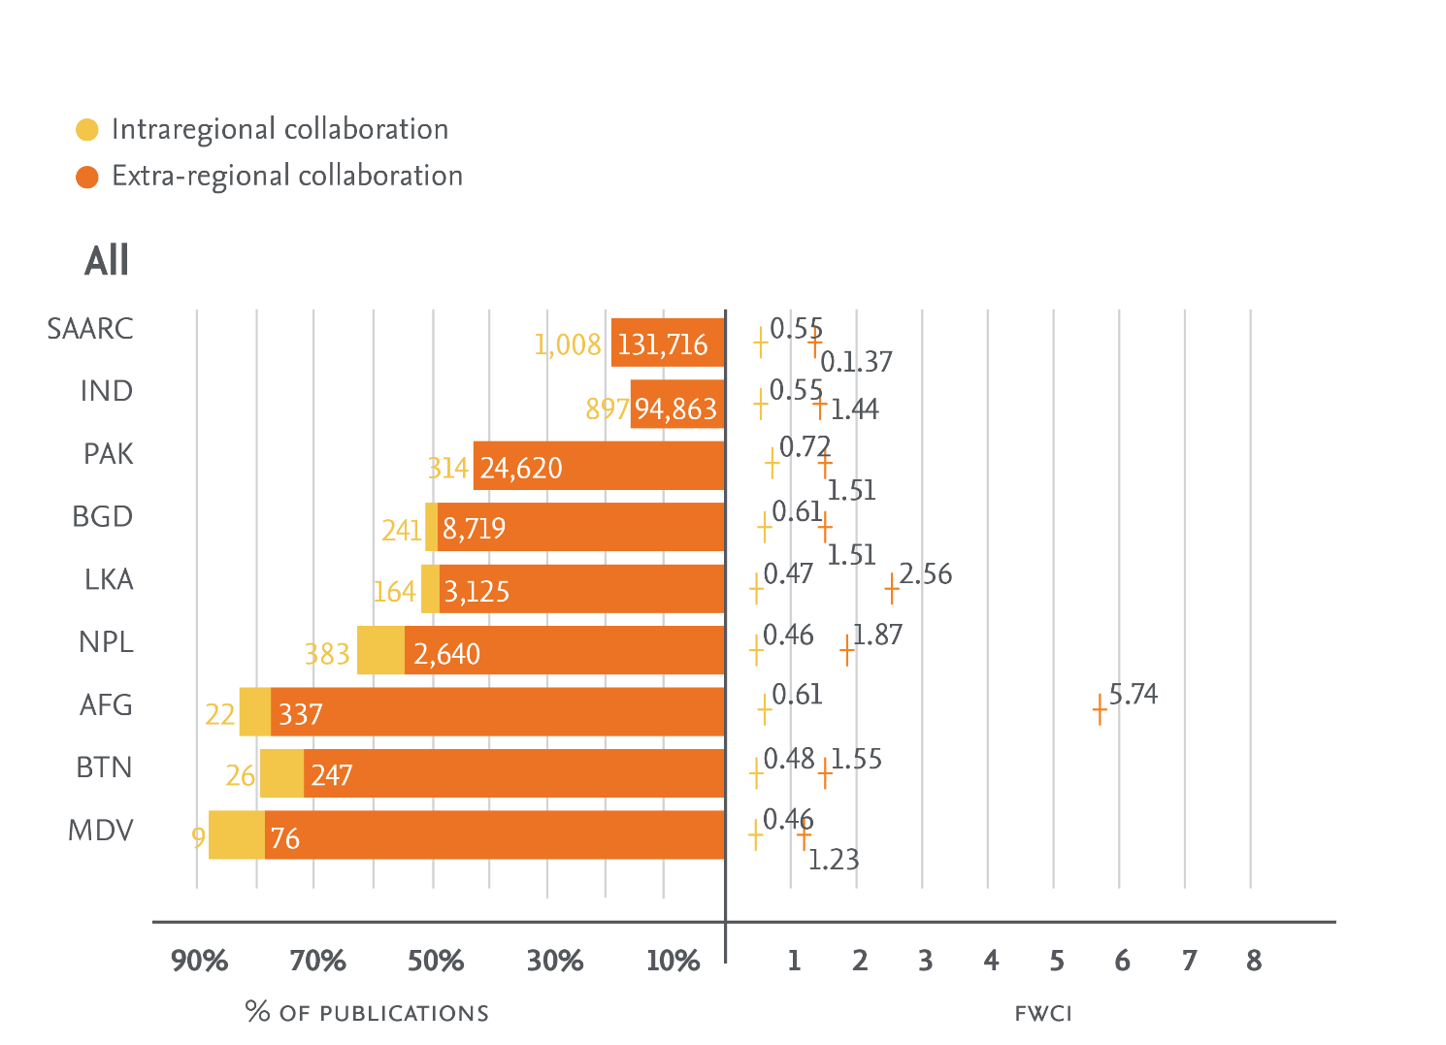
High citation impact from large international collaborations
Share of publications and Field-Weighted Citation Impact from international collaboration
Notes:
For all South Asian countries, most international collaborations include at least one researcher outside the region. The proportion of papers resulting from international collaboration ranges from 0.15% for South Asia and India to 5-10% for smaller countries like Nepal, Afghanistan, Bhutan, and the Maldives. Extraregional international collaborations have a much higher citation impact that intraregional ones, boosted by high impact large collaborations.

Slide 25
Outline
Introduction
Key figures on South Asia’s research
Research collaboration
Knowledge transfer

Slide 26
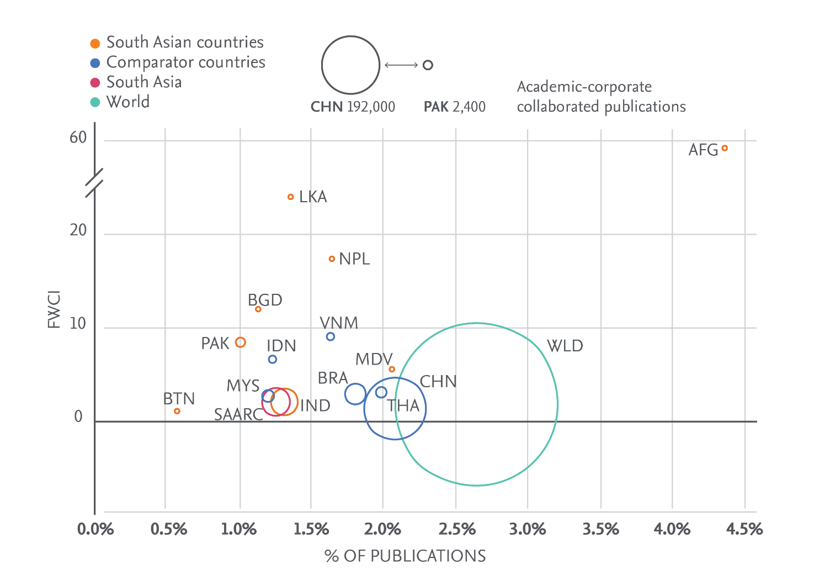
South Asia shows modest levels of academic-corporate collaboration
Academic-corporate co-authored papers and field-weighted citation impact
Notes:
South Asia’s academic-corporate collaboration rate is about half the global average. All countries analysed have lower academic-corporate collaboration percentage than the world average, except for Afghanistan, whose small scholarly output comprises a large proportion of scholarly output resulting from large-scale international and cross-sector collaboration. Overall and across comparators, academic-corporate collaborations tend to have a high FWCI, boosted by large scale collaborations.

Slide 27
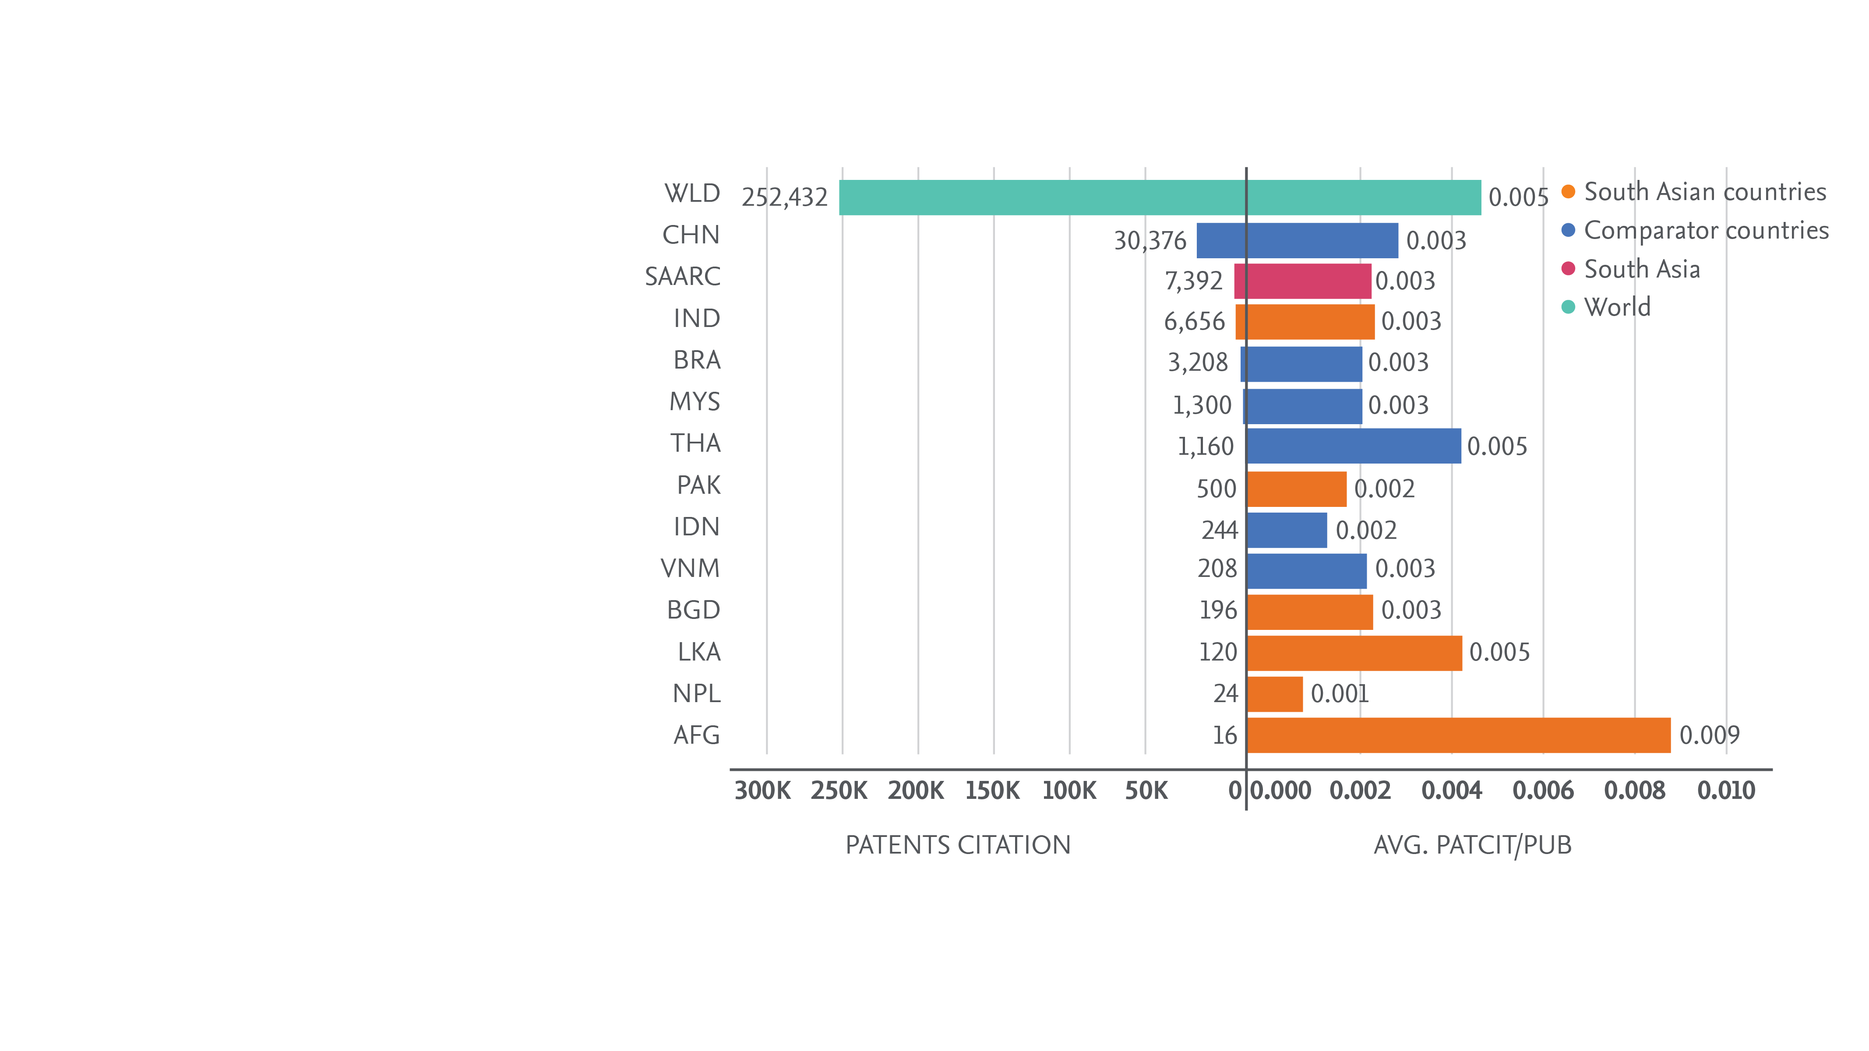
South Asian research has modest effect on global patents
Number of patent citations from South Asian research, absolute (left) and per publication (right)
Notes:
Relative to its scholarly output, South Asia and comparators tend to have fewer patent citations than the world average. To some extent this may be due to WIPO coverage, but could also indicate potential for improvement in cross-sector knowledge transfer through academic-corporate collaboration.

