Slide 1



Good Practices and Bench Marking Approach to Quality Improvement Based on International Good Practices
Annual Academic Conference 2019
Asia-Pacific Quality Network
29th – 30th March 2019,
Colombo, Sri Lanka
Dr. Jagannath Patil*, Savitha D J* and Umesh Kumar R*
National Assessment and Accreditation Council (NAAC) India

Slide 2
Outline
Context: NAAC Initiative towards GPs & Benchmarking Approach
Methodology of the Compilation of Good Practices
Background, Development & Definition of the Compilation of Good Practices
Examples, Identified Themes & Sample Template of GPs
Challenges & Way forward of GPs
EQUAM-BI: Objectives, Partners, Expected outcome & Motivation
EQUAM-BI: Major Achievements/Tasks
EQUAM-BI: Next Steps & Way forward
EQUAM-BI: Linking RAF with International Project

Slide 3
Context: NAAC Initiatives towards Good Practices & Benchmarking Approach to Quality Improvement
Quality Assurance in Higher Education is occupying prominent place on national and global policy agenda in the recent years.
With experience of over 2 decades in handling one of the world’s largest and most diverse higher education system, National Assessment and Accreditation Council (NAAC) of India is considered as one of the advanced quality assurance agency, capable of providing quality assurance resources to other emerging quality assurance bodies and institutions.
From year 2003 to 2009, NAAC has successfully undertaken collection, publications and dissemination of best practices among accredited institutions in India. A series of publications under best practices series has been one of the initiatives of NAAC appreciated by all stakeholders.

Slide 4
NAAC Initiatives towards Good Practices
In last decade, NAAC and its faculty have provided quality assurance resources and training to several other emerging quality assurance bodies in other part of the world. The NAAC’s leadership role in providing quality assurance resources is underscored by its active presence in various projects and governance of Asia Pacific Quality Network (APQN) and International Network for Quality Assurance Agencies in Higher Education (INQAAHE).
Therefore, NAAC has undertaken the research project titled “Compilation of Good Practices in Quality Assurance across the Globe” to compile global best practices in quality assurance which can be useful to NAAC as well as other quality assurance bodies and Higher Education Institutions (HEIs) in India and around the world.

Slide 5
NAAC Initiatives towards Benchmarking Approach
Apart from this, NAAC has undertaken the International Project titled “Enhancing Quality Assurance Management and Benchmarking Strategies in Indian Universities” (EQUAM-BI) co-ordinated by the University of Barcelona (UB) and ANECA, Spain and NAAC, India awarded to consortium of 14 Institutions from India & Europe. The project on higher education benchmarking will focus on quality improvement strategies through benchmarking among select Universities from Europe and India.
The project aims at coordinating efforts in developing an understanding of the concepts and introducing a culture of benchmarking in India as a mean of encouraging institutional reform and as a tool for measuring how effectively universities are governed. The aim is to set quantitative and qualitative indicators as a means of identifying targets for achievement to benchmark progress that may lead to improvements in quality of education, research, innovation, and internationalisation in Indian universities in general and comparing best practices with European Universities.

Slide 6
“Compilation of Good Practices in Quality Assurance across the Globe” Project: Methodology
Status review of compilation of global practices in External Quality Assurance.
Identification of areas/themes in which practices are to be compiled.
Developing templates for survey questionnaires and formats of good practices.
Validation of good practices through consultation, evidences and expert reviews.
Developing a web based database of good practices and ensure its maintenance and updates.
Publication of books on good practices on select themes in print and electronic media.
Promotion of global good practices database on National and International platforms.

Slide 7
“Compilation of Good Practices in Quality Assurance across the Globe” Project: Background
Identiﬁcation of good quality and good practices of external quality assurance agencies has been an international agenda over the past two decades.
The higher education sector demonstrates a strong commitment to support policy interventions with successful development on good practices, and encourages for change (HEFCE business plan 2011/34).
The topic of good practice in higher education has been a priority, due to effectiveness and desired outcomes on quality issues.
QA networks encourage to identify the good practices of QA agencies to learn and exchange from the other agencies through mutual recognition process. QA networks such as INQAAHE, ENQA, CHEA, OECD have contributed for the promotion of good practices of QA both internally and externally.
Besides networks, many QA agencies have taken part in identification and dissemination of good practices in their process (externally) such as IHEQN of Ireland, QAA of UK, HKCAAVQ of Hong Kong (QAOK database) etc. some agencies have listed outstanding good practice of institution or programme during HEIs QA review process like QAA of UK, AUQA of Australia etc.

Slide 8
DEVELOPMENT of Project
Review of various quality assurance agencies across the globe.
Desktop study of various quality assurance agencies across the globe.
Compiling unique good Practices of External QA agencies on selected themes.
Online Survey using the template designed to capture the GPs of QA agencies.

Slide 9
Definition of Good Practice by various organisations
“A method or an innovative process involving a range of safe and reasonable practices resulting in the improved performance of a higher education institution or programmes usually recognised as ‘good’ or ‘best’ by the peer organisation” (UNESCO,2007).
“A good practice is an activity that is clear and coherent and that has been documented as adding significant value to the policies or practices of a quality assurance agency and/or its stakeholders” (INQAAHE, 2012).
“Good practice is an activity that has been verified through a quality audit process as adding commendable value for the agency and its stakeholders, and that may be beneficially transferable to other organisational settings.” (TESQA,2017).
“Best practices are the practices which add commendable value to an institution and its various stakeholders” (NAAC,2005).

Slide 10
Some Examples of GPs Databases
INQAAHE GPQA Database
http://www.inqaahe.org/gpqa-database
AUQA Good Practice Database www.auqa.edu.au/gp
APQN
https://www.apqn.org/library/good-practices
Quality Assurance Online Knowledgebase (QAOK) of HKCAAVQ
https://www.hkcaavq.edu.hk/en/publications/QAOK

Slide 11
Good practices of Quality Assurance Agencies
Good practice in most cases identified initially as informal practice, later noticed as a practice of good or best which are not in practice by the others often disseminated in the community
either self-declared by the QA agency or validated by QA networks, identified by the researcher /reviewer at the time of literature review (agency study).
Self Declaration of Good Practices by QA agencies
Ex: Preparing for Onsite evaluation by ACCSC of United States
Identification and Validation of Good Practices by QA networks and others
Ex: Accreditation of programmes or institutions is made mandatory (NAAC of India, CHE of South Africa, HAC of Hungary)
Identification of Good Practices during literature review
Ex: Public Accountability of QA process, procedure and criteria by NAAC, QAA, HEQC
Challenges
Single databases on good practices on quality assurance are unavailable. If existed they are inaccessible and/ or rarely updated
Regular updating of Good practices information on Quality assurance is unavailable.

Slide 12
Identified Themes of GPs
Some indicative themes of Good Practices are:
1. Stakeholder engagement in QA process
2. Criteria / Standards for Quality Assurance
3. Composition of Peer Team
4. Self Study Report (SSR) and QA Report
5. Onsite visit, Schedule and Logistics
6. Collection of Case studies
7.Linking Internal Quality Assurance (IQA) and External Quality Assurance(EQA)
8.Research in EQA process
9.Cyclical review of QA agency from external QA agency / network
10. Accreditation Outcome
11. Quality Information Dissemination

Slide 13
Project: Current Status
Around 50 GPs of QA agencies were identified through desktop study.
Around 200 QA agencies were contacted for participation on the study and requested to send their GPs on the indicated themes.
Some QA agencies have responded and expecting more in coming days.
The received GPs will be compiled and edited in format.
These practices will be taken up for validation with experts.
Selected practices will be published.

Slide 14
Good Practice Template for External Quality Assurance Agencies
Name of the Quality Assurance Agency:
Country:
Region:
Title of the Good Practice:
Sl | Component/Factors | Description / Requirements
1 | Background Details / Information of the QA agency
2 | Title of the good practice | Describe the good practice of the agency?
3 | Purposes and objective the good practice | Mention the goals and objectives aimed at to achieve by implementing Good Practice?
4 | Context | Describe the Context that required initiation of the good practice
5 | Practice | Methodology of the practice with steps involved in implementing the practice
6 | Evidence of success/ impact or realization the objectives and Success factor | Good Practice Outcome
 |  | B. Describe the conditions that required for implementation of good practice successfully?
7 | Resources required | Mention the resources required for successful implementation like manpower, materials and money etc
8 | Constraints | What are the challenges encountered while applying the good practice and how have they been addressed?

Slide 15
Good Practice Template
Sl | Component/Factors | Description / Requirements
9 | Action Plan | Strategies used / followed to address the constraints
10 | Language | In which language(s) is the good practice on the Internet
11 | Publication date | Documentation /Publication of Good Practice
12 | Promotion of Good Practice | Steps take taken to promote GP Regional/ National/ International level
13 | Validation /Received awards | Relevance for replication at international level. Describe this how GPs by QAAs in other countries?
14 | Author(s) | Authors of the good practice document?
15 | Publishers | Is the good practice published by National/ International Recognized Quality Assurance Agencies or together with partners, in which case please specify the names of the partner organisations ? URL of the Practice (if any) / Related website (if any)
16 | Details of the contact person | Name: Position: Tel: Mob: Fax: Email: Website:

Slide 16
Compilation of Good Practices: Way forward
Expert Committee Constitution comprising of international QA experts to validate and weight the GPS through consultation ,evidences and experts reviews
Good Practices are proposed to be published in the form of book/web portal
Develop the web portal of GPs with the help of ICT Unit.
Collaboration of “Compilation of Good Practices in QA across the Globe” Project with APQN.
Link on APQN website.
Member can contribute Good Practices.
Member can benefit from database to learn new practices.

Slide 17



EQUAM-BI Project
(Enhancing Quality Assurance Management & Benchmarking Strategies in Indian Universities)
Objectives:
Creating benchmarks through comparison and identification of good practice is not a new notion in higher education and the Indian partners recognise the experience and expertise that the European partners can bring to their assistance through this Project.

Slide 18
EQUAM-BI Project: Objectives
Develop an understanding of the concepts and practices of benchmarking in order to accelerate quality improvement and its management in HE in India,
Improve the capacities of Indian universities to use and develop different tools that will allow them to benchmark and focus their quality management against relevant national and international expectations,
Improve the capacities of Indian university and their partners, including improving/enhancing internal QA mechanisms, supported by clear (new) guidelines and standards,
Improve the capacities of Indian universities to collect, process and analyse data,
Establish network(s) of academic leaders, informed by international expectations of HE, as a unique decision-makers’ forum to promote the modernisation of HE management. Such a body would support future leaders and encourage the professionalization of HE management at all levels.
The creation of new frameworks for ensuring successful and sustainable partnerships between Indian and European HEIs and organisations, to enhance quality and promote the application of internationally recognised good practice.

Slide 19






EQUAMBI
Enhancing Quality Assurance Management & Benchmarking Strategies in Indian Universities
SPAIN
Coordinator : UNIVERSITAT DE BARCELONA
Partner : AGENCIA NACIONAL DE EVALUACION DE LA CALIDAD Y ACREDITACION (ANECA)
FRANCE
UNIVERSITE DE MONTPELLIER
ITALY
DEGLI STUDI DI ROMA LA SAPIENZA
Countries & Partners
CYPRUS
EDEX - EDUCATIONAL EXCELLENCE CORPORATION LIMITED
INDIA
NAAC, Jadavpur University, IIT-M, Shivaji University, University of Mysore, Asian Institute of Gaming & Animation (Edulink P Ltd.), Symbiosis International (Deemed University), Mangalore University
SWEDEN
KUNGLIGA TEKNISKA HOEGSKOLAN

Slide 20
EQUAM-BI: The project has following partners from India & Europe:
Consortium Composition
European Partners
Co-ordinator/Grant Holder/Universitat de Barcelona – UB- Spain
National Agency for Quality Assurance and Accreditation of Spain–ANECA-Spain
Kungliga Tekniska Hoegskolan- KTH –Sweden
Università degli Studi di Roma “La Sapienza”- UNIROMA1–Italy
Université de Montpellier- UM-France
University of Nicosia UN–Cyrpus
Indian Partners
National Assessment and Accreditation Council – NAAC (Indian Co-ordinator)
Jadavpur University –JU
Symbiosis International University – SIU
Indian Institute Of Technology Madras – IITM
University of Mysore - UOM
Shivaji University, Kolhapur – SUK
Edulink Private Limited – EDULINK
Mangalore University - MU

Slide 21
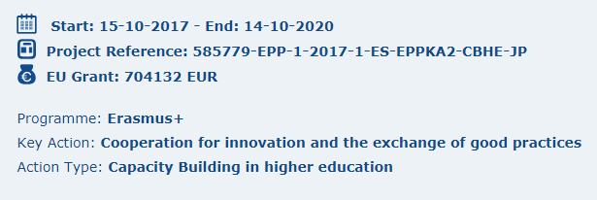
EQUAMBI
Enhancing Quality Assurance Management & Benchmarking Strategies in Indian Universities
Distribution of Euros 704,132/-

Slide 22
EQUAM-BI Project: Expected Outcome
Partnering with leading EU institutions and organizations to nurture a sustainable benchmarking culture.
Creating capacity for improving quality of teaching-learning, research and innovation, academic leadership.
Collection of relevant data to enable the study and updating of benchmarking methodologies.
Creating frameworks for ensuring successful and sustainable partnerships with institutions of higher education in Europe to promote internationalization.

Slide 23
EQUAM-BI Project - Motivation
Expected impact in short and long term at individual, institutional and/or HE system level
Indian HE recognises that, when applied properly, benchmarking can be a very powerful tool through which organizations can learn from the experiences and innovations of others.
Through a collaborative and intelligent approach to benchmarking, organizations can identify the processes, innovations and best practices of each other and, with due respect to context, apply enhanced management decision-making resulting in individual and mutual benefits.
In this sense, despite having the second largest higher education system in the world, India faces major challenges within this essential sector.
The project is designed to address the most significant and overarching of these challenges - inconsistent or inadequate Quality Assurance management to properly support the governance and decision making required for institutional advancement and enhancement.

Slide 24
EQUAM-BI Project - Motivation Continues…
Based on a comparative exploration of current activities and planned objectives, against international best practice, this Project will provide a ‘benchmarking toolkit’ and a programme of capacity building / dissemination will provide guidance for Indian universities on how best to improve / enhance their governance and management of ‘quality’.
The project is targeted at three specific and critical areas: teaching and learning; research and innovation; internationalisation.
Involving key HE institutions in India and supported by leading European partners, the Project will provide an enhanced approach to Quality Management involving the focused application of a set of benchmark tools that take account of, and are relevant to, the complex and different contexts within Indian HE.
This will guide and support specific aspects of benchmarking relevant to quality management, but with flexibility in application to cope with the diverse contexts and priorities within and between Indian HEIs .

Slide 25
Rationale for the setting-up of the consortium
‘Benchmarking’ provides a potential mechanism to demonstrate current achievements and ‘standing’ and, importantly, provide QA management with an evidence base to inform the short and medium term and strategic decision-making required to improve/enhance quality, and demonstrate that this has been achieved.
The Consortium is agreed on the need for effective benchmarking that is directed to providing context-relevant and sustainable support (as opposed to simplistic and often unhelpful ‘ranking’).
The Project brings together European partner HEIs and quality agencies, with an already-proven successful track record in supporting QA/QE in different international contexts, with a series of (‘volunteering’) Indian universities who are keen to be involved in addressing the country’s identified needs for quality improvement in HE.

Slide 26
Rationale for the setting-up of the consortium
The Indian universities demonstrate a range of fundamentally different contexts and (strategic) priorities, and with governance and management systems that also differ in form, experience and expertise.
The Indian partners never-the-less have a shared view that ‘benchmarking’ will prove vital to their ambitions for quality improvement / enhancement.
Overall leadership within the consortium will be taken by NAAC (to ensure outcomes are relevant to the needs of Indian HE and, in particular, enhancing the links between the agency and the universities drives towards more consistent, effective and efficient Quality management.
Responsibility for overseeing administrative and financial matters rest with the University of Barcelona who have an extensive and excellent track record in managing highly productive EU / EHEA projects in the Euro Med, Latin America and elsewhere.

Slide 27
EQUAM-BI: Survey Initiative on QAM
Symbiosis International (Deemed University), one of the Indian Partner Universities of this project, was assigned the responsibility of conducting a survey on ‘Quality Assurance Management Processes & Practices Of Higher Education Institutes In India’. This survey was intended to collect relevant data to enable the study of the current status of Quality Assurance Management (QAM) processes and practices of Higher Education Institutions in India.
The exercise involved reviewing the existing parameters (‘as is’) of QAM processes and practices which will form the basis to subsequently benchmark with the QAM practices (‘to be’) of the European counterparts. This will help identify the gaps between the ‘as is’ and the ‘to be’ environments.

Slide 28
EQUAM-Bi Next Steps/way forward
Comparisons of current Data Management Systems Development of Benchmarking tools to support QA management & Decision making mechanisms.
Implementation and evaluation of the Benchmarking tools and capacity building to ensure their effective application.
Dissemination & Multiplier - Set up and maintain project website - Organise 2 Conferences and one Multiplier effect workshop.
Quality tools for the project implementation. - Set up of a Quality Committee - Set up and follow up of a Quality Plan - Appoint an external evaluator - Present feedback and reports regarding the quality procedures of the project.

Slide 29
Linking RAF with International Project
Revised Accreditation Framework (RAF) of NAAC based on Benchmarking including Qualitative Metric (QlM) & Quantitative Metric (QnM) is a right step in the new era of technology driven mode of assessment.
Possibilities of Integrating RAF work with India-Europe Benchmarking Project on selected European and Indian Universities on “Enhancing Quality Assurance Management and Benchmarking strategies in Indian Universities” (EQUAM-BI).
Novel experiment of integration of Student Satisfaction Survey (SSS) into formal A&A process can be emulated by other agencies.
Raising bar of Indian HEIs through competitive benchmarks using quantitative metrics.
Experience by NAAC in use of ICT based data driven assessment and accreditation and combination of Qualitative Metric (QlM) & Quantitative Metric (QnM) for assessment: A good practices worth adoption.

Slide 30


Towards Global Virtual Accreditation Resource Centre

Slide 31
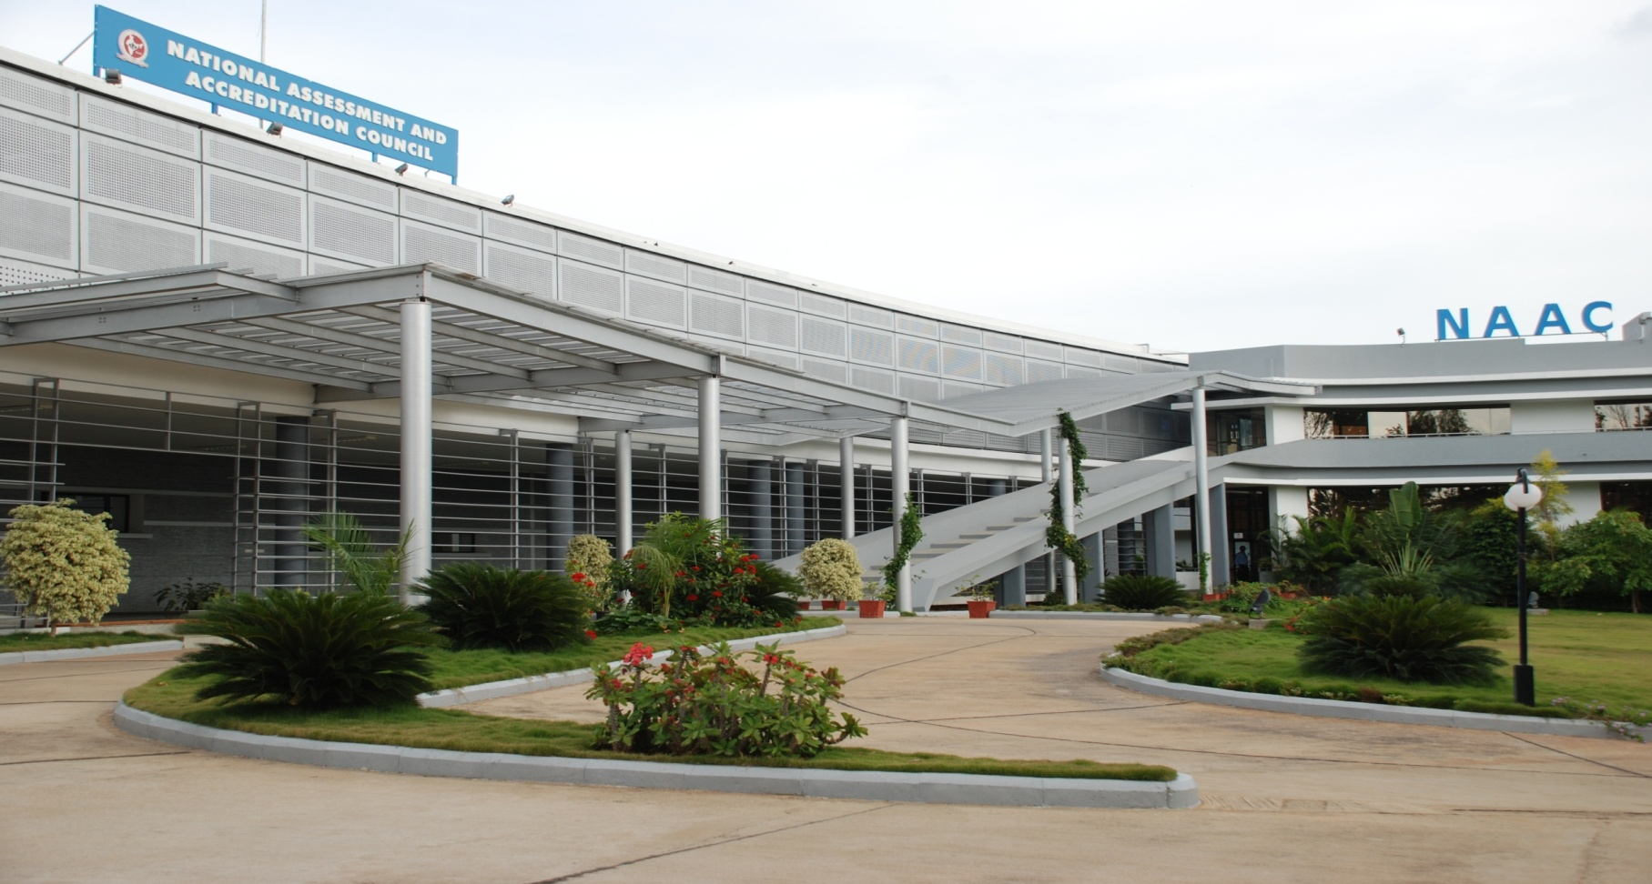

THANK YOU
Dr. Jagannath Patil*
jp.naacindia@gmail.com
*views in this presentation are personal and do not reflect policies or opinions of any organisation

