Slide 1



World-Class Disciplines Evaluation
in Mainland China
-Case Study of Chinese Postgraduate Education and Discipline Evaluation
Prof. Junping Qiu, Dr. Rui Zhang Dr. Jing Tian
Chinese Academy of Science and Education Evaluation, Hangzhou Dianzi University
March 29th, 2019
2019 APQN Conference, Colombo, Sri Lanka

Slide 2

Content
Introduction
The characteristics of the Evaluation
Research Methods
Result and Analysis

Slide 3

Introduction

Slide 4

Double world-class project(2017)
42 world-class universities
465 world-class disciplines in 95 universities

Slide 5






Slide 6


RCCSE（WUHAN）
The evaluation report on subject competitiveness of world-class universities and research institute
Prof. Junping Qiu
Senior Prof. of Hangzhou Dianzi University, Director of RCCSE & CASEE

Slide 7
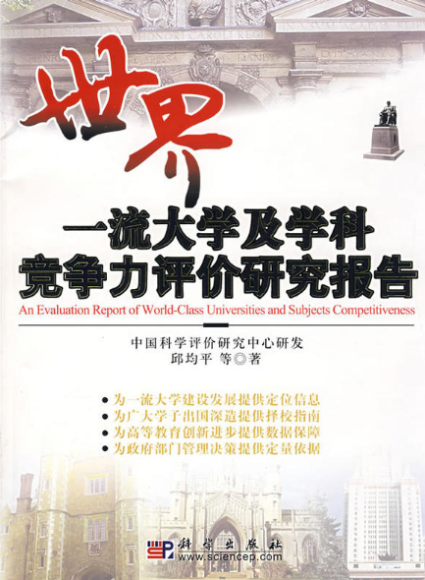



RCCSE（WUHAN）
The evaluation report on subject competitiveness of world-class universities and research institute
Prof. Junping Qiu
Senior Prof. of Hangzhou Dianzi University, Director of RCCSE & CASEE

Slide 8
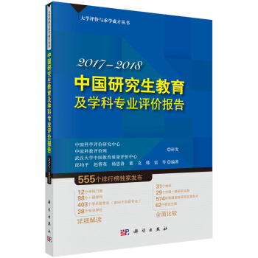
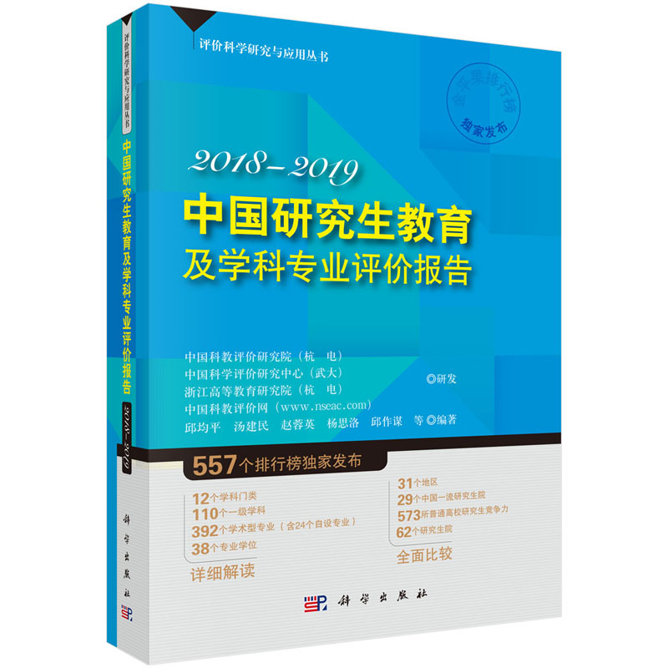
RCCSE（WUHAN）
The evaluation report on subject competitiveness of world-class universities and research institute
CASEE（HANGZHOU）
The evaluation report on world-class universities and world-class desciplines
Prof. Junping Qiu
Senior Prof. of Hangzhou Dianzi University, Director of RCCSE & CASEE
http://casee.hdu.edu.cn/

Slide 9

The characteristics of the Evaluation

Slide 10

The characteristics of the Evaluation
international and national standards are combined in this evaluation
the structure of the evaluation results is scientific and reasonable, and it is convenient to look up
the evaluation is the most detailed and comprehensive Chinese postgraduate disciplines evaluation report at home and abroad
this evaluation combines score and ranking together
paying more attention to preponderant and key disciplines, and taking account of the scale of the discipline simultaneously
we adhere to the idea of “evaluate by categories and compare among the same category”, putting all the universities who provide postgraduate programs in to 10 categories according to Ministry of Education’s higher education running index
the evaluation contains huge information

Slide 11

Research Methods

Slide 12
Research Methods
01
The evaluation objects and scopes
The 2018-2019 Chinese postgraduate education and discipline evaluation of Chinese Academy of Science and Education Evaluation includes 579 universities and institutions who provide postgraduate program in mainland China (military universities and institutions are excluded).There are altogether 62 postgraduate schools, 573 universities (56 national postgraduate schools are included). This evaluation have a comprehensive, systematic and depth evaluation of those universities and institution form eight perspectives. The eight perspectives are 31 provinces, 29 first-class Chinese postgraduate schools, 62 postgraduate schools, 573 universities, 12 subjects and disciplines, 110 first-grade disciplines, 392 academic disciplines and 38 vocational subjects.

Slide 13
Research Methods
02
01
Data collection
We collected data from April to June in 2018. All the data are collected from the following five channels.
Statistic data from relevant government
relevant database at home and abroad.
relevant government departments, universities and institutions’ websites.
Journals, books, newspaper and internal data.
Chinese Academy of Science and Education Evaluation’s own database based on years’ evaluation.
We double-checked all the original data, and dealt with the abnormal data by manual handing to make sure all the data are effective and accurate.
The evaluation objects and scopes

Slide 14
Research Methods
03
02
01
The Establishment of Evaluation Index System
The 2018-2019Chinese postgraduate education and discipline evaluation of Chinese Academy of Science and Education Evaluation’ evaluation index are composed by universities’ resources, teaching and research production, quality and influence and academic reputation those four first-grade indexes. We distribute the weight of the first grade indexes according to the importance of every first grade indexes. The weight of universities’ resources is 0.25, teaching and research production is 0.30, quality and influence is 0.30, and the academic reputation is 0.15. Among them, there are 15 second-grade indexes and 56 observation points.
Data collection
The evaluation objects and scopes

Slide 15
Chinese Postgraduate Education and Discipline Evaluation Index System
First grade indexes | Weight | Second grade indexes
Universities’ Resources | 0.25 | research base; world-class university; degree program; elitist; research project; funding
Teaching and Research Production | 0.30 | talent cultivation; scientific payoffs; inventive patent
Quality and Influence | 0.30 | students’ awards; quality of paper; scientific research awards
Academic Reputation | 0.15 | Chinese world-class discipline; top 1% of ESI databases; excellence discipline in last year

Slide 16


Definition of competitive disciplines
01
We mark five stars (5★) to those universities. We mark the top 1% discipline as 5★+, the top 1%-5% (5% included) as 5★, the top 5%-10% (10% included) as 5★-.The top 10%-20% (20% included) universities and institutions who provide postgraduate education are the advantageous universities and institutions
02
We mark four stars (4★) to those universities and institutions. The proportion of the four stars (4★)universities and institutions is 10% of all the universities and universities.
03
The top 20%-50%(50% included) universities and institutions who provide postgraduate education are the universities and institutions who have competitiveness. We mark three stars (3★)to those universities and institutions.

Slide 17

Result and Analysis

Slide 18
Chinese postgraduate education competiveness ranking by province (31 in total)
Ranking | Province | Number of Universities and institutions | Score | Universities’ Resources | Teaching and Research Production | Quality and Influence | Academic Reputation
1 | Beijing | 56 | 100.00 | 1 | 1 | 1 | 1
2 | Jiangsu | 33 | 91.83 | 2 | 2 | 2 | 2
3 | Shanghai | 27 | 84.99 | 4 | 5 | 3 | 3
4 | Shandong | 30 | 84.56 | 3 | 3 | 6 | 4
5 | Hubei | 28 | 83.41 | 5 | 4 | 5 | 6
6 | Liaoning | 37 | 82.59 | 6 | 6 | 4 | 8
7 | Shan’xi | 27 | 81.14 | 7 | 7 | 9 | 7
8 | Guangdong | 25 | 80.19 | 8 | 8 | 7 | 5
9 | Zhejiang | 21 | 78.25 | 10 | 10 | 8 | 9
10 | Sichuan | 24 | 76.63 | 9 | 9 | 10 | 10
11 | Anhui | 20 | 74.09 | 13 | 12 | 11 | 14
12 | Hunan | 17 | 73.35 | 14 | 15 | 12 | 13
13 | Hebei | 23 | 72.90 | 17 | 17 | 17 | 16
14 | Heilongjiang | 19 | 72.73 | 11 | 11 | 13 | 11
15 | Henan | 19 | 72.53 | 15 | 14 | 15 | 15
16 | Tianjin | 18 | 72.43 | 12 | 13 | 14 | 12
17 | Jilin | 19 | 69.42 | 16 | 16 | 16 | 19
18 | Fujian | 13 | 69.27 | 20 | 20 | 19 | 17
19 | Jiangxi | 16 | 68.53 | 18 | 18 | 20 | 24
20 | Chongqing | 13 | 67.56 | 19 | 19 | 18 | 18
21 | Guangxi | 13 | 63.05 | 22 | 21 | 23 | 23
22 | Shanxi | 11 | 62.93 | 23 | 22 | 21 | 21
23 | Yunnan | 12 | 62.26 | 21 | 23 | 22 | 20
24 | Gansu | 10 | 61.34 | 24 | 24 | 24 | 22
25 | Xinjiang | 11 | 59.28 | 25 | 25 | 26 | 25
26 | Inner Mongolia | 9 | 57.25 | 26 | 26 | 25 | 26
27 | Guizhou | 8 | 55.41 | 27 | 27 | 27 | 27
28 | Ningxia | 4 | 48.25 | 28 | 29 | 29 | 29
29 | Hainan | 4 | 47.61 | 29 | 28 | 28 | 28
30 | Qinghai | 3 | 41.88 | 30 | 30 | 30 | 31
31 | Tibet | 3 | 39.42 | 31 | 31 | 31 | 30

Slide 19
World-class universities comprehensive competiveness ranking
Ranking | University | Score | Ranking | University | Score
1 | University of Chinese Academy of Science | 100.00 | 16 | Renmin University of China | 86.28
2 | Tsinghua University | 98.96 | 17 | Zhongnan University | 85.69
3 | Peking University | 97.46 | 18 | Shandong University | 85.43
4 | Zhejiang University | 96.56 | 19 | Tongji University | 83.47
5 | ShanghaiJiaotong University | 95.08 | 20 | Beijing Normal University | 82.43
6 | Sun Yat-Sen University | 93.18 | 21 | Beihang University | 81.90
7 | Fudan University | 90.64 | 22 | Tianjin University | 81.63
8 | Wuhan University | 90.38 | 23 | Southeast University | 81.56
9 | Sichuan University | 89.88 | 24 | Xiamen University | 81.42
10 | Harbin Institute of Technology | 88.83 | 25 | Beijing Institute of Technology | 81.18
11 | Nanjing University | 88.46 | 26 | Nankai University | 81.03
12 | Huazhong University of Science and Technology | 88.31 | 27 | South China University of Technology | 80.95
13 | Jilin University | 87.53 | 28 | Northwestern Polytechnical University | 80.08
14 | University of Science and Technology of China | 87.31 | 29 | Dalian University of Technology | 77.97
15 | Xian Jiaotong University | 86.63

Slide 20
Chinese first-class postgraduate education ranking by disciplines (12 disciplines in total)
Discipline Code | Discipline | Universities | Ranking in the total universities
01 | Philosophy | Renmin University of China | 15
02 | Economics | Renmin University of China | 15
03 | Law | Renmin University of China | 15
04 | Education | Beijing Normal University | 19
05 | Literature | Peking University | 2
06 | History | Peking University | 2
07 | Natural Science | Peking University | 2
08 | ]Engineering | Tsinghua University | 1
09 | Agriculture | China Agricultural University | 29
10 | Medicine | Shanghai Jiaotong University | 4
12 | Management | Tsinghua University | 1
13 | Art | China Central Academy of Fine Arts | 257

Slide 21
conclusion
It is helpful for Chinese universities, especially the postgraduate school to know the education quality in a national context. The evaluation results can serve as the pushing hands for Chinese universities to promote the world-class universities and disciplines’ construction agenda.
The Chinese Academy of Science and Education Evaluation’s Chinese first-class postgraduate education and disciplines evaluation (2018-2019) insists its own evaluation principles, and has its own characteristic. In accordance with the idea of based in China with global visions, the ranking results will help China have an overall understanding of the national universities’ postgraduate discipline’s developing status and trends. More importantly, the results will help the universities fully realize their status in a broad context, thus to know the gap between the individual discipline and the world-class discipline. The ranking results would act as the guide for individual universities or postgraduate school, even the educational authorities to carry forward the world-class universities and disciplines’ building initiatives.

Slide 22


Thank you
Prof. Junping Qiu, Dr. Rui Zhang Dr. Jing Tian
Chinese Academy of Science and Education Evaluation, Hangzhou Dianzi University
2019 APQN Conference, Colombo, Sri Lanka

