Slide 1
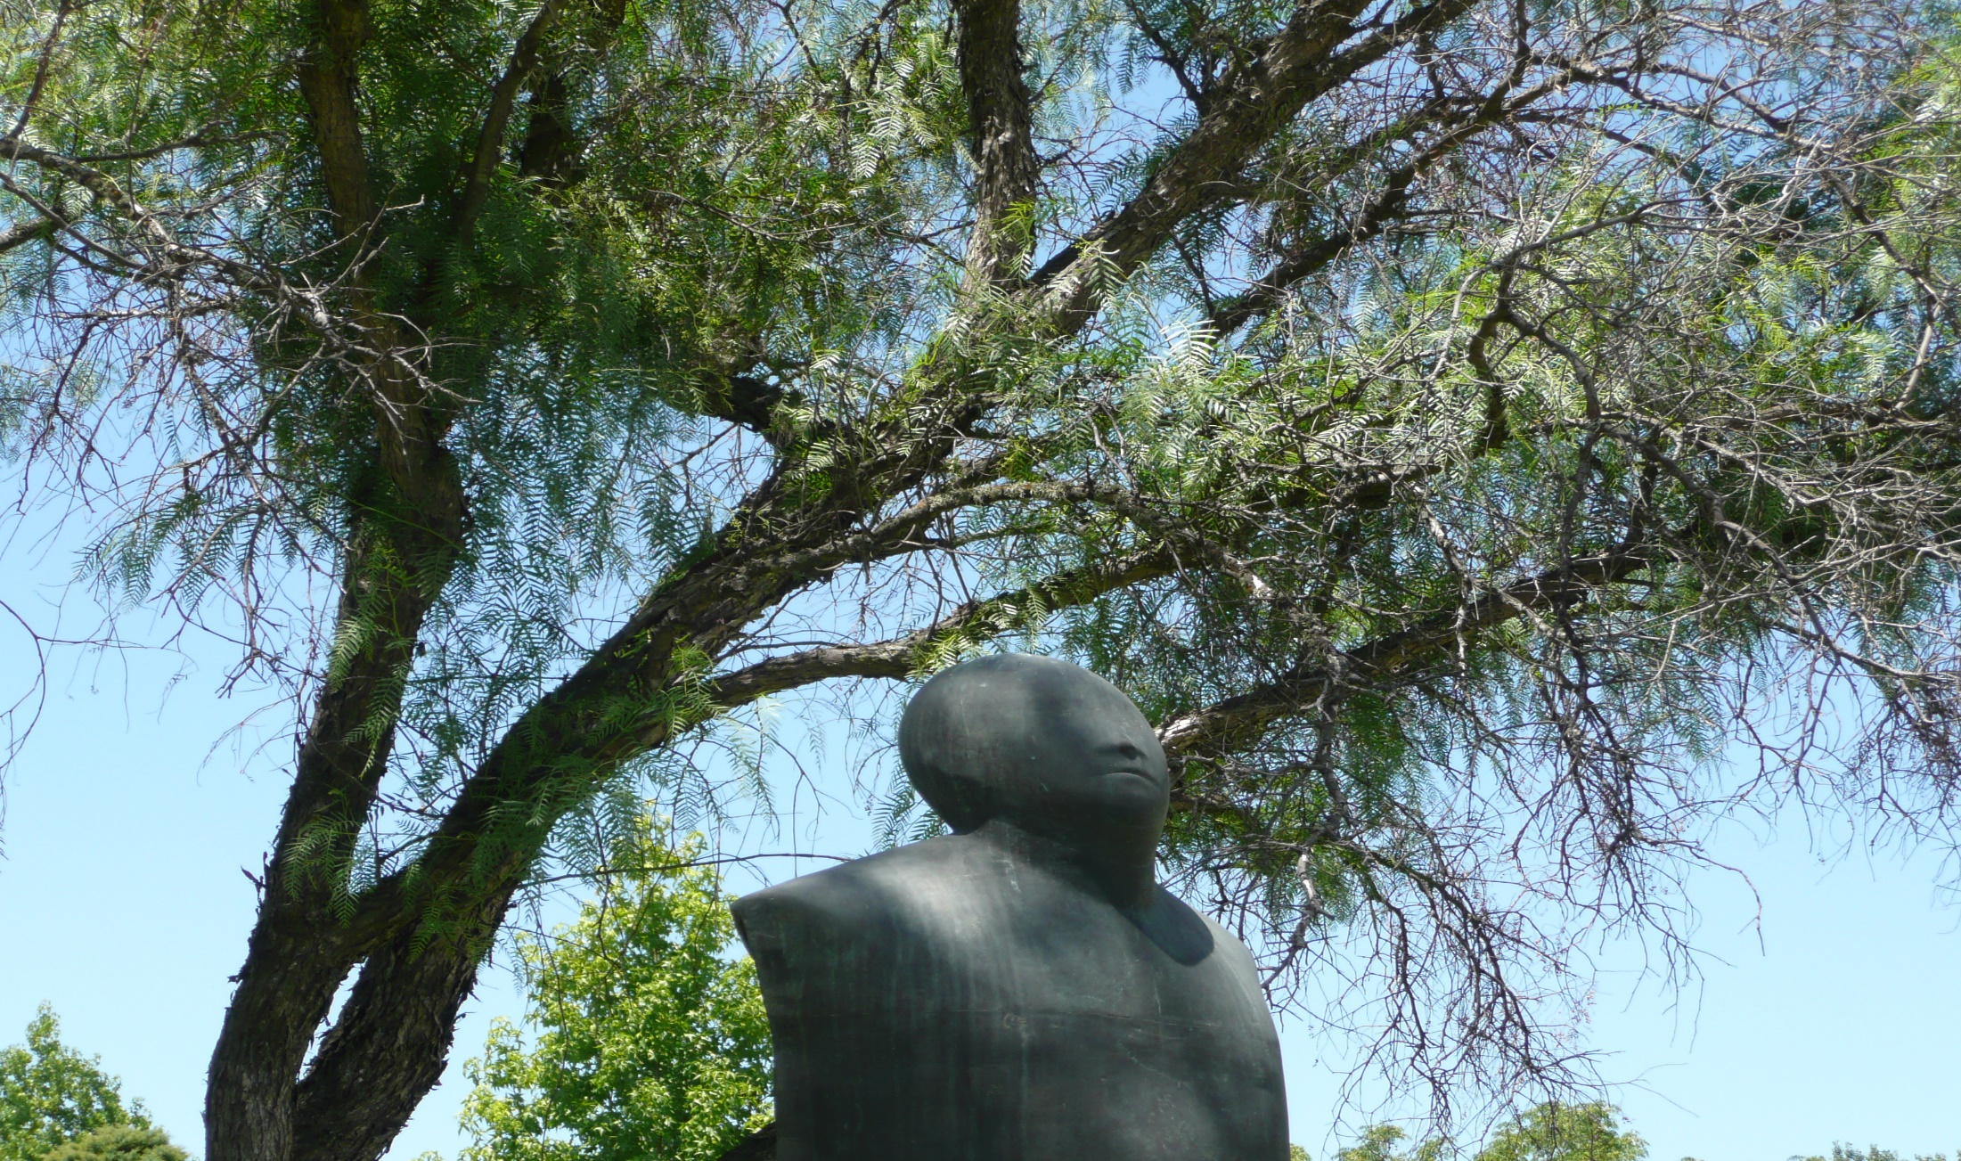
Are Cultural Diversity and
Quality Compatible?
Dilemmas in Cross-Border
Higher Education
UGC/APQN, 29 March 2019
Notes:
Sri Lanka 10 years ago, with UGC, so much progress
INQAHE: 2010 (nine years ago) – GIQAC grant

Slide 2
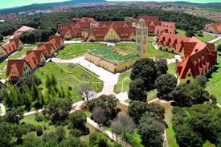
Notes:
Global phenomenon
Shanghai – NYU
Abu Dhabi
Qatar Education City
Malaysia
China: Suzhu (Education City)
Lim Kok Wing U of T and Creativity in London
Teknion in NYC
Convergence towards Western model
But what about cultural heterogeneity?

Slide 3
Notes:
Minister of Education

Slide 4
Outline
Pitfalls of Cultural Diversity
Universal Quality Assurance Standards
Cultural Diversity as Enrichment

Slide 5
Pitfalls of cultural diversity
Discrimination
Corruption
Risks

Slide 6
Segregation
Gender
Ethnic groups
Notes:
Roma

Slide 7
Effects of caste identity on academic performance

Slide 8
Corruption
Admission
Examinations
Notes:
Bribes, sexual favors, connections
Not only developing countries, look at the US
Shams Kassim-Lakha

Slide 9
Excellence and corruption in Colombia
University | Corruption ranking | Excellence ranking | Status
U Externado de Colombia | 1 | 15 | Private
U. Pontificia Javeriana | 2 | 7 | Private
U Los Andes | 3 | 1 | Private
U Santo Tómas | 4 | 49 | Private
U Nacional de Colombia | 5 | 2 | Public
U Libre | 5 | 50-100 | Private
U del Rosario | 7 | 3 | Private
U de Antioquia | 8 | 6 | Public
U del Norte | 8 | 11 | Private

Slide 10
Risks
Critical thinking (or lack thereof)
Respect of authority
Non democratic societies (Internet, CEU)
Bias against science (evolution, vaccines)
Notes:
Morocco primary education classroom
In some cultures, respect of authority, hierarchy
165 flights, avid reader of airline safety reports
Avianca / Korea Airlines

Slide 11
Outline
Pitfalls of Cultural Diversity
Universal Quality Assurance Standards

Slide 12
Core QA Principles
Role of external QA agencies (incl. international)
QA standards, criteria and processes
Internal Quality Assurance
Alignment with Qualifications Frameworks

Slide 13
QA for Borderless Institutions / Programs
Equivalency with standards of mother institution
Local or international accreditation
Guarantee of quality (or even better…)
Notes:
Sometimes even better

Slide 14
Role of QA in an International Perspective
Trust
Transparency
Relevance
Notes:
Transfer from CC to U
Registered in one main institution but courses from other universities
Regular degree with online certificates from professional institutions (Yacine Toronto, U of Dar Es Salaam)

Slide 15
Role of QA in an International Perspective
Collaborative platforms for sharing of experience and capacity building
Outcome-based quality assurance open to innovative practices and cultural diversity
Notes:
Transfer from CC to U
Registered in one main institution but courses from other universities
Regular degree with online certificates from professional institutions (Yacine Toronto, U of Dar Es Salaam)

Slide 16
Conclusion:
Cultural Diversity as Enrichment

Slide 17
Quizz
Saudi Arabia?
Arab United Emirates?
Germany?

Slide 19
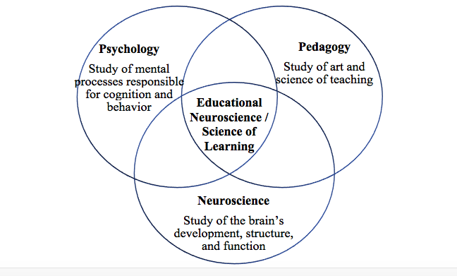
Educational Neuroscience
Notes:
This growing corpus of knowledge has proven that the brains of children and young adults develop more thoroughly if they are intellectually challenged. It has also shown that students learn more effectively if they enjoy a gratifying educational experience that stimulates the pleasure centers in the brain

Slide 20
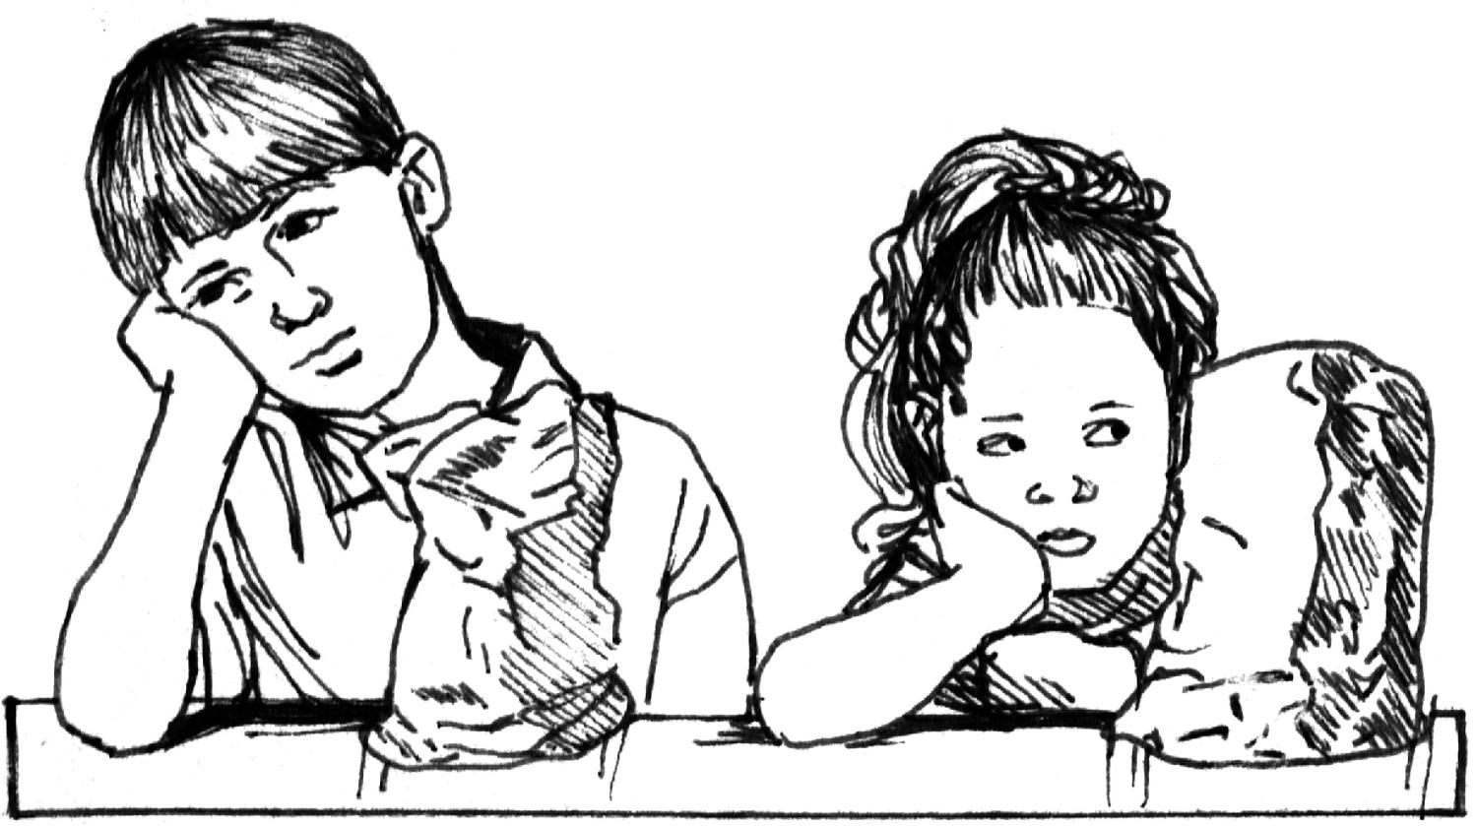
Learning is not a spectator sport
Notes:
Student-centered
Active, interactive, experiential
Lifelong learning

Slide 21
Student-Centered Learrning
Sparking Curiosity
Igniting Passion
Unleashing Genius
Importance of peer learning and group learning in teams
Positive role of diversity
Notes:
Martin quote
Listening to each other
One that struck us was the commencement address at the University of Southern California by Siddhartha Mukherjee, Pulitzer Prize-winning author of “The Emperor of All Maladies: A Biography of Cancer.” He stressed the importance of listening—“to another mind, to nature, to history.”
“In the past one year or so we have turned into a nation of bad listeners,” he told the graduates. Twitter, he complained, may have started out as a method of communal listening, but it has turned into a way to stay inside our own heads, and to build echo chambers. “You, of course will be part of the listening generation,” he said hopefully. “You will learn to hear each other out and listen to each other.”

Slide 23
Culture is multi-dimensional
Nationality
Ethnic groups (language, religion)
Refugees
Social groups
Los Andes
Cambridge

Slide 24
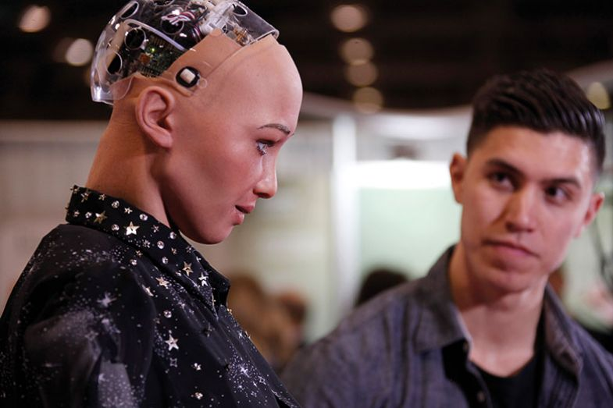

Slide 25
Multi-disciplinarity
Lorenzo’s oil
STEAM, not STEM
Olin College of Engineering
Notes:
Liberal arts majors outperforming science majors at Google

Slide 26
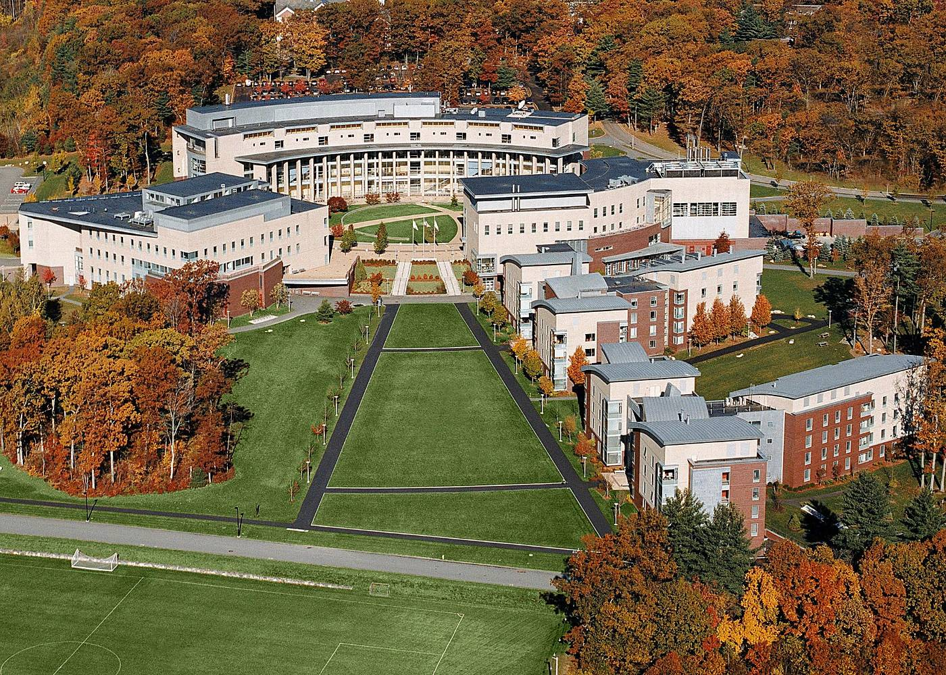

Slide 27
Olin College of Engineering
Designed-based learning (as teams)
Multi-disciplinary
No academic departments / no tenure
Integration of engineering, entrepreneurships and humanities
Notes:
Transfer from CC to U
Registered in one main institution but courses from other universities
Regular degree with online certificates from professional institutions (Yacine Toronto, U of Dar Es Salaam)

Slide 28
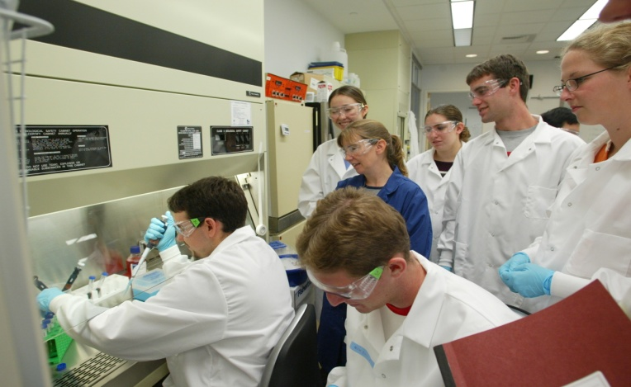
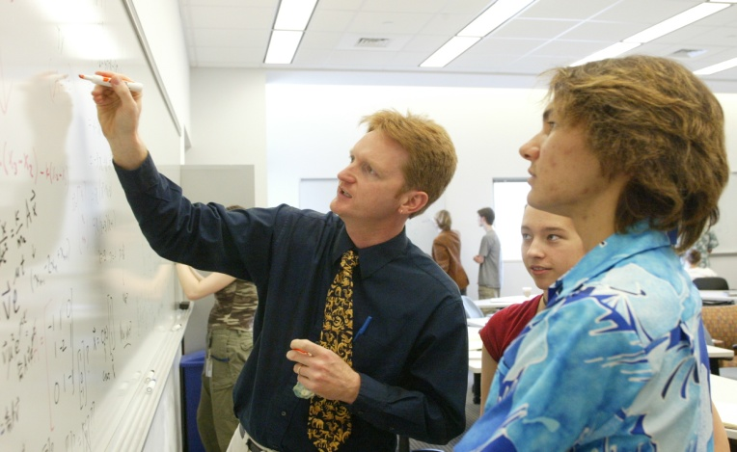
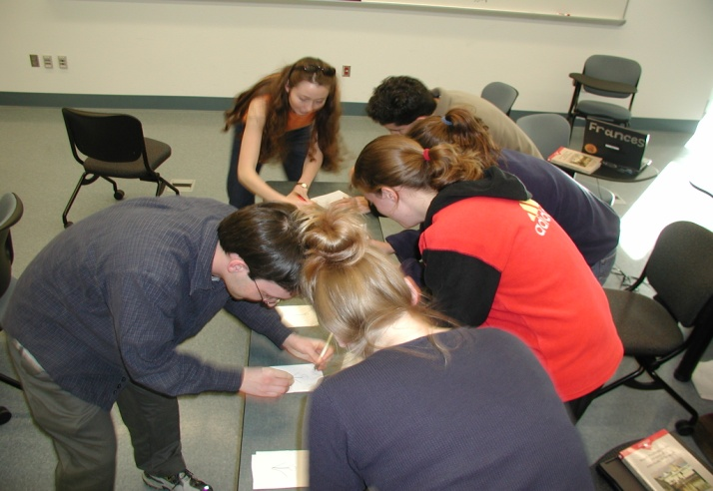
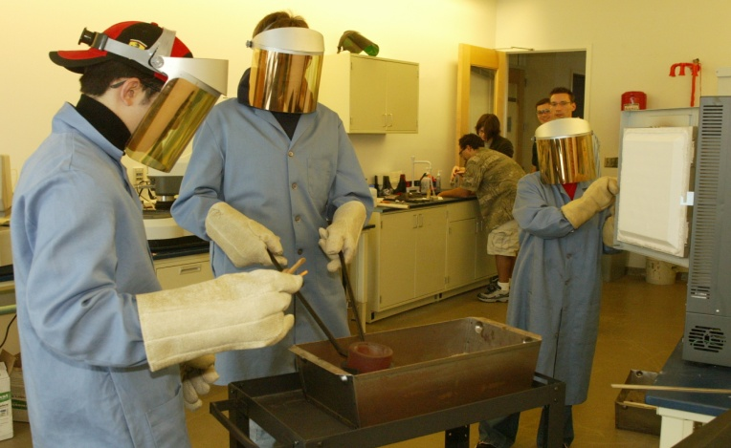
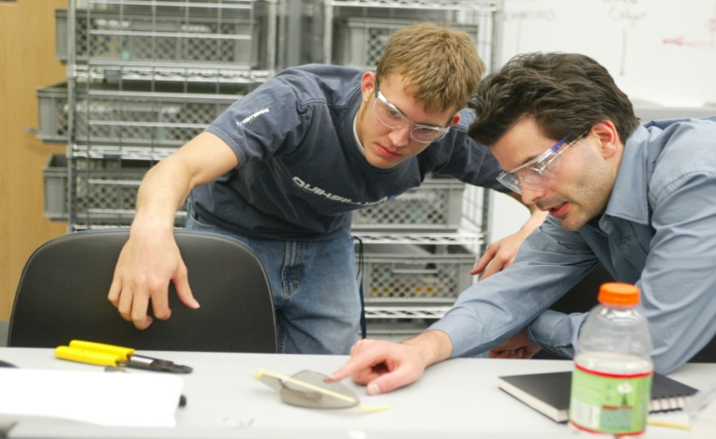
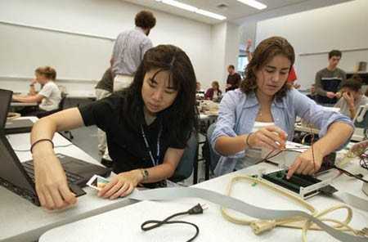
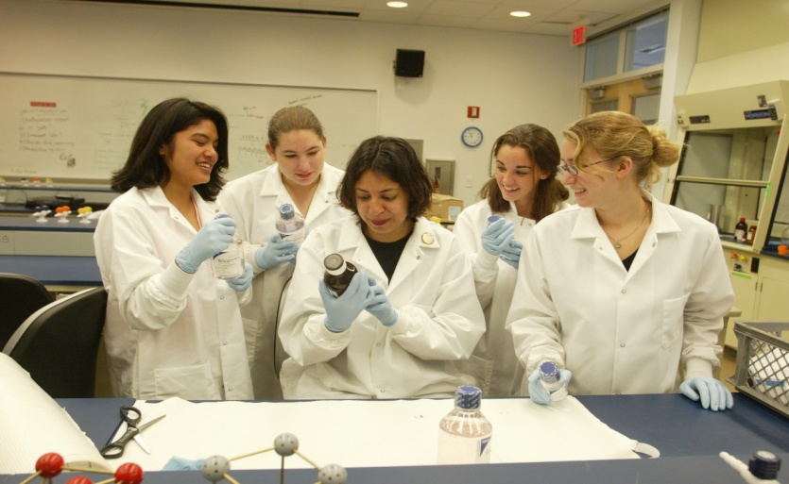
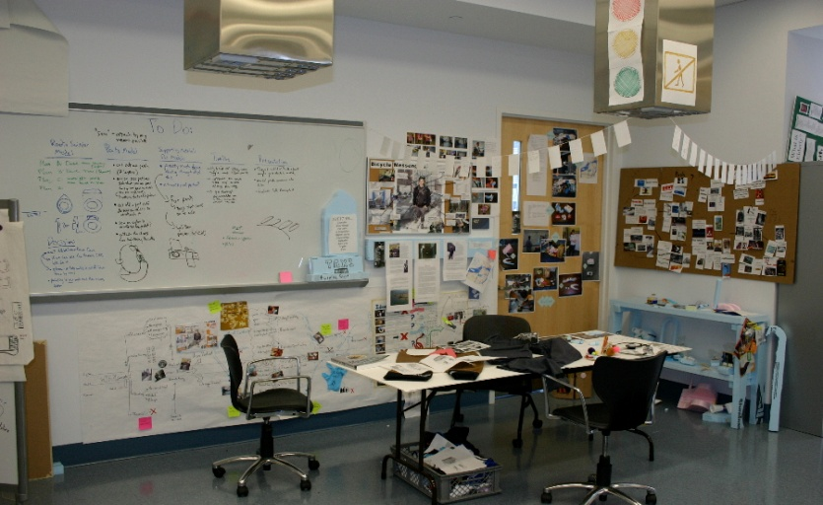
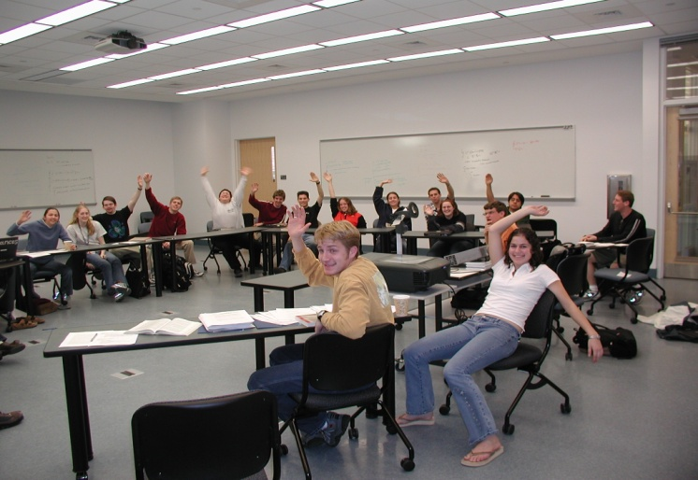
MODES OF TEACHING AND LEARNING
AT OLIN, WE TEACH, AND STUDENTS LEARN, IN
A VARIETY OF MODES
HANDS-ON PROJECT-BASED LEARNING
LABORATORY-BASED EXPERIENCES
SEMINAR-DISCUSSION
INTERACTIVE LECTURE
STUDENT-BASED INDEPENDENT LEARNING
TEAM-BASED INDEPENDENT LEARNING
INDIVIDUAL AND TEAM MENTORSHIP BY FACULTY
Notes:
Extensive (but not exclusive) project-based pedagogyIntegrated, coordinated and interdisciplinary curricular themes Entrepreneurial thinking and practiceDesign as creative, innovative, distinctive engineering processEngineering in social and technical contextsImportance of the liberal artsRigorous fundamentalsCommunication, teamworkAuthenticity of experience and assessment of outcomesOlin Expo each semester

